Slide 1
FINAL DEFENSE
NEXIS
A Multi-Agent Autonomous Engineering Platform with Closed-Loop Fault Recovery
Live in production at nexis.sh
Under the guidance of
Dr. Kazi Muheymin-Us-Sakib
Professor, Institute of Information Technology, University of Dhaka
Ratul Sikder | Roll: 2506102 | EMIT
Institute of Information Technology, University of Dhaka

Slide 2
SECTION A — WHAT
What Is NEXIS
NEXIS is a multi-tenant SaaS platform that models a software engineering team as nine role-specialised AI agents. It detects a production fault the moment it occurs, determines its root cause, synthesises and validates a repair, and deploys it — with a single human approval gate as the only point of manual intervention.
Core Guarantees
– Proactive Detection — faults surfaced in seconds via streaming telemetry, not discovered hours later
– Causal Root Cause — graph traversal of real service dependencies, not keyword matching
– Constrained Repair — LLM-generated patches bound by formal architecture contracts
– Shadow Validation — every patch executed in a locked-down sandbox before a human sees it
– Single Human Gate — nothing reaches production without an explicit approve / reject / modify decision
2/12

Slide 3
SECTION B — PROBLEM
Why This Needed To Be Built
The Cost of Unresolved Failures
$9,000 / minute
$10B+
average enterprise downtime cost — ITIL Global Survey, 2025
total CrowdStrike outage remediation — Parametrix Insurance, 2025
$2.3B
$300B / year
Microsoft Azure / M365 outage, January 2025
global enterprise IT outage losses — ITIL Global Survey, 2025
40–60%
81 minutes
of engineer time spent on maintenance, not development — DORA State of DevOps, 2024
mean time to respond to a production incident — Atlassian, 2024
Monitoring tools detect symptoms. None of them diagnose, repair, and validate a fix autonomously.
3/12

Slide 4
SECTION C — HOW
A Two-Layer Agent Architecture
Layer 2 — Self-Healing Loop
Layer 1 — Execution Team
– Sentinel — always-on fault detector (streaming telemetry)
– Pathfinder — root-cause localisation over the code dependency graph
– Synthesiser — classifies the incident, generates the repair patch
– Validator — shadow-executes the patch in an isolated sandbox
– Architect — decomposes the incident into a structured repair plan
– Backend — generates the minimal-diff code patch
– QA — writes property-based tests for the patch
– DevOps / Data Engineer — deployment manifests and schema migrations
The Human Gate
Every candidate patch stops at a severity-classified Approval Gate before deployment. The engineer chooses Approve, Reject, or Modify — an edited diff is captured as RLHF training data. GitOps opens the pull request only after that decision.
Detect → Diagnose → Plan → Patch → Test → Approve → Ship
4/12

Slide 5
FULL COVERAGE
Everything Built Into NEXIS
– Self-Healing Core — 9 specialised agents, Temporal-durable orchestration, severity-classified Approval Gate (Approve / Reject / Modify), RLHF feedback export
– Identity & Access — JWT sessions, WorkOS SSO, MFA (TOTP), API keys, magic-link login, session/device management, PostgreSQL row-level multi-tenant isolation
– Preview-Deploy Engine — automatic stack detection, Dockerfile generation, containerised build and run, live HTTP verification, failures routed into the same recovery pipeline
– Intelligent Operations — heuristic, explainable role-recommendation engine; hash-chained tamper-evident audit log; daily admin digest email
– Observability & Cost — KPI dashboard (MTTR, recovery rate), per-agent token/cost ledger, system health probes, performance monitoring
– Integrations — GitHub App (PR automation), Sentry, Datadog, PagerDuty, Slack (interactive approvals), ArgoCD, Stripe billing
– Research Tooling — OpenAI-vs-Ollama provider evaluation harness, 11-scenario fault-injection fixture library, NASA-TLX cognitive workload survey
5/12

Slide 6
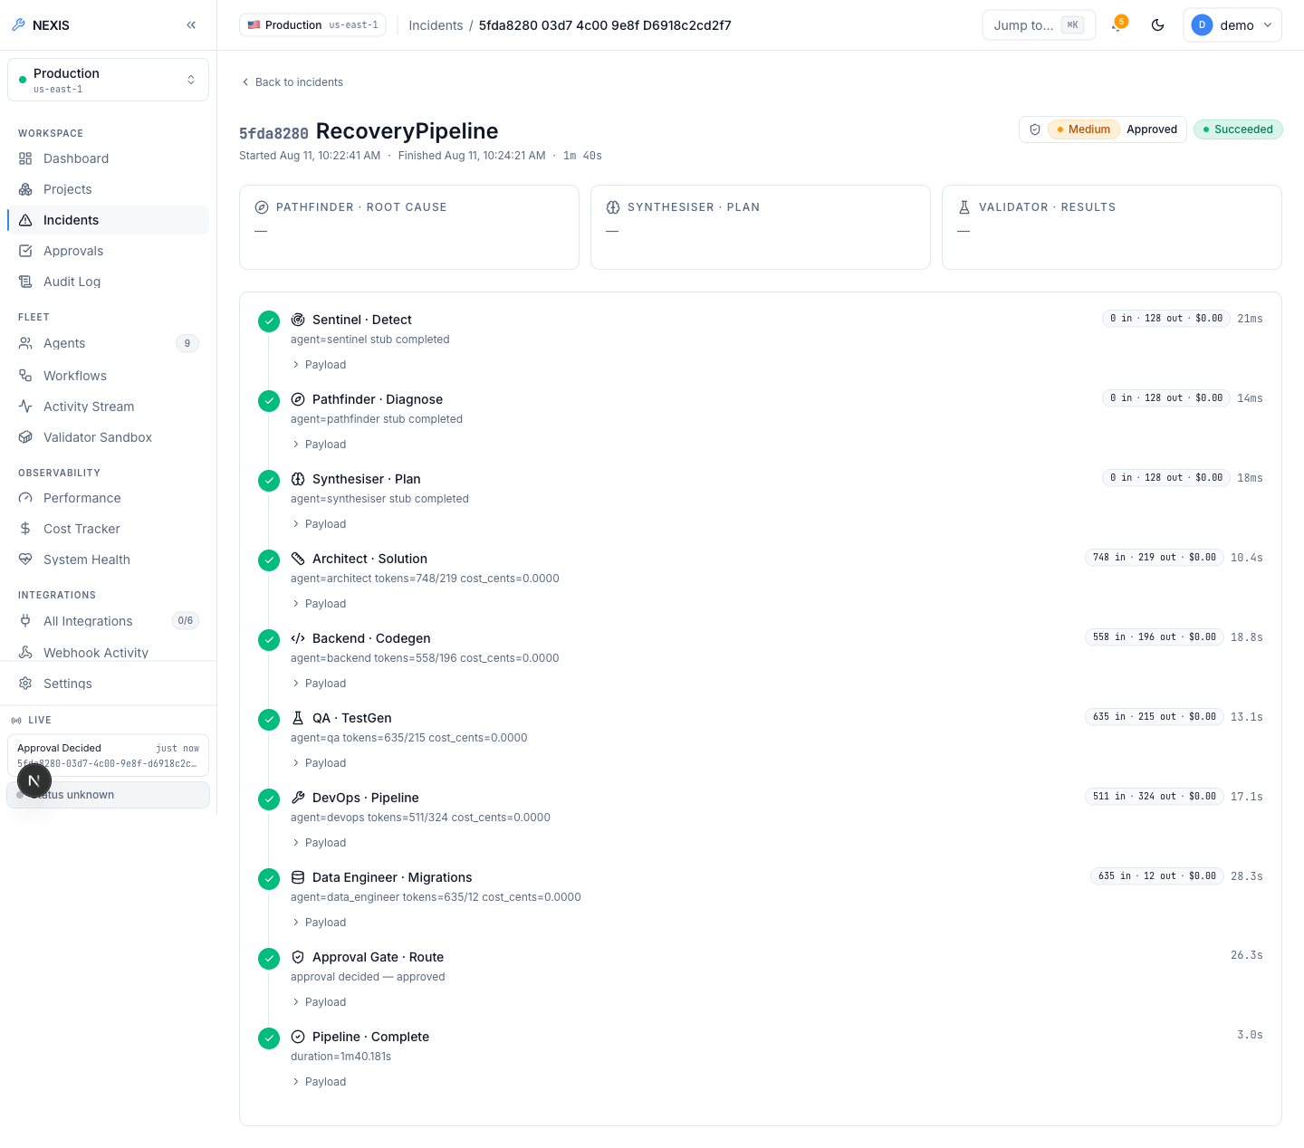
WOW FEATURE 1 — WITH EVIDENCE
A Real Fault, Fixed in 1 Minute 40 Seconds
1m 40s
detection → diagnosis → patch → tests → approval → shipped
– Sentinel detects the fault the instant it happens
– Pathfinder + Architect trace the root cause and write a plan
– Backend writes the patch a real generated code diff
– QA + Validator generate and run tests in a locked sandbox
– A human approves and the pipeline ships it — Succeeded
Fig. 1 — Real RecoveryPipeline run, nexis.sh console
6/12

Slide 7
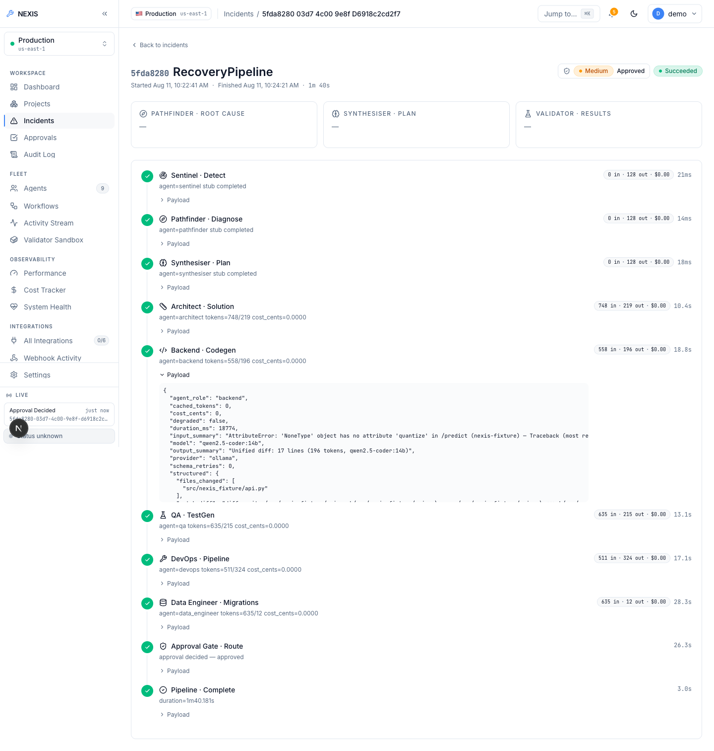
WOW FEATURE 2 — WITH EVIDENCE
It Writes Real Code, Not Templates
This is the raw, unedited event the Backend agent produced on a real run.
– Real model — qwen2.5-coder:14b, provider “ollama” — logged on every run
– Real output — a genuine unified diff, not a canned string
– Real accounting — input / output tokens and cost, per agent, per run
– Fully inspectable — every agent's raw JSON payload is one click away
Fig. 2 — Backend agent payload, raw JSON
7/12

Slide 8
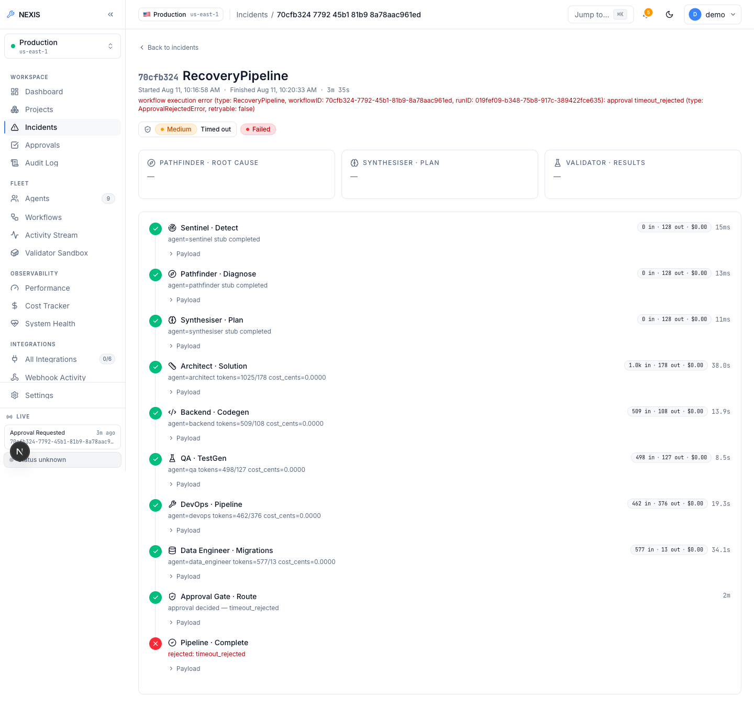
WOW FEATURE 3 — WITH EVIDENCE
When Nobody Answers, Nothing Ships
A second real run. The approval window closed with no answer — so the platform refused to ship.
“Timed out” is not a failure here — it is the safety design working exactly as intended.
– Fail-closed by design — silence is treated as refusal, never as consent
– Nothing ships unreviewed — not even a patch that passed every test
– Every outcome recorded — honestly, including the runs that don't ship
Fig. 3 — Timeout-rejected run, nexis.sh console
8/12

Slide 9
WOW FEATURE 4 — WITH EVIDENCE
Give It a Broken Repo — It Figures Out How to Run It
Real public repository, zero Dockerfile: heroku/node-js-getting-started
Fig. 4 — Live deploy-engine transcript
– Detects the stack from marker files alone
– Writes a working Dockerfile from nothing
– Builds, runs, and verifies it is alive over real HTTP
– Cleans up after itself automatically
– Build failures feed the same self-healing pipeline as any other incident
POST /v1/deploy (repo has no Dockerfile)
→ 200 OK
detected_stack: "node" dockerfile_source: "generated"
build_log: "...npm ci... EXPOSE 3000... CMD [\"npm\",\"start\"]..."
container_log: "Listening on 3000"
GET http://localhost:54671/
→ real rendered HTML of the running app — verified
POST /v1/deploy/test-e2e-001/stop → {"status":"stopped"}; container removed.
9/12

Slide 10
RIGOR & INTEGRITY
Proof, Not Promises
Verification Results
Known Limitations
– 100% clean builds — 4 Go services: build, vet, and test, zero errors
– 38 backend tests passing — causal-inference service, full pytest suite
– 3 live end-to-end runs — 2 recovery pipelines + 1 deploy-engine, all real
– 2 real bugs found & fixed — a silent JWT clock bug; a reserved-keyword migration bug
– No production PR merges yet — GitHub App / vendor credentials aren't connected; the path is built and tested, not exercised live
– 1 of 27 demo scenarios wired — the rest are UI-complete, backend-pending
– Root-cause ranking is a proxy — an honest statistical method, not yet a fitted causal model
– No formal load testing yet — timings shown are real single-run measurements, not a benchmark
None of this is hidden behind softer wording — the boundary of the evidence is drawn exactly where the evidence stops.
10/12

Slide 11
LOOKING AHEAD
Future Work
– Go fully credentialed — connect a real GitHub App and production LLM account so approved patches become real, merged pull requests
– Finish the scenario library — wire the remaining 26 fault scenarios to real fixtures
– Run the human-subjects study — the NASA-TLX workload survey is already built into the product; recruitment is what remains
– Formal load benchmarking — characterise throughput and queueing under real concurrent incidents
– Fit a real causal model — once production incident data accumulates, replace the graph-evidence proxy with a fitted DoWhy model
Each item builds on architecture that already exists — none of this is a rewrite.
11/12

Slide 12
LIVE DEMONSTRATION
Let's Break Something. Right Now.
Nothing about this is scripted inside NEXIS. A real fault is injected from the terminal; the platform detects it on its own and drives the repair — the only human step is the approval decision it was always meant to make.
$ ./scripts/break-it.sh
Thank You
nexis.sh
Ratul Sikder · Roll 2506102 · Institute of Information Technology, University of Dhaka

