Slide 1
NEXIS
Title
Project progress review
Project progress review
NEXIS
Multi-tenant agentic fault-recovery platform
Architecture · database schema · phase progress
Author
Reporting period
Status
Ratul Sikder
2026-05-10 → 2026-05-14
Phase 8 shipped · Phase 9 in flight
1 / 11

Slide 2
NEXIS
Scope
Project progress review
Project scope
A multi-tenant SaaS that runs a 9-agent recovery pipeline per incident, with human approval on risky patches
Inputs
Pipeline
Outputs
Sentry / ArgoCD / OTel webhooks
9 LLM agents on Temporal
Pull request on tenant repo
GitHub repo (via App)
Sandbox-validated patches
Audit-logged decision trail
Per-tenant API keys + RLS
Severity-routed approval gate
Token + cost ledger
Three deployable services + one Python sidecar + one Next.js frontend. All tenant data row-level isolated in Postgres.
2 / 11

Slide 3
NEXIS
Tech stack
Project progress review
Tech stack
Same code path runs in docker-compose (dev) and ECS Fargate (cloud)
Backend
Data + Infra
Frontend + Ops
Go 1.22
Postgres 16 + pgvector
Next.js 16.2.2
control-plane · validator · gitops
34 tables · RLS FORCE on every tenant table
landing + console · LIGHT default
Chi
Neo4j 5
shadcn · Tremor · Monaco
HTTP router + middleware chain
code dependency graph for Pathfinder
primitives · charts · diff viewer
Temporal
Redis 7
OTel → Grafana stack
workflow orchestration · replay-deterministic
rate-limit + cache
Prometheus · Loki · Tempo
sqlc + pgx
MinIO / S3
docker-compose
compile-time-checked SQL
envelope-encrypted patches + audit
16 services for full local parity
Python 3.12
Temporal dev-svr
GitHub Actions
DoWhy causal-inference sidecar (gRPC)
Postgres-backed history
lint · typecheck · test · build
3 / 11

Slide 4
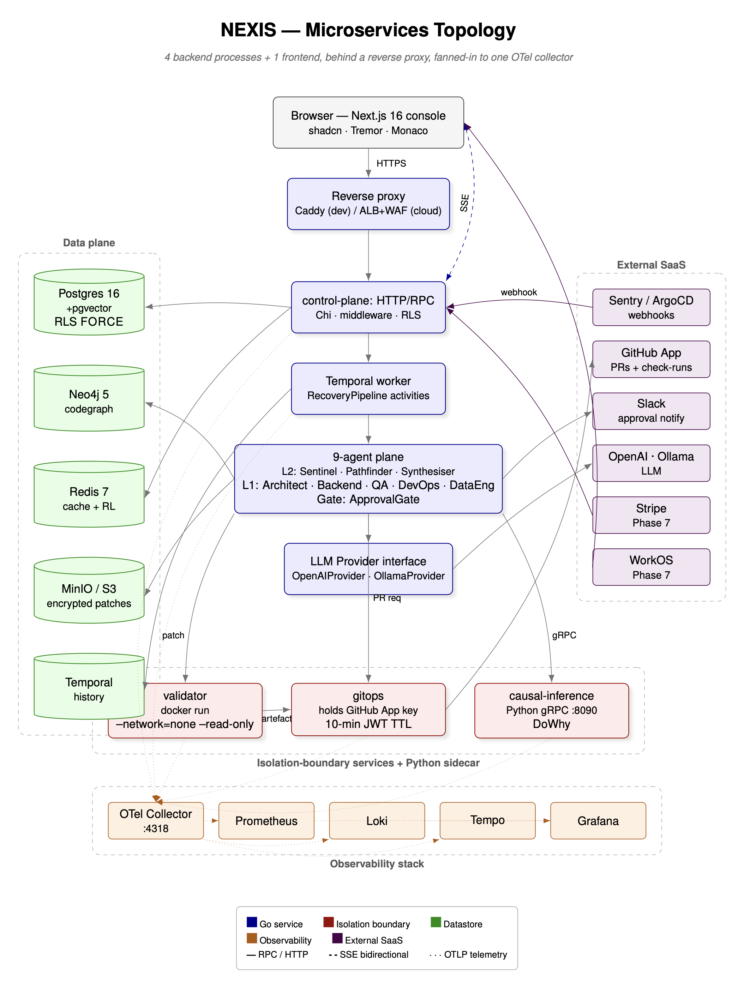
NEXIS
Architecture
Project progress review
System architecture
Modular monolith for the agent plane + two carved-out services for security boundaries
control-plane
Go modular monolith. HTTP + Temporal worker + 9-agent plane in one binary. Internal packages enforced by go-arch-lint.
validator
Carved-out service. Runs untrusted patch inside --network=none --read-only container.
gitops
Carved-out service. Sole holder of the GitHub App private key. 10-min JWT TTL.
causal-inference
Python gRPC sidecar at :8090 for DoWhy backdoor adjustment. Stateless.
Data plane
Postgres + Neo4j + Redis + MinIO + Temporal — all on the same docker network.
4 / 11

Slide 5
NEXIS
DB schema
Project progress review
Database schema — 34 tables across 8 domains
Postgres 16 + pgvector. All tenant tables FORCE row-level security on org_id.
Identity & Tenancy
8 tables
Workflow & Agents
7 tables
Approval & Audit
6 tables
Integrations & Sources
5 tables
organizations
users
workflow_runs
activity_events
approval_decisions
approval_policies
integrations
incidents_raw
org_members
sessions
agent_runs
patch_candidates
slack_notifications
audit_log
incidents
connectors
magic_tokens
api_keys
validation_runs
root_cause_reports
audit_anchors
audit.audit_events
services
org_invites
workspaces
deployments
LLM Spine
6 tables
Evaluation
3 tables
Billing
5 tables
Org Structure
5 tables
token_budgets
token_ledger
eval_runs
eval_transcripts
payment_methods
invoices
teams
team_members
code_embeddings
prompt_versions
nasa_tlx_responses
usage_records
entitlements
invite_codes
clerk_webhook_events
memory_documents
feedback_examples
stripe_events_processed
waitlist
Latest migration: 0020_phase8_public_beta · 25 up-migrations on control-plane · all RLS-tested in CI
5 / 11

Slide 6
NEXIS
ERD
Project progress review
Entity-relationship diagram — core entities
Every tenant entity FK to organizations via org_id, enforced at the DB layer
organizations
Lines = foreign-key relationships · arrows simplified to vertical
users
org_members
api_keys
workspaces
integrations
incidents_raw
workflow_runs
activity_events
agent_runs
token_ledger
approval_decisions
patch_candidates
validation_runs
invoices
payment_methods
usage_records
eval_runs
code_embeddings
nasa_tlx_resp.
6 / 11

Slide 7
NEXIS
Pipeline
Project progress review
RecoveryPipeline workflow — Temporal-orchestrated DAG
Sequential L2 → sequential L1 → parallel DevOps∥DataEng → approval join → validate → PR
Sentinel
Detect
Pathfinder
Diagnose
Synthesiser
Plan
Architect
Solution
Backend
Codegen
QA
TestGen
DevOps
Pipeline
DataEng
Migrations
ApprovalGate
Route
validator
sandbox
gitops
open PR
Severity routing at ApprovalGate
Activity timeouts
low → auto-approved
medium → 120 s signal/timer race
high → human required (no timer)
stub 30 s start-to-close · 3 retries
LLM-bound 5 min · 2 retries
recorder 5 s · 3 retries
7 / 11

Slide 8
NEXIS
Progress
Project progress review
Phase progress — 8 of 9 phases shipped to main
Two-day autonomous build sprint · all eight phases on main as of 2026-05-13
Phase 1
Foundations + landing
shipped
Next.js + docker-compose + Caddy TLS
Phase 2
Auth + RLS + OTel
shipped
WorkOS stub + 34-table RLS + Grafana stack
Phase 3
Console + integrations
shipped
8 surfaces + GitHub App + Sentry webhook
Phase 3.5
Workspaces + billing
shipped
Onboarding wizard + Stripe-style mock
Phase 4
Temporal + sandbox
shipped
RecoveryPipeline DAG + validator sandbox
Phase 5
L1 agents + LLM spine
shipped
Architect/Backend/QA/DevOps/DataEng + pgvector
Phase 6
L2 + Approval + GitOps
shipped · MVP
Sentinel + Pathfinder + Synthesiser + gate
Phase 7
WorkOS + Stripe wiring
scaffolded
Real-provider gated behind env flags
Phase 8
Public beta + docs
shipped
Nextra docs + Shepherd tour + NASA-TLX
Phase 9
Thesis + pilot + defence
in flight
Plan exists · activated this week
8 / 11

Slide 9
NEXIS
Build stats
Project progress review
Build stats — snapshot
Snapshot of the main branch as of 2026-05-14
9
34
25
4
cooperating LLM agents
Postgres tables (RLS FORCE)
control-plane migrations
backend services
287
47k
232
64
Go source files
lines of Go
TS / TSX files (web + ui)
Go test files
16
52
8 / 9
2 days
docker-compose services
commits this sprint
phases shipped
autonomous build sprint
9 / 11

Slide 10
NEXIS
Work done
Project progress review
Work shipped this reporting period
Highlights from the last 52 commits — surfaces, plumbing, observability
Console + UX
Backend + agents
28-provider integration catalog with brand logos
L1 agents (5) calling LLM Provider iface
Live-demo scenario library + recharts dashboards
L2 agents (Sentinel, Pathfinder, Synthesiser)
Onboarding wizard with provisioning animation
ApprovalGate signal/timer race + Slack notifier
Shepherd in-app tour + NASA-TLX widget
L1 stub fallback for keyless demos
Platform + ops
Data + persistence
RLS on every tenant table + CI fuzzer
20 forward migrations · 34 tables
Audit hash-chain + nightly anchor
pgvector RAG corpus for Backend agent
OTel pipeline → Grafana / Loki / Tempo
Token ledger + monthly budget enforcer
System-health page wired to real probes
First-class self-healing projects schema
10 / 11

Slide 11
NEXIS
Next
Project progress review
Outstanding work · risks · next steps
Phase 9 = thesis chapters 1–4 + pilot tenant activation + viva preparation
Next steps (Phase 9)
Open risks
Provision real OpenAI + WorkOS + Stripe keys (env-gated)
Scope creep
Phase scope contractual · backlog otherwise
Investigate causal-inference container unhealthy state
LLM cost runaway
Recruit 5 pilot tenants from waitlist (target end-of-month)
Pre-call budget + Ollama path mitigates
Validator escape
Run 30-fault × 5-seed × 2-provider eval benchmark
Modal swap in Phase 7 · sandbox network=none
Multi-tenant leak
Begin NASA-TLX user study (ethics approved Week 0)
RLS FORCE + CI fuzzer covers every table
Draft thesis chapters 1–4 (intro · system · eval · discussion)
Design-partner ghosting
Oversubscribe to 5 partners; live demo as fallback
Defence-rehearsal slot booked at Phase 6 completion
Defence scheduling
12-week lead booked · Phase 9 buffer absorbs slip
Repo: github.com/.../nexis-eco · local: app.nexis.local · spec: docs/PROJECT_PLAN.md
11 / 11

