Slide 1

Redmine, A Web-based project management and issue tracking tool

Slide 2
Restaurant management system (team 2)
Md. Rafid Islam (170042009)
Ratun Rahman (170042011)
Akib Ahmed (170042013)

Slide 3
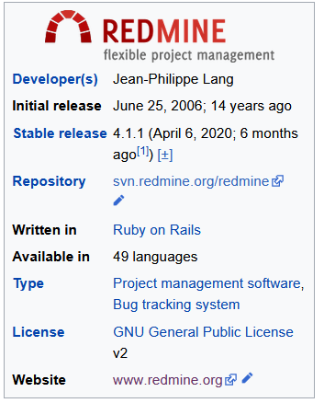
Overview

Slide 4
Why redmine
Free and open source.
Roll-based access control.
Time tracking.
Multiple project management.
Versatile and reliable support.
Redmine has a built in gantt chart.

Slide 5
Getting started with redmine
Let’s start with the first set of slides

Slide 6
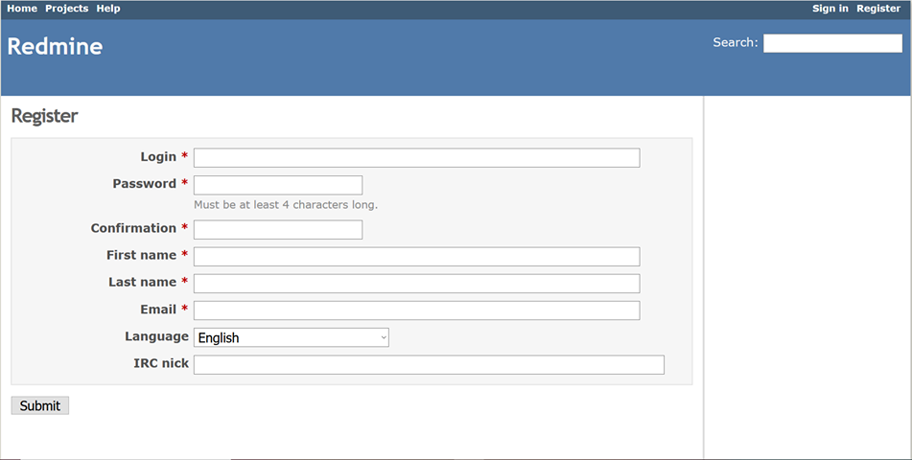
Register
Select a username and give a password. Insert first and last name. Give email address and email confirmation to finish registration.
Place your screenshot here

Slide 7
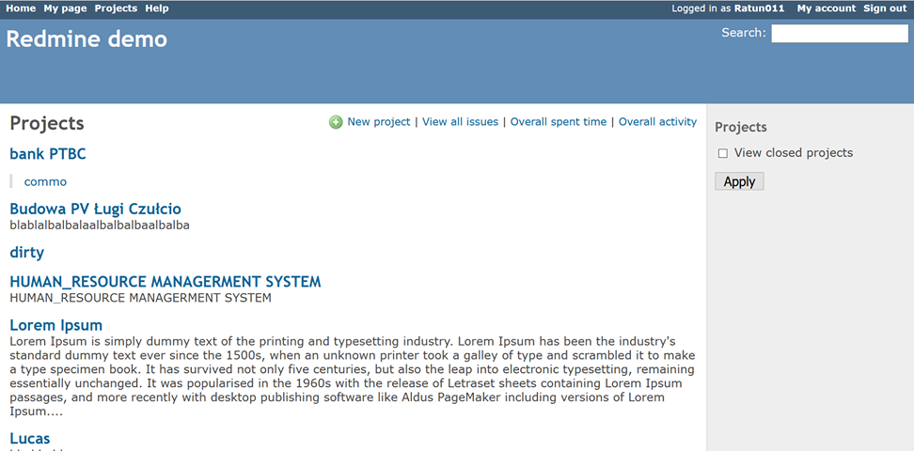
Project
Go to projects (on the top left corner). We can see lots of Demo projects. We can create new project by clicking new project (on top right corner)
Place your screenshot here

Slide 8
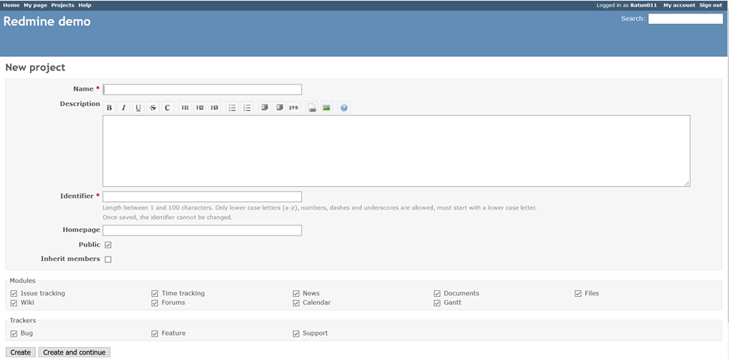
Creating project
Give Name and descriptions of project. We can make the project public for general viewer or private and invite only. We can also select custom modules and trackers.
Place your screenshot here

Slide 9
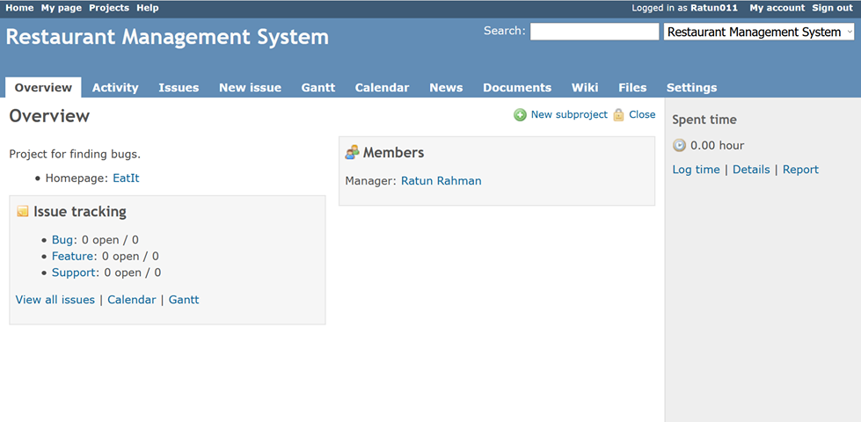
Project overview
Inside the project, on the overview section, we can see project conditions and the general bug reports.
Place your screenshot here

Slide 10
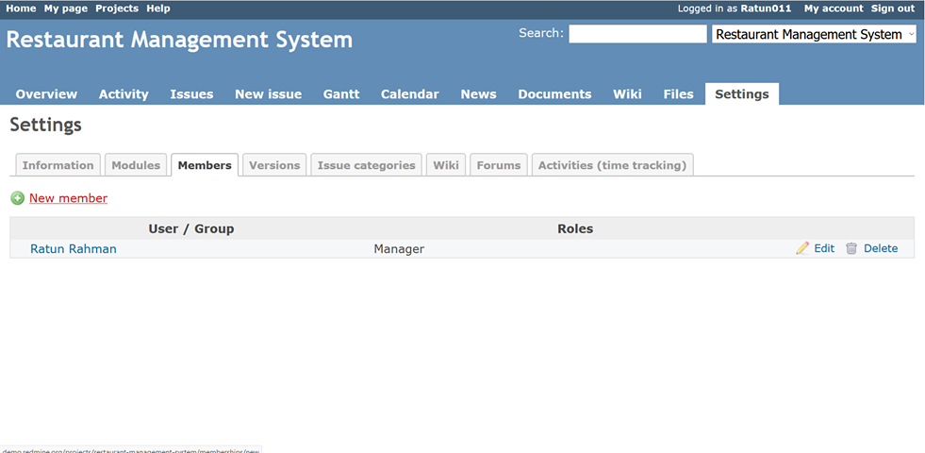
Check members
On the project, under setting section we can select member and see all the members in the project
Place your screenshot here

Slide 11
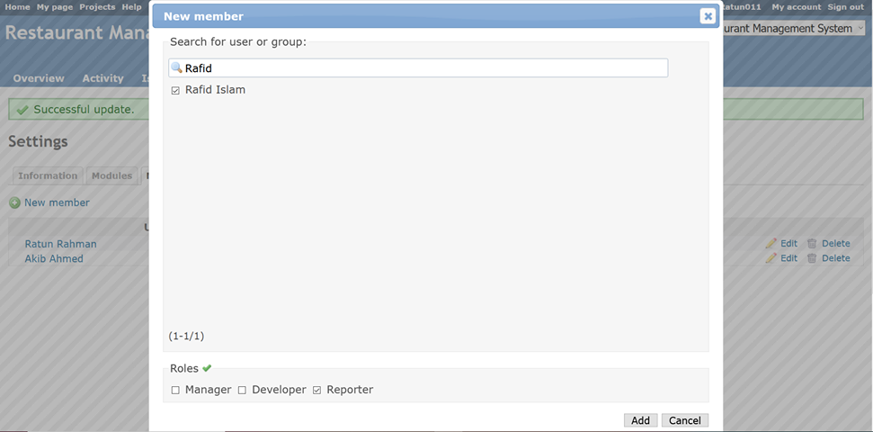
Add new member
Click on new member under member section. We can find it by searching new member. And we can add them as manager, developer or reporter.
Place your screenshot here

Slide 12
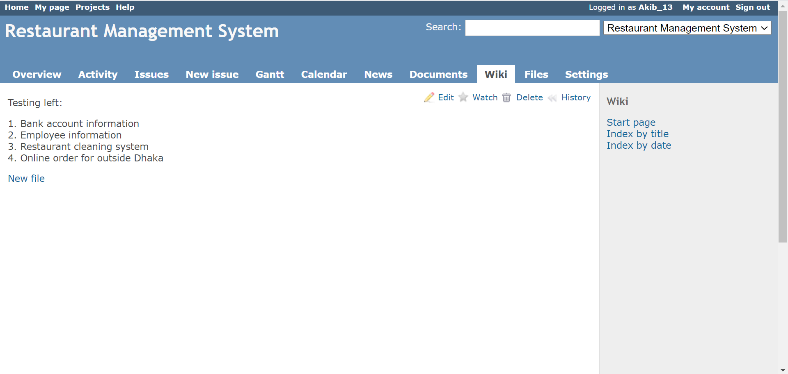
Check wiki
We can check the wiki in the wiki section.
Place your screenshot here

Slide 13
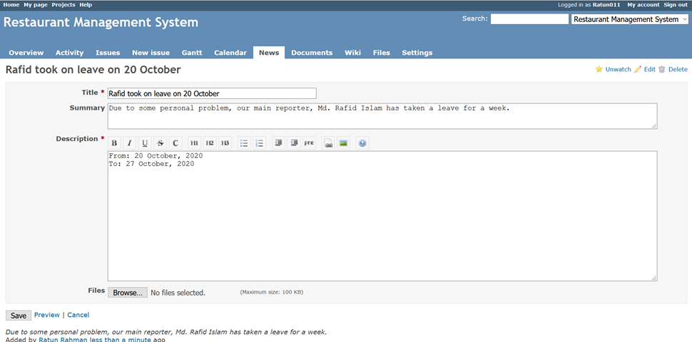
News
Select title and description also additional summary and image (if possible) to add new news.
Place your screenshot here

Slide 14
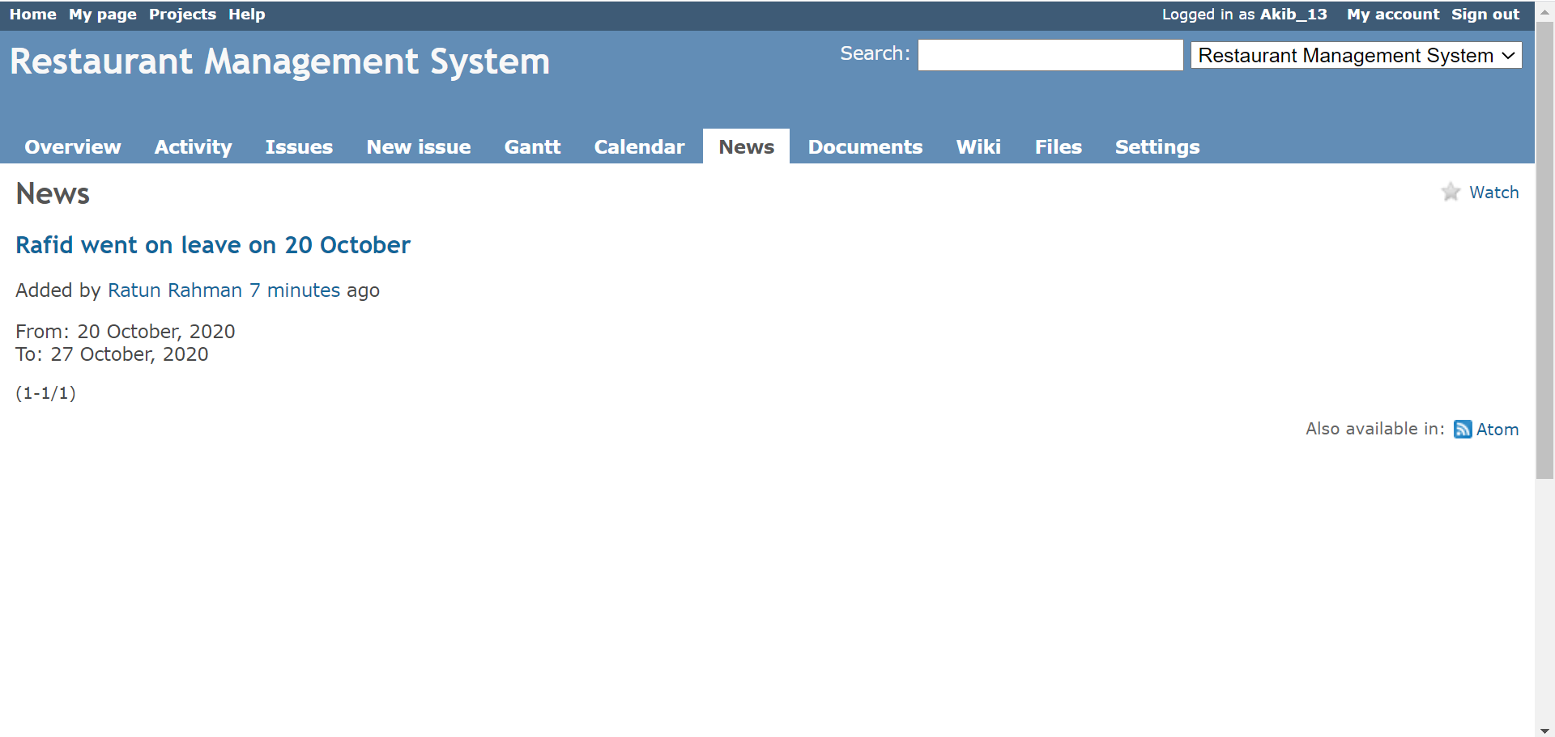
Check news
We can check new news along with summary and description and also the person who added the news in news section
Place your screenshot here

Slide 15
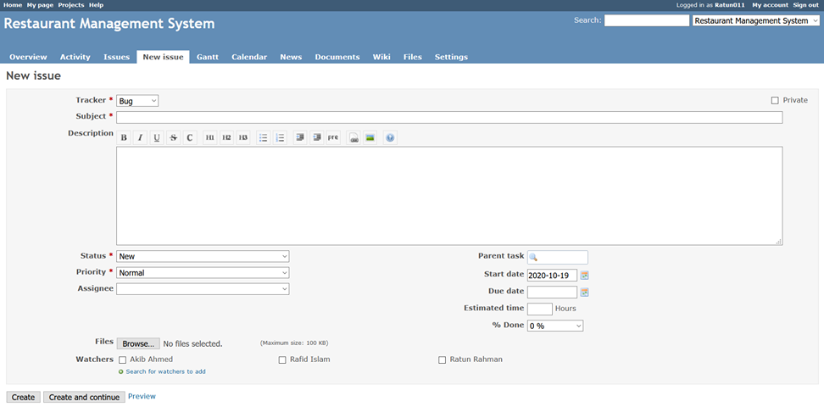
Issue (bug)
Select issue type (bug/ feature/ patch). Insert name, status, priority as well as time description and image if necessary.
Place your screenshot here

Slide 16
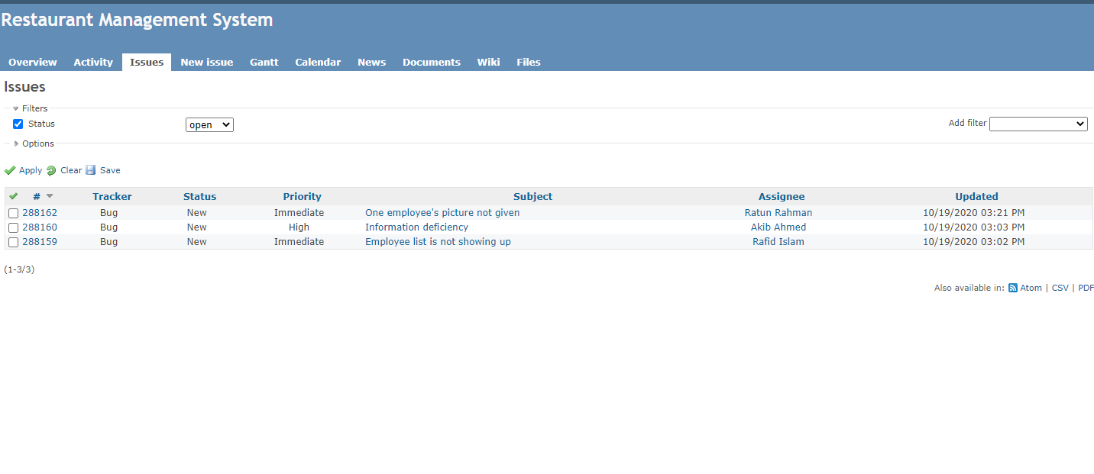
View issues
We can check issues, the assigned members, time, issue status, priority and type of issue.
Place your screenshot here

Slide 17
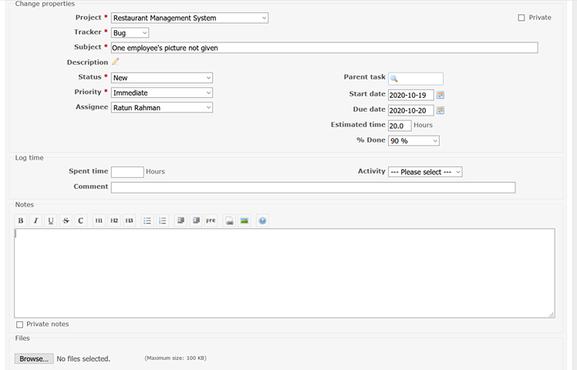
Update bug status
Update bug status and add completed time, activity status and percentage of work done.
Place your screenshot here

Slide 18
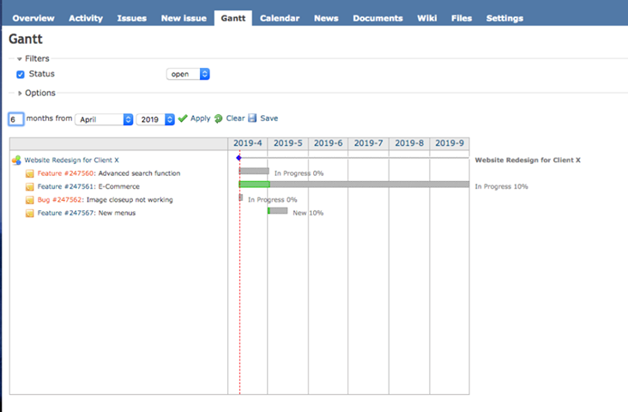
Gantt chart
Place your screenshot here

Slide 19
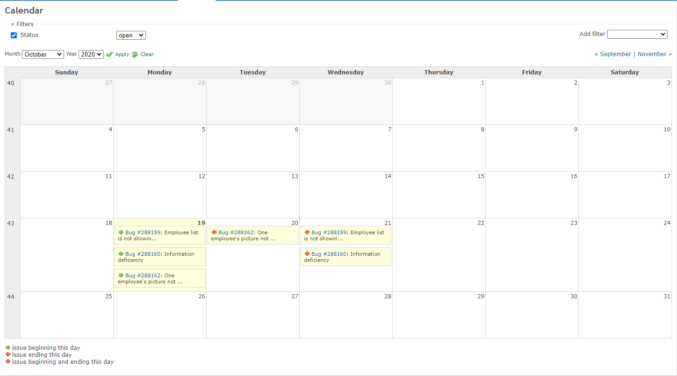
Calendar
Place your screenshot here

Slide 20
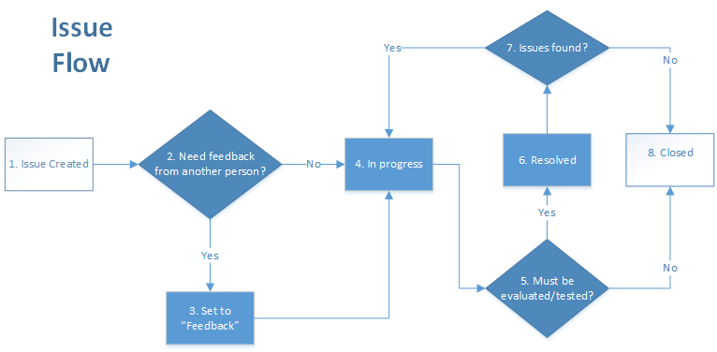

Slide 21
Disadvantages of Redmine
Design and user-interface are a little outdated. Looks like a product that was designed ages ago.
It’s a little feature lacking compared to some other platforms that do the same thing.

Slide 22
Thanks!

