Slide 1
Viper, A New Programming Language
An Interpreter
Rafid Islam , 170042009
Ratun Rahman , 170042011
Akib Ahmed , 170042013

Slide 2
DESCRIPTION
An interpreter based programming language

Slide 3
MOTIVATION
Create our own language
Making language more user friendly (removed semicolon and tab)
Better and accurate error handling system

Slide 4
OBJECTIVE
The framework
The scanner
The symbol table
Parsing and interpreting expressions and assignment statements
Parsing and interpreting control statements
Parsing and interpreting declarations.

Slide 5
REQUIREMENTS
Python compiler
Parser knowledge

Slide 6
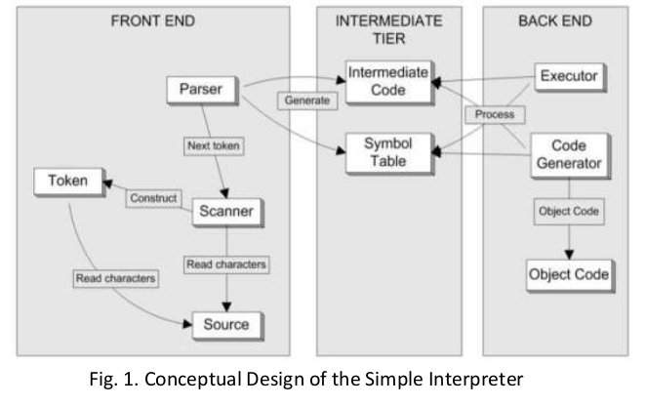
FEATURES

Slide 7
FEATURES
Conceptual Design
Basic Interpreter Framework
Scanning
Symbol Analysis
Expression and Assignment Statement
Control Statement (IF,FOR, WHILE)
Parsing Declaration

Slide 8
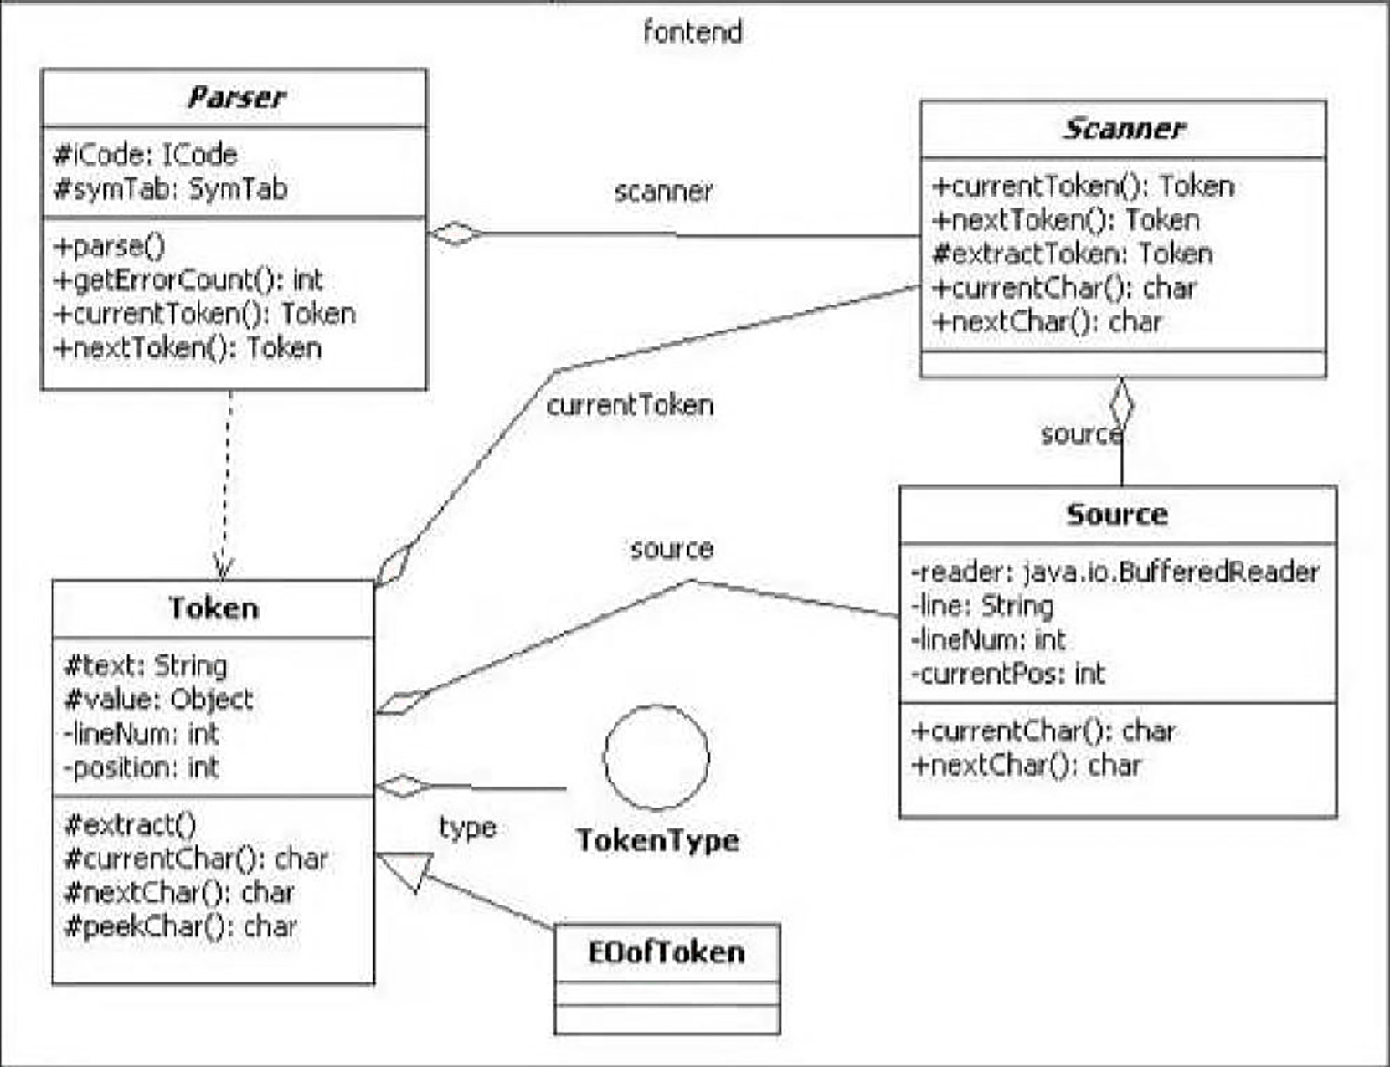
ER DIAGRAM

Slide 9
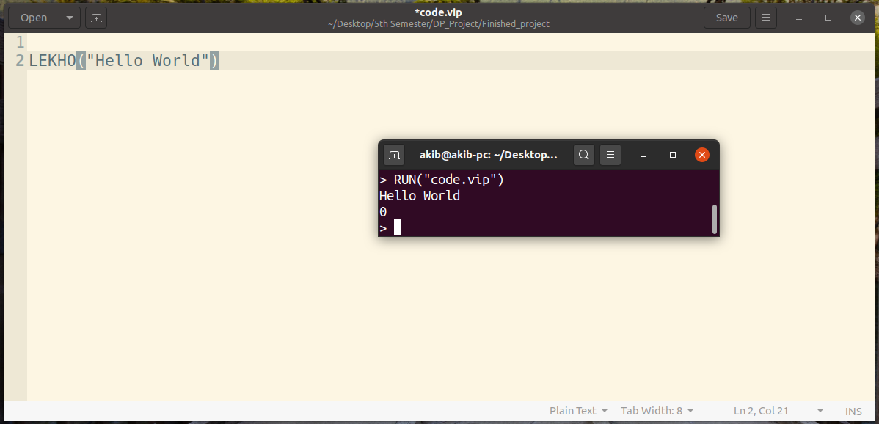
EXAMPLE
* Print “Hello World”

Slide 10
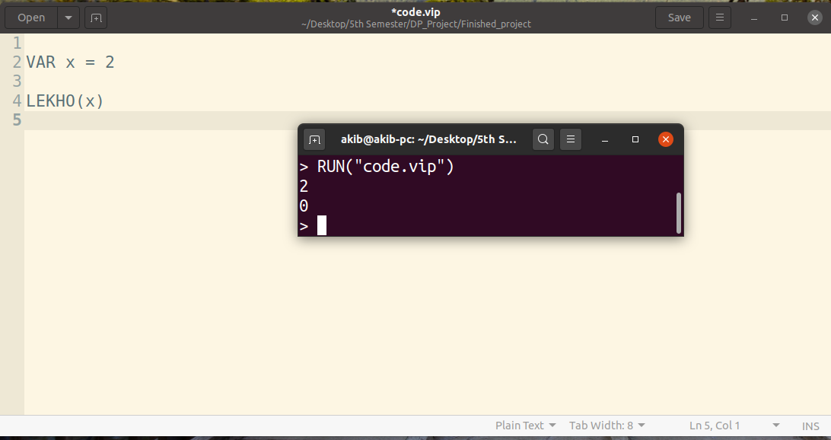
EXAMPLE
* Declare a variable

Slide 11
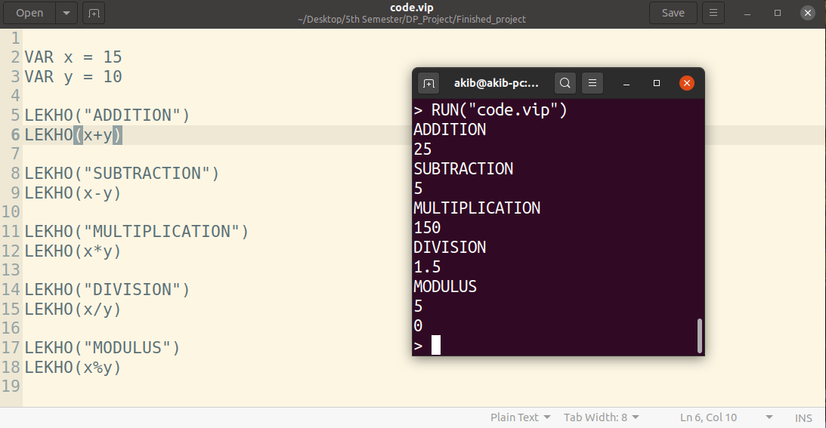
EXAMPLE
* Addition, subtraction, multiplication, division, modulus of 2 variables

Slide 12
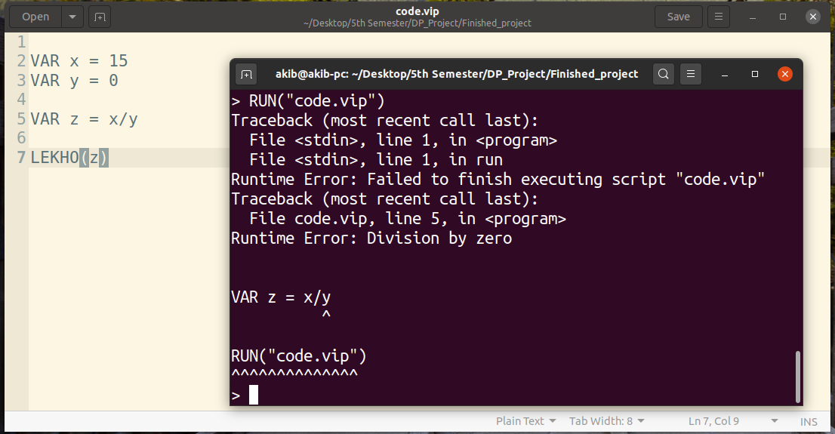
EXAMPLE
* Division by 0 error

Slide 13
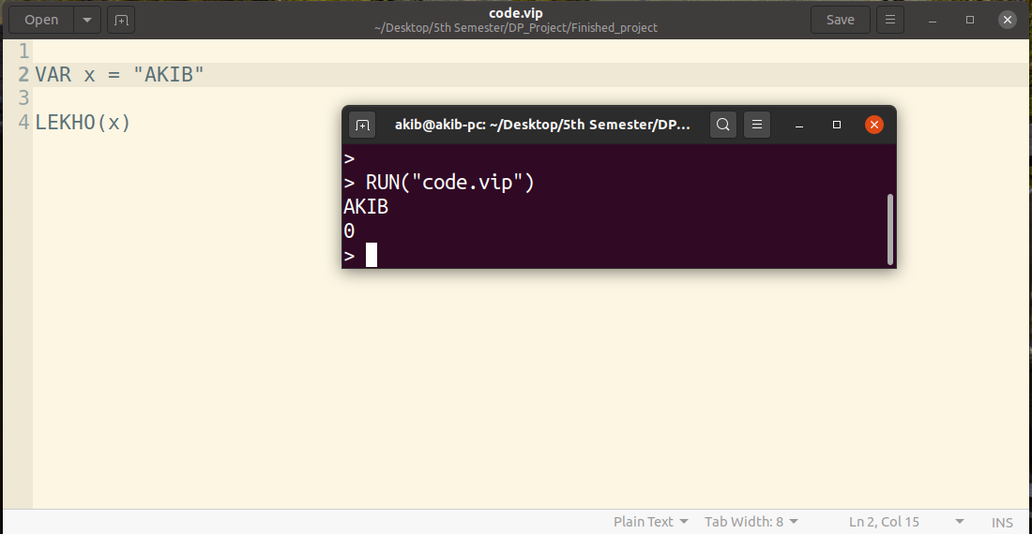
EXAMPLE
* String

Slide 14
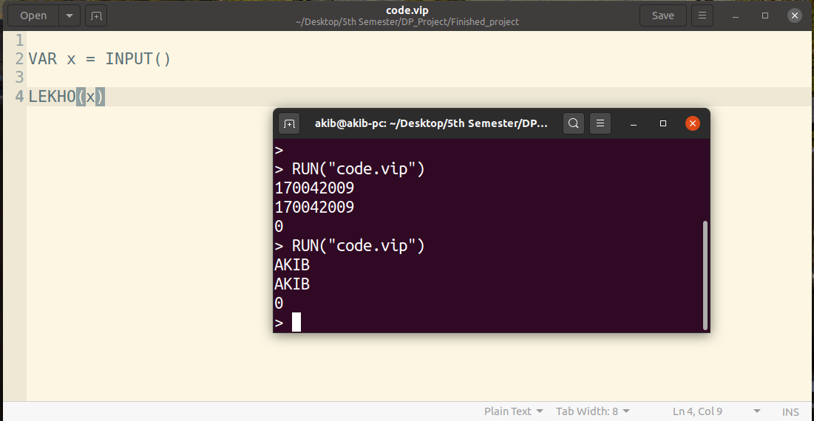
EXAMPLE
* Taking input from user (Integer, string both)

Slide 15
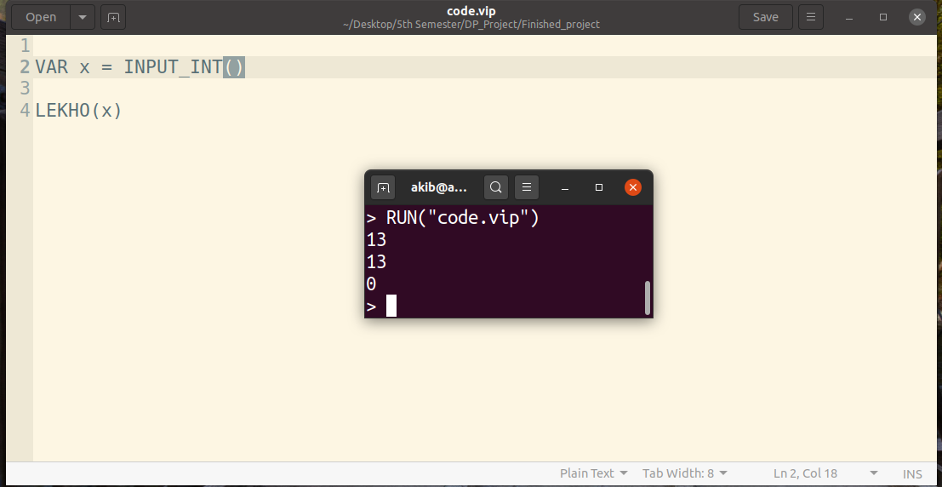
EXAMPLE
*
Taking input from user (Integer only)

Slide 16
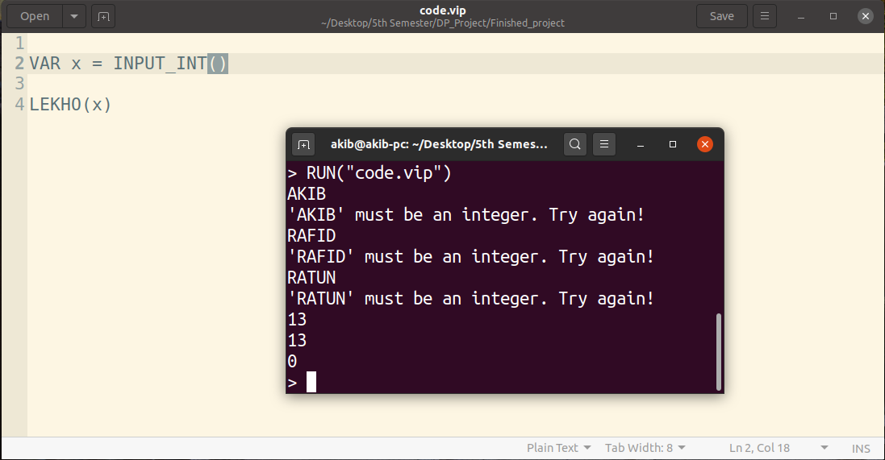
EXAMPLE
* Try to put string value in INPUT_INT()

Slide 17
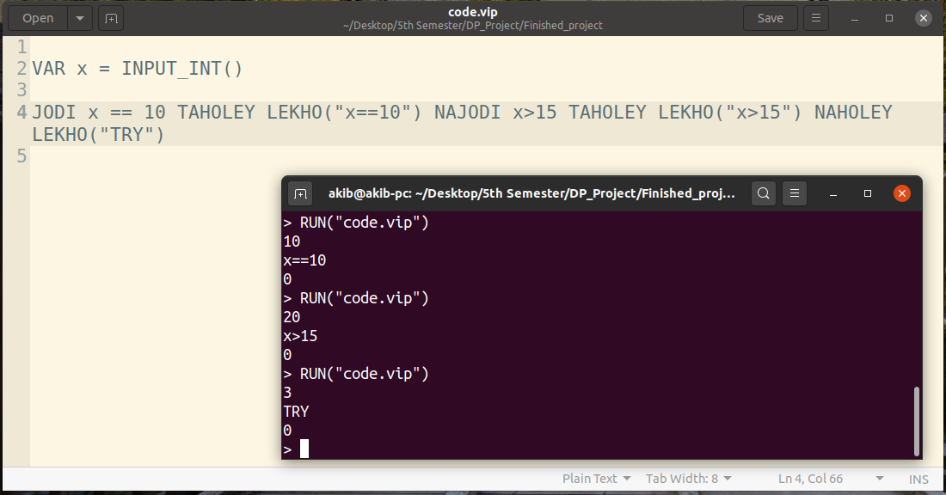
EXAMPLE
* Conditions

Slide 18
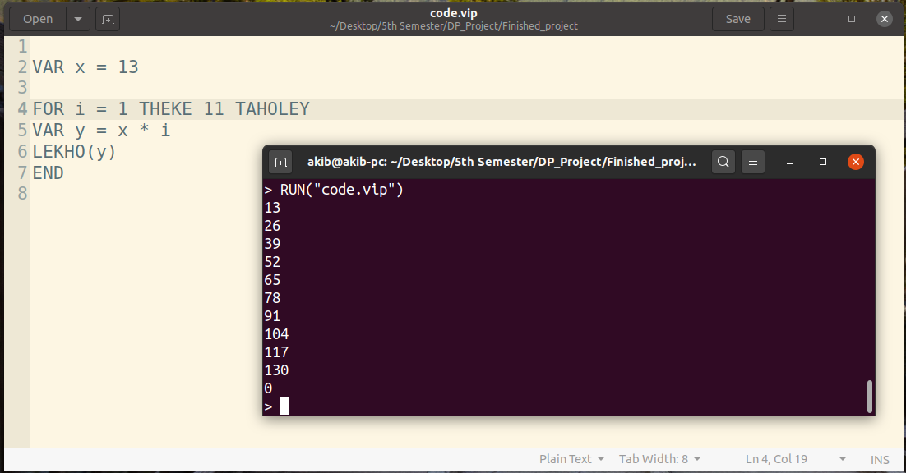
EXAMPLE
* Loop (for loop)

Slide 19
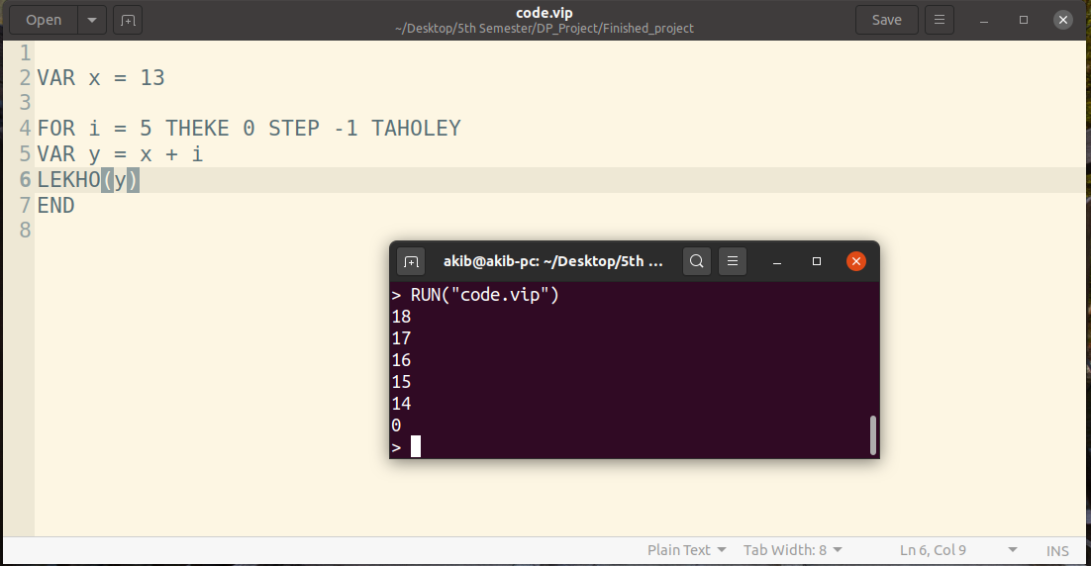
EXAMPLE
* For loop with steps (and reverse)

Slide 20
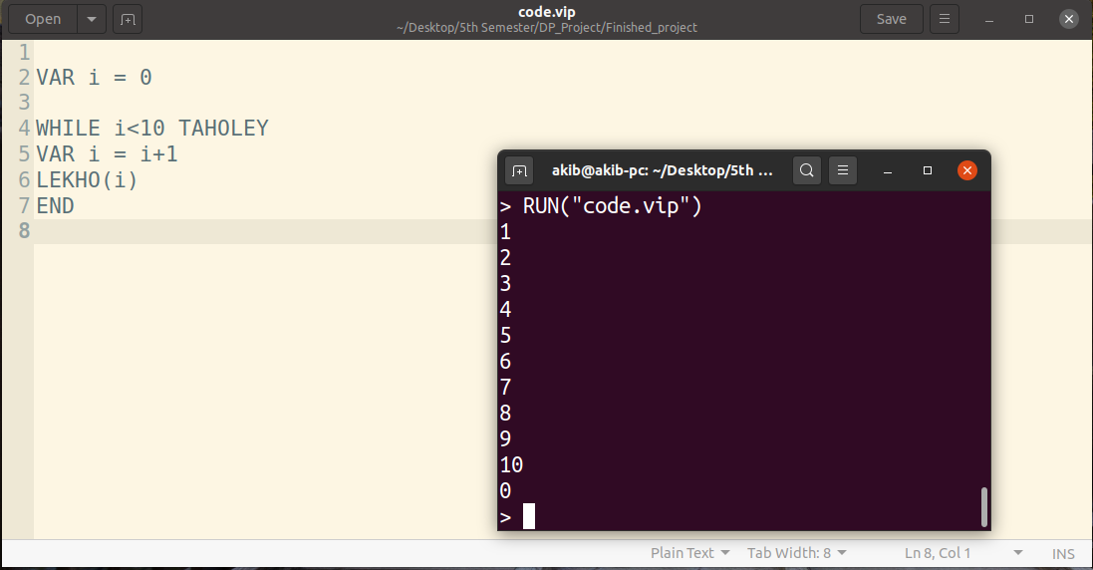
EXAMPLE
* Loop (While loop)

Slide 21
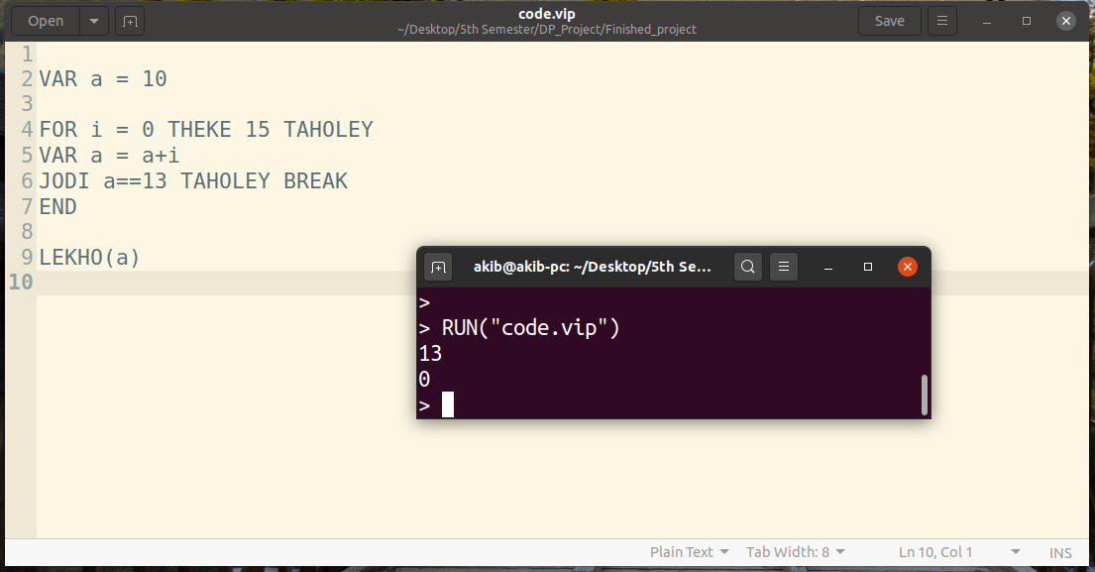
EXAMPLE
* Break

Slide 22
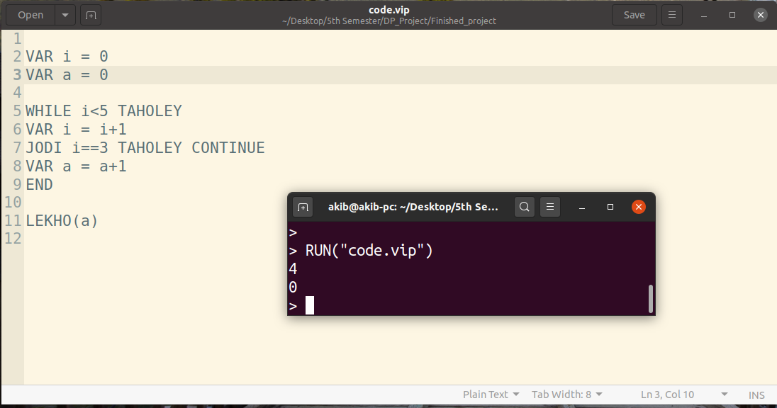
EXAMPLE
* Continue

Slide 23
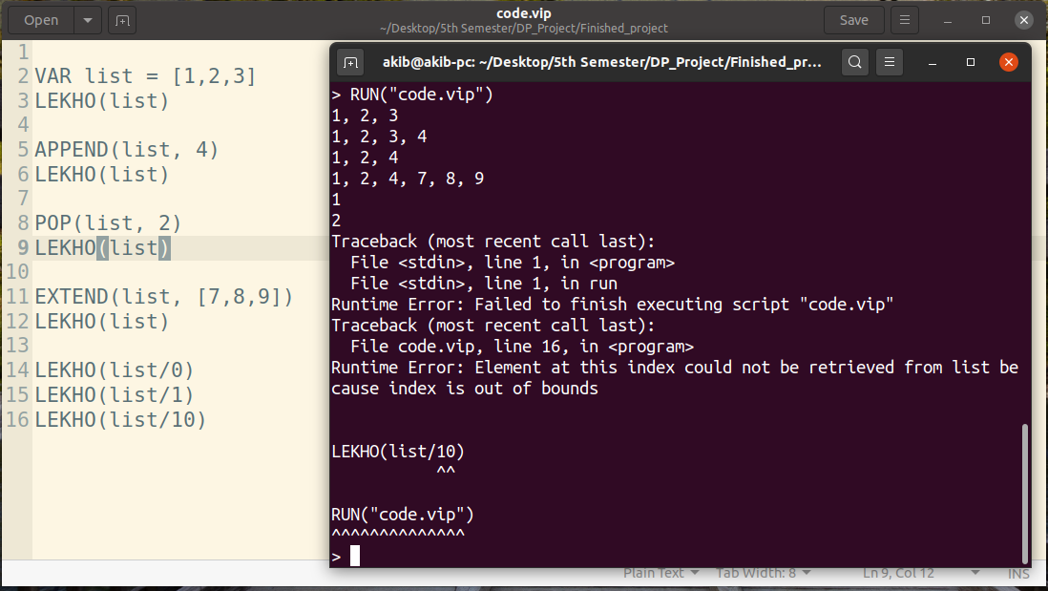
EXAMPLE
* List (append, pop, extend, index)

Slide 24
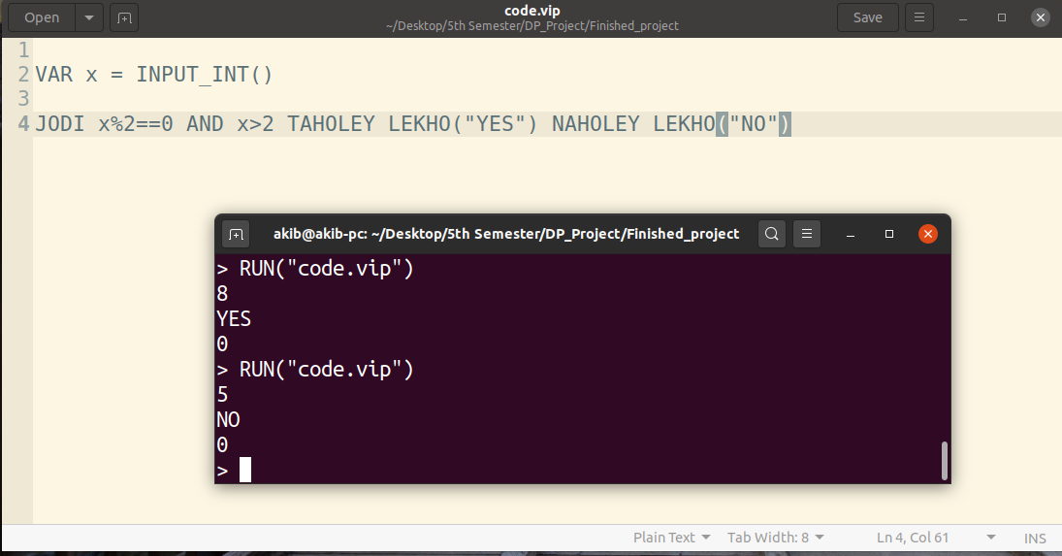
EXAMPLE
* Codeforces: 4A Watermelon
https://codeforces.com/problemset/problem/4/A

Slide 25
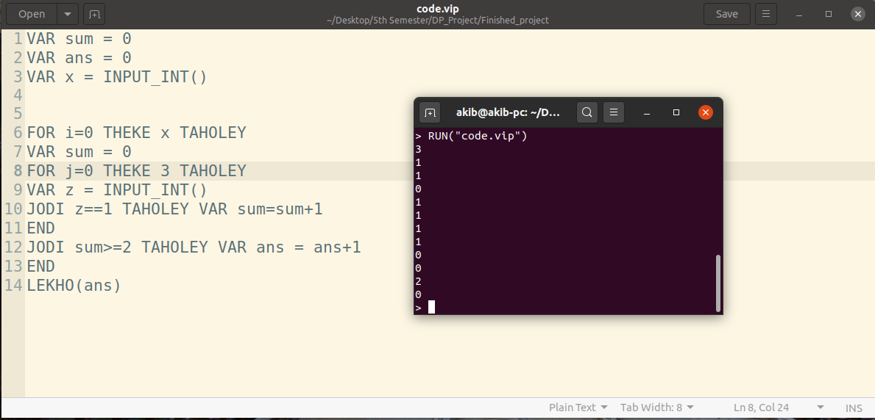
EXAMPLE
* Codeforces: 231A Team
https://codeforces.com/problemset/problem/231/A

Slide 26
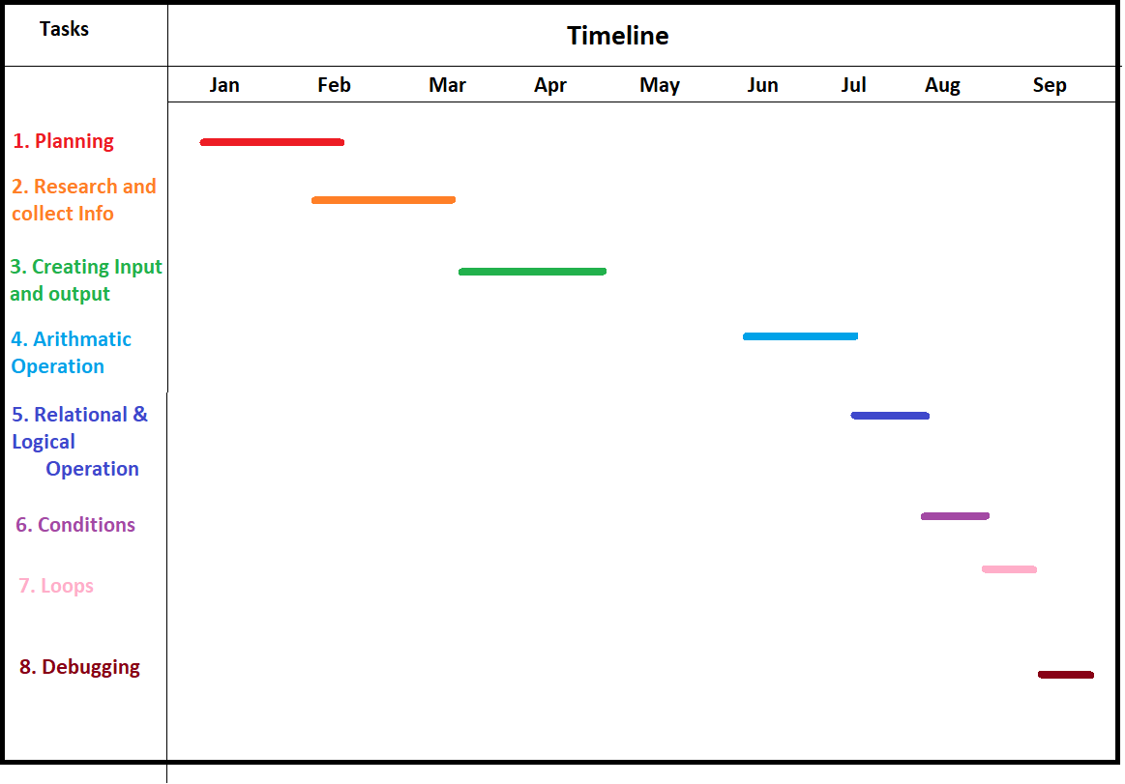
TIMELINE

Slide 27
FUTURE PLAN
Graphics Design
Add some more software terms such as object oriented, design pattern, UML diagram etc.
More specific error handling system
Future implement: String’s functionality, 2D array, Bit wise Operator

Slide 28
THANK YOU

