Slide 1
Sales Performance & Customer Segmentation Analysis
12th May 2026

Slide 2
Agenda
1
The Challenge & The Data
2
Approach & Methodology
3
Executive Summary Insights
4
Sales Overview
5
Customer Segmentation
6
Advanced Business Insights
7
Recommendations
8
Conclusion

Slide 3
The Challenge & The Data
The Challenge
ABC Corp operates across multiple regions and sales channels and wants to better understand business performance across products, customers, and regions.
Which regions and product categories drive the highest sales
Whether online or offline channels perform better
How customer value is distributed
Which segments or regions underperform
What strategic actions can improve business growth
The Data
Tables
Key Attributes
KPIs Analyzed
Customers
Products
Sales
Region
Product Category
Channel
Order Date
Customer ID
Revenue
Total Revenue
Total Orders
Average Order Value
Revenue Growth %
Repeat Customer %

Slide 4
Approach & Methodology
Analytical Approach
Data Preparation
KPI Development
Customer Segmentation
Created DAX measures for:
Revenue
Orders
AOV
Growth Metrics
Customer Revenue
Segmented customers into:
High Value
Medium Value
Low Value
Based on customer spending behavior
Cleaned and transformed data using Power Query
Handled relationships and data consistency
Created star schema data model
Built calendar table for time-based analysis

Slide 5
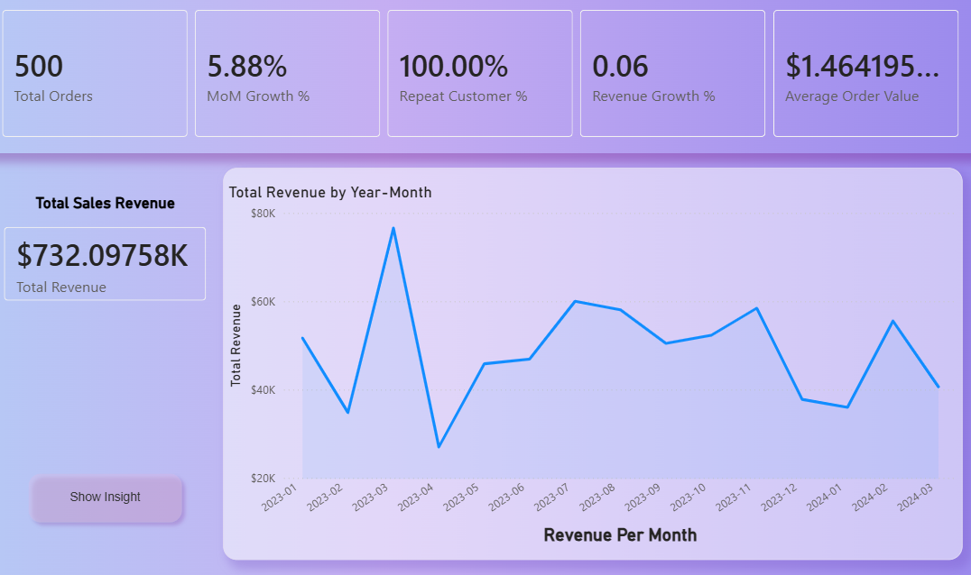
Executive Summary Insights
Key Insights
ABC Corp generated approximately $732K in total revenue from 500 orders and nearly 3K units sold.
The business achieved a positive 5.88% Month-over-Month growth, indicating stable sales performance.
The Average Order Value (AOV) is approximately $1.46K, reflecting high-value customer transactions.
Revenue trends show noticeable fluctuations, with peak sales observed around March 2023.
Revenue remained relatively stable during the second half of 2023.
A 100% repeat customer rate highlights strong customer retention and recurring purchasing behavior.

Slide 6
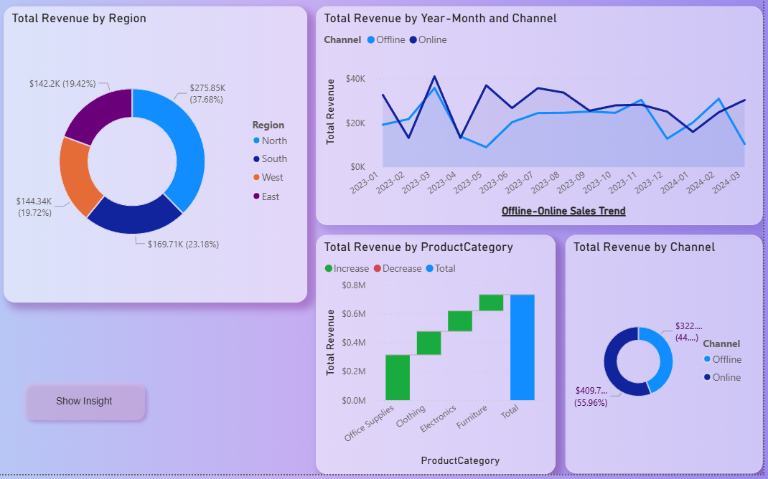
Sales Overview
Sales Performance Insights
North region contributes the highest share of total revenue (~38%).
Online sales contribute approximately 56% of total sales, outperforming offline channels.
Office Supplies is the highest-performing product category.
Monthly sales trends indicate seasonal demand fluctuations.
Revenue growth remained relatively stable across most months.
Offline sales performance presents opportunities for further optimization.

Slide 7
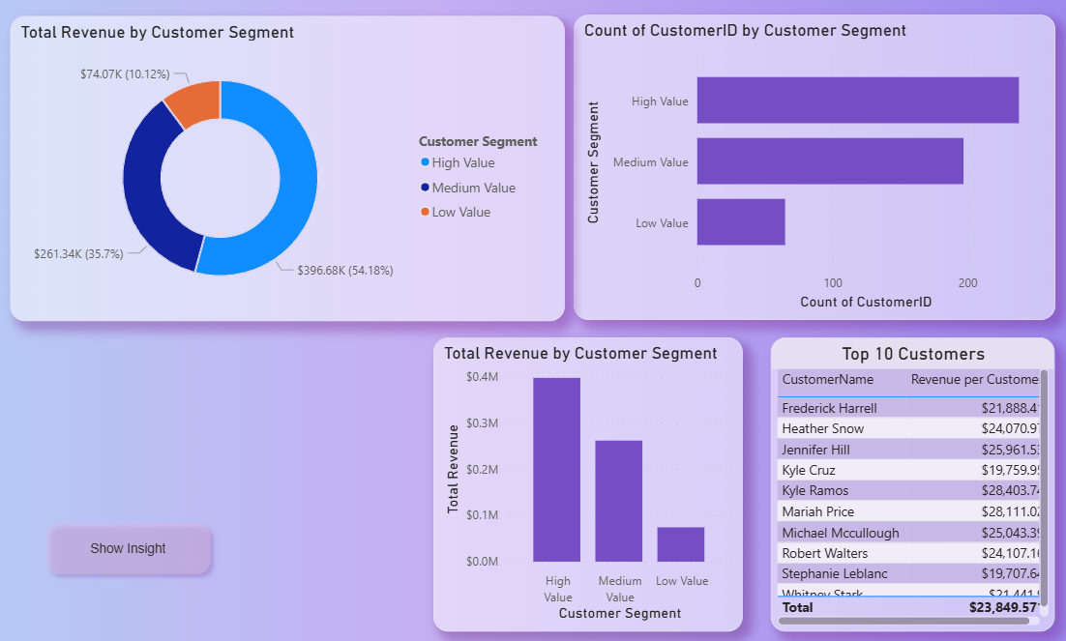
Customer Segmentation
Customer Insights
High-value customers contribute over 54% of total revenue despite representing a smaller customer segment.
Medium-value customers contribute approximately 36% of total revenue, indicating strong upselling opportunities.
Low-value customers contribute a smaller portion of revenue but represent potential future growth.
Revenue distribution is heavily concentrated among high and medium-value customers.
Top customers individually generate significant revenue, highlighting the importance of customer retention strategies.

Slide 8
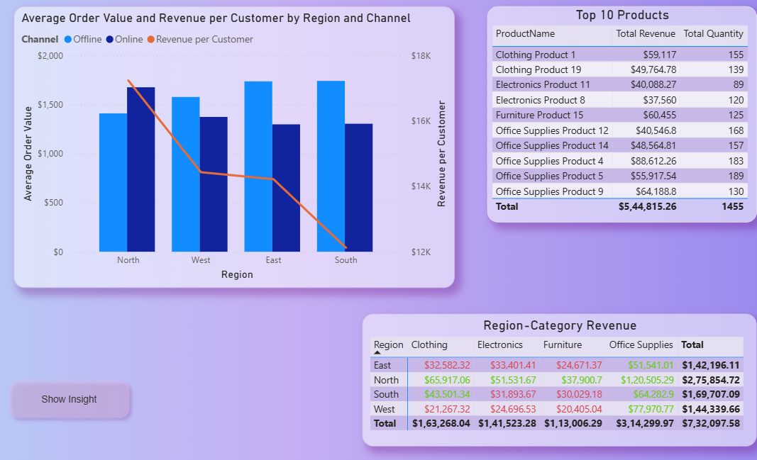
Advanced Business Insights
Advanced Insights
North region performs consistently across all product categories and generates the highest overall revenue.
Office Supplies contributes the largest share of category revenue across most regions.
East and South regions show comparatively higher Average Order Value (AOV).
Revenue per customer varies significantly across regions, indicating different purchasing behaviors.
Top-performing products are primarily concentrated within the Office Supplies category.
Electronics and Furniture categories contribute comparatively lower revenue, indicating potential growth opportunities.

Slide 9
Recommendations
Strategic Recommendations
Regional Strategy
Product Optimization Strategy
Customer Retention & Segmentation Strategy
Channel Performance Strategy
Increase investment and marketing focus in the North region, as it consistently generates the highest revenue across product categories.
Develop targeted regional campaigns for East and West regions to improve customer acquisition and sales contribution.
Analyze customer preferences region-wise to create localized promotional strategies and improve market penetration.
Expand and prioritize the Office Supplies category, since it contributes the largest share of total revenue and contains most top-performing products.
Improve the performance of lower-contributing categories such as Furniture and Electronics through:
  targeted discounts,
  bundled offers,
  seasonal campaigns,
  and improved product visibility.
Monitor category-wise sales trends regularly to identify changing customer demand patterns.
Retain high-value customers through:
  loyalty programs,
  personalized recommendations,
  exclusive offers,
  and premium customer engagement initiatives.
Upsell medium-value customers using cross-selling and bundled product strategies to increase customer lifetime value.
Increase engagement for low-value customers through promotional campaigns and personalized communication to encourage repeat purchases.
Continue strengthening the online sales channel, as it contributes a higher share of revenue and demonstrates stronger customer engagement. Improve offline sales performance through:
  better in-store promotions,
  customer experience improvements,
  and region-specific offline campaigns.
Integrate online and offline customer strategies to provide a more seamless customer experience.

Slide 10



Conclusion
The analysis demonstrates that ABC Corp maintains stable business performance driven primarily by:
North region
Online sales channel
High-value customers
Office Supplies category
Strong customer retention
Consistent revenue generation
Stable growth trends
The business show:
Significant opportunities exist to improve underperforming regions and product categories through targeted strategic initiatives and customer-focused growth strategies.

