Slide 1
RC CAR IOT
Rauf Pere & Darren Ofori Appiah

Slide 2
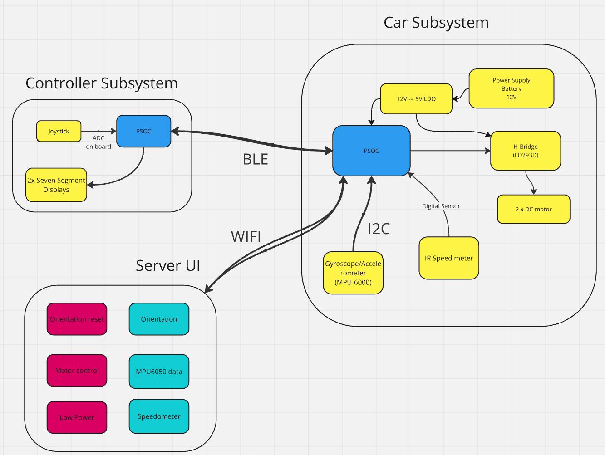
Block Diagram
Controller
Car
Server

Slide 3
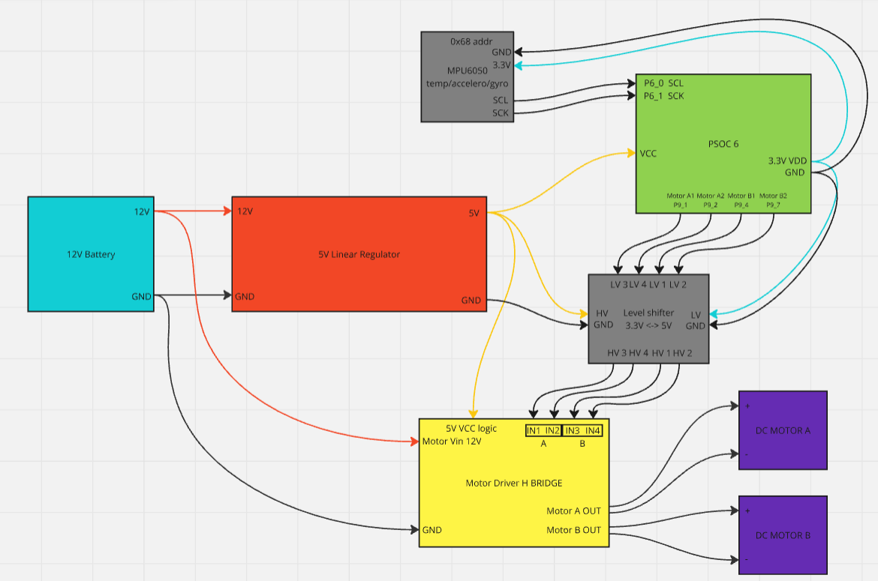
Car System
12V battery power source
5V linear regulator for PSoC power source
MPU6050 I²C interfaced temperature sensor/
accelerometer/gyroscope
Logic level shifter using mosfets
L293D H bridge IC
Two DC motors
BLE

Slide 4
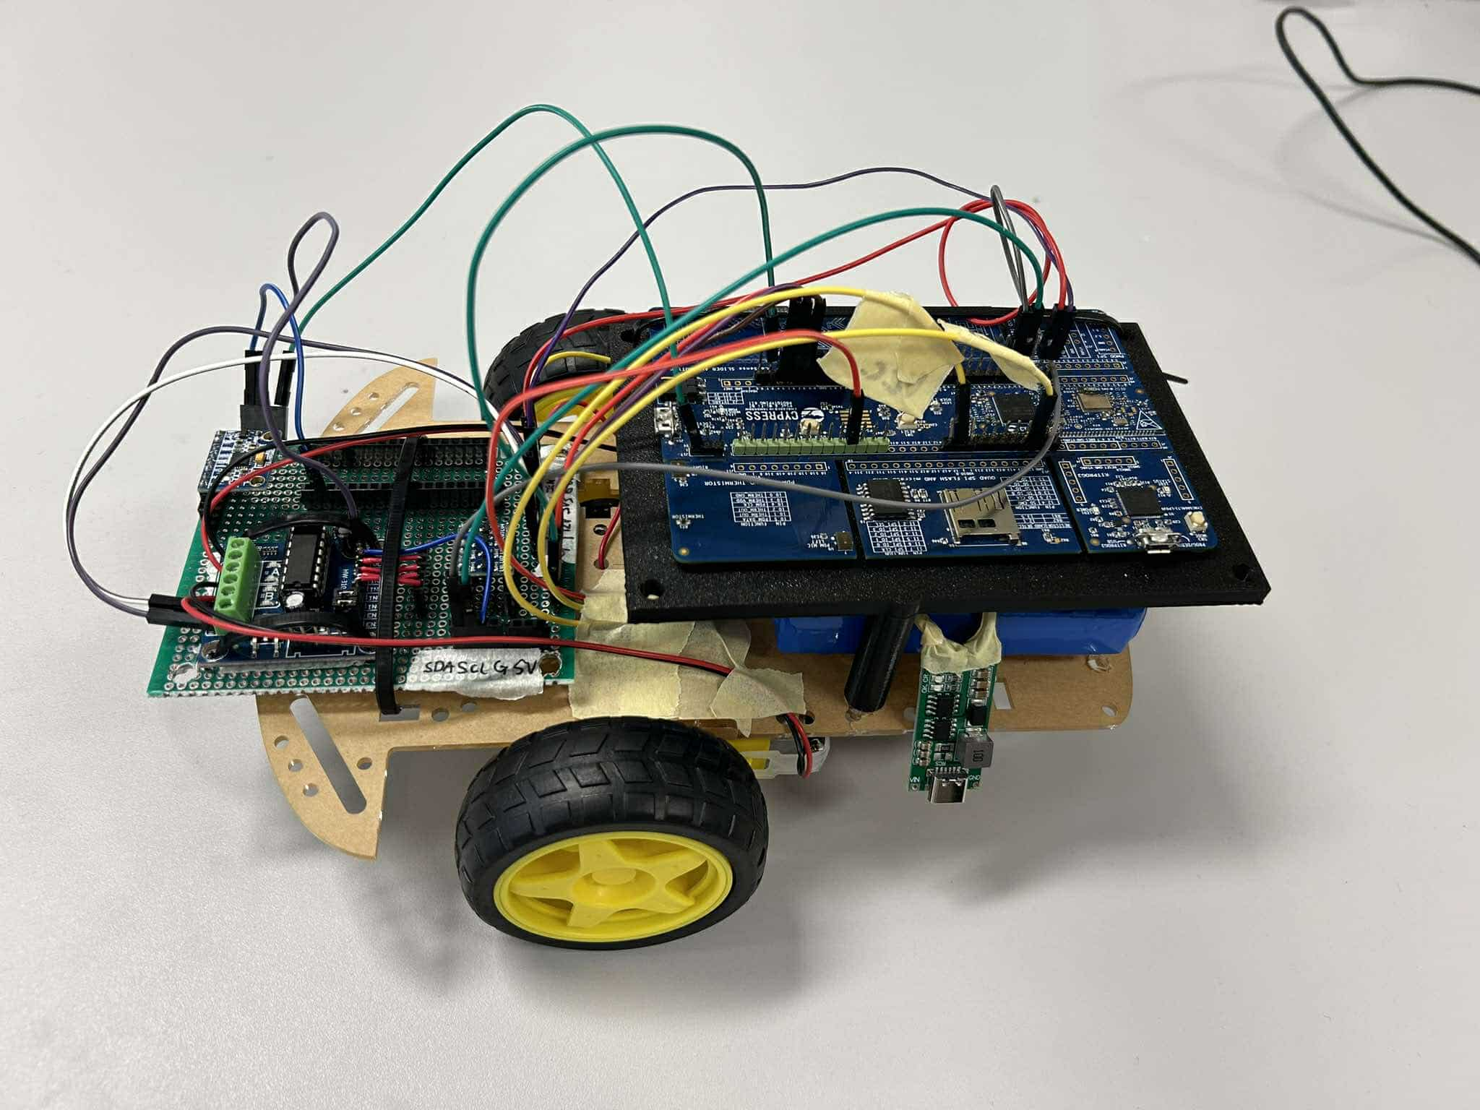
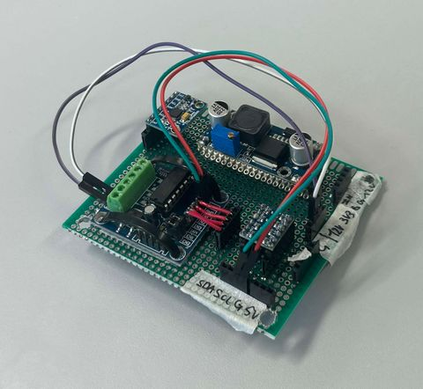
Car System
Custom soldered circuit board for cleaner setup
Full car setup along with black 3D printed frame and battery

Slide 5
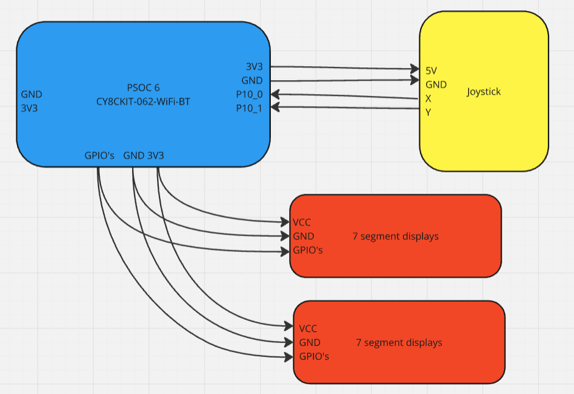
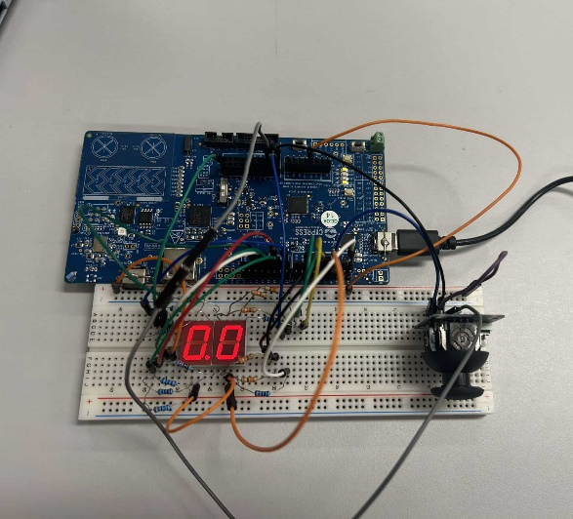
Controller System
Joystick analog in
2x 7-segment displays digital out
BLE

Slide 6
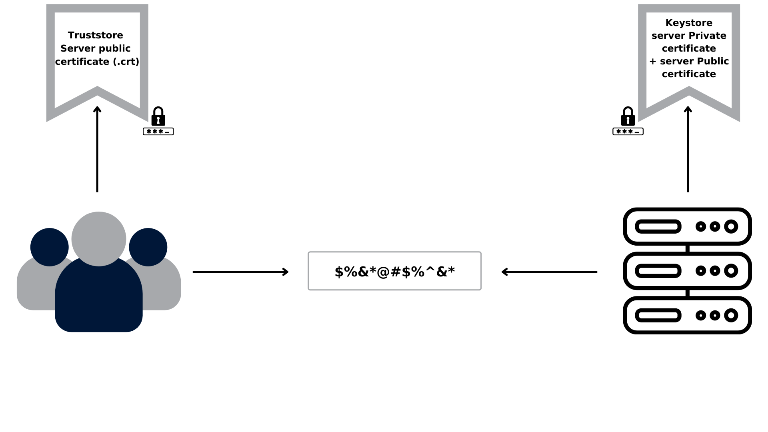
MQTT and Security
TLS protocol (transport layer security)
CRT file: Validates client’s identity against a trusted Certificate Authority (CA)
Key file: Key of the client
PEM file: Encodes the private key of the client
Enhances data integrity and prevents MITM attacks

Slide 7
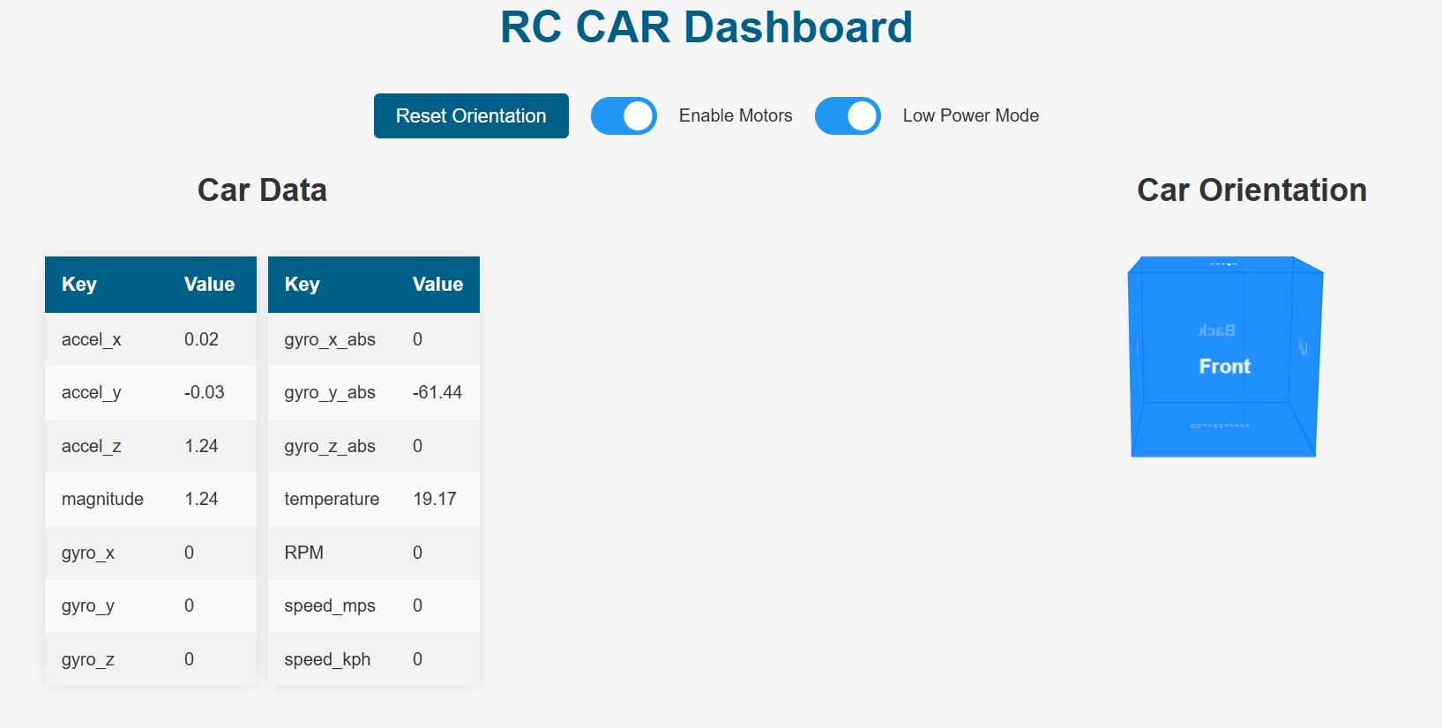
Server UI
MPU6050 data
Car orientation
Speedometer data
Reset orientation
Motor control
Low power control

Slide 8
Power Consumption
State | Voltage (V) | Current (mA) | Power (W)
Idle | 12 | 175 | 2.1
Full drive | 12 | 600 | 7.2
Full drive low power | 12 | 400 | 4.8

Slide 9
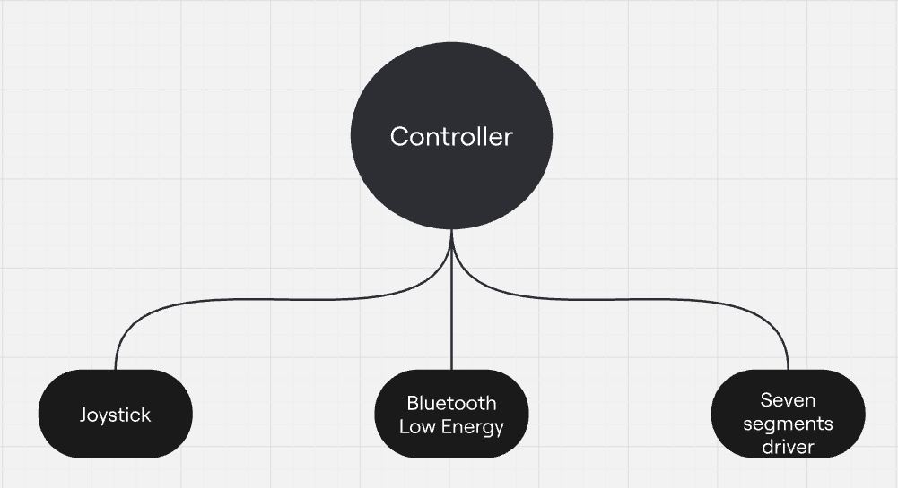
Software Architecture RTOS
Controller subsystem
Read joystick x, y data
BLE communication for joystick data to car subsystem
Show speed on two seven segments displays

Slide 10
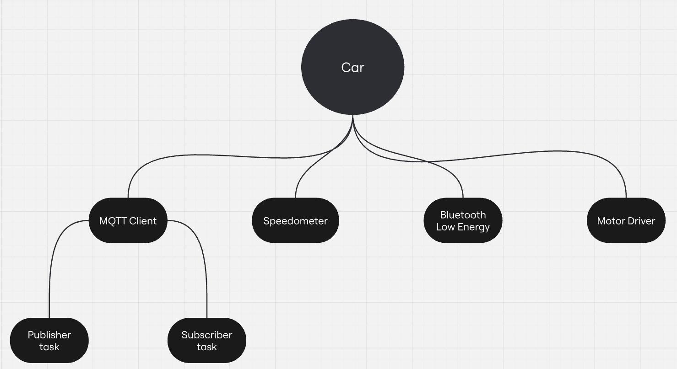
Software Architecture RTOS
Car subsystem
MQTT Client setup and regulation of MQTT connection
Speedometer calculates RPM to send via BLE to the controller subsystem
BLE communication for the controller
Motor driver PWM with joystick data

