Slide 1
RC CAR IOT
Rauf Pere & Darren Ofori Appiah

Slide 2
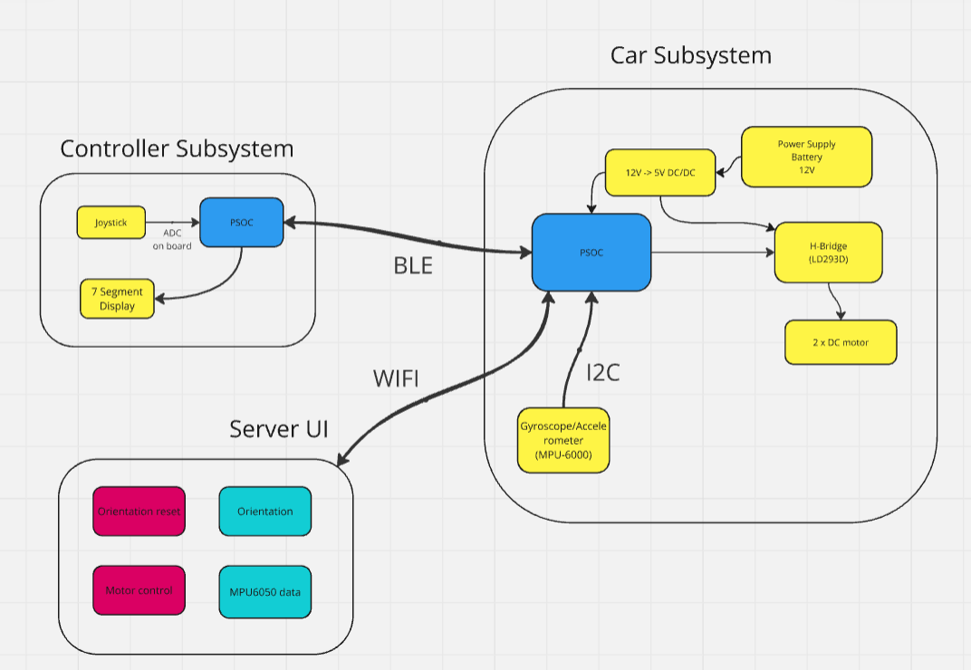
Block Diagram
Controller
Car
Server

Slide 3
Car System

Slide 4
Controller System

Slide 5
MQTT and Security

Slide 6
Server UI

Slide 7
Power Consumption
Before and after low power

Slide 8
Software Architercture

