Slide 1
RC CAR IOT
Rauf Pere & Darren Ofori Appiah

Slide 2
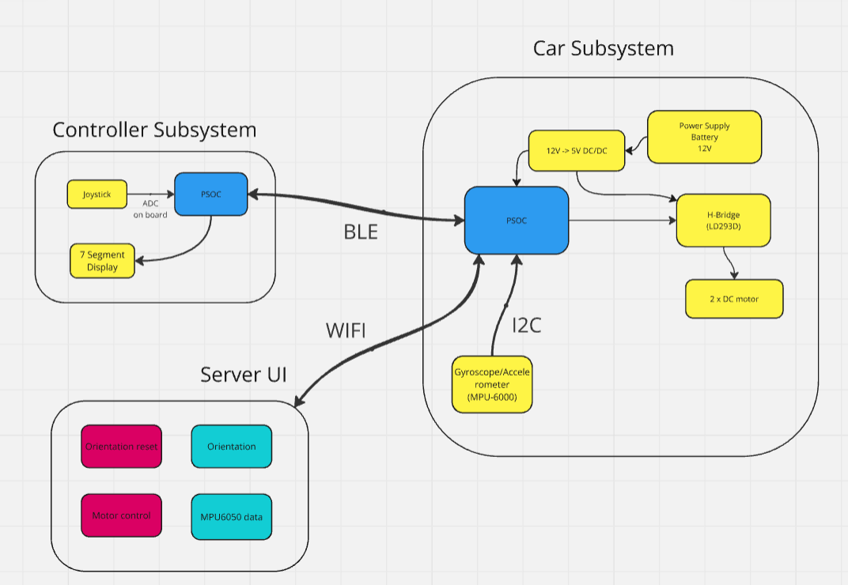
Block Diagram
Controller
Car
Server

Slide 3
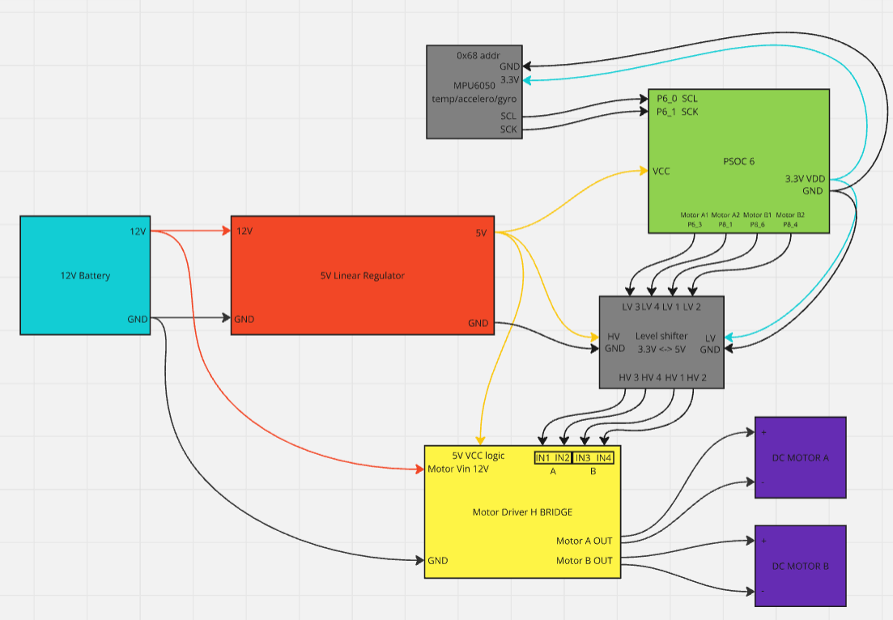
Car System
12V battery power source
5V linear regulator for PSoC power source
MPU6050 I²C interfaced temperature sensor/
accelerometer/gyroscope
Logic level shifter using mosfets
L293D H bridge IC
Two DC motors

Slide 4
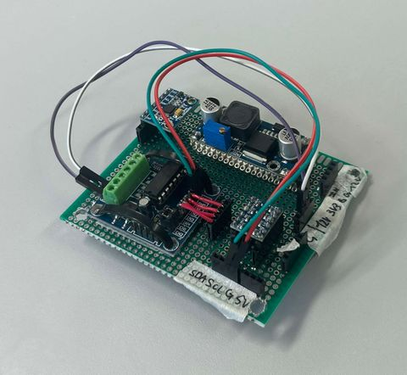
Car System
Custom soldered circuit board for cleaner setup
Full car setup along with black 3D printed frame

Slide 5
Controller System

Slide 6
MQTT and Security

Slide 7
Server UI

Slide 8
Power Consumption
Before and after low power

Slide 9
Software Architercture

