Slide 1


اللّهُ لاَ إِلَـهَ إِلاَّ هُوَ الْحَيُّ الْقَيُّومُ لاَ تَأْخُذُهُ سِنَةٌ وَلاَ نَوْمٌ لَّهُ مَا فِي السَّمَاوَاتِ وَمَا فِي الأَرْضِ مَن ذَا الَّذِي يَشْفَعُ عِنْدَهُ إِلاَّ بِإِذْنِهِ يَعْلَمُ مَا بَيْنَ أَيْدِيهِمْ وَمَا خَلْفَهُمْ وَلاَ يُحِيطُونَ بِشَيْءٍ مِّنْ عِلْمِهِ إِلاَّ بِمَا شَاء وَسِعَ كُرْسِيُّهُ السَّمَاوَاتِ وَالأَرْضَ وَلاَ يَؤُودُهُ حِفْظُهُمَا وَهُوَ الْعَلِيُّ الْعَظِيمُ
5 IMPORTANT QUALITIES OF AAYATHUL QURZI

Slide 2

70000 Malaks (angels) protect you from the Right, Left, Front & Back.
Recite Aayathul Qursi
At the time of leaving House,
The person dies before returning
he will get
70 Martyrs reward

Slide 3
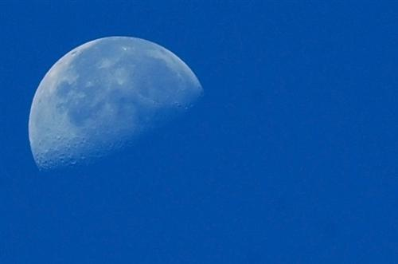
40 times everyday at the time of sunset,
Recite Aayathul Qursi
the person will get reward of 40 Hajj.

Slide 4
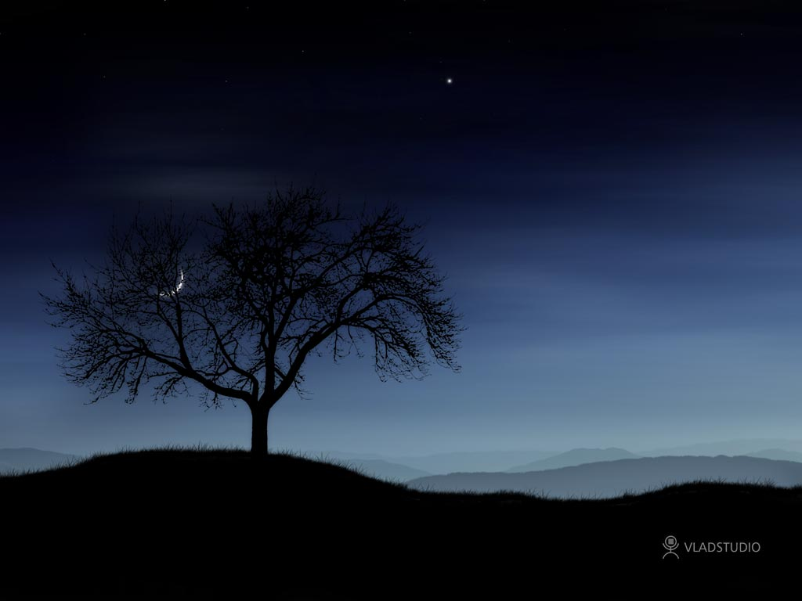
one Malakh (angel) will guard the person till morning.
Recite Aayathul Qursi
everyday
at the time of going bed

Slide 5
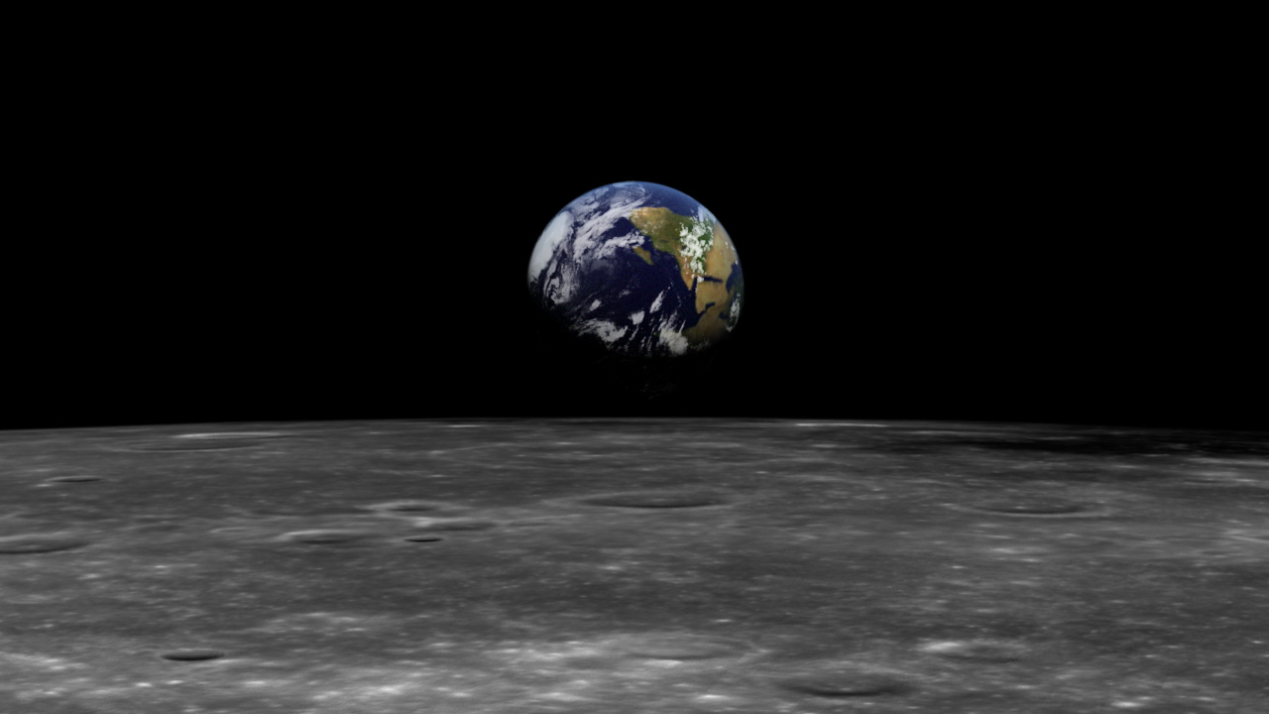
it keeps you away from poverty.
Recite Aayathul Qursi every time after returning home,

Slide 6
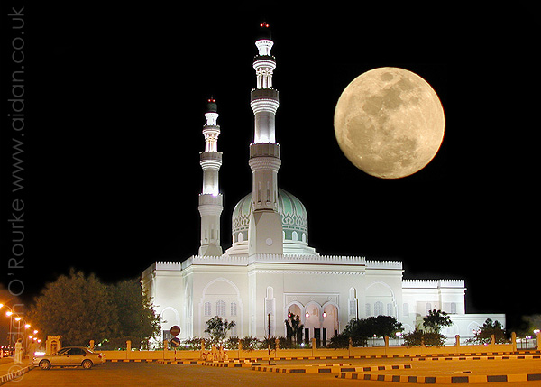
Recite Aayathul Qursi every time
after doing ablution (Wuzu)
will raise person 40 times
in rank from each word

Slide 7

Please send this to yours friends
and enjoy the reward from Allah

