Slide 1
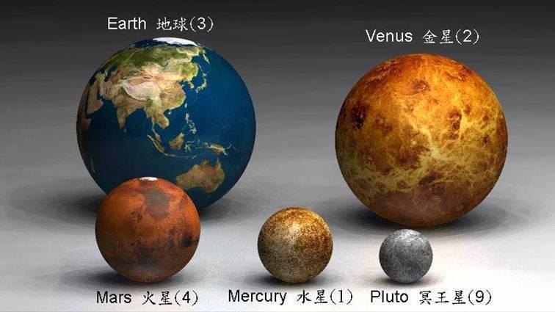
Compare the size of the earth with other planets

Slide 2
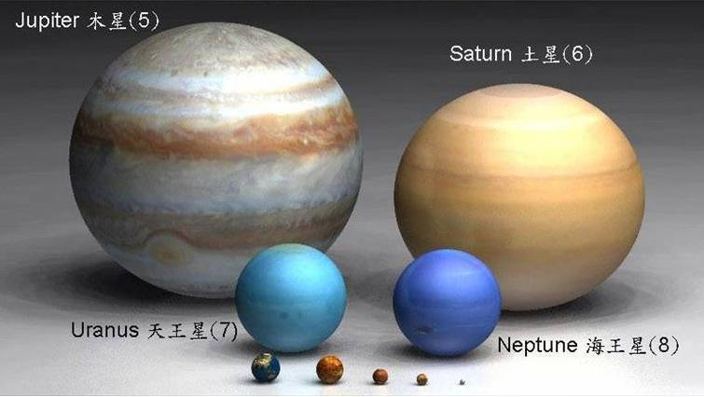
Now compare it with Uranus & Neptune
This is the Earth

Slide 3
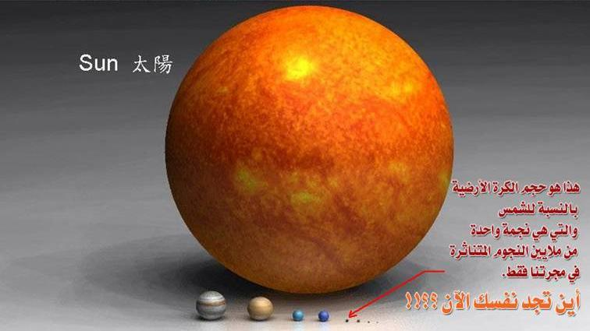
Now Earth against Sun
Against Sun, Earth is like a dot
Think !! Where do you find yourself now??
This is the Earth

Slide 4
Suppose if we assume Sun as a 100 inch - for Demo
 | Actual | Scale | Scale
 | Diameter | Diameter | Diameter
Body | kilometers | inches | mm
Sun | 1391900 | 100
Mercury | 4866 |  | 8.88
Venus | 12106 |  | 22.092
Earth | 12742 |  | 23.252
Mars | 6760 |  | 12.336
Jupiter | 139516 |  | 254.595
Saturn | 116438 |  | 212.481
Uranus | 46940 |  | 85.658
Neptune | 45432 |  | 82.906
Pluto | 3400 |  | 6.204
The Earth would be 23.253 mm

Slide 5
As we have compared the Earth with Sun
Now !!
Start comparing the Sun with the Universe

Slide 6
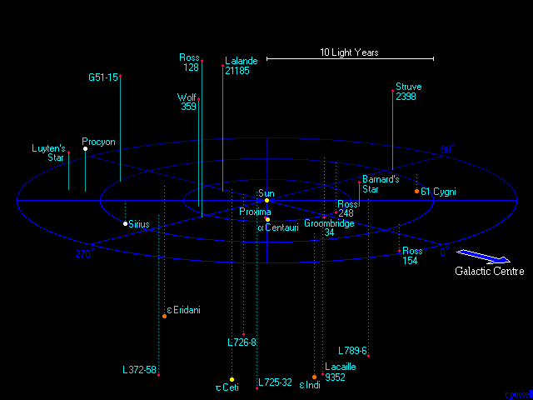
The Nearest Stars from Sun
The closest star to the Sun is only 7000 times further than the edge of our solar system.
This map shows all of the stellar systems that lie within 12.5 light years from us.

Slide 7
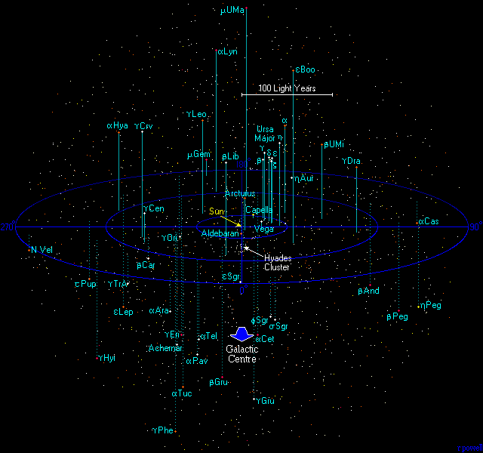

The Solar Neighbourhood
Universe within 250 light years
This map is a plot of the 1500 most luminous stars within 250 light years.
All of these stars are much more luminous than the Sun and most of them
can be seen with the naked eye. About one third of the stars visible with the
naked eye lie within 250 light years, even though this is only a tiny part of our galaxy.

Slide 8
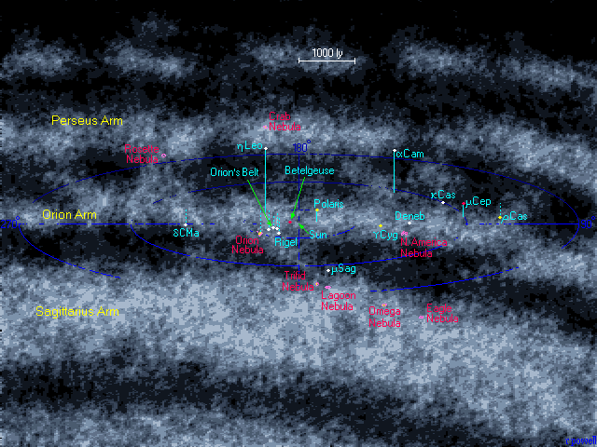

Corner of the Milky Way galaxy
4000 light years away
The Sun is located in the Orion Arm - a fairly minor arm compared with the Sagittarius Arm,
which is located closer to the galactic centre.
The map shows several stars visible with the naked eye which are located deep within the
Orion arm. The most notable group of stars here are main stars in the constellation of Orion
from which the spiral arm gets its name. All of these stars are bright giant and supergiant
stars, thousands of times more luminous than the Sun. The most luminous star on the map
is Rho Cassiopeia - to us 4000 light years away, it is a dim naked eye star, but in reality
it is a huge supergiant star 100 000 times more luminous than our Sun.

Slide 9
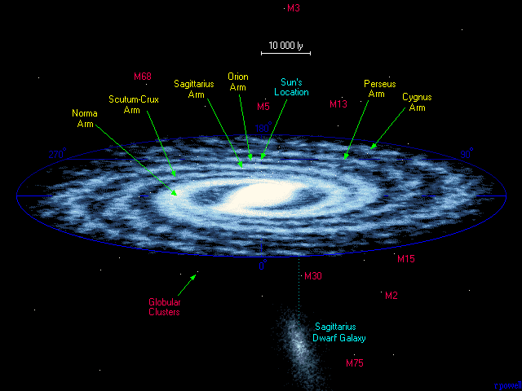

The Universe within 50,000 Light Years
The Milky Way Galaxy
A spiral galaxy of at least two hundred billion stars. Our Sun is buried deep within the
Orion Arm about 26 000 light years from the centre. Towards the centre of the Galaxy
the stars are packed together much closer than they are where we live. Notice also the
presence of small globular clusters of stars which lie well outside the plane of the Galaxy,
and notice too the presence of a nearby dwarf galaxy - the Sagittarius dwarf –
which is slowly being swallowed up by our own galaxy.

Slide 10
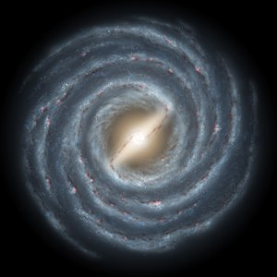
Now!! Canyou find the Solar system
agaisnt the Milkay way.
Although the Milky Way is but one of billions of galaxies in the universe,
the Galaxy has special significance to humanity as
it is the home of the solar system.
As a guide to the relative physical scale of the Milky Way,
if the galaxy were reduced to 130 km (80 mi) in diameter,
the solar system would be a mere 2 mm (0.08 in) in width.

Slide 11
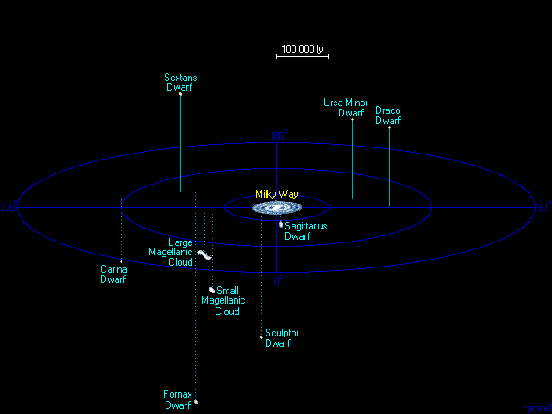

Number of large galaxies within 500 000 light years = 1
Number of dwarf galaxies within 500 000 light years = 9
Number of stars within 500 000 light years = 225 billion .
The Universe within 5,00,000 Light Years
The Satellite Galaxies
The Milky Way is surrounded by several dwarf galaxies, ypically containing a
few tens of millions of stars, which is insignificant compared with the number of
stars in the Milky Way itself. This map shows the closest dwarf galaxies,
they are all gravitationally bound to the Milky Way requiring billions of years to orbit it.

Slide 12
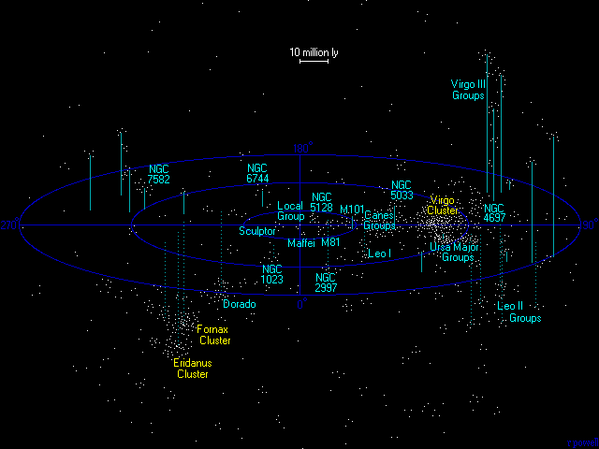

The Universe within 100 million Light Years
The Virgo Supercluster
Can you find the Milky Way in this??
Our Milky Way galaxy is part of Local Group & it is in centre
Number of galaxy groups within 100 million light years = 200
Number of large galaxies within 100 million light years = 2500
Number of dwarf galaxies within 100 million light years = 25 000
Our galaxy is just one of thousands that lie within 100 million light years. The above map
shows how galaxies tend to cluster into groups, the largest nearby cluster is the Virgo
cluster a concentration of several hundred galaxies which dominates the galaxy groups
around it. Collectively, all of these groups of galaxies are known as the Virgo Supercluster
The second richest cluster in this volume of space is the Fornax Cluster, but it is not
nearly as rich as the Virgo cluster. Only bright galaxies are depicted on the map, our
galaxy is the dot in the very centre.

Slide 13
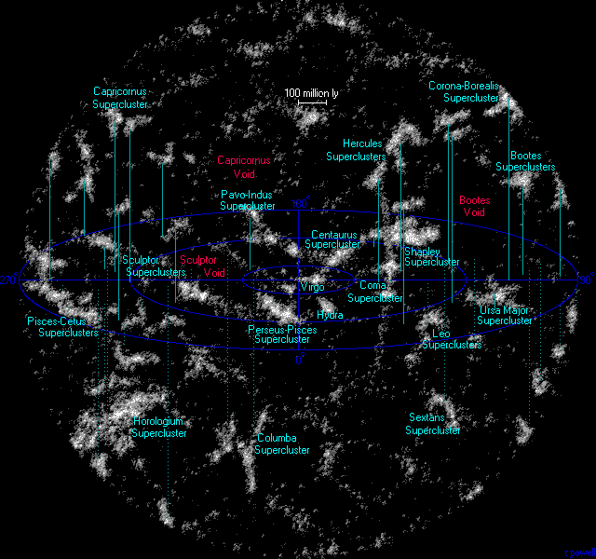

The Universe within 1 billion Light Years
The Neighbouring Superclusters
Galaxies and clusters of galaxies are not uniformly distributed in the Universe, instead they
collect into vast clusters and sheets and walls of galaxies interspersed with large voids in
which very few galaxies seem to exist. The map above shows many of these superclusters
including the Virgo supercluster - the minor supercluster of which our galaxy is just a minor
member. The entire map is approximately 7 percent of the diameter of the entire visible Universe.

Slide 14
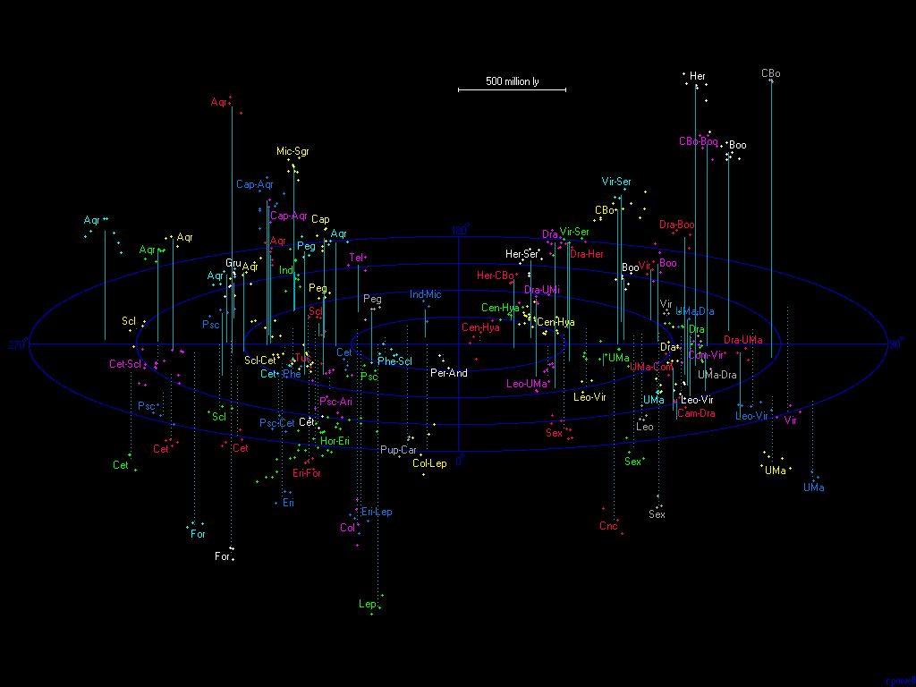
The Universe within 2 billion Light Years

Slide 15
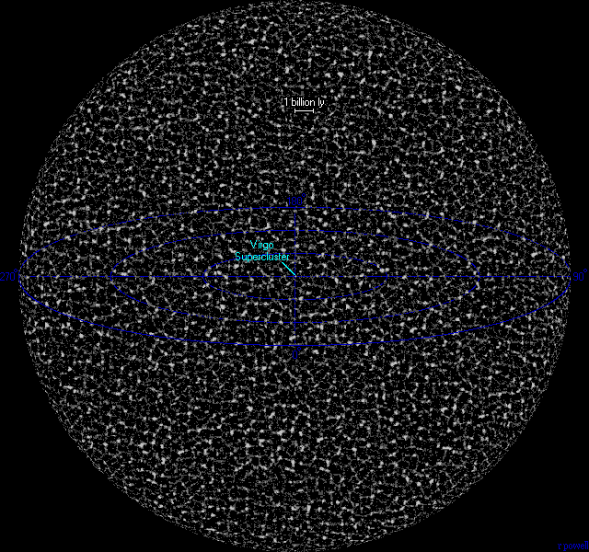

The Universe within 14 billion Light Years
The Visible Universe
This map attempts to show the entire visible Universe. The galaxies in the universe
tend to collect into vast sheets and superclusters of galaxies surrounding large
voids giving the universe a cellular appearance. Because light in the universe only
travels at a fixed speed, we see objects at the edge of the universe when it was
very young up to 14 billion years ago.

Slide 16
Now Stop Comparing
& start thinking about the
Knowledge & Power
of the Creator by seeing this Creation
Don’t you ever ponder over the signs of the Creator ???
All Praise is to the Lord of the Universe
The Almighty, The all-Knowing, The Omnipotent
ALLAH
Can you imagine the Knowledge & Power
Of the creator of this universe???

