Slide 1

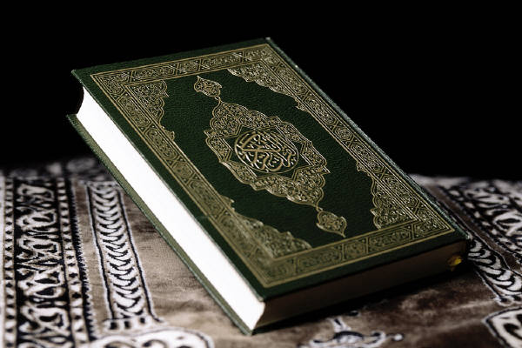
I am a book in elegant prints, to know my name here are some hints
Holy Qur’an is My Name

Slide 2
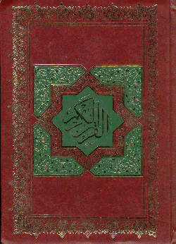
Rich in cover and nicely bound
In hearts of Muslims I am rarely found

Slide 3

High on a shelf, I am kept
Forgotten there, I am left.

Slide 4

With respect I do get lots of kiss
My main point is what they always miss

Slide 5

Neglecting the message inside me
At times I am used for phony swear,
My true use is very very rare

Slide 6

A miracle I am that can change the world
All one has to do is understand my word.

Slide 7
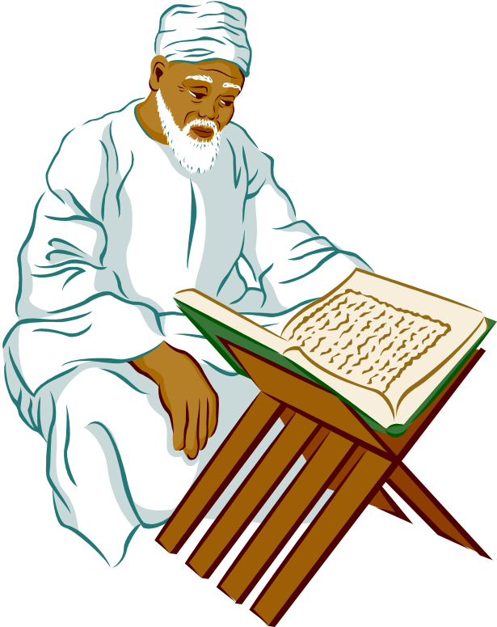
I have wisdom
I have treasure
So much so there is no measure

Slide 8

I'm your savior,
I'm your guide
but who's there to take my ride

Slide 9
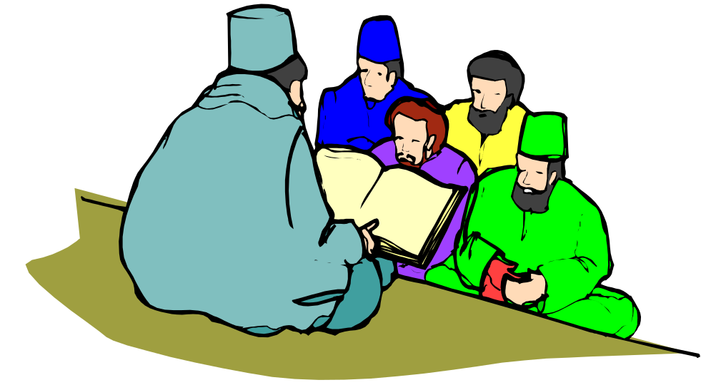
Right from wrong is my fame,
Holy Qur'an is my name.

Slide 10
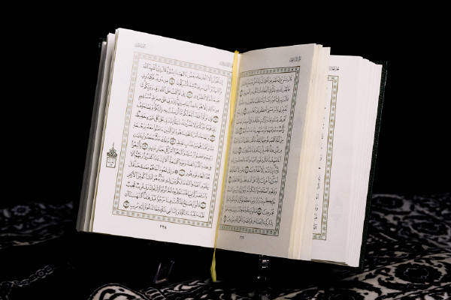
Humble Request
If you find it useful please feel free to forward to your near & dear ones.
Jazakallah!

