Slide 1
Attrition
Analysis
A deep look into the causes of attrition
Samuel Carmona Skories

Slide 2
Table of contents
01
Objectives
02
Process
Business questions
Data handling and machine learning process
03
Analysis Findings
04
Recommendations
Discussing the causes of attrition
Possible ways to deal with the attrition

Slide 3
Objectives
01

Slide 4

Business questions
As management send us the project, we formulated the following questions:
In which department do we have more attrition?
What role has the more attrition?
What’s the salary range with more attrition?
Does attrition affect more our juniors or seniors?
Does working overtime affect attrition?

Slide 5
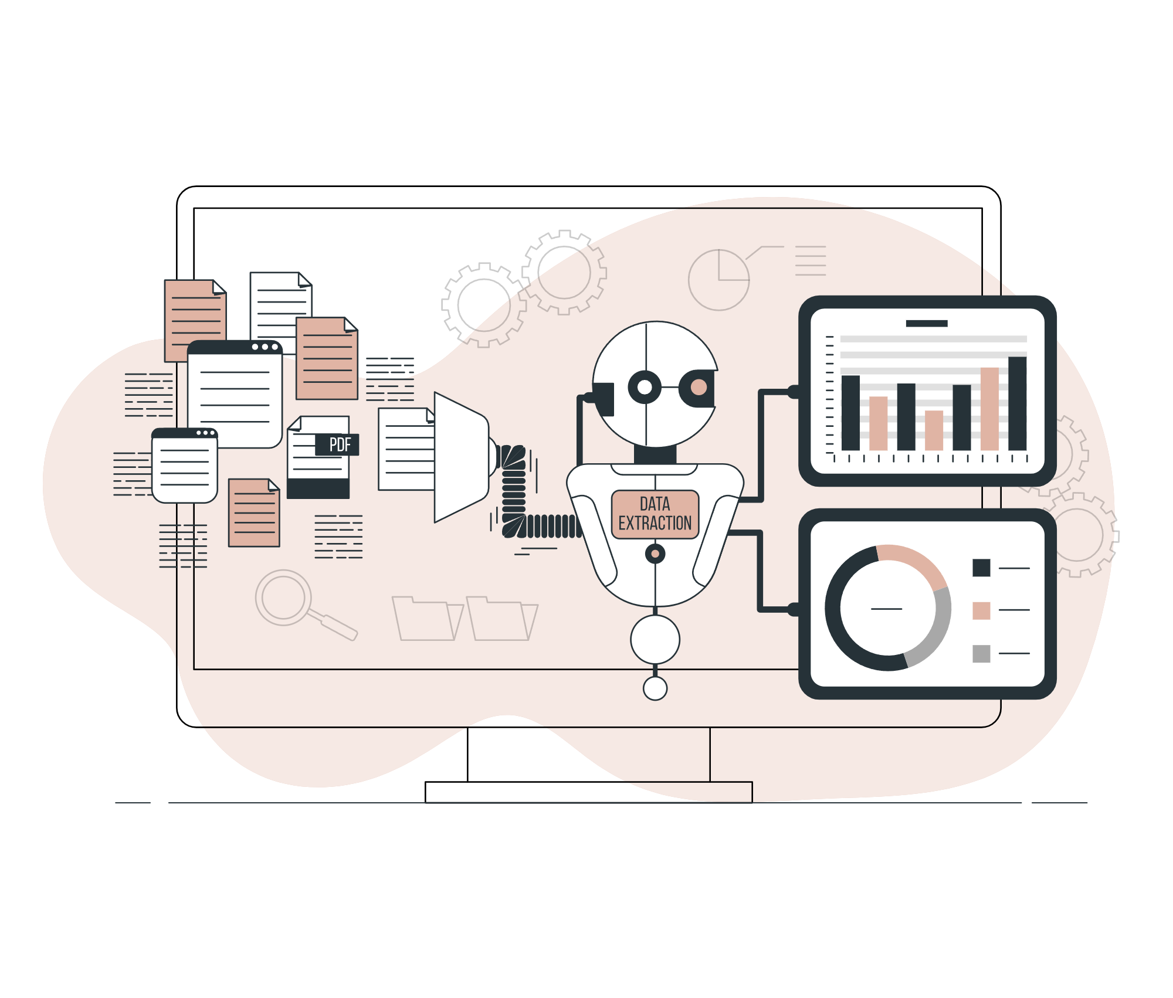
Prediction
Create a machine learning model to predict the attrition of new employees and deploy a web app for HR to use.

Slide 6
Process
02

Slide 7
Analysis Process
Data Exploration
Create the model
Data Analysis
Explore and manipulate the data using Python to get the first insights
Train and deploy the machine learning model.
Use Tableau to get insights and show the data.

Slide 8
Data Exploration
Imbalanced Data
Lack of data regarding HR
Heavily imbalance data. In the future.
The data about the HR department is lacking information about exact roles.

Slide 9
Results of our model
 | Results
Accuracy | 73%
Precission | 35%
Recall | 78%
AUC-PR | 0.74
AOC-ROC | 0.41

Slide 10
Analysis Findings
03

Slide 11
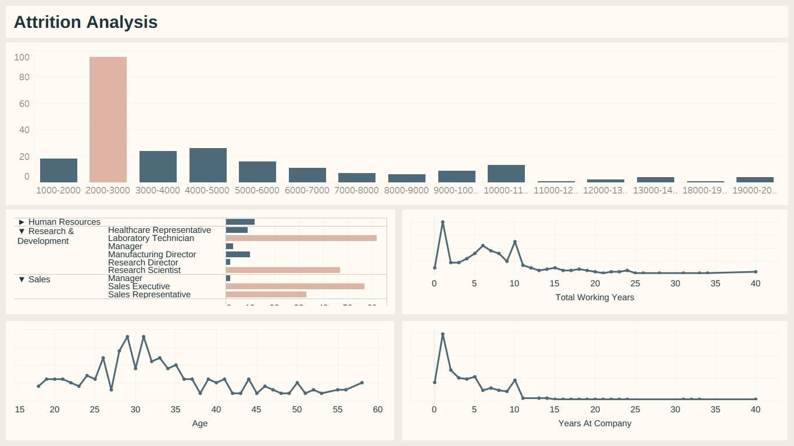
Dashboard

Slide 12
Answering the questions
Department and job role
R&D leads the numbers, followed by sales. Laboratory roles have more attrition, while almost all of the sales team have it.
Salary range
Most of the attrition comes from a salary range between 2k and 3k.
Junior or senior
Almost all the attrition comes from employees at the junior level, with ages between 25-35.

Slide 13
Recommendations
04

Slide 14
A few suggestions
Revisit onboarding
Create and improve the onboarding training of junior and new employees.
Career path
Offer the junior employees a career path to keep them engaged.
Discuss conditions
Discuss with the R&D and sales teams different ways to improve their conditions and avoid losing talent already trained.

Slide 15
Thanks!
Does anyone have any questions?
Check the web app at Streamlit
Business illustrations by Storyset

