Slide 1



NOTHING CHATS
Professor: Crișan-Vida Mihaela Marcella
Students: Raul Bărbosu
Alin Costuț
Timișoara, 2026

Slide 2
Objectives and Motivation behind the project
Real-time MERN chat app with secure JWT auth, live messaging, online status, typing indicators, and media sharing
Modern React frontend + Node/Express backend using Socket.io, MongoDB, Cloudinary, Resend, and Zustand for a smooth, scalable experience, and Arcjet for spam protection

Slide 3
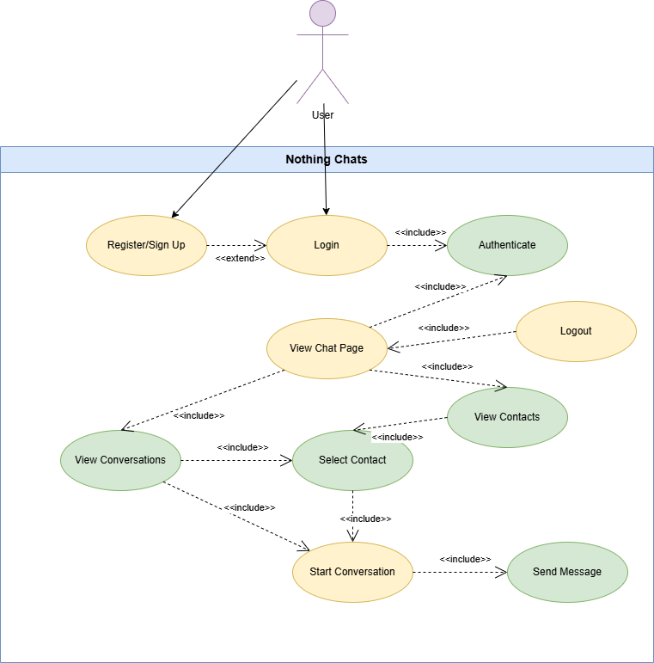
UML Use
Case Diagram

Slide 4
Design Pattern and Motivation
Instant message delivery
Real-time user presence
Live typing indicators
Event-driven communication
Decoupled client updates

Slide 5
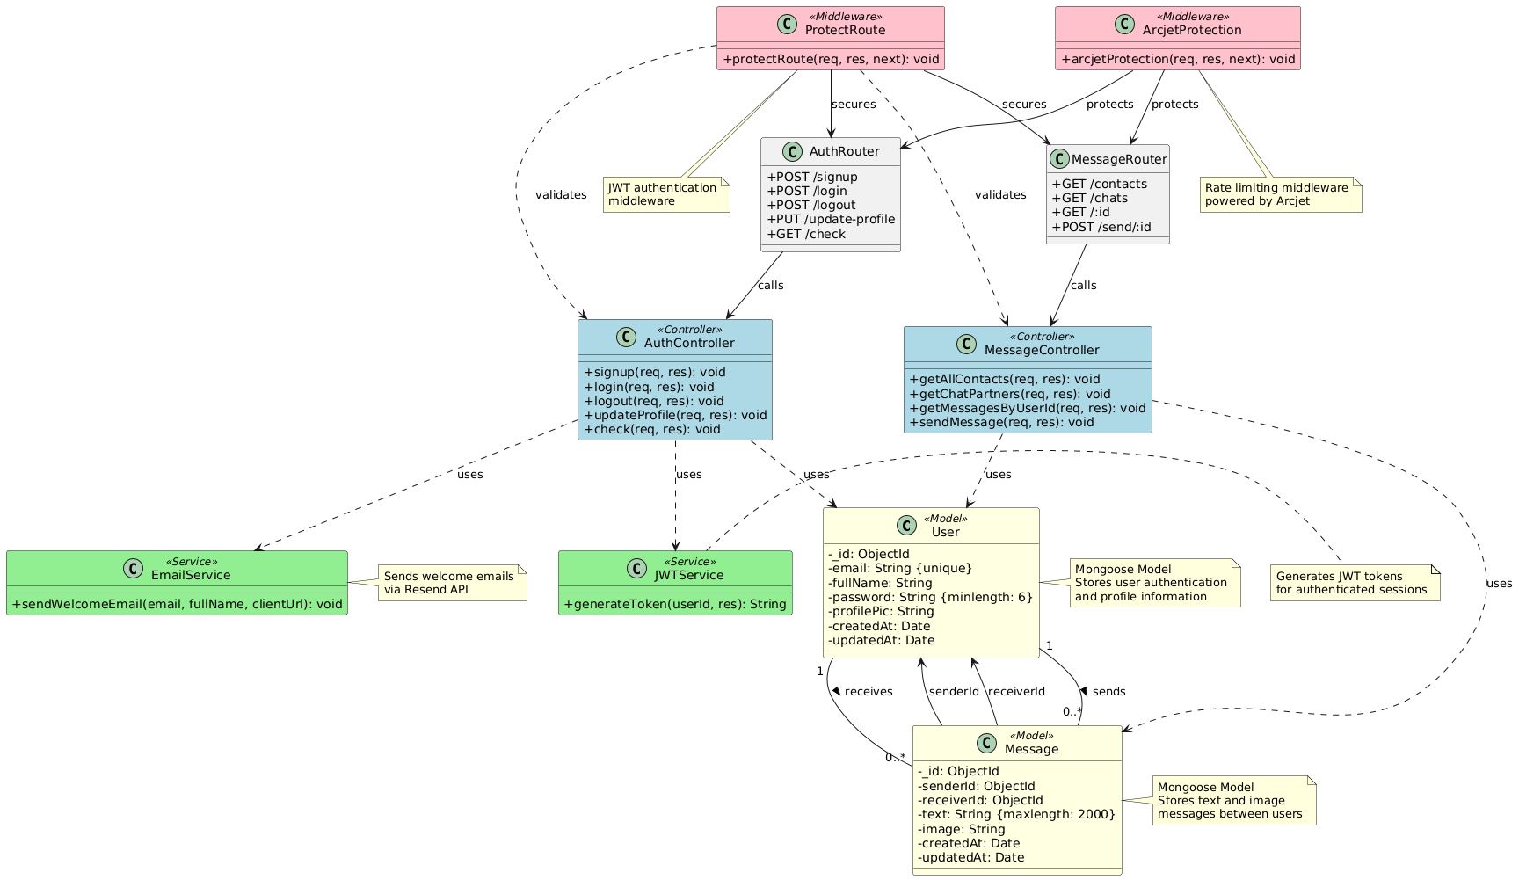
UML Class
Diagrams

Slide 6
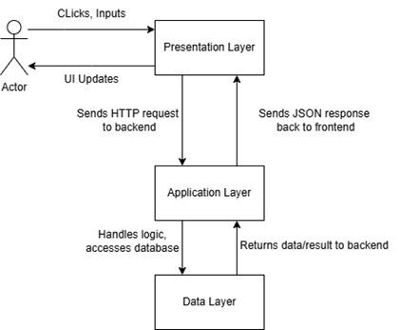
Architecture of the system

Slide 7
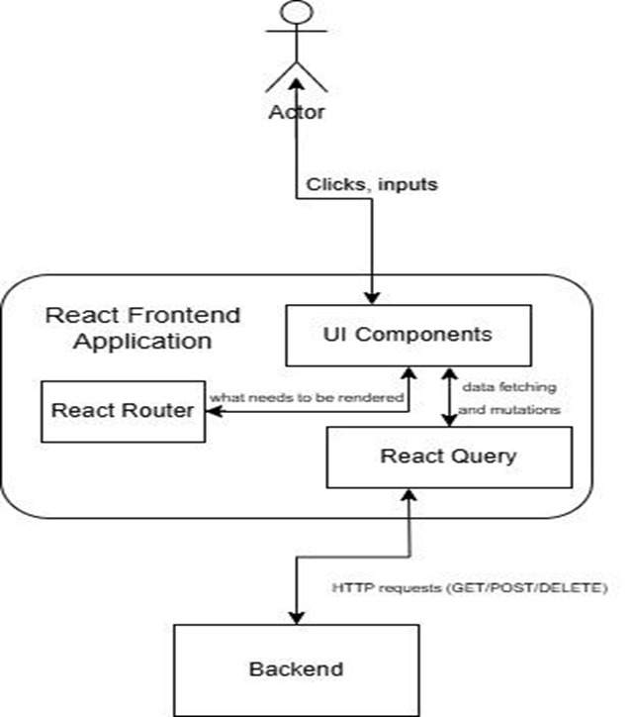
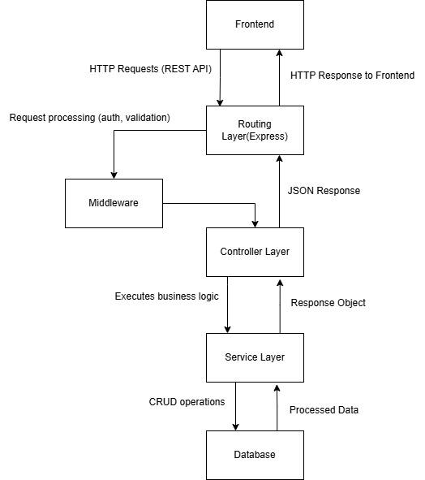

Slide 8
Conclusions and Future Work
Conclusions:
  Successfully implemented a real-time messaging platform with secure authentication
  Covered core features: sending messages/media, online/offline status, spam protection
Future work:
  Add more features(resetting password, deleting chats/messages)
  Optimize performance and scalability under heavy user load

Slide 9
Thank you for your attention!

