Slide 1
Course 10

Slide 2
Scanning & Parsing Tools
Scanning => lex
Parsing => yacc

Slide 3
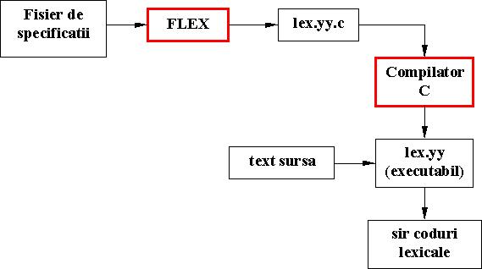
Lex – Unix utilitary (flex – Windows version)

Slide 4
INPUT FILE FORMAT
The file containing the specification is a text file, that can have any name. Due to historic reasons we recommend the extension .lxi.
Consists of 3 sections separated by a line containing %%:
definitions
%%
rules
%%
user code

Slide 5
Example 1:
%%
username printf( "%s", getlogin() );
specifies a scanner that, when finding the string “username”, will replace it with the user login name

Slide 6
Definition Section:
- declarations of simple name definitions (used to simplify the scanner specification), of the form
name definition
where:
name is a word formed by one or more letters, digits, '_' or '-', with the remark that the first character MUST be letter or '_' and must be written on the FIRST POSITION OF THE LINE.
definition is a regular expression and is starting with the first nonblank character after name until the end of line.
declarations of start conditions.

Slide 7
Rules Section
- to associate semantic actions with regular expressions. It may also contain user defined C code, in the following way:
pattern action
where:
pattern is a regular expression, whose first character MUST BE ON THE FIRST POSITION OF THE LINE;
action is a sequence of one or more C statements that MUST START ON THE SAME LINE WITH THE PATTERN. If there are more than one statements they will be nested between {}. In particular, the action can be a void statement.

Slide 8
User Defined Code Section:
Is optional (if is missing, then the separator %% following the rules section can also miss). If it exists, then its containing user defined C code is copied without any change at the end of the file lex.yy.c.
Normally, in the user defined code section, one may have:
- function main() containing call(s) to yylex(), if we want the scanner to work autonomously (for ex., to test it);
- other called functions from yylex() (for ex. yywrap() or functions called during actions); in this case, the user code from definitions section must contain: either prototypes, either #include directives of the headers containing the prototypes

Slide 9
Launching the execution:
lex [option] [name_specification _file]
where name_specification _file is an input file (implicitly, stdin)
$ lex spec.lxi
$ gcc lex.yy.c -o your_lex
$ your_lex<input.txt
options: http://dinosaur.compilertools.net/flex/manpage.html

Slide 10
Example

Slide 11
Parsing (syntax analysis) modeled with cfg:
cfg G = (N, 𝜮,P,S):
N – nonterminal: syntactical constructions: declaration, statement, expression, a.s.o.
𝜮 – terminals; elements of the language: identifiers, constants, reserved words, operators, separators
P – syntactical rules – expressed in BNF – simple transformation
S – syntactical construct corresponding to program
THEN
Program syntactical correct <=> w ∊ L(G)

Slide 12
yacc – Unix tool (Bison – Window version)
Yet Another Compiler Compiler
LALR
C code

Slide 13
A yacc grammar file has four main sections
%{
C declarations
%}
yacc declarations
%%
Grammar rules
%%
Additional C code
contains declarations that define terminal and nonterminal symbols, specify precedence, and so on.

Slide 14
The grammar rules section
contains one or more yacc grammar rules of the following general form:
result: components... {C statements}
;
exp: exp '+' exp
;
result: rule1-components...
| rule2-components...
...
;
result: /*empty */
| rule2-components...
;

Slide 15
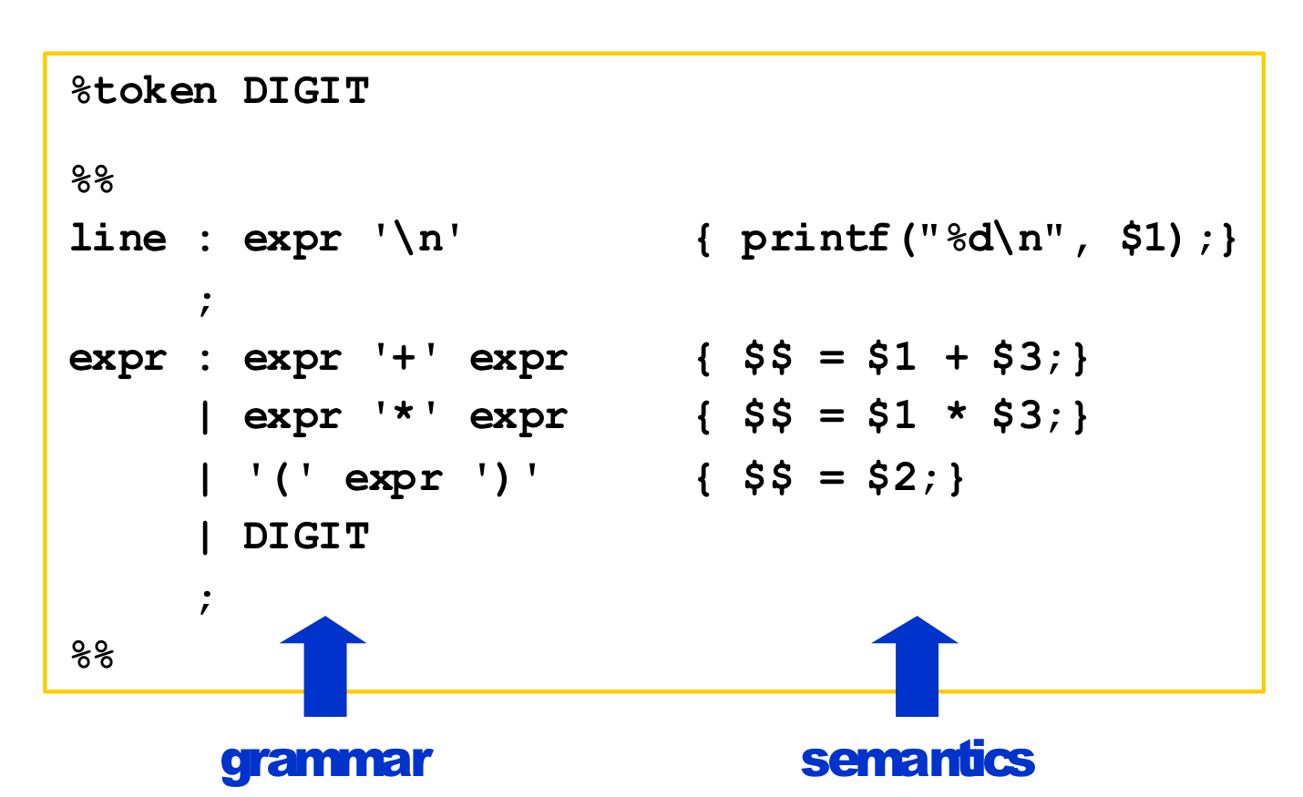
Example: expression interpreter
input
Yacc has a stack of values - referenced ‘$i’ in semantic actions

Slide 16
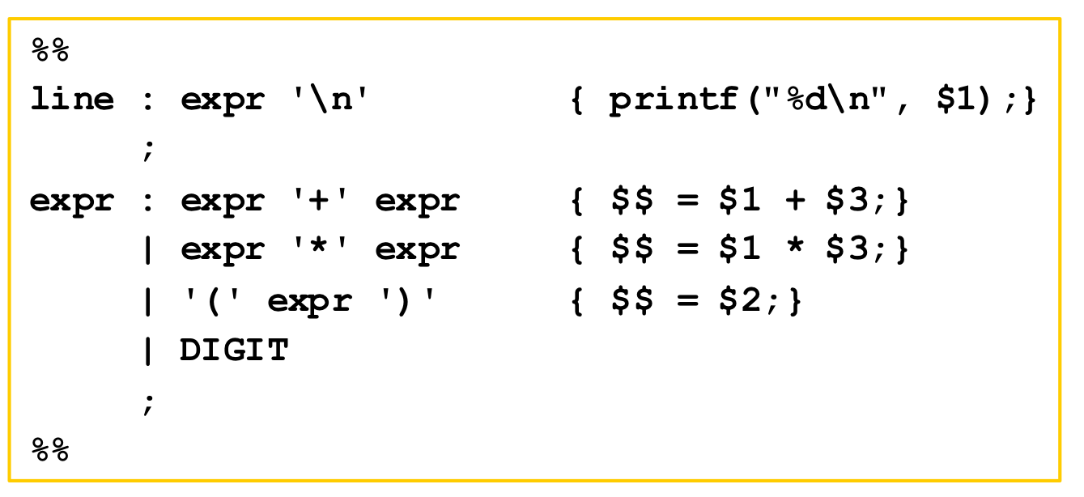
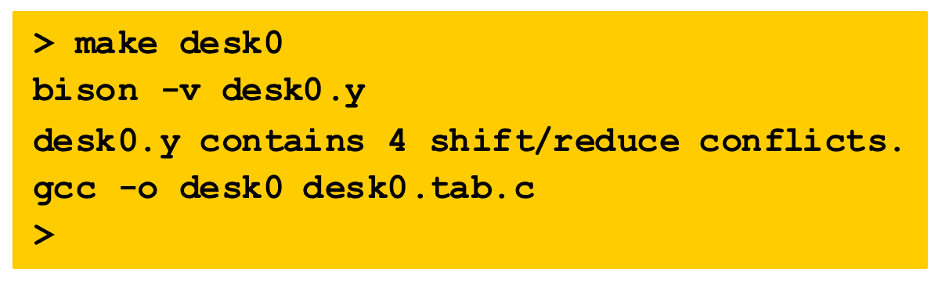
Input file (desk0)

Slide 17
Conflict resolution in yacc
Conflict shift-reduce – prefer shift
Conflict reduce-reduce – chose first production

Slide 18
Run yacc
Run desk0

Slide 19
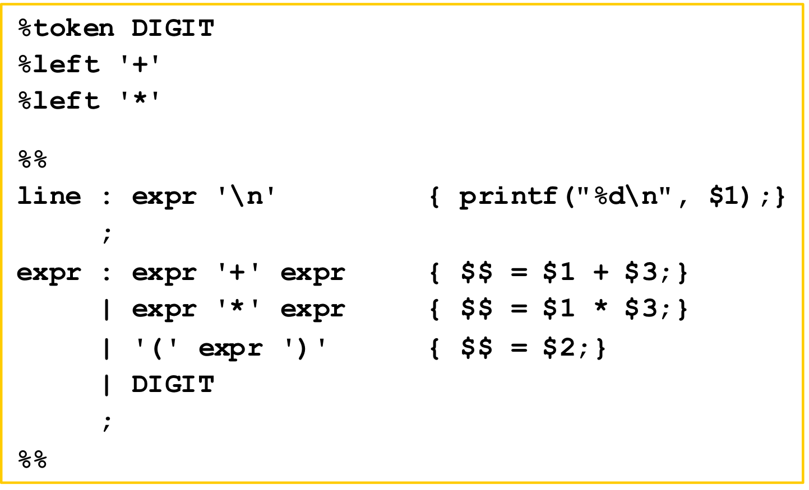
Operator priority in yacc
From low to great

Slide 20
>lex spec.lxi >yacc -d spec.y >cc lex.yy.c y.tab.c -o rezultat -lfl >rezultat<fis_intrare
Use
More on
http://catalog.compilertools.net/lexparse.html
Example

