Slide 1
Course 11

Slide 2
Push-Down Automata (PDA)

Slide 3
Intuitive Model

Slide 4
Definition
A push-down automaton (APD) is a 7-tuple M = (Q,𝞢,𝞒,𝞭,q₀,Z₀,F) where:
Q – finite set of states
𝞢 - alphabet (finite set of input symbols)
𝞒 – stack alphabet (finite set of stack symbols)
𝞭 : Q x (𝞢 U {𝜺}) x 𝞒 →𝒫(Qx 𝞒*) –transition function
q₀ ∈Q – initial state
Z₀ ∈ 𝞒 – initial stack symbol
F ⊆Q – set of final states

Slide 5
Push-down automaton
Transition is determined by:
Current state
Current input symbol
Head of stack
Reading head -> input band:
Read symbol
No action
Stack:
Zero symbols => pop
One symbol => push
Several symboluri => repeat push

Slide 6
Configurations and transition / moves
Configuration:
(q, x, 𝞪) ∈Q x 𝜮* x 𝜞*
where:
PDA is in state q
Input band contains x
Head of stack is 𝞪
Initial configuration (q₀, w, Z₀)

Slide 7
Configurations and moves(cont.)
Moves between configurations:
p,q ∈Q, a∈𝜮, Z ∈𝜞, w ∈𝜮*,𝜶,𝜸 ∈𝜞*
(q,aw,Z𝜶) ⊢ (p,w,𝜸𝜶) iff 𝜹(q,a,Z) ∋ (p,𝜸)
(q,aw,Z𝜶) ⊢ (p,aw,𝜸𝜶) iff 𝜹(q,𝜺,Z) ∋ (p,𝜸)
(𝜺-tranziție)
⊢ , ⊢ , ⊢
k
+
*

Slide 8
Language accepted by PDA
Empty stack principle:
L_{𝜺}(M) = {w|w∈𝜮*, (q₀,w,Z₀) ⊢ (q,𝜺,𝜺), q∈ Q}
Final state principle:
L_{f}(M) = {w|w∈𝜮*, (q₀,w,Z₀) ⊢ (q_{f},𝜺,𝜸), q_{f}∈ F}
*
*

Slide 9
Representations
Enumerate
Table
Graphic

Slide 10
Construct PDA
L = {0^{n}1^{n}| n ≥ 1}
States, stack, moves?
States:
Initial state:q₀ – beginning and process symbols ‘0’
When first symbol ‘1’ is found – move to new state => q₁
Final: final state q₂
Stack:
Z0 – initial symbol
X – to count symbols:
When reading a symbol ’0’ – push X in stack
When reading a symbol ‘1’ – pop X from stack

Slide 11
Exemple 1 (enumerate)
M = ({q₀,q₁,q₂}, {0,1}, {Z₀,X},𝜹,q₀,Z₀,{q₂})
𝜹(q₀,0,Z₀) = (q₀,XZ₀)
𝜹(q₀,0,X) = (q₀,XX)
𝜹(q₀,1,X) = (q₁,𝜺)
𝜹(q₁,1,X) = (q₁,𝜺)
𝜹(q₁,𝜺,Z₀) = (q₂,Z₀)
⊢ (q₁, 𝜺, 𝜺)
(q₀,0011,Z₀) ⊢ (q₀,011,XZ₀) ⊢ (q₀,11,XXZ₀) ⊢ (q₁,1,XZ₀) ⊢(q₁, 𝜺, Z₀) ⊢ (q₂, 𝜺, Z₀)
Empty stack
𝜹(q₁,𝜺,Z₀) = (q₁, 𝜺)
Final state

Slide 12
Exemple 1 (table)
 |  | 0 | 1 | 𝜺
q₀ | Z₀ | q₀,XZ₀
 | X | q₀,XX | q₁,𝜺
q₁ | Z₀ |  |  | q₂,Z₀
 | X |  | q₁,𝜺
q₂ | Z₀
 | X

Slide 13
Exemple 1 (graphic)
push
pop
0, X➝XX
0, Z₀➝XZ₀
1, X➝𝜺
1, X➝𝜺
𝜺, Z₀➝Z₀
q₀
q₁
q₂

Slide 14
Properties
Theorem 1: For any PDA M, there exists a PDA M’ such that
L _{𝜺}(M) = L_{f}(M)
Theorem 2: For any PDA M, there exists a context free grammar such that
L _{𝜺}(M) = L(G)
Teorema 3: For any context free grammar there exists a PDA M such that
L(G) = L _{𝜺}(M)

Slide 15
HW
Parser:
Descendent recursive
LL(1)
LR(0), SLR, LR(1)
Corresponding PDA

Slide 16
Structure of compiler
analysis
Source program
scanning
parsing
semantic analysis
generate intermediary code
optimize intermediary code
generate object code
Sequence of tokens
Parse tree
Adnotated syntax tree
synthesis
Intermediary code
Optimized intermediary code
Object program

Slide 17
Semantic analysis
Attach meanings to syntactical constructions of a program
What:
Identifiers -> values / how to be evaluated
Statements -> how to be executed
Declaration -> determine space to be allocated and location to be stored
Examples:
Type checkings
Verify properties
How:
Attribute grammars
Manual methods

Slide 18
Semantic analysis – Attribute grammars
Parsing – result: syntax tree (ST)
Simplification: abstract syntax tree (AST)
Adnotated abstract syntax tree (AAST)
Attach semantic info in tree nodes

Slide 19
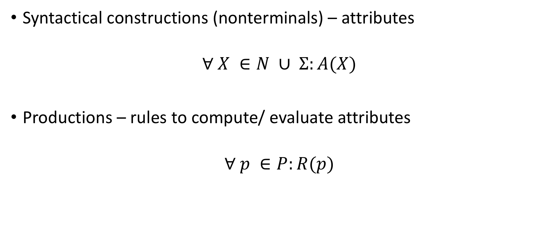
Attribute grammar
Syntactical constructions (nonterminals) – attributes
$$∀ X ∈N ∪ Σ:A(X)$$
Productions – rules to compute/ evaluate attributes
$$∀ p ∈P:R(p)$$

Slide 20
Definition
AG = (G,A,R) is called attribute grammar where:
G = (N,𝜮,P,S) is a context free grammar
A = {A(X) | X ∈N U 𝜮} – is a finite set of attributes
R = {R(p) | p ∈P} – is a finite set of rules to compute/evaluate attributes

Slide 21
Example 1
G = ({N,B},{0,1}, P, N}
P: N -> NB
N -> B
B -> 0
B -> 1
N₁.v = 2* N₂.v + B.v
N.v = B.v
B.v = 0
B.v = 1
Attribute – value of number = v
Synthetized attribute: A(lhp) depends on rhp
Inherited attribute: A(rhp) depends on lhp

Slide 22
Evaluate attributes
Traverse the tree: can be an infinite cycle
Special classes of AG:
L-attribute grammars
S-attribute grammars

Slide 23
Generate intermediary code

Slide 24
Forms of intermediary code
Java bytecode – source language: Java
– machine language (dif. platforms) JVM
MSIL (Microsoft Intermediate Language)
– source language: C#, VB, etc.
– machine language (dif. platforms) Windows
GNU RTL (Register Transfer Language)
– source language: C, C++, Pascal, Fortran etc.
– machine language (dif. platforms)

Slide 25
Representations of intermediary code
Adnotated tree: intermediary code is generated in semantic analysis
Polish postfix form:
No parenthesis
Operators appear in the order of execution
Ex.: MSIL
3 address code
Exp = a + b * c ppf = abc*+
Exp = a * b + c ppf = ab*c+
Exp = a * (b + c) ppf = abc+*

Slide 26
3 address code
= sequence of simple format statements, close to object code, with the following general form:
< result >=< arg1 >< op >< arg2 >
Represented as:
Quadruples
Triplets
Indirected Triplets

Slide 27
Quadruples:
< op > < arg1 > < arg2 > < result >
Triplets:
< op > < arg1 > < arg2 >
(considered that the triplet is storing the result)

Slide 28
Special cases:
Expressions with unary operator: < result >=< op >< arg2 >
Assignment of the form a := b => the 3 addresss code is a = b (no operatorand no 2nd argument)
Unconditional jump: statement is goto L, where L is the label of a 3 address code
Conditional jump: if c goto L: if c is evaluated to true then unconditional jump to statement labeled with L, else (if c is evaluated to false), execute the next statement
Function call p(x1, x2, ..., xn) – sequence of statements: param x1, param x2 , param xn, call p, n
Indexed variables: < arg1 >,< arg2 >,< result > can be array elements of the form a[i]
Pointer, references: &x, ∗x

Slide 29
Example 1: b∗b−4∗a∗c
op | arg1 | arg2 | rez
* | b | b | t1
* | 4 | a | t2
* | t2 | c | t3
- | t1 | t3 | t4
nr | op | arg1 | arg2
(1) | * | b | b
(2) | * | 4 | a
(3) | * | (2) | c
(4) | - | (1) | (3)

