Slide 1
Formal Languages - basic notions-
Course 2

Slide 2
Examples of languages
natural (ex. English, Romanian)
programming (ex. C,C++, Java, Python)
formal

Slide 3
Example
A boy has a dog.
S→PV P→ a N N→ boy or N→ dog (N→boy|dog) V → QC Q → has C → AN A → a | an
A→ α = rule
S,P,V,N,Q,C,A = nonterminal symbols
a,an,boy,dog,has = terminal symbols
Remarks
Sentence = word, sequence (contains only terminal symbols) ; denoted w.
S⇒PV⇒a NV⇒a NQC⇒a N has C - sentential form
In general : w=a₁a₂. . . a_{n}
The rule guarentees syntactical correctness, but not the semantical corectness

Slide 4
Grammar
Definition: A (formal) grammar is a 4-tuple: G=(N,Σ,P,S) with the following meanings:
N – set of nonterminal symbols and |N| < ∞
Σ - set of terminal symbols (alphabet) and |Σ|<∞
P – finite set of productions (rules), with the propriety:
P⊆(N∪Σ)∗ N(N∪Σ)∗ X(N∪Σ)∗
S∈N – start symbol /axiom
Remarks :
(α,β)∈P is a production denoted α→β
N ∩ Σ = ∅

Slide 5
Binary relations defined on (N ∪ Σ)∗
Direct derivation α ⇒ β , α,β ∈ (N ∪ Σ)∗ if α=x1xy1 , β=x1yy1 and x→y∈P
(x is transformed in y)
k derivation
α ⇒ β ,α,β ∈ (N ∪ Σ)∗
sequence of k direct derivations α⇒α₁ ⇒α₂ ⇒...⇒α_{k−1} ⇒β, α,α₁,α₂,...α_{k−1},β∈(N∪Σ)∗
+ derivation
α ⇒ β if ∃ k>0 such that α ⇒ β (there exists at least one direct derivation)
* derivation
α ⇒ β if ∃ k≥0 such that α ⇒ β namely, α⇒ β⇔α⇒ β OR α⇒ β (α=β)
k
+
k
*
k
*
+
0

Slide 6
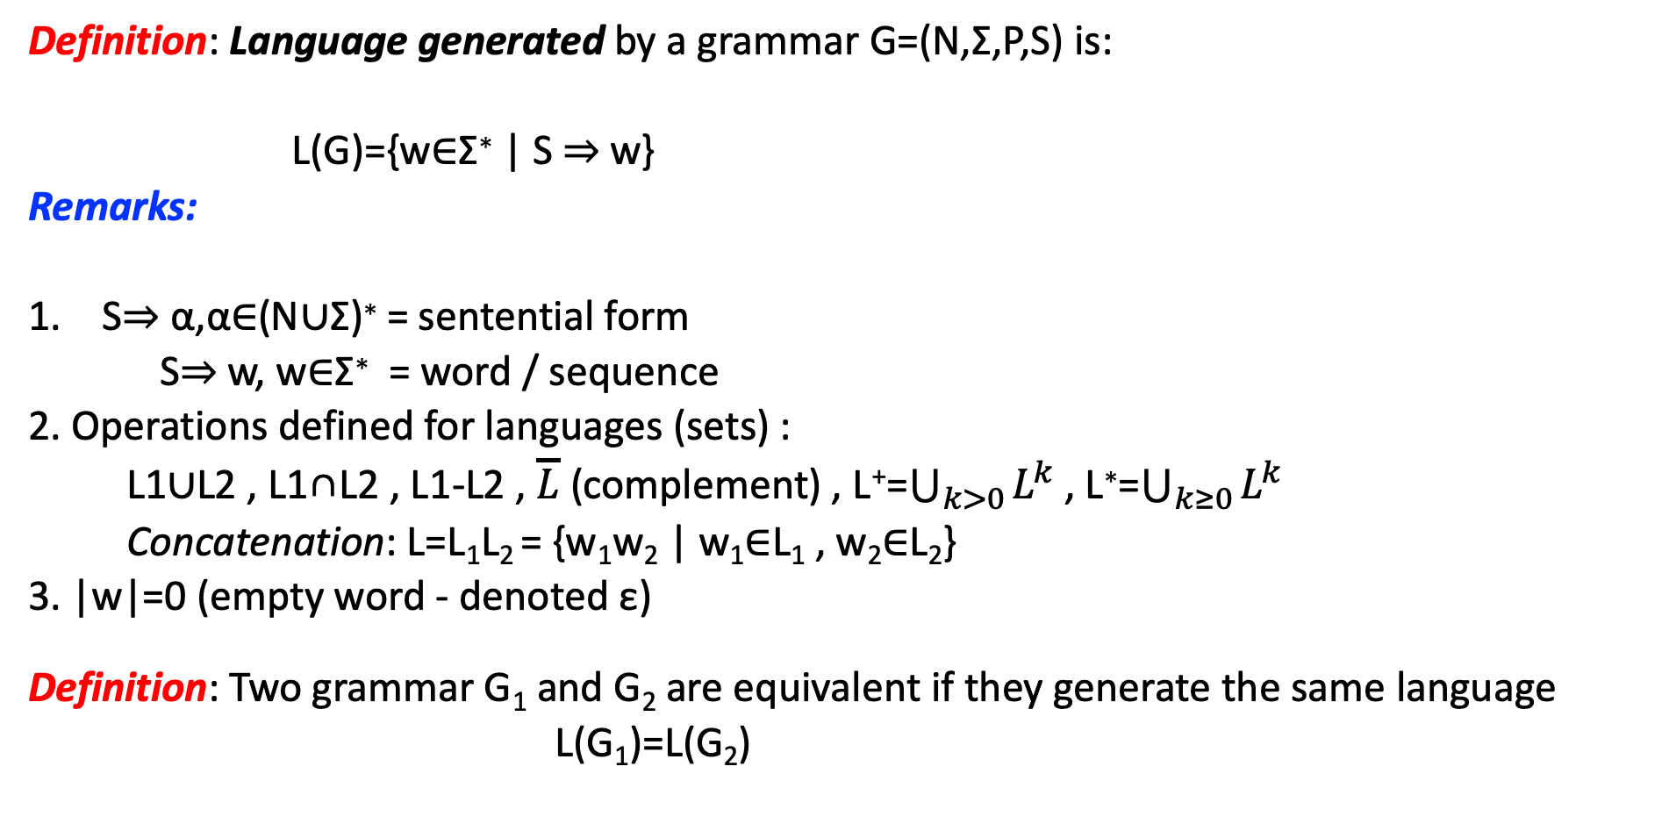
Definition: Language generated by a grammar G=(N,Σ,P,S) is:
L(G)={w∈Σ∗ | S ⇒ w}
Remarks:
S⇒ α,α∈(N∪Σ)∗ = sentential form
S⇒ w, w∈Σ∗ = word / sequence
2. Operations defined for languages (sets) :
L1∪L2 , L1∩L2 , L1-L2 , $\overline{L}$ (complement) , L⁺=$\bigcup_{k>0}{L^{k}}$ , L∗=$\bigcup_{k≥0}{L^{k}}$
Concatenation: L=L₁L₂ = {w₁w₂ | w₁∈L₁ , w₂∈L₂}
3. |w|=0 (empty word - denoted ε)
Definition: Two grammar G₁ and G₂ are equivalent if they generate the same language
L(G₁)=L(G₂)
*
*
*

Slide 7
Chomsky hierarchy(based on form α → β ∈ P)
type 0 : no restriction
type 1 : context dependent grammar (x₁Ay₁ → x₁γy₁)
type 2 : context free grammar (A → α ∈ P ,where A∈N and α∈(N ∪ Σ)∗ )
type 3 : regular grammar ( A → aB|a ∈ P)
Remark :
type 3 ⊆ type 2 ⊆ type 1 ⊆ type 0

Slide 8
Notations
A,B,C,... – nonterminal symbols
S ∈ N – start symbol
a,b,c,... ∈ Σ – terminal symbol
α,β,γ ∈ (N ∪ Σ)∗ - sentential forms
ε – empty word
x,y,z,w ∈ Σ∗ - words
X,Y,U,... ∈ (N ∪ Σ) – grammar symbols (nonterminal or terminal)

Slide 9
Finite Automata
Intuitive model

Slide 10
Definition: A finite automaton (FA) is a 5-tuple
M = (Q,Σ,δ,q0,F)
where:
• Q - finite set of states (|Q|<∞) • Σ - finite alphabet (|Σ|<∞) • δ – transition function : δ:Q×Σ→P(Q) • q₀ – initial state q₀ ∊ Q
• F⊆Q – set of final states

Slide 11
Remarks
Q∩Σ=∅
δ:Q×Σ→P(Q) , ε∈Σ⁰ - relation δ(q,ε)=p NOT allowed
If |δ(q,a)|≤1 => deterministic finite automaton (DFA)
If |δ(q,a)|>1 (more than a state obtained as result) => nondeterministic finite automaton (NFA)
Property: For any NFA M there exists a DFA M’ equivalent to M

Slide 12
Configuration C=(q,x)
where:
q state
x unread sequence from input: x ∊ ∑*
Initial configuration : (q₀,w) , w - whole sequence
Final configuration: (q_{f} ,ε) , q_{f} ∈ F, ε –empty sequence
(corresponds to accept)

Slide 13
Relations between configurations
⊢ move / transition (simple, one step) (q,ax) ⊢ (p,x) , p ∈ δ(q,a)
⊢ k move = a sequence of k simple transitions) C₀ ⊢ C₁ ⊢... ⊢ C_{k}
⊢ + move C ⊢ C′ : ∃ k>0 such that C ⊢ C′
⊢ * move (star move) C ⊢ C′ : ∃ k≥0 such that C ⊢ C′
k
+
+
k
*
k
*

Slide 14
Definition : Language accepted by FA M = (Q,Σ,δ,q0,F) is:
L(M)={ w ∈ Σ∗ | (q₀,w) ⊢ (q_{f} ,ε) , q_{f} ∈F }
Remarks
2 finite automata M₁ and M₂ are equivalent if and only if they accept the same language
L(M₁)=L(M₂)
ε ∈ L(M) ⬄ q₀∈F (initial state is final state)
*

Slide 15
Representing FA
List of all elements
Table
Graphical representation

