Slide 1
Course 3 & 4
Regular Languages

Slide 2
Why?
Search engine – succes of Google
Unix commands
Programming languages – new feature

Slide 3
Remember
Grammar
G=(N,Σ,P,S)
L(G)={w∈Σ∗ | S ⇒ w}
Finite automaton
M = (Q,Σ,δ,q₀,F)
L(M)={ w ∈ Σ∗ | (q₀,w) ⊢ (q_{f} ,ε) , q_{f} ∈F }
*

Slide 4
Reg exp
Regular grammars
Finite Automata

Slide 5
Reminder: Regular grammars
G = (N, 𝚺, P, S) right linear grammar if
∀p∊P: A→aB or A →b, where A,B ∊N and a,b ∊ 𝚺
G = (N, 𝚺, P, S) regular grammar if
G is right linear grammar
and
A→𝜀 ∉ P, with the exception that S →𝜀 ∊ P, in which case S does not appear in the rhs (right hand side) of any other production
L(G) = {w ∊ 𝚺* | S => w} - right linear language
*

Slide 6
Theorem 1: For any regular grammar G=(N, 𝚺, P, S) there exists a FA M=(Q, 𝚺, 𝛿, q₀,F) such that L(G) = L(M)
Proof: construct M based on G
Q = N U {K}, K ∉ N 𝛿: if A →aB ∊ P then 𝛿(A,a) = B
q₀ = S if A →a ∊ P then 𝛿(A,a) = K
F = {K} U {S| if S→𝜺 ∊ P}
Prove that L(G) = L(M) (w∈L(G) ⇔ w∈L(M)):
S⇒w ⇔ (S,w) ⊢ (qf , 𝜺)
w= 𝜺: S⇒ 𝜺 ⇔ (S, 𝜺) ⊢ (S, 𝜺) – true
w=a₁a₂. . .a_{n}: S ⇒ w ⇔ (S,w) ⊢ (K, 𝜺)
S ⇒ a₁A₁ ⇒ a₁a₂A₂ ⇒ . . . ⇒ a₁a₂. . .a_{n−1}A_{n−1} ⇒ a₁a₂. . .a_{n−1}a_{n}
S ⇒ a₁A₁ exists if S → a₁A₁ and then δ(S,a₁)=A₁
A₁ → a₂A₂ : δ(A₁,a₂)=A₂ . . .
A_{n−1} → a_{n} : δ(A_{n−1},a_{n})=K
(S,a₁a₂. . .a_{n}) ⊢ (A₁,a₂. . .a_{n}) ⊢ (A₂,a₃. . .a_{n}) ⊢ . . . ⊢ (A_{n−1},a_{n}) ⊢ (K, 𝜺) , K∈F
*
*
*
*
*
*

Slide 7
Theorem 2: For any FA M=(Q, 𝚺, 𝛿, q₀,F) there exists a regular grammar G=(N, 𝚺, P, S) such that L(G) = L(M)
Proof: construct G based on M P: if 𝛿(q,a) = p then q →ap ∊ P
N = Q if p ∊ F then q →a ∊ P
S = q₀ if q₀ ∊ F then S → 𝜺
Prove that L(M) = L(G) (w∈L(M) ⇔ w∈L(G)):
P(i): q ⇒ x ⇔ (q,x) ⊢ (q_{f} , 𝜺) , q_{f}∈F -prove by induction
Apply P : q₀ ⇒ w ⇔ (q₀,w) ⊢ (q_{f} , 𝜺) , q_{f}∈F
If i=0: q⇒x ⬄ (q,x) ⊢ (q_{f} , 𝜺) (x= 𝜺,q=q_{f} ) q⇒ 𝜺 ⬄ q₀→ 𝜺 , q₀∈F
Assume ∀ k≤i P is true
q ⇒ x ⇔ (q,x) ⊢ (q_{f} , 𝜺)
For q ∊ N apply ”⇒” : q ⇒ ap ⇒ ax
If q ⇒ ap then 𝛿(q,a)= p ; if p ⇒ ax then (p,x) ⊢ (q_{f} , 𝜺) , qf∈F
THEN (q,ax) ⊢ (q_{f} , 𝜺) , qf∈F
i+1
i
i+1
i
0
i+1
i
i
i
i-1
i

Slide 8
Regular sets
Definition: Let 𝚺 be a finite alphabet. We define regular sets over 𝚺 recursively in the following way:
𝞥 is a regular set over 𝚺 (empty set)
{𝞮} is a regular set over 𝚺
{a} is a regular set over 𝚺, ∀ a∊𝚺
If P, Q are regular sets over 𝚺, then P∪Q, PQ, P* are regular sets over 𝚺
Nothing else is a regular set over 𝚺

Slide 9
Regular expressions
Definition: Let 𝚺 be a finite alphabet. We define regular expressions over 𝚺 recursively in the following way:
𝞥 is a regular expression denoting the regular set 𝞥 (empty set)
𝞮 is a regular expression denoting the regular set {𝞮}
a is a regular expression denoting the regular set {a}, ∀ a∊𝚺
If p,q are regular expression denoting the regular sets P, Q then:
p+q is a regular expression denoting the regular set P∪Q,
pq is a regular expression denoting the regular set PQ,
p* is a regular expression denoting the regular set P*
Nothing else is a regular expression

Slide 10
Remarks:
Examples
p⁺ = pp*
Use paranthesis to avoid ambiguity
Priority of operations: *, concat, + (from high to low)
For each regular set we can find at least one regular exp to denote it (there is an infinity of reg exp denoting them)
For each regular exp, we can construct the corresponding regular set
2 regular expressions are equivalent iff they denote the same regular set

Slide 11
Algebraic properties of regular exp
Let 𝛂, 𝛃, 𝛄 be regular expressions.
𝛂 + 𝛃 = 𝛃 + 𝛂
𝞥* = 𝞮
𝛂 + (𝛃 + 𝛄) = (𝛂 + 𝛃) + 𝛄
𝛂(𝛃𝛄) = (𝛂𝛃)𝛄
𝛂 (𝛃 + 𝛄) = 𝛂𝛃 + 𝛂𝛄
(𝛂 + 𝛃)𝛄 = 𝛂𝛄 + 𝛃𝛄
𝛂 𝞮 = 𝞮 𝛂 = 𝛂
𝞥𝛂 = 𝛂𝞥 = 𝞥
𝛂*= 𝛂 + 𝛂*
(𝛂*)* = 𝛂*
𝛂 + 𝛂 = 𝛂
𝛂 + 𝞥 = 𝛂

Slide 12
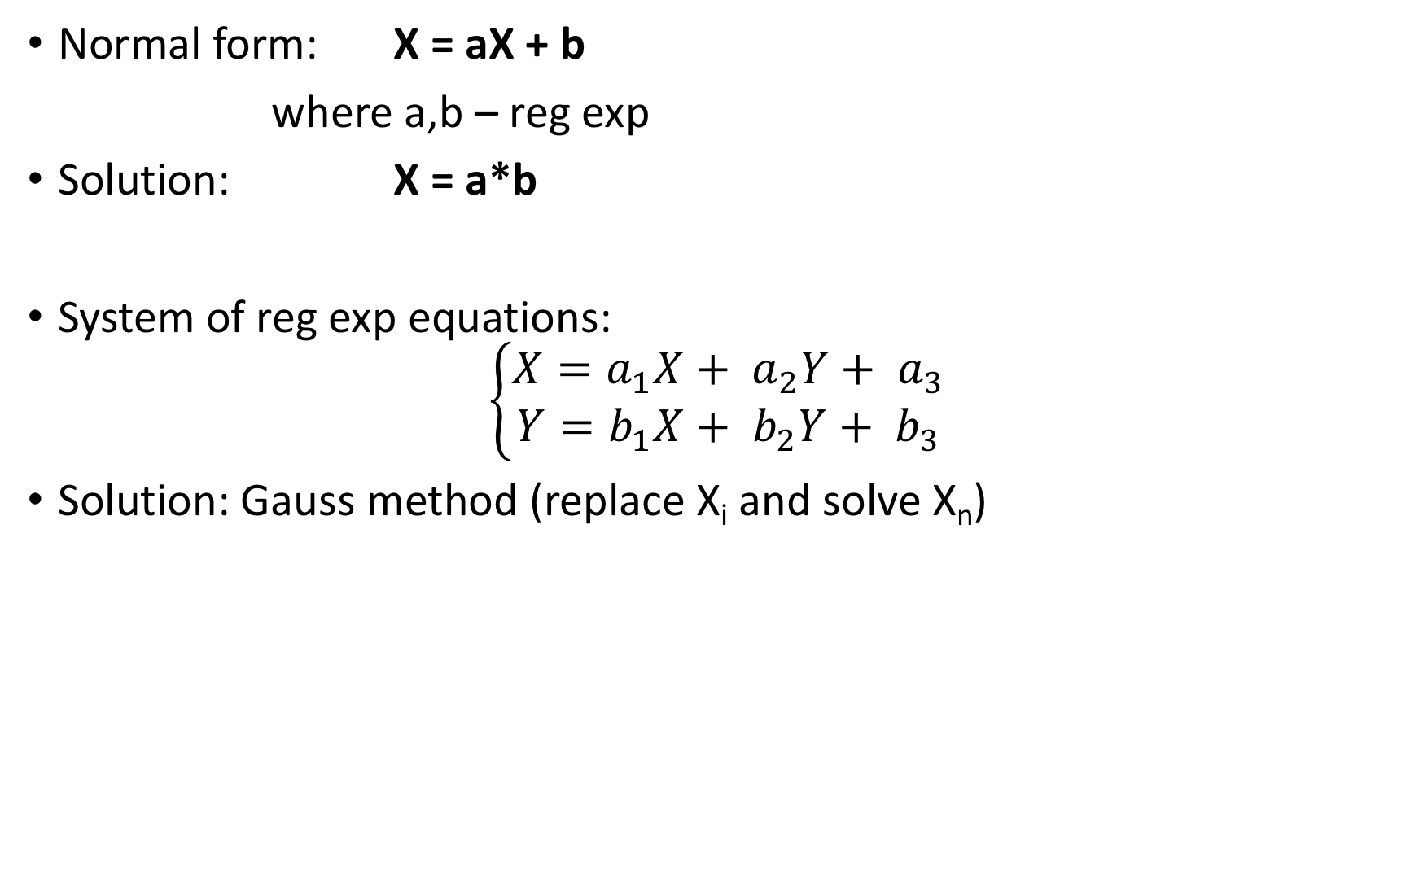
Reg exp equations
Normal form: X = aX + b
where a,b – reg exp
Solution: X = a*b
System of reg exp equations:
$$\left\{\begin{aligned}X=a_{1}X+ a_{2}Y+ a_{3} \\ Y=b_{1}X+ b_{2}Y+ b_{3}\end{aligned}\right.$$
Solution: Gauss method (replace X_{i} and solve X_{n})
a a*b + b = (aa* +𝛆)b = a*b

Slide 13
Why?
Reg exp
Regular grammars
Finite Automata
Maths

Slide 14
Prop:Regular sets are right linear languages
Lemma 1: 𝞥,{𝞮}, {a},∀a∊𝚺 are right linear languages
Proof: constructive
G = ({S}, 𝚺, 𝞥, S) – regular grammar such that L(G) = 𝞥
G = ({S}, 𝚺,{S→𝞮}, S) – regular grammar such that L(G) ={𝞮}
G = ({S}, 𝚺,{S→a}, S) – regular grammar such that L(G) ={a}

Slide 15
Lemma 2: If L₁ and L₂ are right linear languages then:
L₁ ∪ L₂, L₁L₂ and L₁* are right linear languages.
Proof: constructive
L₁,L₂ right linear languages => ∃G₁, G₂ such that
G₁ = (N₁, 𝚺₁,P₁,S₁) and L₁ = L(G₁)
G₂ = (N₂, 𝚺₂,P₂,S₂) and L₂ = L(G₂) assume N₁∩N₂ = ∅

Slide 16
G₃ = (N₃, 𝚺,P₃,S₃)
N₃ = N₁U N₂U {S₃}; ∑₃ = ∑₁ U ∑₂
P₃ = P₁U P₂U {S₃→ S₁| S₂}
{S₃→ 𝛂₁| S₁→ 𝛂 ₁∊ P₁} U {S₃→ 𝛂₂| S₂→ 𝛂 ₂∊ P₂}
G₃ – right linear language
and
L(G₃) = L(G₁) U L(G₂)
PROOF!!! Homework

Slide 17
G₄ = (N₄, 𝚺,P₄,S₄)
N₄ = N₁U N₂; S₄= S_{1;}∑₄=∑₁U∑₂
P₄ = {A→ aB| if A→ aB ∊ P₁} U
{A→ aS₂| if A→ a ∊ P₁} U P₂
G₄ – right linear language
and
L(G₄) = L(G₁) L(G₂)
PROOF!!! Homework

Slide 18
G₅ = (N₅, 𝚺₁,P₅,S₅)
//IDEA: concatenate L₁ with itself
N₄ = N₁U {S₅};
P₅ = P₁ U {S₅ → 𝝴} U
{S₅→ 𝛂₁| S₁→ 𝛂 ₁∊ P₁} U
{A→ aS₁| if A→ a ∊ P₁}
G₅ – right linear language
and
L(G₅) = L(G₁)*
PROOF!!! Homework

Slide 19
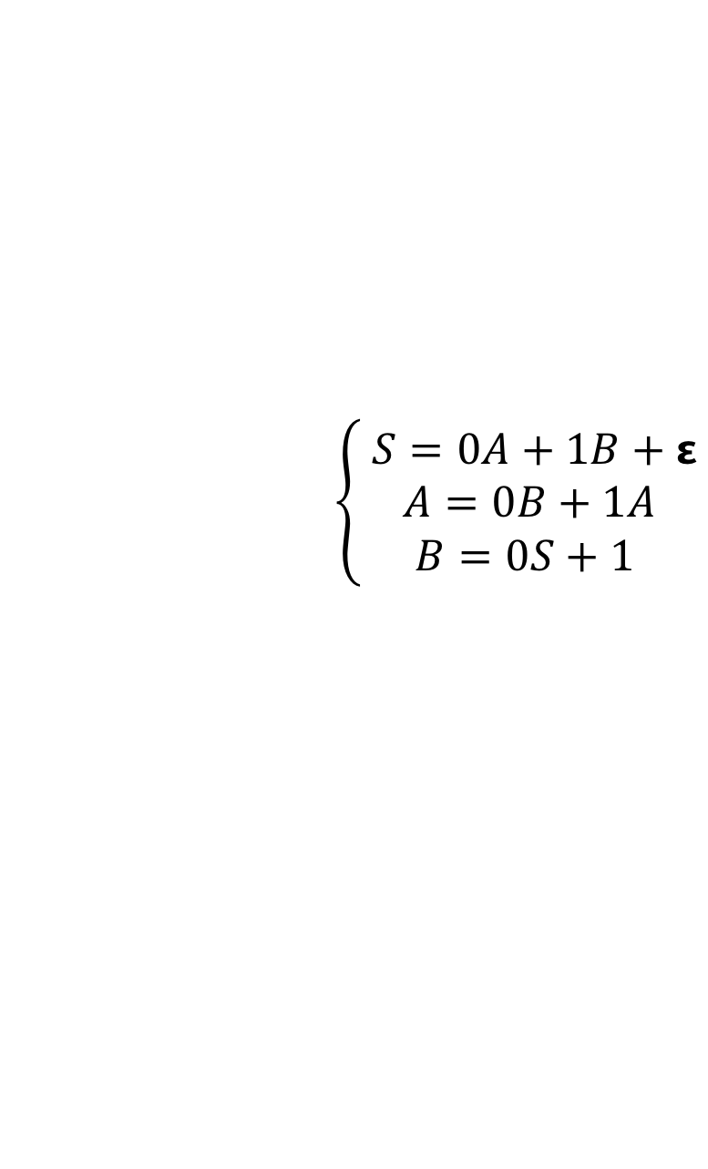
Theorem: A language is a regular set if and only if is a right linear language
Proof:
=> Apply lemma 1 and lemma 2
<= construct a system of regular exp equations where:
Indeterminants – nonterminals
Coefficients – terminals
Equation for A: all the possible rewritings of A
Example: G=({S,A,B},{0,1}, P, S)
P: S → 0A | 1B | 𝝴
A → 0B | 1A
B → 0S | 1
$$\left\{\begin{aligned} S=0A+1B+\text{ε} \\ A=0B+1A \\ B=0S+1 \end{aligned}\right.$$
Regular exp = solution corresponding to S

Slide 20
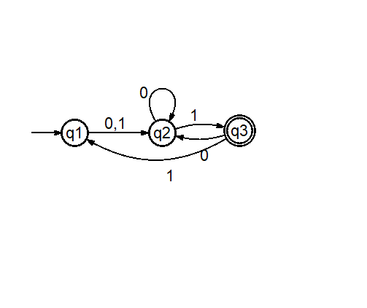
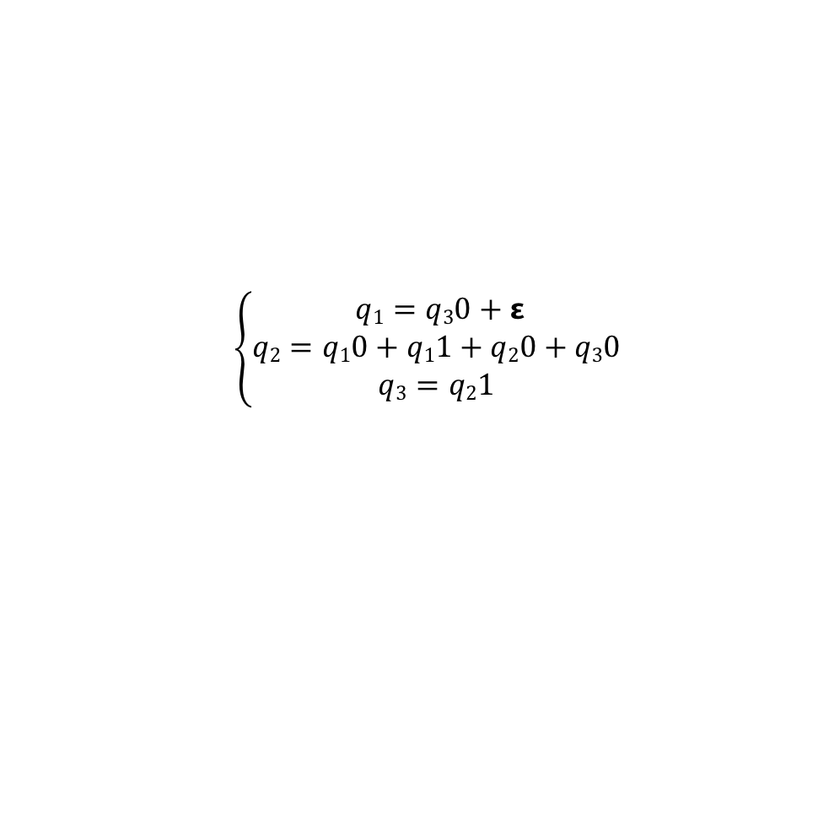
Theorem: A language is a regular set if and only if is accepted by a FA
$$\left\{\begin{aligned} q1=q30+\text{ε} \\ q2=q10+q11+q20+q30 \\ q3=q21\end{aligned}\right.$$
Proof:
=> Apply lemma 1 and lemma 2 (to follow, similar to RG)
<= construct a system of regular exp equations where:
Indeterminants – states
Coefficients – terminals
Equation for A: all the possibilities that put the FA in state A
Equation of the form: X=Xa+b => solution X=ba*
Regular exp = union of solutions corresponding to final states

Slide 21
Lemma 1’:𝞥,{𝞮}, {a},∀a∊𝚺 are accepted by FA
Reg exp | FA
𝞥 | M = (Q, 𝚺, 𝛿, q_{0,} 𝞥)
𝞮 | M = (Q, 𝚺, 𝞥, q_{0,} {q₀})
a,∀a∊𝚺 | M = ({q₀,q₁}, 𝚺, {𝛿(q₀,a) = q₁}, q_{0,} {q₁})

Slide 22
Lemma 2’:If L₁ and L₂ are accepted by a FA then: L₁ ∪ L₂, L₁L₂ and L₁* are accepted by FA
Proof:
M₁ = (Q₁, 𝚺₁, 𝛿₁, q₀₁, F₁) such that L₁= L(M₁)
M₂ = (Q₂, 𝚺₂, 𝛿₂, q₀₂, F₂) such that L₂ = L(M₂)
M₃ = (Q₃, 𝚺_{1U}, 𝛿₃, q₀₃, F₃)
Q₃ = Q₁ U Q₂ U {q₀₃}; ∑₃ = ∑₁ U ∑₂
F₃ = F₁ U F₂ U {q₀₃ | if q₀₁ ∊ F₁ or q₀₂ ∊ F₂}
𝛿₃ = 𝛿₁ U 𝛿₂ U {𝛿₃(q₀₃,a) = p | ∃𝛿₁(q₀₁,a) = p} U
{𝛿₃(q₀₃,a) = p | ∃𝛿₂(q₀₂,a) = p}
L(M₃) = L(M₁) U L(M₂)
PROOF!!! Homework

Slide 23
M₄ = (Q₄, 𝚺₄, 𝛿₄, q₀₄, F₄)
Q₄ = Q₁ U Q₂; q₀₄ = q₀₁;
F₃ = F₂ U {q ∊ F₁ | if q₀₂ ∊ F₂}
𝛿₃(q,a) = 𝛿₁(q,a), if q ∊ Q₁-F₁
𝛿₁(q,a) U 𝛿₂(q₀₂,a) if q ∊ F₁
𝛿₂(q,a), if q ∊ Q₂
L(M₃) = L(M₁)L(M₂)
PROOF!!! Homework

Slide 24
M₅ = (Q₅, 𝚺₁, 𝛿₅, q₀₅, F₅)
Q₅ = Q₁; q₀₅ = q₀₁
F₅ = F₁ U {q₀₁}
𝛿₅(q,a) = 𝛿₁(q,a), if q ∊ Q₁-F₁
𝛿₁(q,a) U 𝛿₁(q₀₁,a) if q ∊ F₁
L(M₃) = L(M₁)*
PROOF!!! Homework

Slide 25
Pumping Lemma
Not all languages are regular
How to decide if a language is regular or not?
Idea: pump symbols
Example: L = {0^{n}1^{n} | n>= 0}

Slide 26
Theorem: (Pumping lemma, Bar-Hillel)
Let L be a regular language. ∃p∊ N, such that if w ∊ L with |w|>p, then
w = xyz, where 0<|y|<=p
and
xy^{i}z ∊ L, ∀i ≥ 0

Slide 27
Proof
L regular => ∃ M = (Q,𝜮,𝜹, q₀, F) such that L= L(M)
Let |Q| = p
If w ∊ L(M): (q₀,w) ⊢ (q_{f} , 𝜺) , q_{f}∈F process at least p+1 symbols
and
|w|>p p states
∃ q₁ that appear in at least 2 configurations
(q₀,xyz) ⊢ (q1,yz) ⊢ (q1,z) ⊢ (q_{f} , 𝜺) , q_{f}∈F => 0<=|y|<=p
*
*
+
*

Slide 28
Proof (cont)
(q₀,xy^{i}z) ⊢ (q₁,y^{i}z)
⊢ (q₁,y^{i-1}z)
⊢ ...
⊢ (q₁,yz)
⊢ (q₁, z)
⊢(q_{f} , 𝜺) , q_{f}∈F
So, if w=xyz ∈ L then xy^{i}z ∈ L, for all i>0
If i=0: (q₀,xz) ⊢ (q₁, z) ⊢(q_{f} , 𝜺) , q_{f}∈F
*
*
*
*
*
*
*
*

Slide 29
Example: L = {0^{n}1^{n} | n>= 0}
Suppose L is regular => w= xyz = 0^{n}1^{n}
Consider all possible decomposition =>
Case 1. y = 0^{k}
xyz = 0^{n-k}0^{k}1^{n}; xy^{i}z = 0^{n-k}0^{ik}1^{n} ∉ L
Case 2. y = 1^{k}
xyz = 0^{n}1^{k}1^{n-k}; xy^{i}z = 0^{n}1^{ik}1^{n-k} ∉ L
Case 3. y = 0^{k} 1^{l}
xyz = 0^{n-k}0^{k}1^{l}1^{n-l}; xy^{i}z = 0^{n-k}(0^{k}1^{l})^{i}1^{n-l} ∉ L
Case 4. y = 0^{k} 1^{K}
xyz = 0^{n-k}0^{k}1^{k}1^{n-k}; xy^{i}z = 0^{n-k}0^{k}1^{k}0^{k}1^{k}...1^{n-l} ∉ L
=> L is not regular

