Slide 1
Course 6

Slide 2
Parsing
Cfg G = (N, 𝚺, P,S) check if w ∊ L(G)
Construct parse tree
How:
Top-down vs. Bottom-up
Recursive vs. linear

Slide 3
 | Descendent | Ascendent
Recursive | Descendent recursive parser | Ascendent recursive parser
Linear | LL(k): LL(1) | LR(k): LR(0), SLR, LR(1), LALR

Slide 4
Result – parse tree -representation
Arbitrary tree – child sybling representation
Sequence of derivations S => 𝜶₁ => 𝜶₂ =>… => 𝜶_{n} = w
String of production – index associated to prod – which prod is used at each derivation step

Slide 5
Descendent recursive parser
Example

Slide 6
Formal model
Initial configuration:
(q,1,𝜀, S)
Configuration
(s, i, 𝛼, 𝛽)
where:
s = state of the parsing, can be:
q = normal state
b = back state
f = final state - corresponding to success: w ∊ L(G)
e = error state – corresponding to insuccess: w ∉ L(G)
i – position of current symbol in input sequence
w = a1a2…an, i ∊ {1,...,n+1}
𝛼 = working stack, stores the way the parse is built
𝛽 = input stack, part of the tree to be built
Define moves between configurations
Final configuration:
(f,n+1, 𝛼,𝜀)

Slide 7
Expand
WHEN: head of input stack is a nonterminal
(q,i, 𝜶, A𝜷) ⊢ (q,i, 𝜶A₁, 𝜸₁𝜷)
where:
A → 𝜸₁ | 𝜸₂ | … represents the productions corresponding to A
1 = first prod of A

Slide 8
Advance
WHEN: head of input stack is a terminal = current symbol from input
(q,i, 𝜶, a_{i}𝜷) ⊢ (q,i+1, 𝜶a_{i}, 𝜷)

Slide 9
Momentary insuccess
WHEN: head of input stack is a terminal ≠ current symbol from input
(q,i, 𝜶, a_{i}𝜷) ⊢ (b,i, 𝜶, 𝜷)

Slide 10
Back
WHEN: head of working stack is a terminal
(b,i, 𝜶a, 𝜷) ⊢ (b,i-1, 𝜶, a𝜷)

Slide 11
Another try
WHEN: head of working stack is a nonterminal
(b,i, 𝜶 A_{j}, 𝜸_{j} 𝜷) ⊢ (q,i, 𝜶A_{j+1}, 𝜸_{j+1}𝜷) , if ∃ A → 𝜸_{j+1}
(b,i, 𝜶, A 𝜷), otherwise with the exception
(e,i, 𝜶, 𝜷), if i=1, A =S, ERROR

Slide 12
Success
(q,n+1, 𝜶, 𝜀) ⊢ (f,n+1, 𝜶, 𝜀)

Slide 13
Algorithm

Slide 14
w ∊ L(G) - HOW
Process 𝜶:
From left to right (reverse if stored as stack)
Skip terminal symbols
Nonterminals – index of prod
Example: 𝜶 = S₁ a S₂ a S₃ c b S₃ c

Slide 15
LL(1) Parser

Slide 16
Linear algorithm

Slide 17
FIRST_{k}
≈ first k terminal symbols that can be generated from 𝛼
Definition:

Slide 18
Construct FIRST
Concatenation of length 1
FIRST₁ denoted FIRST
Remarks:
If
are 2 languages over alphabet 𝛴, then
and

Slide 19
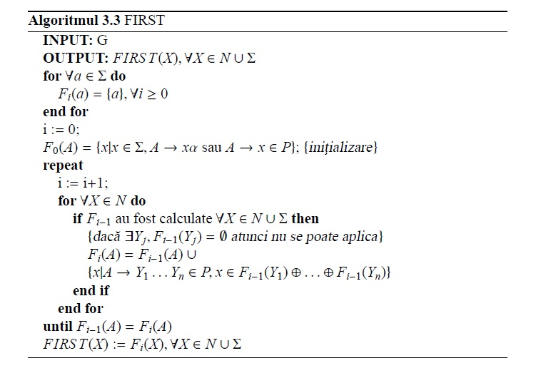
A

Slide 20
FOLLOW
A → 𝛆
FOLLOW_{k}(A)≈ next k symbols generated after/ following A A

Slide 21
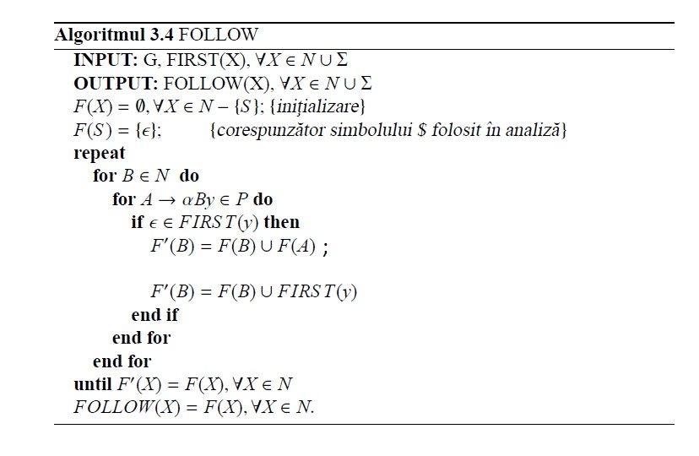
Correction:
In order for the algorithm to function correctly, consider:
For ∀a ∊ FIRST(y) do
else

