Slide 1

A journey through the “Ages” of Real-Time Communication in .NET
A short story

Slide 2
Agenda
Alice & Bob
The Four Three Horsemen
A Hero’s Welcome
Too many cooks
World peace
Better together

Slide 3
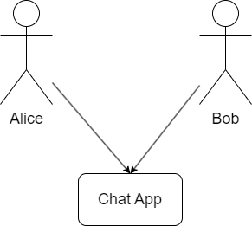
Alice & Bob
Alice & Bob wanted to design an app
The app would allow them to exchange messages
A simple chat

Slide 4
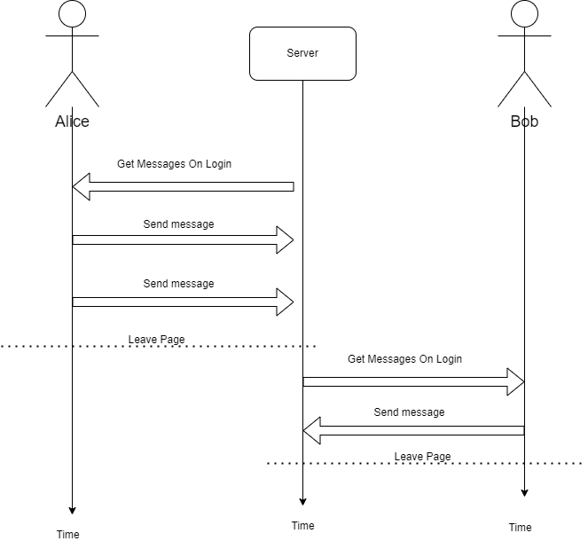
The first draft
They realized the app only works if they are not using it simultaneously
It’s the nature of the HTTP request ←→ response unidirectional flow
Client always initiates the requests

Slide 5
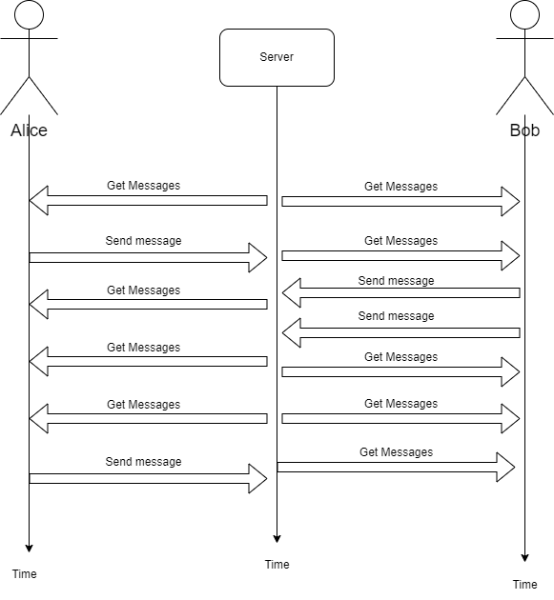
Http Polling → A “necessary evil”
“Automatic hidden refresh”
Causes potentially unnecessary network traffic
“Feeling” depends on the actual refresh period
Easy to implement

Slide 6
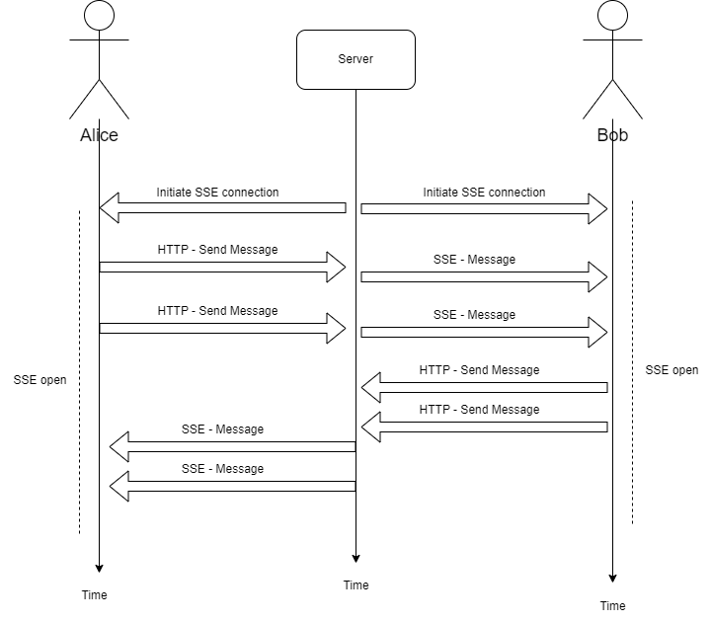
SERVER SENT EVENTS – Flip the script
Client initiates connection
Server keeps connection open and streams data
Server → Client unidirectional
Data from client still sent over regular HTTP
Only UTF-8 text data

Slide 7
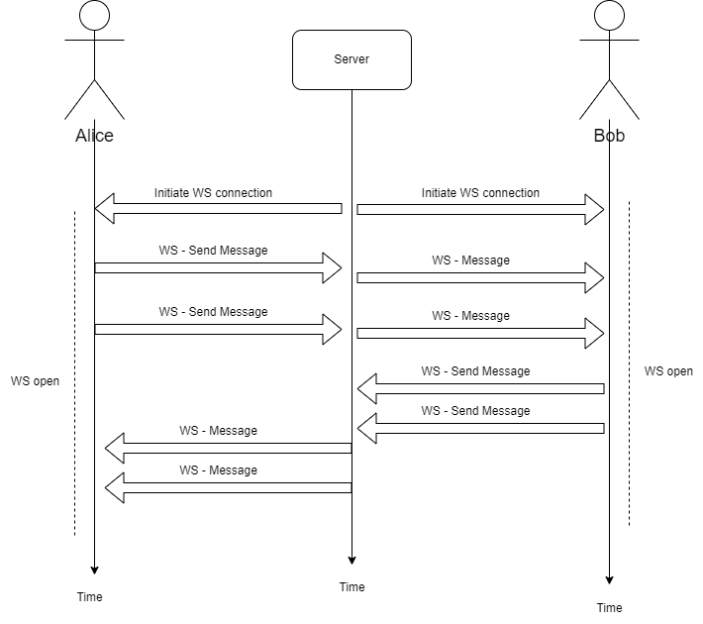
Websockets – two-way traffic
Similar to the combo of SSE server + HTTP client all in one
Bidirectional traffic from both sides
Supports binary data
Complexity for handling recconections

Slide 8
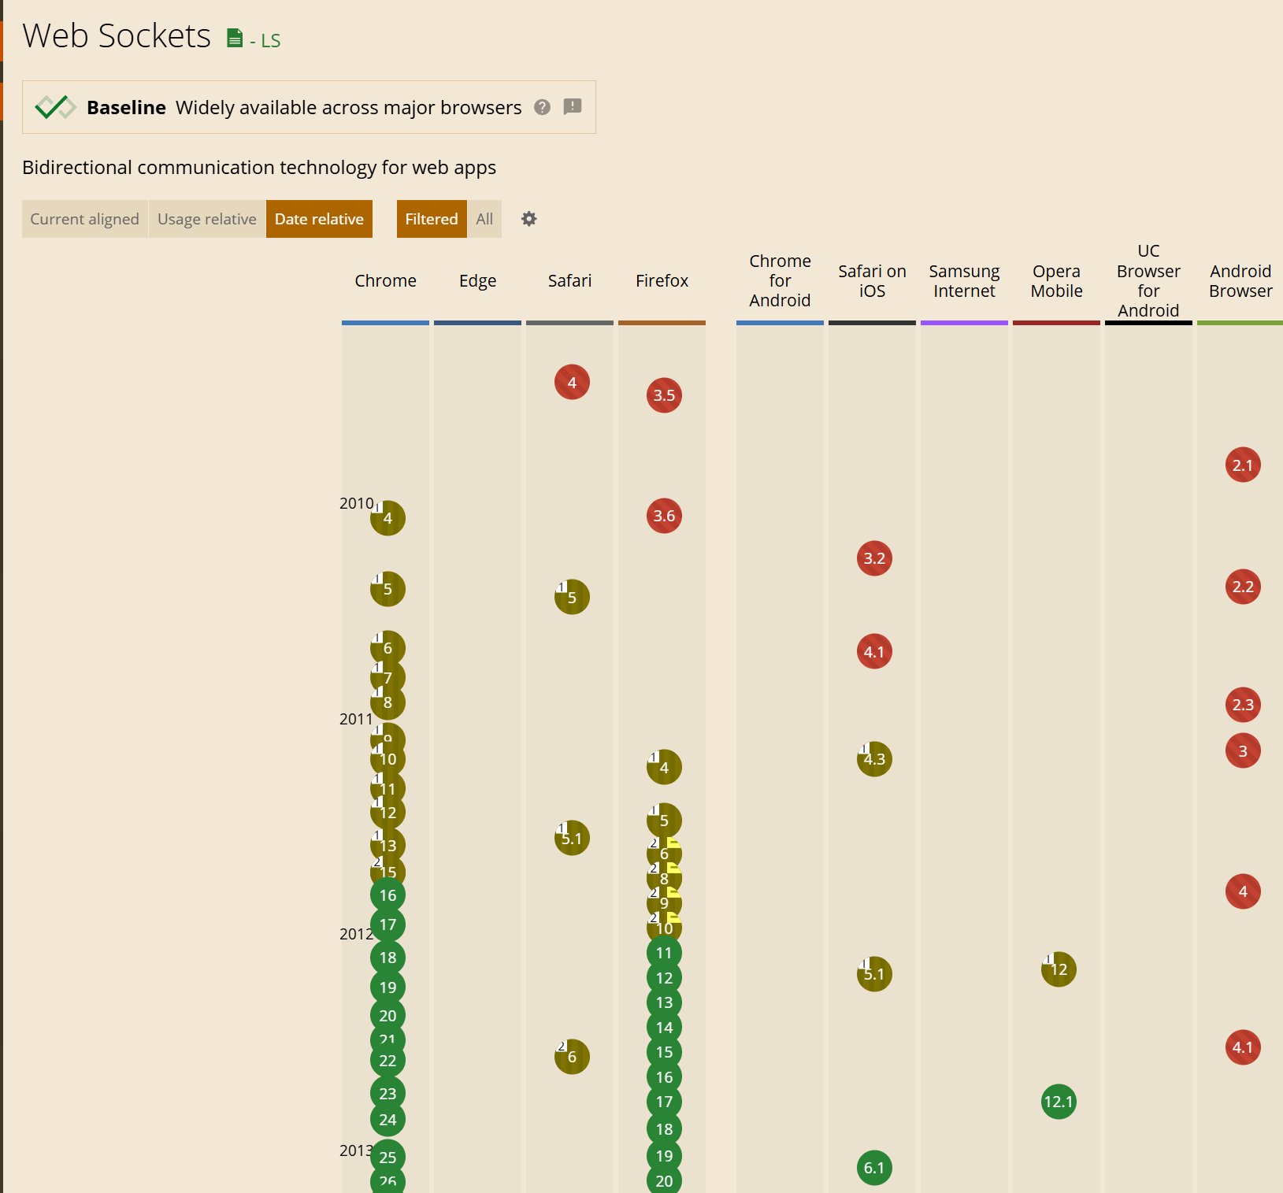
The three Horsemen
HTTP Polling
Server sent events
Web sockets
2000s – early 2010s
https://caniuse.com/

Slide 9
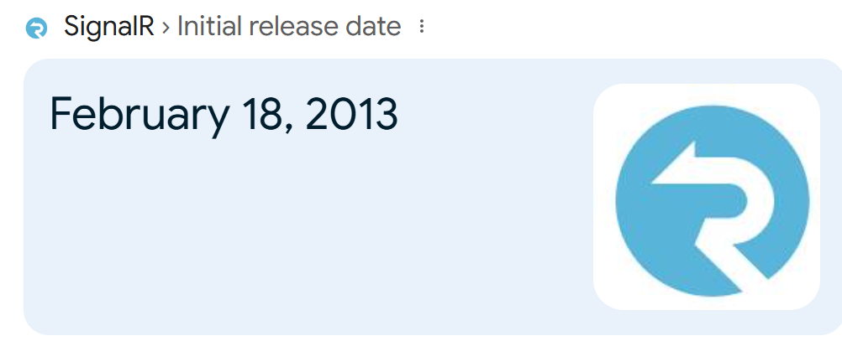
SignalR – A hero’s Welcome
Two-way communication between client & server
Abstracts away transport type & connection headaches
Adapts to what the client supports
Small “vendor lock-in” as the client has to use SignalR as well

Slide 10
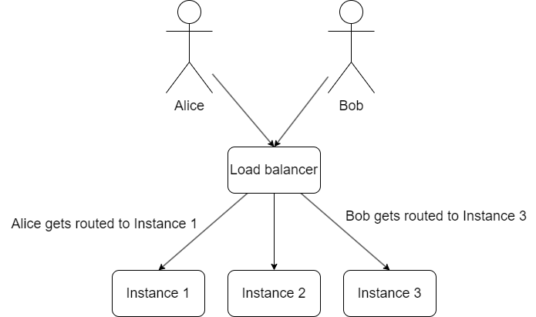
too many cooks

Slide 11
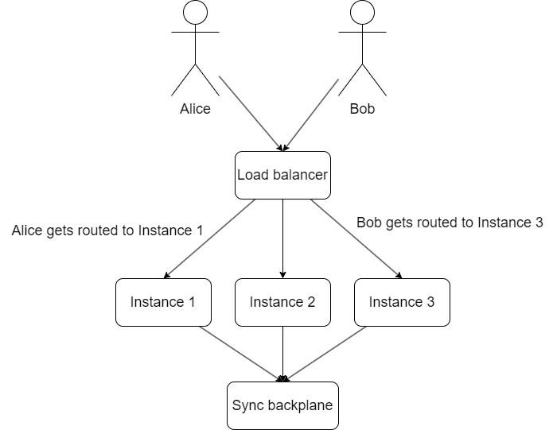
world peace

Slide 12
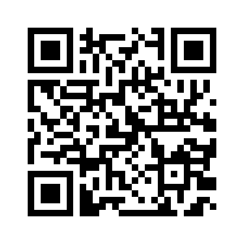
Better together
https://rt-net.azurewebsites.net/index.html

Slide 13
Links
https://github.com/RaulBurian/RT-NET
Overview of ASP.NET Core SignalR
.NET 10 better SSE

