Slide 1
ABAP Data Dictionary (DDIC)
04.10.2021
Notes:
Welcome, self-introduction and stuff….

Slide 2

ERP Praktikum 2021
- Online Version -
Introduction
ABAP DDIC
ABAP
ABAP-OO
Fiori Elements
List Report
Object Page
Extensions
Overview Page
Notes:
Brief orientation on where we are and what is to come (just as context, of course the upcoming stuff is still unknown to the recipients).
Explain the name ABAP (Advanced Business Application Programming, formerly Allgemeiner Berichtsaufbereitungsprozessor)

Slide 3

Agenda
Data Dictionary (DDIC)
Domains
Data Elements
Structures
Tables
Table Types
CDS View Entities
Notes:
Overview over what we want to do in this lecture
Tell that CDS View Entities are an exception as they are not DDIC objects

Slide 4
Agenda
Data Dictionary (DDIC)
Domains
Data Elements
Structures
Tables
Table Types
CDS View Entities
Notes:
This is just here for completeness sake
The overall agenda was already explained on the previous page and DDIC will be explained in the next.

Slide 5

Data Dictionary (DDIC)
In essence the DDIC is a central repository of data related definitions.
Those definitions are needed to store and access data on the database and are used to handle data in code.
They are in general called „DDIC objects“.
In this unit we focus on the 5 DDIC object types that are relevant for the overall course, which are:
Domains
Data Elements
Structures
Tables
Table Types
Notes:
CDS View Entities are not in this list, because they are not DDIC objects.
DDIC can be defined broader to also include the tools to manage it and the interface to the DB.
Also there technically are runtime objects for the DDIC definitions that get created/updated on activation.
None of this information is needed for this course and is therefore left out and only hinted using the phrase „In essence“.

Slide 6
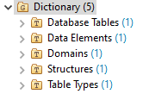
Overview
Data Dictionary
Relationships of DDIC objects
View in Eclipse
Domain
uses
Data Element
uses
uses
uses
Table Type
Structure
Table
uses
uses
Notes:
Explain the relationship of the different objects in general terms.
e.g. “A Domain is the lowest level in the hierarchy, and the Data Element is based on it”
Also explain the “multiparent” nature of the hierarchy (Table Type can e.g. be based on DE, Struct, Tab; Structure does not need to use DE, there are other options)

Slide 7
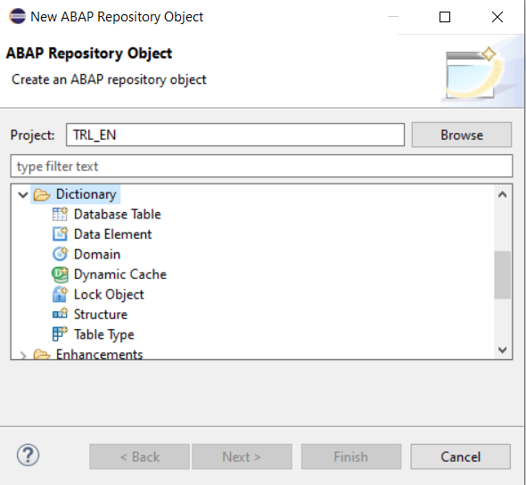
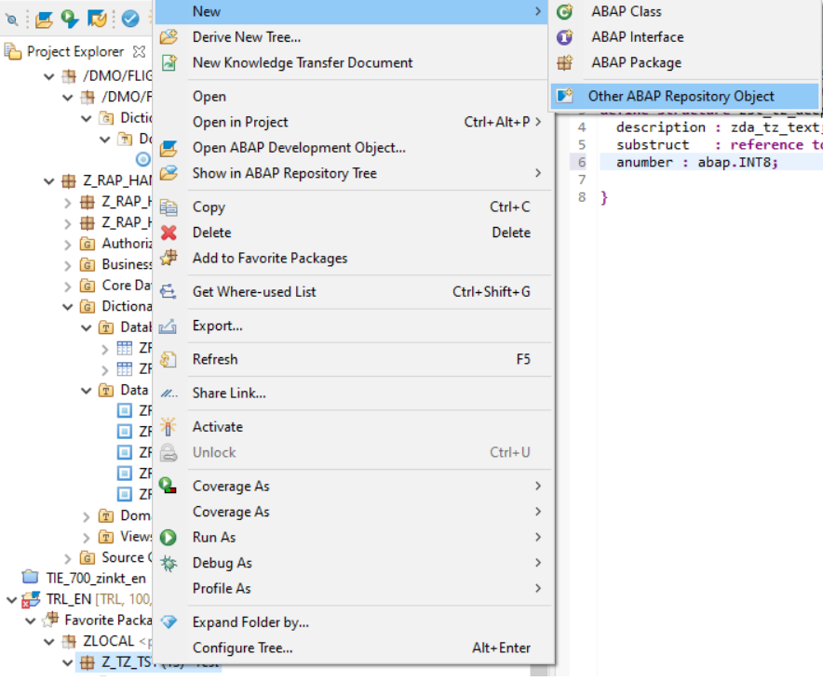
Creation of DDIC Objects from package
Data Dictionary
Right click on the package
Notes:
Explain the creation of the object and how eclipse looks like here.
Tell the students to try it (maybe also let them create their packages here as ZRAPH_##_2021)

Slide 8
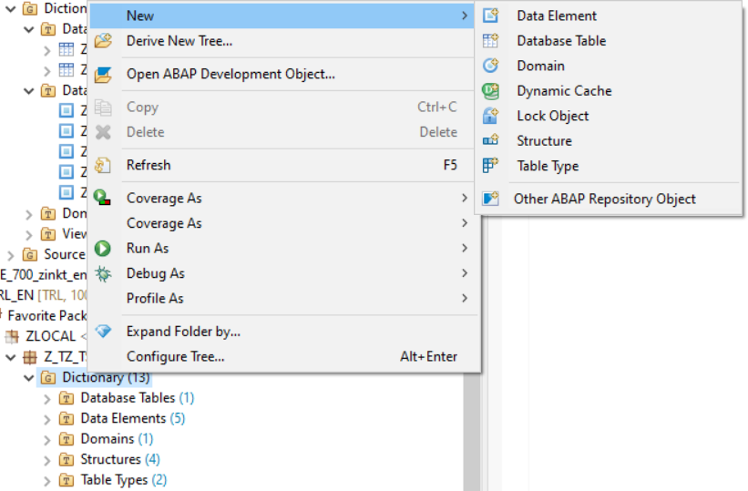
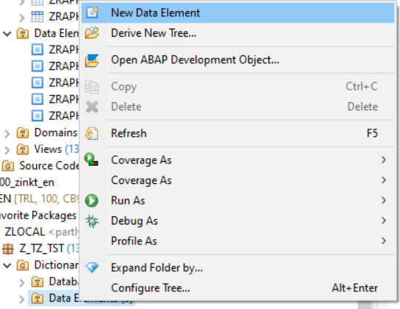
Creation of DDIC Objects from sub folders of the package
Data Dictionary
Right click on “Dictionary”
Right click on e.g. “Data Element”

Slide 9
Agenda
Data Dictionary (DDIC)
Domains
Data Elements
Structures
Tables
Table Types
CDS View Entities
Notes:
Short retrospective on the overview over the DDIC and now we go into the (for us important) objects that are in there.

Slide 10
Domains
Data needs to have a basic data type, so its environment knows how to handle it.
This concept is implemented in programming languages using as „Types“.
There are elementary types that are natively built into programming languages and types that are derived from them.
In ABAP there are built-in dictionary types that are derived from elementary types.
Domains are the DDIC objects that define types out of ABAP-built-in dictionary types.

Slide 11
Overview
Domains
Elementary data type
Elementary data types represent the most primitive and basic concept of types.
Built-In dictionary types are based on elementary types and give some additional handling instructions to the code.
Domains are the most high-level kind of technical type in ABAP and are based on Built-In dictionary types.
based on
Built-In dictionary type
based on
Domain
Notes:
The elementary data types are documented here: https://help.sap.com/doc/abapdocu_752_index_htm/7.52/en-us/abenpredefined_abap_type_glosry.htm
The built-in dictionary types are documented here: https://help.sap.com/doc/abapdocu_752_index_htm/7.52/en-US/abenddic_builtin_types.htm

Slide 12
What is an elementary type?
Domains
They give very basic meaning to 0s and 1s.
On a physical level data exists as bytes, which in turn consist of 8 bits each.
However some chunks of bytes or a single byte shall be interpreted by code or the database as numbers, some as text others again as truth value (which can only have 2 states: true or false).
There is no way to tell what kind of information a byte represents just by looking at the byte itself.
Example: the 2 bytes 00000000 01000001 could mean the letter „A“ if interpreted as character or the number 65 if interpreted as integer.
When a type is assigned to the bytes, its technical meaning becomes clear.
The code then knows:
what do the bytes technically represent (e.g. an integer number, a floating point number or characters)
how many bytes belong together to form the information (e.g. an „i“ integer in ABAP is 4 bytes long, whereas „int8“ is 8 bytes long and can therefore encode much larger numbers)
Notes:
The Example with the 2 bytes is in Big-Endian notation as it is easier to read/understand than Little-Endian, but this really does not matter to understand for the students.
The elementary data types are documented here: https://help.sap.com/doc/abapdocu_752_index_htm/7.52/en-us/abenpredefined_abap_type_glosry.htm

Slide 13
What are built-in dictionary types?
Domains
Built-in dictionary types are based on elementary types
They define additional properties needed by ABAP
the places used for output (e.g. 3 for INT1 which has a range from 0 – 255)
the initial value assigned to the type
decimal places used in the type (if it supports such, Integers and Chars for example don‘t; decimal floating points do)
Often used built-in dictionary types are
CHAR – defines characters
NUMC – defines characters, but must consist entirely of numbers
CURR – defines an amount field based on a currency with specifiable length and decimal places
INT1 (INT2, INT4, INT8) – Integer number with 1 byte (2, 4, 8 bytes)
DEC – Decimal value with specifiable length and decimal places
Notes:
The built-in dictionary types are documented here: https://help.sap.com/doc/abapdocu_752_index_htm/7.52/en-US/abenddic_builtin_types.htm
The initial value is handled differently in other languages such as C, where you have to explicitly initialize a variable as it otherwise points to undefined content.
ABAP is built as being as easy to use as possible.

Slide 14
What are domains?
Domains
Domains are based on built-in dictionary types.
They add technical references as to which data can be contained
Fixed values
Check tables
They add output rules
Conversion (ALPHA, PDATE)
Output Length
Case sensitiveness
Notes:
Fixed values and check tables often already define (a part of) business rules and are therefore no longer strictly technical, although it‘s a technical setting still.

Slide 15

Hands-On Time Klick me
Notes:
https://bitbucket.org/ThomasZink/erp-praktikum-ddic/src/master/Domains.md

Slide 16
Agenda
Data Dictionary (DDIC)
Domains
Data Elements
Structures
Tables
Table Types
CDS View Entities
Notes:
Short Retrospective on DDIC and Domains and short peek that we will now build upon it.

Slide 17
Data Elements
In contrast to the technical settings of Domains, Data Elements define semantics.
Additionally advanced settings can be maintained, which are not relevant for this course.
Notes:
The „Advanced Settings“ mentioned above are for DynPro and Logging only.

Slide 18
What are data elements?
Data Elements
Data Elements are mainly based on domains (or built-in dictionary types, but this is bad practice in most circumstances).
They can also define references to data types (or built-in dictionary types) and classes, but this is not part of this course, as such references are usually handled directly (see later in chapter „Structures“.
There are 4 Texts (Short, Medium, Long, Heading) that can be defined as a semantic description. These texts can be used by the UI as labels for fields and provide a description of what the data shall refer to.
Notes:
Using built-in dictionary types is bad practice, because you miss all the technical settings provided by the domain (like check table).
Also the domains reuse layer with its where-used-list is often helpful for analysis (e.g. in one component an account number is 10 digits and it is referenced in different tables as from-account, to-account, customer-account, they should have the same domain and different data elements).

Slide 19
Hands-On Time Klick me
Notes:
https://bitbucket.org/ThomasZink/erp-praktikum-ddic/src/master/DataElements.md

Slide 20
Agenda
Data Dictionary (DDIC)
Domains
Data Elements
Structures
Tables
Table Types
CDS View Entities
Notes:
Short Retrospective on the basic definition of the scalar data types and short peek that we now go to more complex types.

Slide 21
Structures
Some data does not make sense alone, but only in conjunction with other data.
In other instances the grouping together of data makes the program flow better readable/maintainable.
In lists of data (see later chapter „Table Types“) rows are also often represented as structures.
For these cases structures exist in ABAP.
Notes:
Explain why grouping of data makes sense (sort of like an object)

Slide 22
What are structures?
Structures
Structures mainly consist of fields.
Fields represent
single chunks of data and therefore have a data type assigned (either Data Element or built-in dictionary type)
references to any data
references to interfaces/classes
Some data types in fields need to be connected together
Currency Amount fields need a connection to a Currency field (for e.g. „10.50 EUR“)
Quantity fields need a connection to a unit field (for e.g. „1 kg“ or „3 pieces“)
Structures can also contain other structure definitions and even table types to form complex structures
When a structure contains at least one substructure, it is classified „nested structure“
When it also contains at least one table type, string or reference (no matter of substructures included), it is classified as „deep structure“
If none of the two criteria apply, the structure is classified as „flat structure“
It is possible to include the components of another structure instead of defining a substructure, though this is considered bad practice.
Notes:
The division of the classification „flat structure“ into „flat structure“ and „flat character-like structure“ is not important in most circumstances and certainly for this course. Therefore it is omitted.
Also boxed components lead to a „deep structure“ classification, but this is no topic for this course.
Source for classification: https://help.sap.com/doc/abapdocu_752_index_htm/7.52/en-US/abendata_objects_structure.htm
Here is the source for the statement that including components into a structure is bad practice“: https://help.sap.com/doc/abapdocu_752_index_htm/7.52/en-US/abenincluding_structures_guidl.htm
In essence its namespacing…

Slide 23
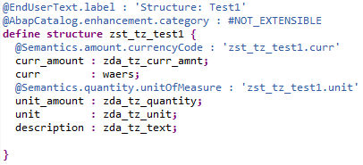

Flat structure details
Structures
Definition of the structure
Example of data in the structure
In this structure zst_tz_test1 we see 5 components defined, which are all flat fields:
curr_amount (type zda_tz_curr_amnt; defines curr as its currency code)
curr (type waers)
unit_amount (type zda_tz_quantity; defines unit as its unit of measure)
unit (type zda_tz_unit)
description (type zda_tz_text)
Notes:
Explain the definition line by line.
Explain the representation of the data on the right (as a runtime object in contrast to the definition).

Slide 24
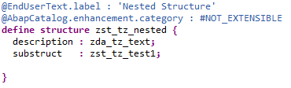
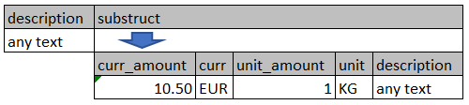
Nested structure details
Structures
Definition of the structure
Example of data in the structure
In this structure zst_tz_nested we see 2 components defined, which are:
description (type zda_tz_text)
substruct (type zst_tz_test1)
zst_tz_test1 is itself a flat structure and its defined components curr_amount, curr, unit_amount, unit and description can be accessed, as well.
So in essence we have 6 fields accessible, even though we defined 2 components.

Slide 25
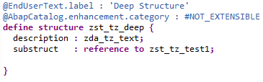
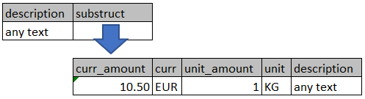
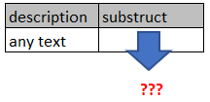
Deep structure details - references
Structures
Definition of the structure
Example of data in the structure with bound reference
Example of data in the structure with unbound reference
In this structure zst_tz_deep we see 2 components defined, which are:
description (type zda_tz_text)
substruct (type reference to zst_tz_test1)
Here substruct is referenced and therefore not actually part of the structure.
Its components therefore can only be accessed indirectly and in principle the reference could be invalid (unbound)

Slide 26
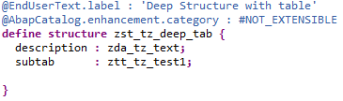
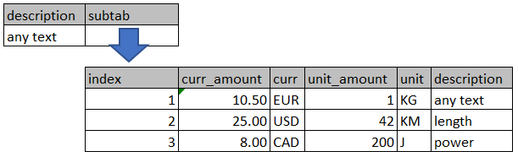
Deep structure details - table types
Structures
Definition of the structure
Example of data in the structure and table
In this structure zst_tz_deep_tab we see 2 components defined, which are:
description (type zda_tz_text)
subtab (type ztt_tz_test1; this is a table type)
Here subtab refers to an internal table (data of a table type) which is not embeded in the structure itself.
Its rows and components within the rows can be accessed by first specifying the index of the row and then the field to be accessed.
The table can be empty, but not invalid (unbound).

Slide 27
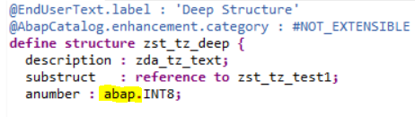
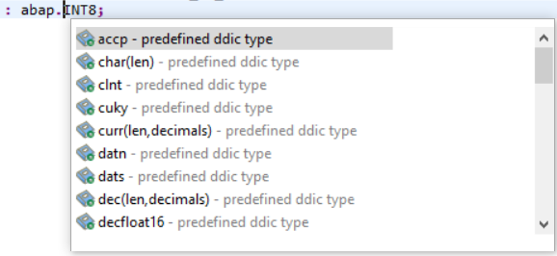
Using predefined DDIC Types
Structures
Definition of the structure
Code Completion
As seen in the left screenshot, predefined DDIC types can be accessed by prefixing them with “abap.”.
As in many places within Eclipse you can use CTRL+SPACE for code completion (right screenshot) to show you your possibilities at the specific cursor location.
Notes:
The CTRL+SPACE of course also works for other types, but this I would just tell them for the exercise. For “abap.” I find it especially useful and therefore will emphasize this here, but also telling that this is only one example. This is to differentiate the predefined DDIC types actual name from how it can be used.

Slide 28
Hands-On Time Klick me
Notes:
https://bitbucket.org/ThomasZink/erp-praktikum-ddic/src/master/Structures.md

Slide 29
Agenda
Data Dictionary (DDIC)
Domains
Data Elements
Structures
Tables
Table Types
CDS View Entities

Slide 30
Tables
In order to communicate with the database, a special DDIC object exists in ABAP.
This DDIC object is the table.

Slide 31
What are tables?
Tables
Tables define a flat structure.
This definition is pushed down to the database by creating a database table there.
It is used as a proxy-object to access the database table associated with it.
This is done in an ABAP specific SQL dialect „ABAP SQL“ (formerly known as Open SQL)
It can be given a description to further describe what it is about.
There are many settings for the optimization of the creation/access of the database table.
Index for performance optimization can be created.
Foreign keys for referential integrity can be defined.
Tables can have different delivery classes to reflect different use cases
Application table for master data and transactional data
Customizing table for configuration/test data
Notes:
Remember the students of the term “flat structure”.
„proxy-object“ means that we talk to it (DDIC Table) when we actually want to talk to the actual DB Table. It, so to say, forwards the request.

Slide 32
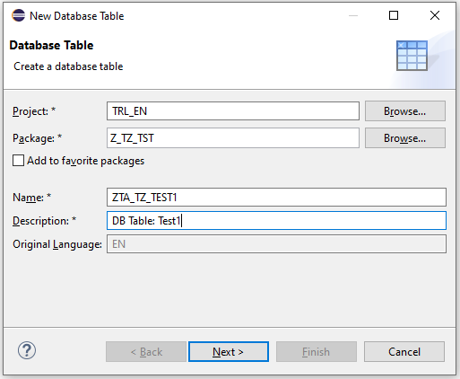
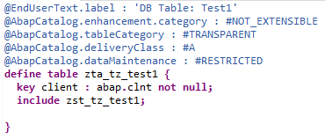
Implementation
Tables
Creation wizard
Definition of the table

Slide 33
Hands-On Time Klick me
Notes:
https://bitbucket.org/ThomasZink/erp-praktikum-ddic/src/master/Tables.md

Slide 34
Agenda
Data Dictionary (DDIC)
Domains
Data Elements
Structures
Tables
Table Types
CDS View Entities

Slide 35
Table Types
Often it is necessary to process a number of equally structured data in the same way.
This number might not be known at design time and could change in the course of the software running.
To be able to handle such situations (and others) some sort of lists of data are needed and those are called internal tables in ABAP.
Table types are the DDIC types that are used to declare internal tables.
Notes:
Emphasize that internal tables are in memory only, they do not connect to any database.
„Design time“ being the standard term for the phase of writing code (and other stuff that is not relevant here) as opposed to the „run time“.

Slide 36
Overview
Table Types
Domain
uses
Data Element
uses
uses
uses
Table Type
Structure
Table
uses
uses

Slide 37
What can table types do?
Table Types
Table types define a list (or table) of another type.
DDIC Types like a data element, structure or even another table type
Built-in dictionary types
References to the above and interfaces/classes
It is possible to define an initial number of rows for which memory is allocated initially.
This is to tweak performance as dynamic allocation of memory is relatively slow.
Internal tables rows can be accessed by index or by its data.
For accessing rows by data different primary key access methods exist to optimize for performance.
Standard Table
Sorted Table
Hashed Table
Additionally secondary keys can be defined for faster data access in certain circumstances.
Keys (primary and secondary) can be unique and non-unique.
Notes:
The other options of the line type definition of a table type would be range tables which are basically typed SelOpt-tables.
Explain: ABAP has a 1-based index instead of 0-based as e.g. c-like languages have.
For the access methods: Index Table is not explained here its actually a general term for non-hashed tables like standard table and sorted table.

Slide 38
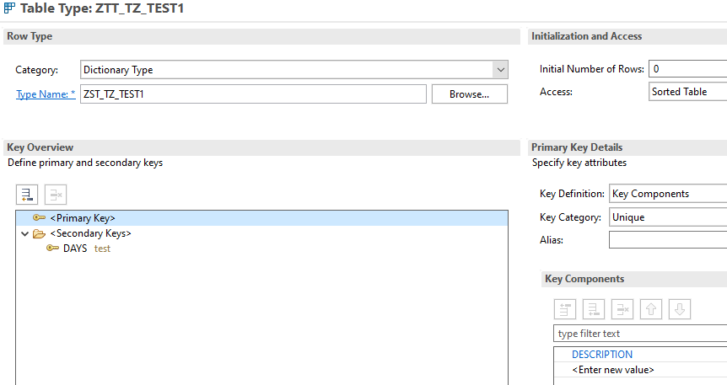
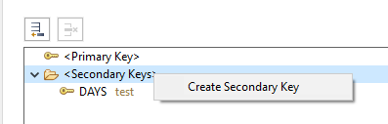
How to define a table type
Table Types
Overview in Eclipse
Creation of secondary key (right click)

Slide 39
Hands-On Time Klick me
Notes:
https://bitbucket.org/ThomasZink/erp-praktikum-ddic/src/master/TableTypes.md

Slide 40
Agenda
Data Dictionary (DDIC)
Domains
Data Elements
Structures
Tables
Table Types
CDS View Entities

Slide 41
CDS View Entities
Core Data Service View Entities are not defined within the DDIC but strongly interact with DDIC objects.
These views are the basic interface from ABAP Code to the Database.
They provide flexible modelling of data access and additional capabilities (these capabilities are not part of this lesson, but some of them will appear in later lessons).

Slide 42
What are CDS View Entities?
CDS View Entities
They are the second generation of CDS Views and the successors of DDIC based CDS Views.
The first generation of CDS Views (DDIC based CDS Views) generated a DDIC View, which is no longer happening.
DDIC Views are rather limited views on tables, which were basically replaced by CDS Views (but can still be used).
They define queries on other CDS View Entities and database tables.
These queries are defined in a SQL-Like Syntax.
Queries can connect multiple CDS View Entities and database tables together.
They are the interface of the RESTful ABAP Programming Model (RAP) towards the database.
They also incorporate advanced features for RAP.
Annotations for the UI (Fiori Elements & Smart Controls)
Annotations for Behavior
For fields of the queries, new names can be defined in order to keep the names unique and make them better readable.
Notes:
The advanced features are implemented as annotations

Slide 43
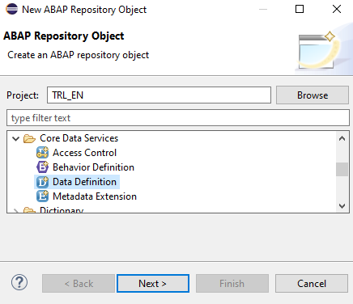
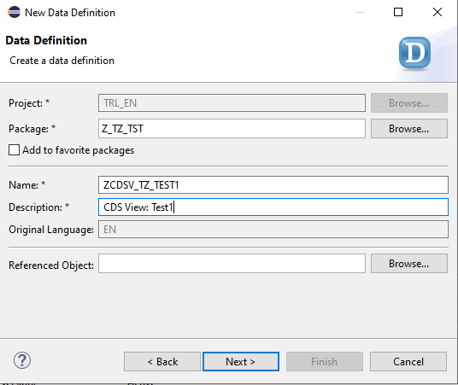
Implementation 1/2
CDS View Entities
Selection of the correct repository object
Define name and description

Slide 44
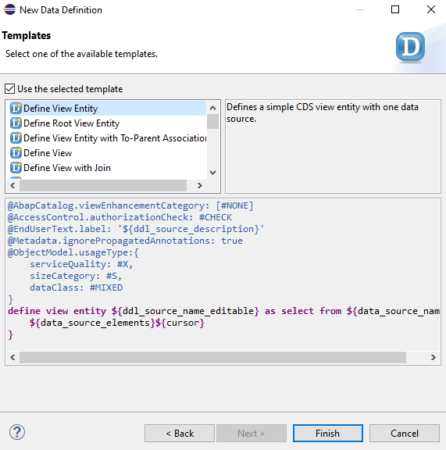
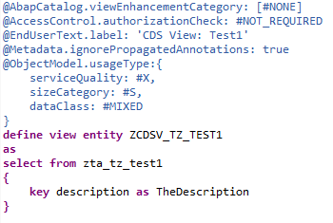
Implementation 2/2
CDS View Entities
Selection of the correct template
Source in Eclipse
Note that the placeholders are already substituted in this example.
Also the AccessControl.authorizationCheck was changed to #NOT_REQUIRED.
For the field a new name was defined using the “as” keyword. This new name is case sensitive.

Slide 45
Joins and Associations
CDS View Entities
To combine multiple data sources (like tables and cds view entities), joins and associations can be used.
For both, 2 sources can be combined at once:
Columns of the sources are defined to form the connection.
Joins come in 2 kinds:
Inner Join combines the sources where the data in the defined connection columns are equal.
Outer Join uses one of the 2 sources as leading, of which all data is selected, while the data of the secondary source is only selected when the connection can be made.
Associations behave mostly like outer joins, but are only resolved when accessed.
Therefore multiple associations can be defined in one cds view entity and selectively resolved on demand.
Associations can additionally be qualified with expected cardinality as a hint for the query engine.

Slide 46
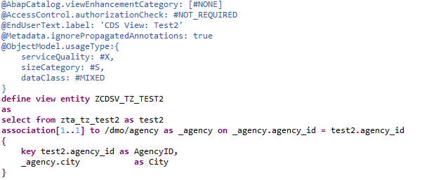
Joins and Associations
CDS View Entities
Implementation of an association
This cds view entity gets the data of table zta_tz_test2 and combines it with table /dmo/agency.
zta_tz_test2 is therefore the primary source while /dmo/agency is an association target.
with the “as” statement, both the primary source and the association can be aliased.
Here “[1..1]” is the optional cardinality hint for the query engine.
The equation after “on” is the column connection definition.
Everything within the curly brackets are the fields of this cds view entity (called “projection list”)
As /dmo/agency.city is in the projection list, the association is used in the cds view entity itself and therefore always resolved.

Slide 47
Hands-On Time Klick me
Notes:
https://bitbucket.org/ThomasZink/erp-praktikum-ddic/src/master/CDSViews.md

Slide 48
Sources
The End
Data Dictionary
Overview
Domains
Data Elements
Structures
Tables
Table Types
Core Data Service
CDS View Entity
© msg | Oktober 2021 | ERP Praktikum - ABAP DDIC

Slide 49


msg systems ag
Robert-Buerkle-Str. 1, 85737 Ismaning
Germany
www.msg.group
Thomas Zink
Lead IT Consultant
thomas.zink@msg.group

