Slide 1
Molecular language models
Raul Fernandez-Diaz

Slide 2
What are language models?
Natural language processing basics

Slide 3
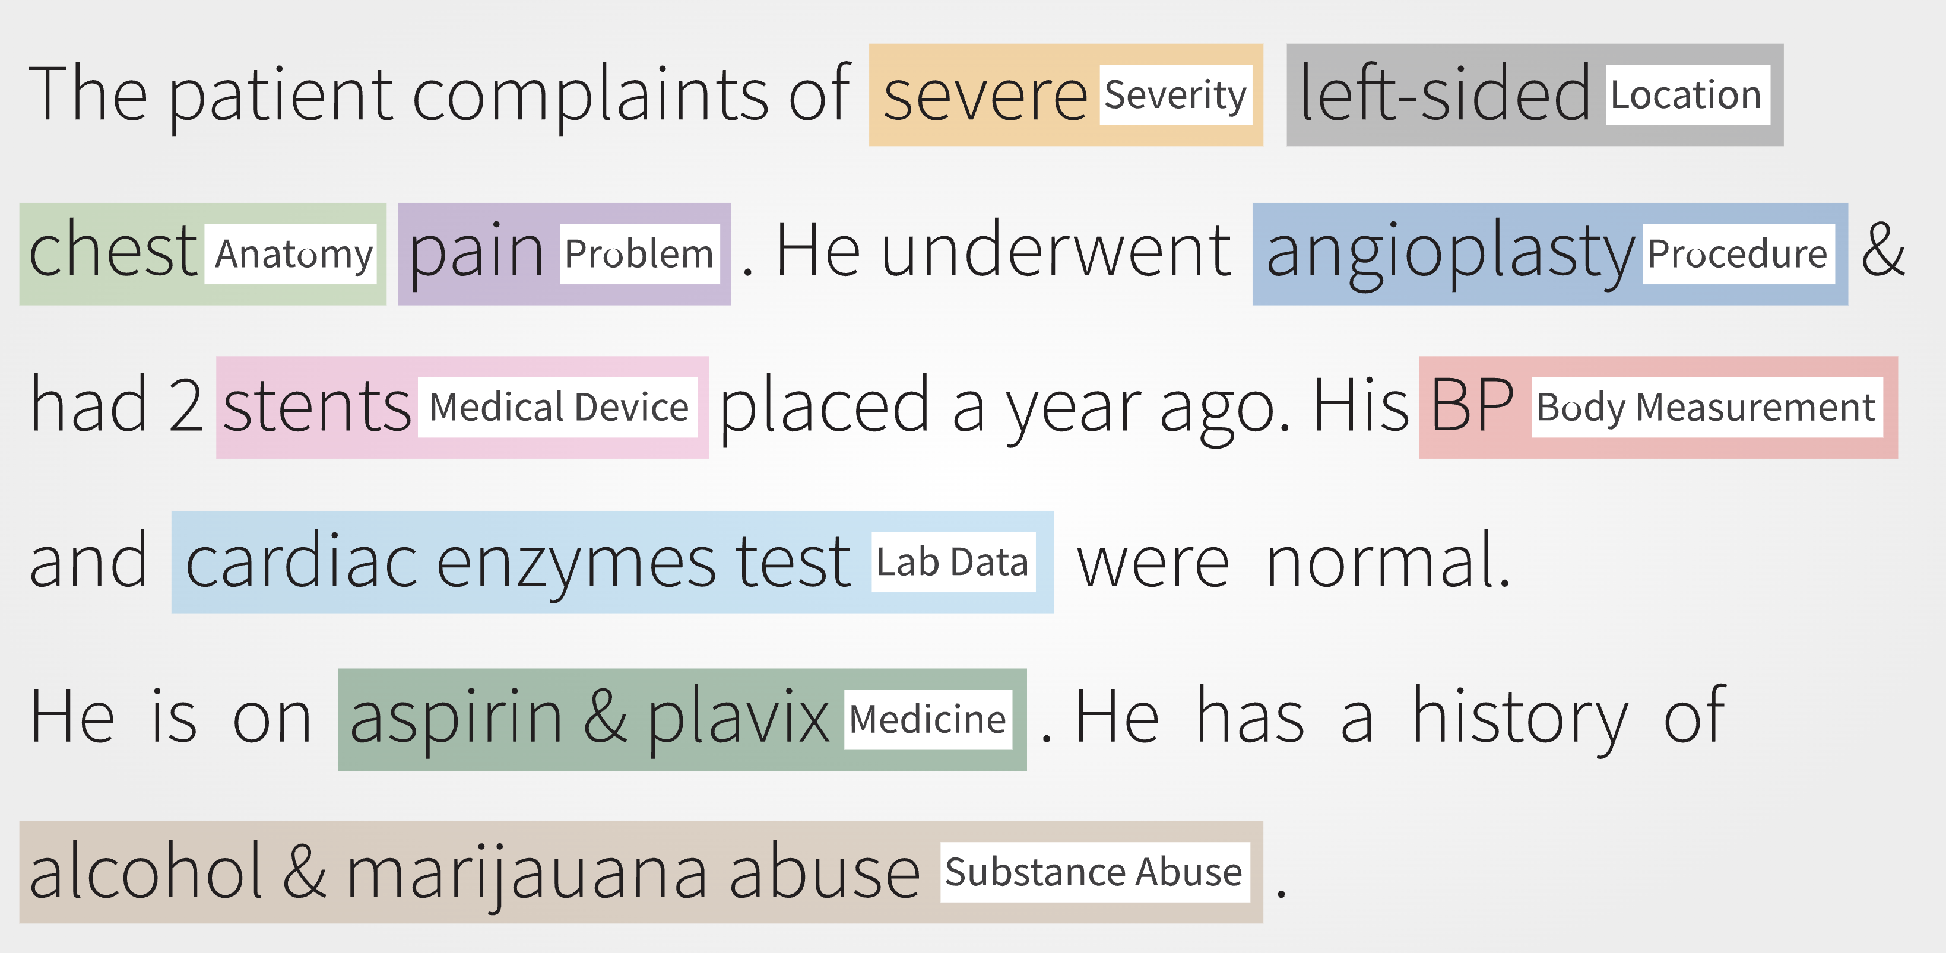
Natural language

Slide 4

How do we learn language?

Slide 5
How do we learn language?
General rules
Induction
Observation

Slide 6
How do we learn language?
General rules
Induction
Deduction
Observation
Prediction
Induction: Process of inferring general rules from discrete observations
Deduction: Process of deriving discrete predictions from general rules

Slide 7

How can we teach a model languages?
To be or not to be, that is the question: Whether ’tis nobler in the mind to suffer the slings and arrows of outrageous fortune,
General rules
Induction
Deduction
Observation
Prediction

Slide 8
How can we teach a model languages?
To be or not to be, that is the question: Whether ’tis nobler in the mind to suffer the slings and arrows of outrageous fortune,
Reconstruct original sentence
General rules
Induction
Deduction
Mask words (tokens)
Observation
Prediction
To be or not to be, that is the question: Whether ’tis nobler in the mind to suffer the slings and arrows of outrageous fortune,

Slide 9
How can we teach a model languages?
To be or not to be, that is the question: Whether ’tis nobler in the mind to suffer the slings and arrows of outrageous fortune,
Reconstruct original sentence
General rules
Induction
Deduction
Mask words (tokens)
Observation
Prediction
To be or not to be, that is the question: Whether ’tis nobler in the mind to suffer the slings and arrows of outrageous fortune,
p(w | T)
Conditional probability of word (w), given the rest of the text (T)

Slide 10
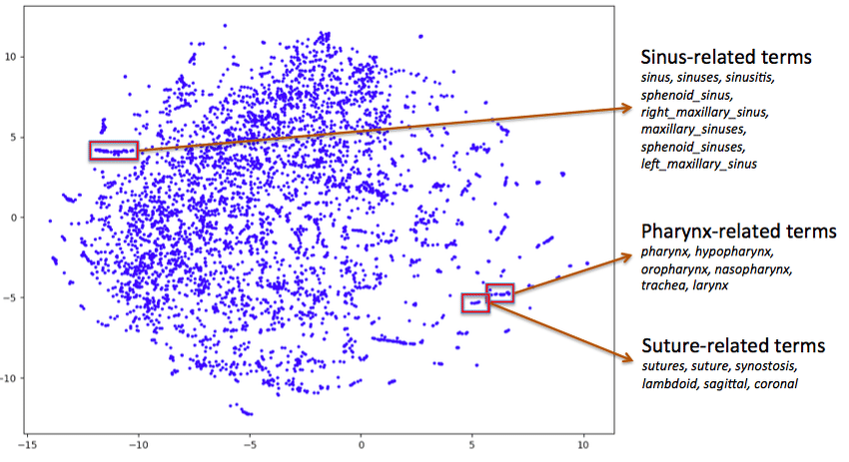
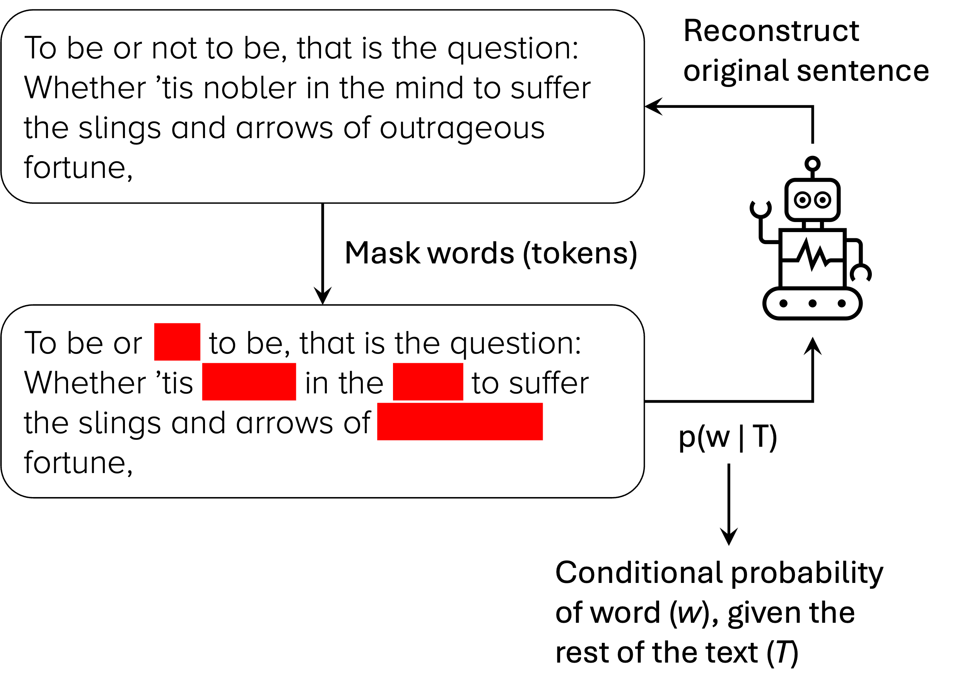
Words are embedded as vectors
General rules
2D representation of multidimensional space
Induction
Deduction
Observation
Prediction
Similar words are close together in the embedding/representation space

Slide 11
Resources
Model comparison
Language modelling visual explanation
https://arena.ai/
https://www.youtube.com/watch?v=LPZh9BOjkQs
https://www.youtube.com/watch?v=eMlx5fFNoYc

Slide 12
How can we model language?
Transformers and the attention mechanism

Slide 13
Objective: pay attention to the right words
The girl went to her grandma’s <mask>. <mask> had made cookies.
The ship was lost in the <mask>.
There was <mask> in the M50.

Slide 14
Objective: pay attention to the right words
The girl went to her grandma’s house. <mask> had made cookies.
The ship was lost in the <mask>.
There was <mask> in the M50.

Slide 15
Objective: pay attention to the right words
The girl went to her grandma’s house. She had made cookies.
The ship was lost in the <mask>.
There was <mask> in the M50.

Slide 16
Objective: pay attention to the right words
The girl went to her grandma’s house. She had made cookies.
The ship was lost in the sea/ocean.
There was <mask> in the M50.

Slide 17
Objective: pay attention to the right words
The girl went to her grandma’s house. She had made cookies.
The ship was lost in the sea/ocean.
There was traffic/an accident in the M50.

Slide 18
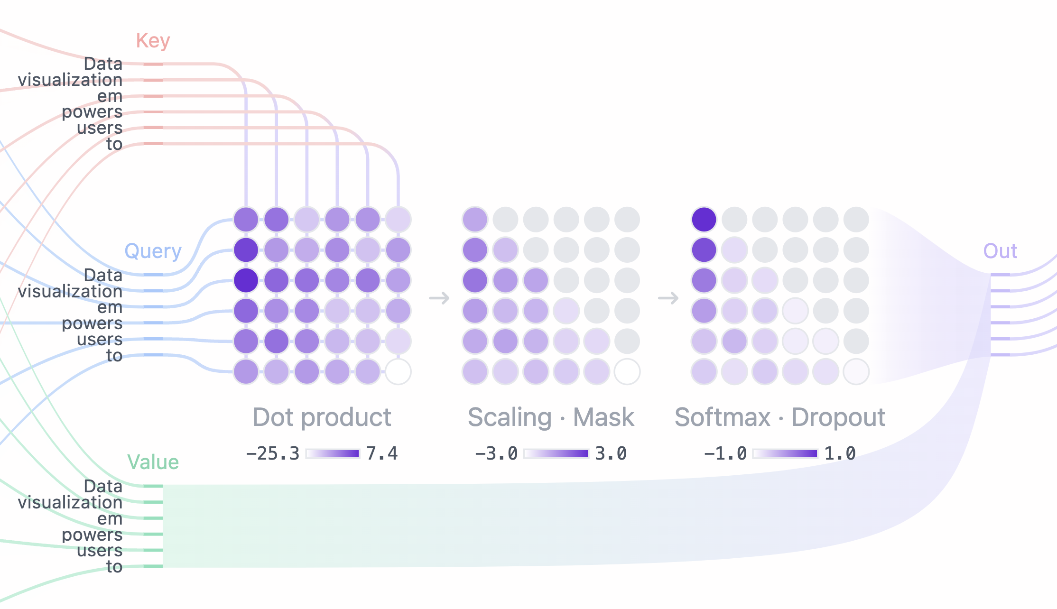
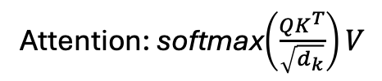


Attention Layer: Query, Key, Value
Attention: softmax$\left(\frac{QK^{T}}{\sqrt{d_{k}}}\right)V$
$$\left(\frac{QK^{T}}{\sqrt{d_{k}}}\right)$$
Key: embedding of word we are interested in
Quey: embedding of words we want to see if they are worth attending to
Value: embedding of all words
softmax$\left(\frac{QK^{T}}{\sqrt{d_{k}}}\right)$
softmax$\left(\frac{QK^{T}}{\sqrt{d_{k}}}\right)V$
QK^{T}

Slide 19
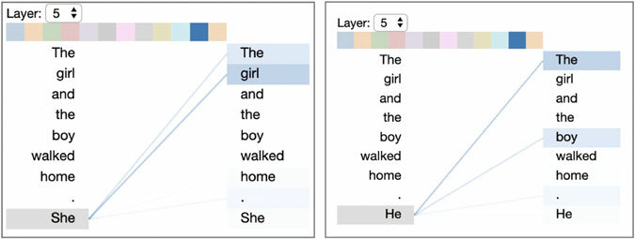
Objective: pay attention to the right words

Slide 20
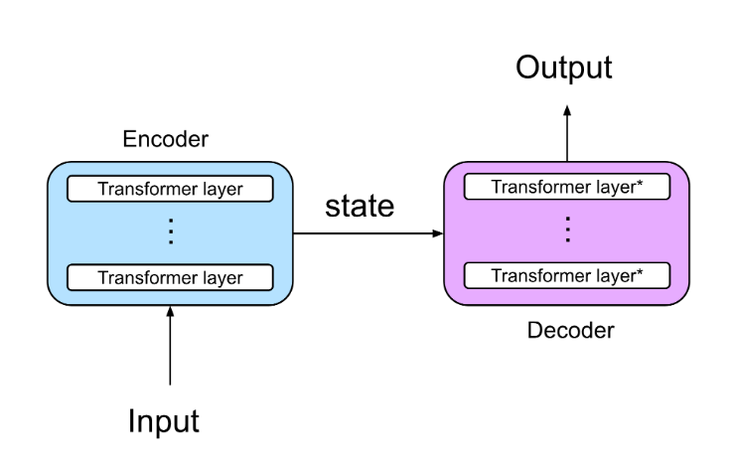
Transformer architecture
- Encoder: Text to numerical vector
- Decoder: Numerical vector to text
Tokenizer
Embedding layer
Attention layer
Fully connected layers
Attention layer
Fully connected layers
Prediction head

Slide 21
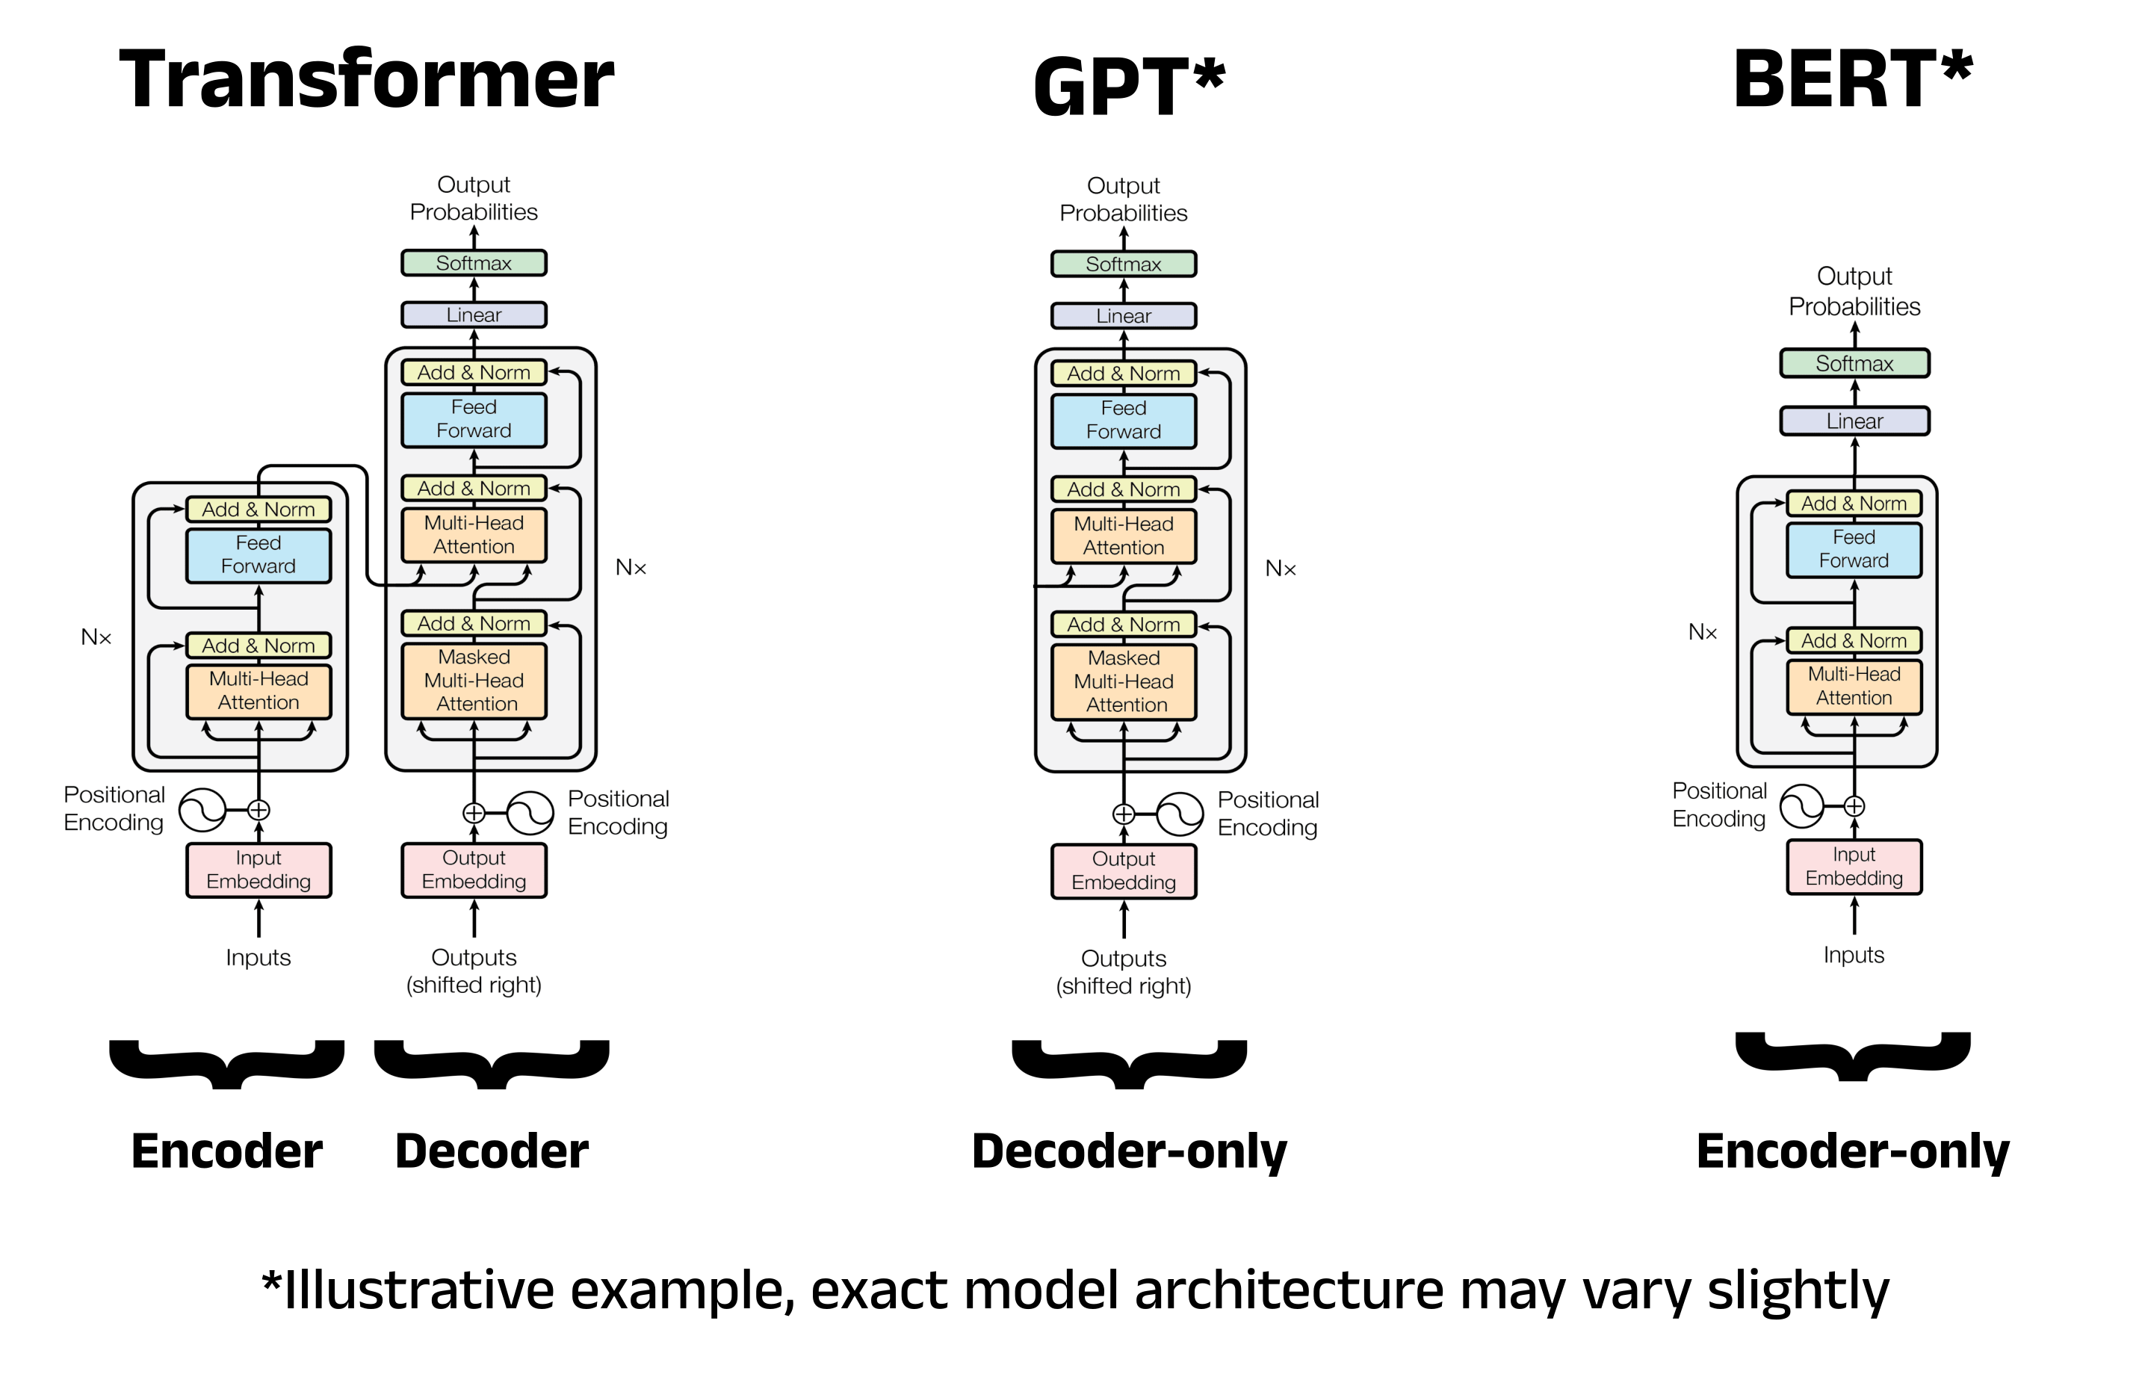
Types of architecture

Slide 22
What are the molecular languages?
Transforming biomolecules into strings

Slide 23
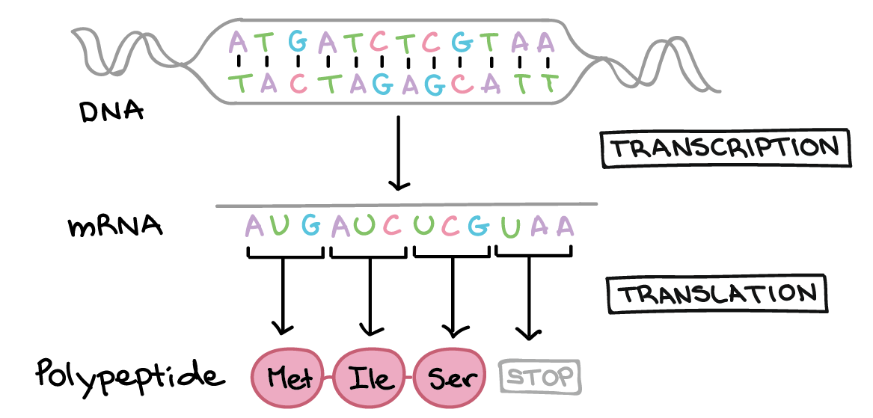
Biosequences
DNA and RNA: 4 letter alphabet, huge context
Proteins: ~20 letter alphabet, smaller context

Slide 24
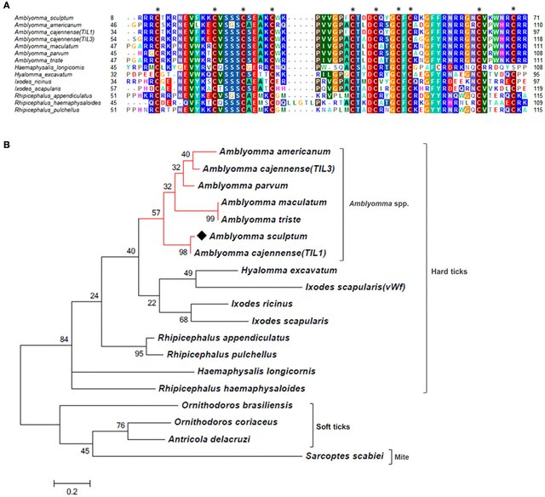
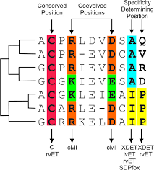
Biosequence evolution

Slide 25
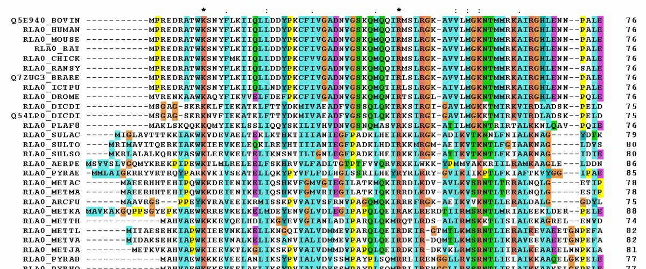
Biosequences
Language models learn evolutionary conservation

Slide 26
Protein Language Models
Name | Num params | Laboratory | Year
ESM-1b | 650M | Meta | 2019
ProtBERT | 400M | RostLab | 2020
Prot-T5-XL | 560M | RostLab | 2020
ProtGPT2 | 730M | Noelia Ferruz Lab (Barcelona) | 2022
ESM-2 | 8M, 35M, 150M, 650M, 3B y 15B | Meta | 2022
ESM-Fold | 3B (+ 690M) | Meta | 2022
ProstT5 | 560M (From Prot-T5-XL) | RostLab | 2023

Slide 27
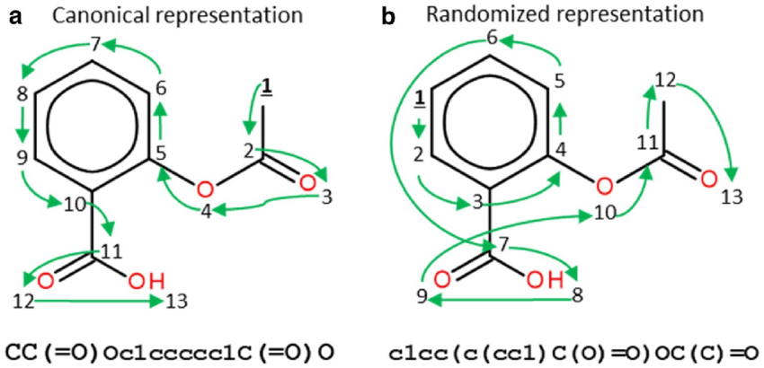
Small molecules: SMILES
Simplified
Molecular
Input
Line
Entry
System

Slide 28
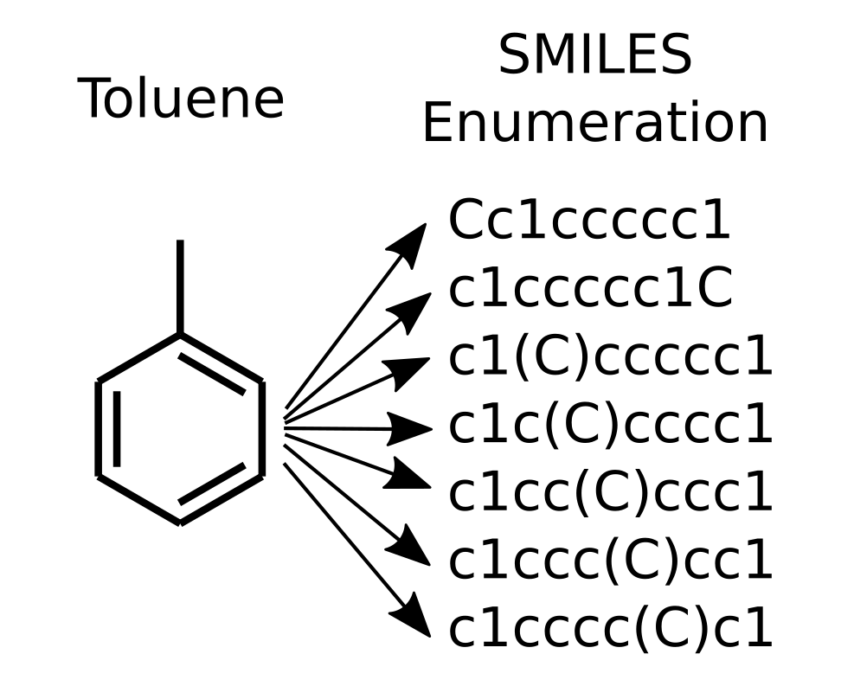
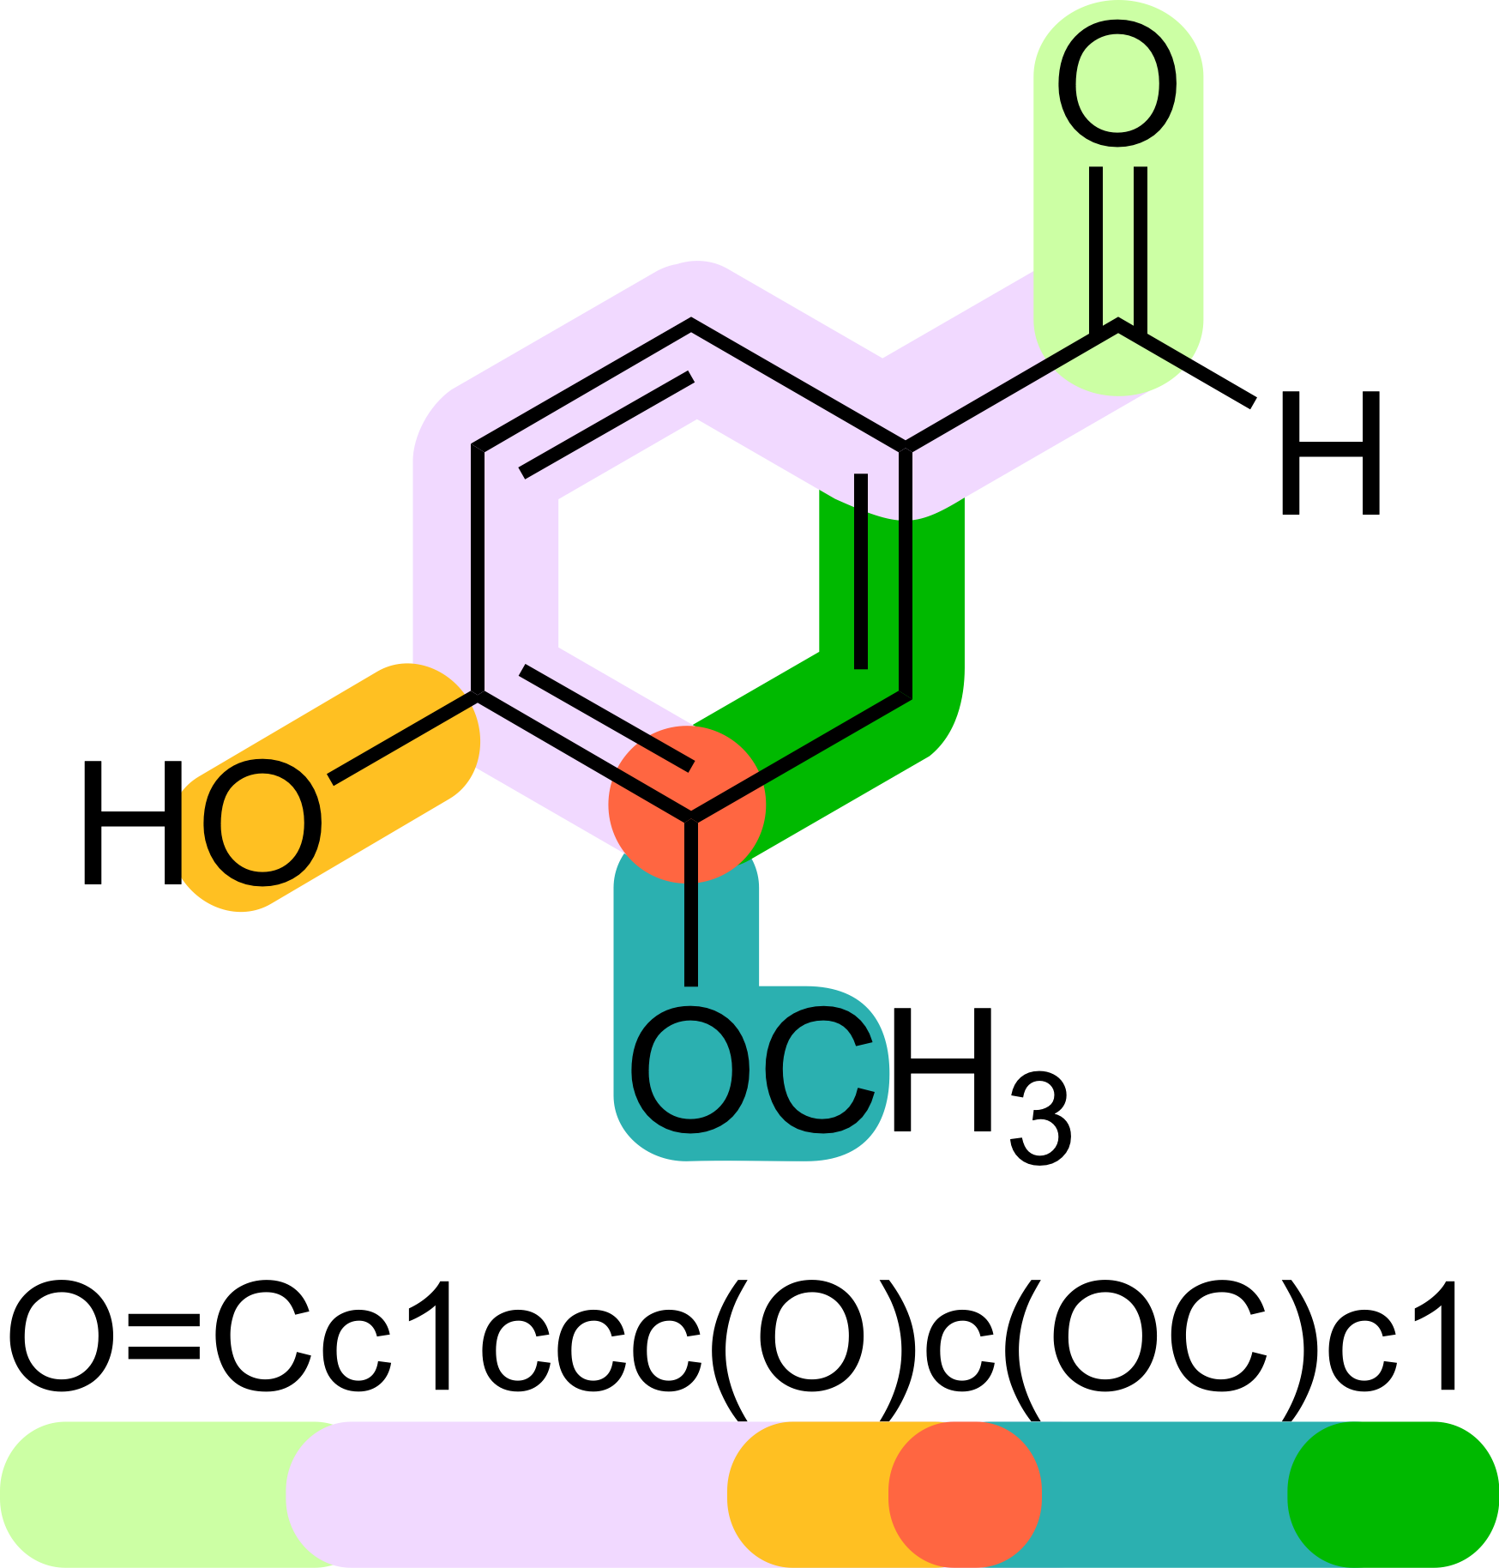
SMILES

Slide 29
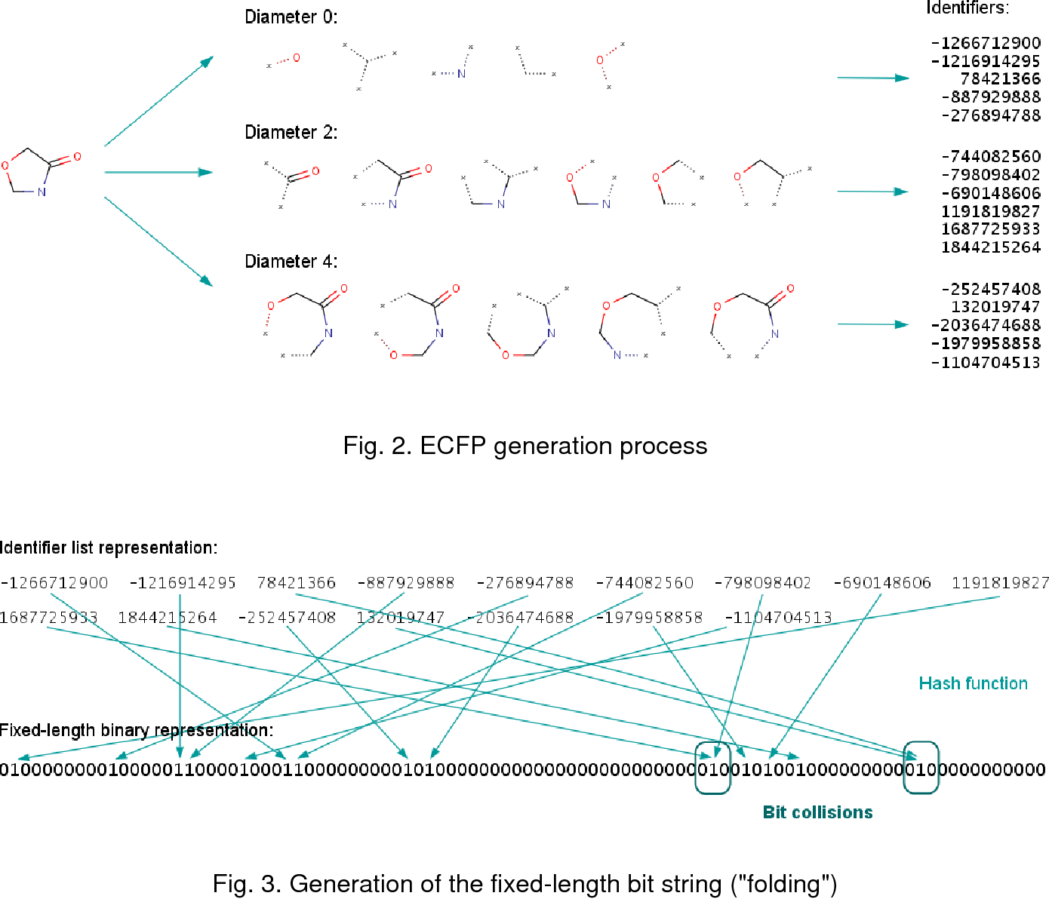
Chemical fingerprints
Define circular substructures
Hash the substructures
Fold the hashes into bit-vector

Slide 30
Chemical Language Models
Name | Num params | Laboratory | Year
ChemBERTa | 3.5M | Ramsudar Lab | 2020
Molformer-XL | 45M | IBM | 2022
Prot-T5-XL | 560M | RostLab | 2020
ProtGPT2 | 730M | Noelia Ferruz Lab (Barcelona) | 2022
ESM-2 | 8M, 35M, 150M, 650M, 3B y 15B | Meta | 2022
ESM-Fold | 3B (+ 690M) | Meta | 2022
ProstT5 | 560M (From Prot-T5-XL) | RostLab | 2023

