Slide 1
CyberFlow IDS Technical Presentation
Dr. Raul C. Gacusan | AIM Capstone | July 2026

Slide 2
Problem and Objective
Detect malicious network traffic with low false positives and low latency
Frame: binary classification for intrusion detection
Goal: reproducible training-to-deployment IDS workflow

Slide 3
Dataset and Data Quality
Dataset: CIC-IDS-2017 derivative traffic
Processed sample: 126,038 rows, 54 columns
Quality checks: null/infinity cleansing, duplicate scan, outlier profiling

Slide 4
Preprocessing Pipeline
Label remap: benign/normal -> 0, attack -> 1
Metadata exclusion and numeric-only feature projection
StandardScaler persisted for production parity

Slide 5
Feature Engineering and Selection
Leakage shield removes near-proxy features (|r| > 0.98)
Zero-variance feature filtering applied
Final model feature space: 51 numeric features

Slide 6
Model Tournament
Candidates: Decision Tree, Random Forest, XGBoost, Naive Bayes
Metrics: Accuracy, Precision, Recall, F1, Train Time
Champion selected by strongest F1 performance

Slide 7
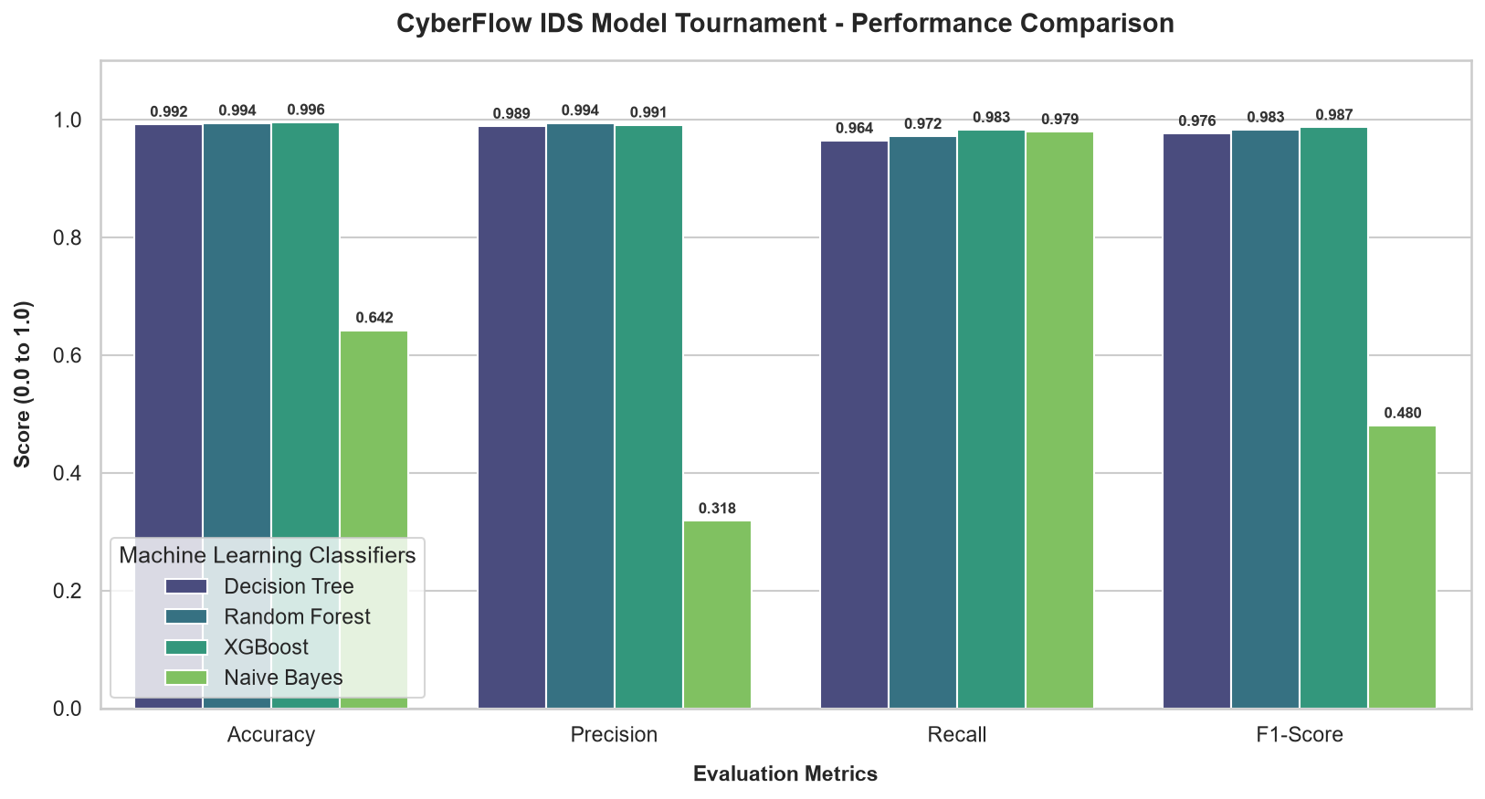
Model Comparison
Tournament metrics visualization from training run.

Slide 8
Champion Performance
XGBoost won tournament (F1 = 0.9868, Accuracy = 0.9956)
Artifacts saved: models/intrusion_detector.joblib, models/scaler.joblib
Inference validated through dashboard and replay simulation

Slide 9
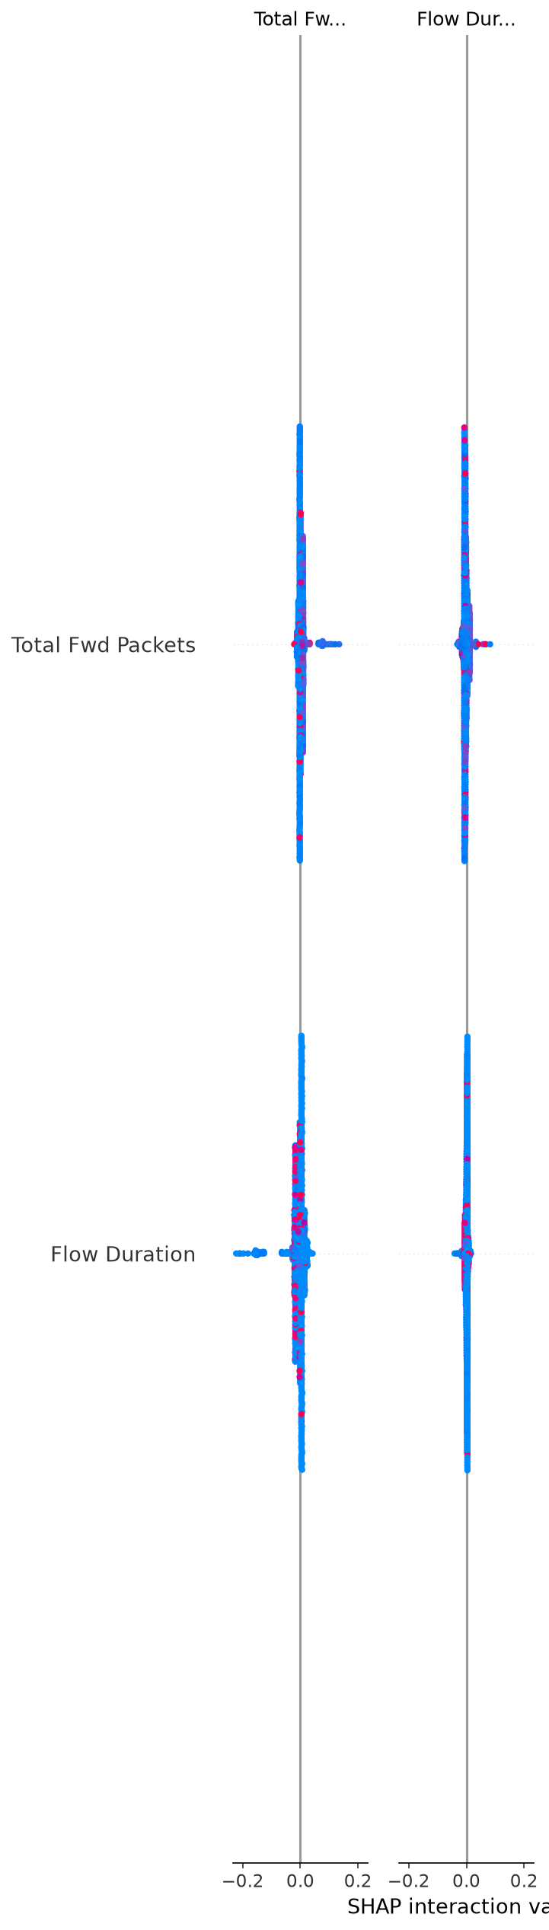
SHAP Explainability
Top feature contributions driving intrusion predictions.

Slide 10
Deployment and Reproducibility
Local FastAPI app implemented for serving predictions
GitHub public repo with release tag: v1.0-submission
Complete submission bundle with reports, code, and evidence

