Slide 1

Epic SIEGE
By: Eleazar Del Toro, Joselito Guardado, Huvence Guerrero, Raul Muniz
Team 6

Slide 2
Game development
Idea
Proposal
Design
Evaluation
Coding
Testing
Release

Slide 3
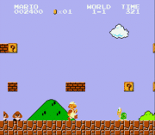
Idea
Our idea was to develop a platform game similar to the design of the famous classic “Super Mario” game.

Slide 4
Proposal: Epic SIEGE
The objective in Epic Siege is to make it across a map while avoiding obstacles and facing mighty warriors without being defeated. Finally, the game leads to an epic showdown with Epic Sieges’ final boss, one must defeat the boss in order to beat the game. Similar to the famous classic Super Mario Game.

Slide 5
Proposal continued
GOALS
Purpose & Innovation
Make it through the map area without being destroyed.
Destroy the final boss to win the game.
This game is designed to help other college students relax and serve as means to distract themselves temporarily during difficult situations. It is an original game that will provide all college students and players with fun and exciting way to take their mind off their troubles simply by playing this game on their phones...

Slide 6
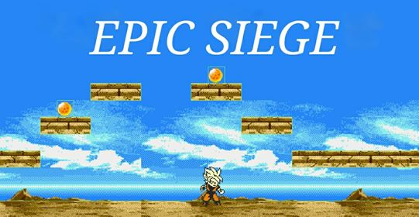
Design
Our Hero character must avoid obstacles and collect the magical dragon balls in order to summon the almighty Dr. Kim to receive an A.

Slide 7

Evaluation: libgdx
Libgdx is a cross-platform game and visualization development framework. It currently supports Windows, Linux, Mac OS X, Android, Blackberry, iOS, and HTML5 as target platforms.
Libgdx allows you to write your code once and deploy it to multiple platforms without modification. You can use all the tools of the Java ecosystem to be as productive as you can be.

Slide 8

Evaluation: gradle
Gradle is a build tool with a focus on build automation and support for multi-language development. If you are building, testing, publishing, and deploying software on any platform, Gradle offers a flexible model that can support the entire development lifecycle from compiling and packaging code to publishing web sites. Gradle has been designed to support build automation across multiple languages and platforms including Java, Scala, Android, C/C++, and Groovy, and is closely integrated with development tools and continuous integration servers including Eclipse, IntelliJ, and Jenkins.

Slide 9
Coding: Assets
Details about assets folder here

Slide 10
Coding: Core
Scenes
screens

Slide 11
Coding: Core continued
sprites
tools

Slide 12
Coding: Core continued
Mygdxgame.java
Info on how main file works

Slide 13
Coding: desktop
Info on desktop launcher

Slide 14






Coding: heroes

Slide 15
Testing
Our observations, problems, debugging, etc.

Slide 16
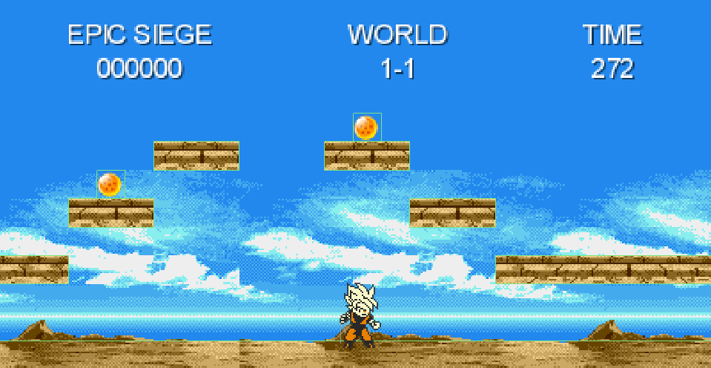
Release

