Slide 1

Android Repackaging Attack Lab
By Sebastian Medina & Owen Bartels

Slide 2
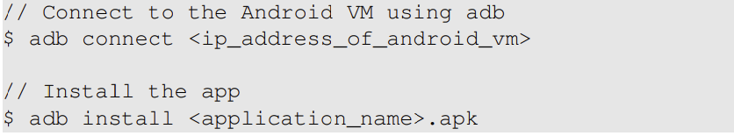
Obtaining an Android App
First step is to obtain a host app also know as a APK file. (Most of the time these are popular apps)
Uses adb (Android Debug Bridge) tool to connect Ubuntu VM with the Android VM.

Slide 3
Disassemble Android App
To do the attack you need to modify the app
Can directly change the APK file but not the easiest way because the code contains Dalvik byte code, witch we can not read
Use apktool to disassemble dex code to smali code.
Use apktool d [appname].apk to decode the Android app.

Slide 4
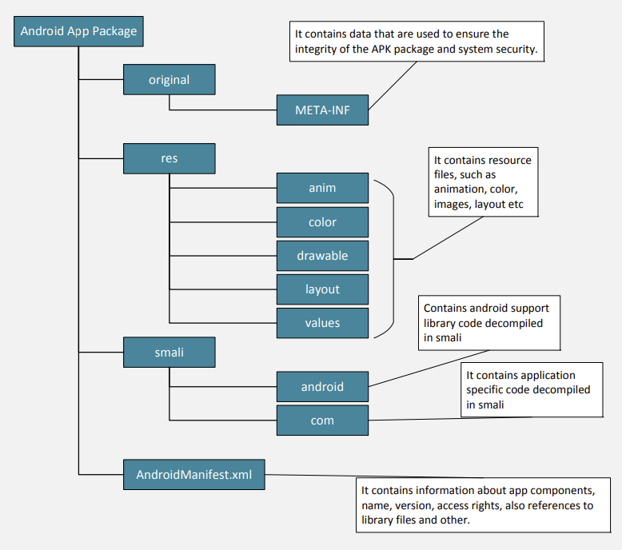

Slide 5
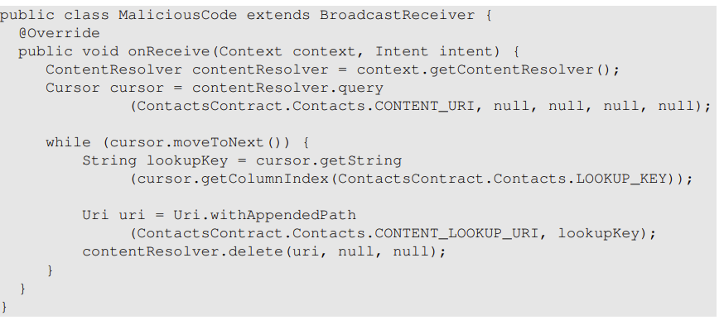
Inject Malicious Code
Now we need to inject malicious code into the target app’s smali code.
Two ways to do this you can modify some existing smali file, or add a new component/ smali file to the app.
The second options is easier because it does not affect the apps behavior at all.

Slide 6
Tell system when to invoke our broad cast receiver
Now they we have put our smali code in the app we have to modify the XML file.
We have to modify the XML in order to give our smali code permissions to do what it needs to.
Also tell the app where our smali code is and when to execute it.

Slide 7
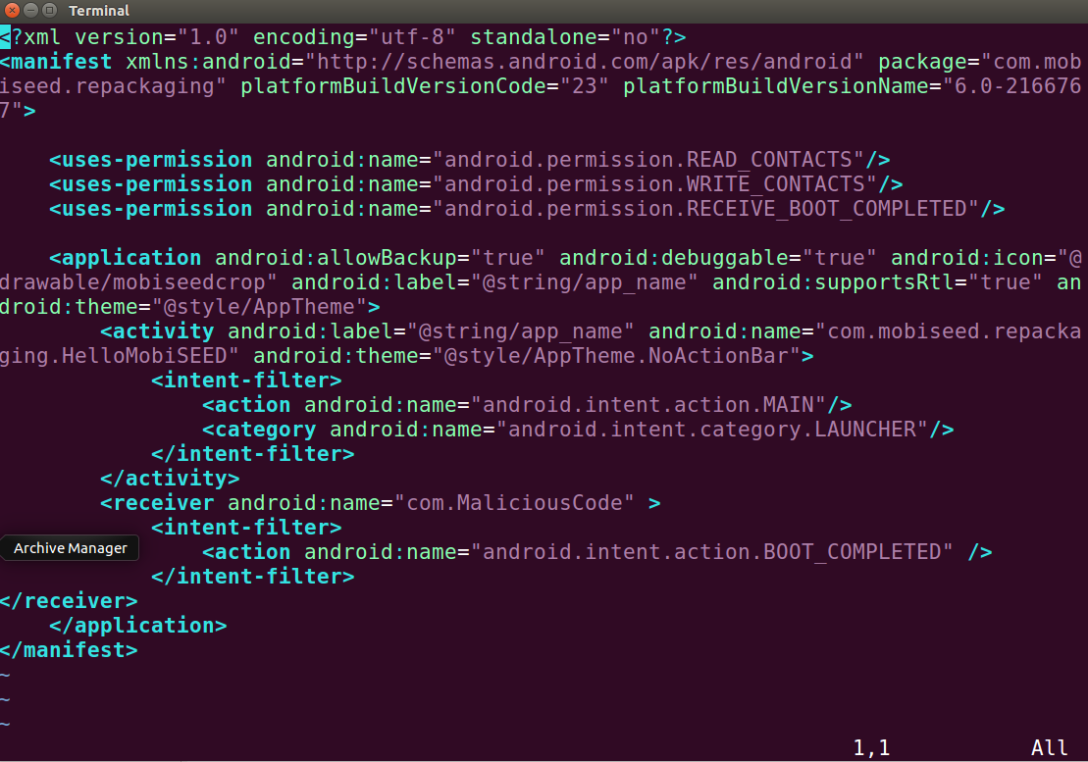

Slide 8
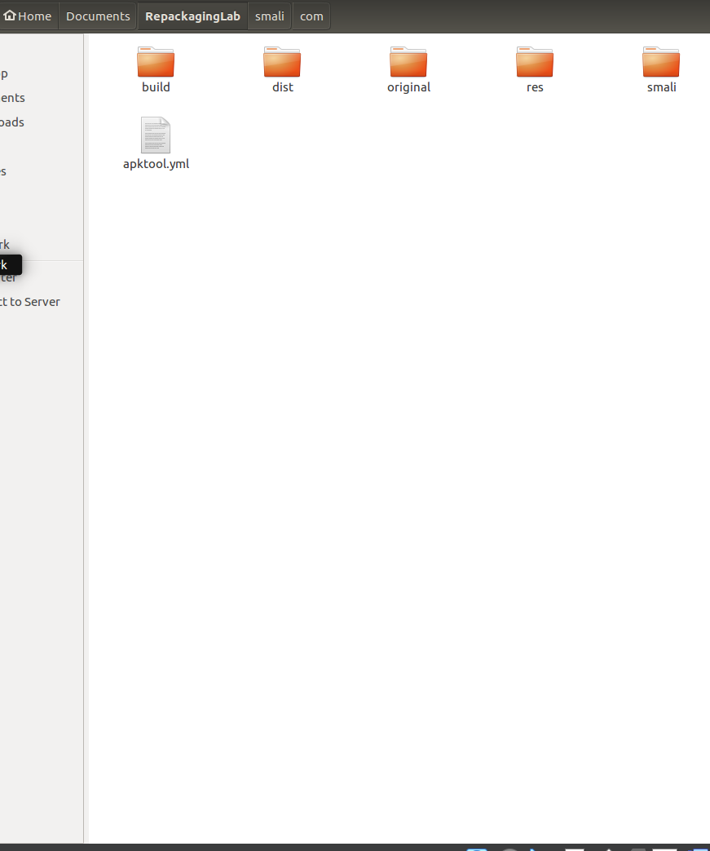
Repack Android App with Changes
Now that all changes are made we have to now make a new apk file (the app) with all our new changes.
To do this you would use apktool b [application_folder]
Once made it is put into a new directory inside the dissemble app folder called dist.

Slide 9
Sign the APK file
Android requires all apps to be digitally signed before they can be installed.
For security reason apps need to be signed by a certificate authority.
However you can sign the app your self so signing your apps has no become more of a way to see if it is creatable or not.

Slide 10
Signing instructions and installation
The first command to sign your app is $ keytool -alias -genkey -v -keystore mykey.keystore
This creates a public/private key pair and stores it in a keystore file like mykey.keystore.
The second command to sign your app is $ jarsigner -keystore mykey.keystore app_name.apk
No this command actual sign’s the APK file using the key created from the previous step.
Lastly you install the app to the android VM with the command adb install [android_app].apk and then complete the task that will trigger the attack on the android machine

Slide 11
Questions?

