Slide 1

From Strings to Blocks: Mastering Ruby’s Core Concepts
By Sebastian Medina

Slide 2
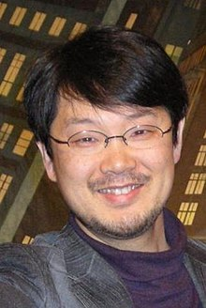
Introduction to Ruby
Created in 1995 by Yukihiro Matsumoto (Matz)
Early development started in the early 1990’s in Japan
Yukihiro Matsumoto wanted to create a language that is more object-oriented
Yukihiro M. also wanted a language to be simple and productive.
Combines Perl, Smalltalk, and Scheme making a simple and powerful syntax
From Ruby came the Ruby on Rails Framework

Slide 3
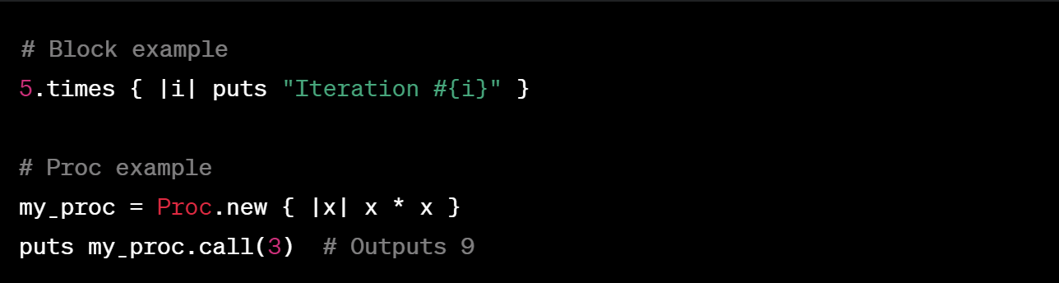
Syntax and Language Features
The language is made to be simple and productive.
Clean and readable but still concise syntax that is like natural language.
List of Features:
- Dynamic Typing: variable types are determined at runtime
- Object-Oriented Nature: Everything is an object even classes
- Ruby has Blocks and Procs (procedures)
- Has Strings, Conditional Statements, and Classes
- Method Chaining: Call multiple methods

Slide 4
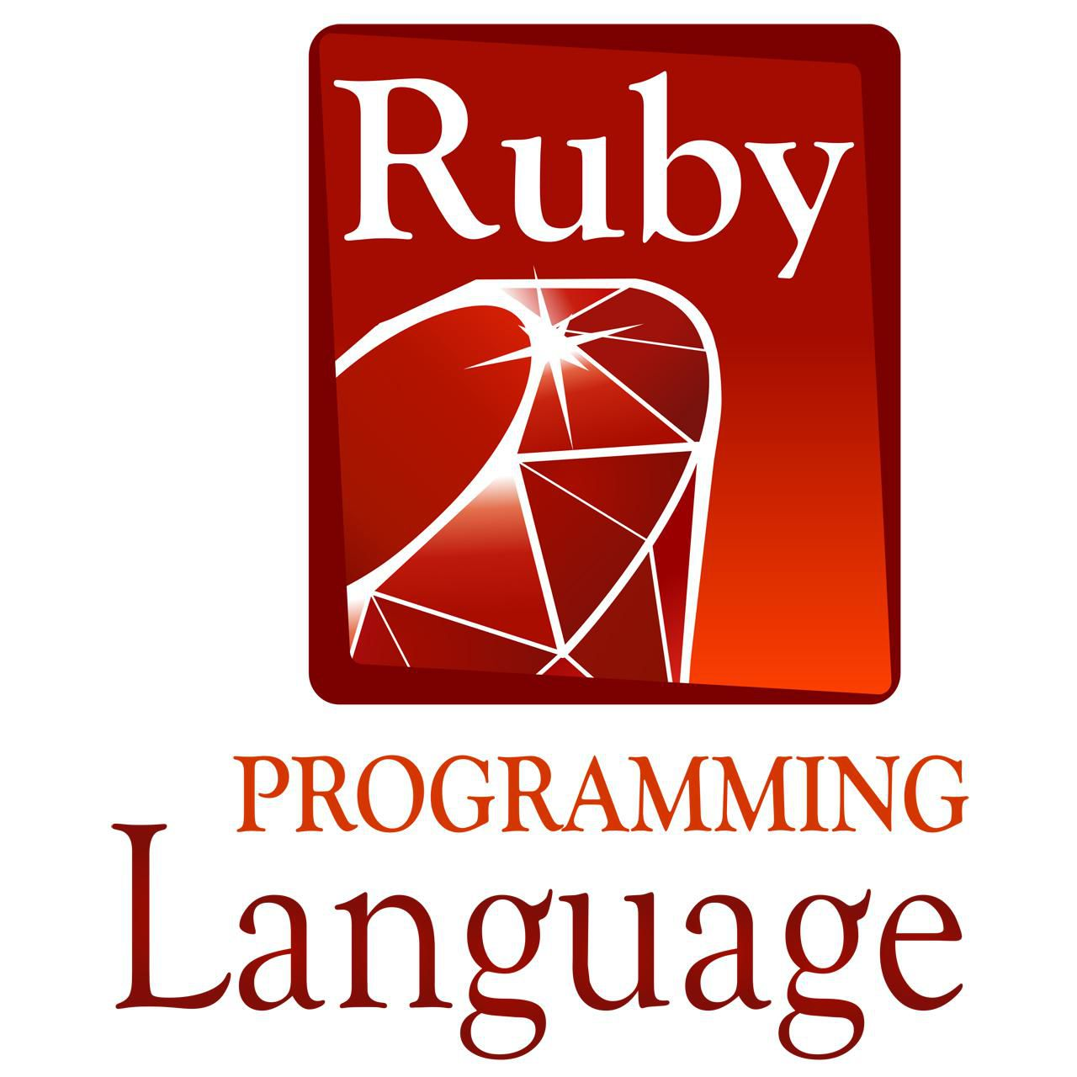
What so Special
Yukihiro Matsumoto emphasized the importance of making programmers happy.
Allows for variable types to be determined at runtime allowing more concise code.
Uses duck typing allowing objects to be used on their behavior.
Everything is an Object which promotes consistency and metaprogramming
Using Blocks, Procs and Lambdas allows for functional programming within an (OOL).
Gems
Ruby on Rails (Rails) for web development
Cross-Platform
Clean API Design in order to keep good readable and maintainable

Slide 5
Ruby Gems
Gem is a packaged and shareable library or application.
They are used to make it easy for developers to share and use reusable code.
Gems allow developers to package their code in a modular and reusable form.
Ruby Gems are distributed through RubyGems website.
Can specify dependencies of other gems.
Install though a command-line tool
Gems carry metadata about gem, code, and other directories for test docs, and assets
Gemfile specity the gems dependencies and Bundler manages the dependencies

Slide 6

Ruby on Rails (Rails)
Created by David Hansson and first released in 2005 but brought up in 2000.
This is a web application framework written in Ruby.
Has Model-View-Controller (MVC) which separates an application into three parts.
Has Convention over Configuration (CoC) which allow developers to not require detail of a app
Has Don’t Repeat Yourself (DRY) eliminates redundancy in code. Streamline common task.
Object-Relational Mappin called active record allows interact with a database.
RESTful Routes called Representational State Transfer (Rest). Map HTTP methods to controller actions.

Slide 7



Real Life Examples
To make desktop applications
Static Websites
Data Processing services
GitHub
Airbnb
Groupon
Shopify
Hulu

Slide 8
Conclusion
Ruby is simple easy to understand and read but still is concise with its code.
Used in many applications and websites we know today
Ruby is unique because of gems and Ruby on Rails.
Ruby is fun easy and can expand your knowledges about other languages.
Questions?

Slide 9
Works Cited
Camperbot, and kevcomedia Closed. “The History of Ruby - the Friendly Programming Language.” The freeCodeCamp Forum, 3 Sept. 2019, forum.freecodecamp.org/t/the-history-of-ruby-the-friendly-programming-language/19141.
Consulting, MyTaskPanel. “Programming Language Ruby: Features and Utilities.” LinkedIn, 20 Sept. 2023, www.linkedin.com/pulse/programming-language-ruby-features-utilities-mytaskpanel-consulting/.
Maiorana, Christopher. “Special Features of the Ruby Programming Language.” InMotion Hosting Support Center, 29 Nov. 2023, www.inmotionhosting.com/support/website/special-features-ruby-programming-language/.
Miller, Stephan. “What Is Ruby on Rails?” Codecademy Blog, 15 Sept. 2021, www.codecademy.com/resources/blog/what-is-ruby-on-rails/.
Team, Altcademy. “What Are Gems in Ruby?” Altcademy Blog, Altcademy Blog, 28 Apr. 2023, www.altcademy.com/blog/what-are-gems-in-ruby/#:~:text=Gems%20are%20packages%20of%20code,or%20perform%20tasks%20more%20easily.

