Slide 1
BUS 9430 · CAPSTONE 3 · BACKUP SLIDES FOR QUESTIONS
Tomorrow's Sun,
Today's Plan
Detail behind the numbers, for the question period
Team Solar Foresight
Team: Carolina Lenes Arreola, Juan David Jaimes, Mohammad Mahmud, Vince Lanzillo and Raúl J. Solá Navarro
December 14, 2026
Notes:
Backup slides. Use only if asked. Slide 2: three ordinary days. 3: error by month. 4: practice runs against test. 5: why CAISO adjusted is not a fair yardstick. 6: the 20 inputs. 7: what the 10 a.m. rule costs. 8: backup power in detail. 9: what the dollar figure means. 10: how we kept the test honest. 11: limits and open items. 12: sources.

Slide 2
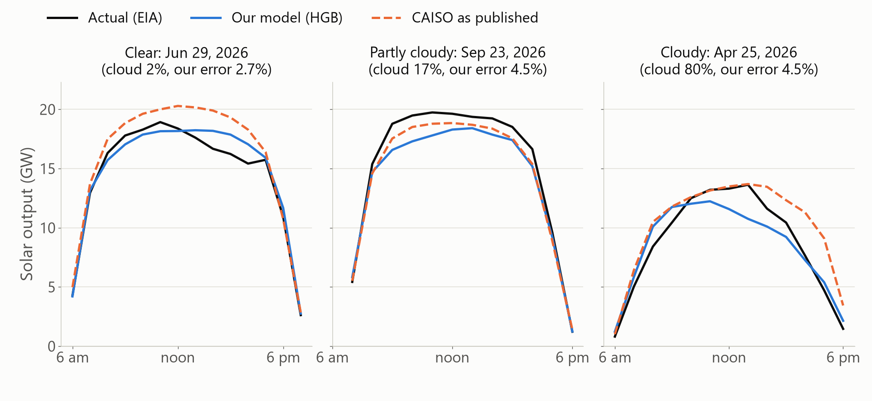
BACKUP: WHAT A FORECAST DAY LOOKS LIKE
Three ordinary test days, forecast against actual
Each day is the median-error day in its cloud group, chosen by rule, not by hand. Our error that day: 2.7%, 4.5%, 4.5%. Solar output is in gigawatts (GW).
Median-error day among test days in each group of average day-2 cloud forecast (0 to 10, 10 to 60, above 60%). Pacific time. Actual: EIA hourly solar, CISO.
Notes:
These are not our best or worst days. We picked the median-error day in each cloud group by a written rule. On the clear day our line sits a little under the actual peak and CAISO's sits above it. On the partly cloudy day both forecasts sit under the actual. On the cloudy day we fall below the afternoon output and CAISO stays above it.

Slide 3
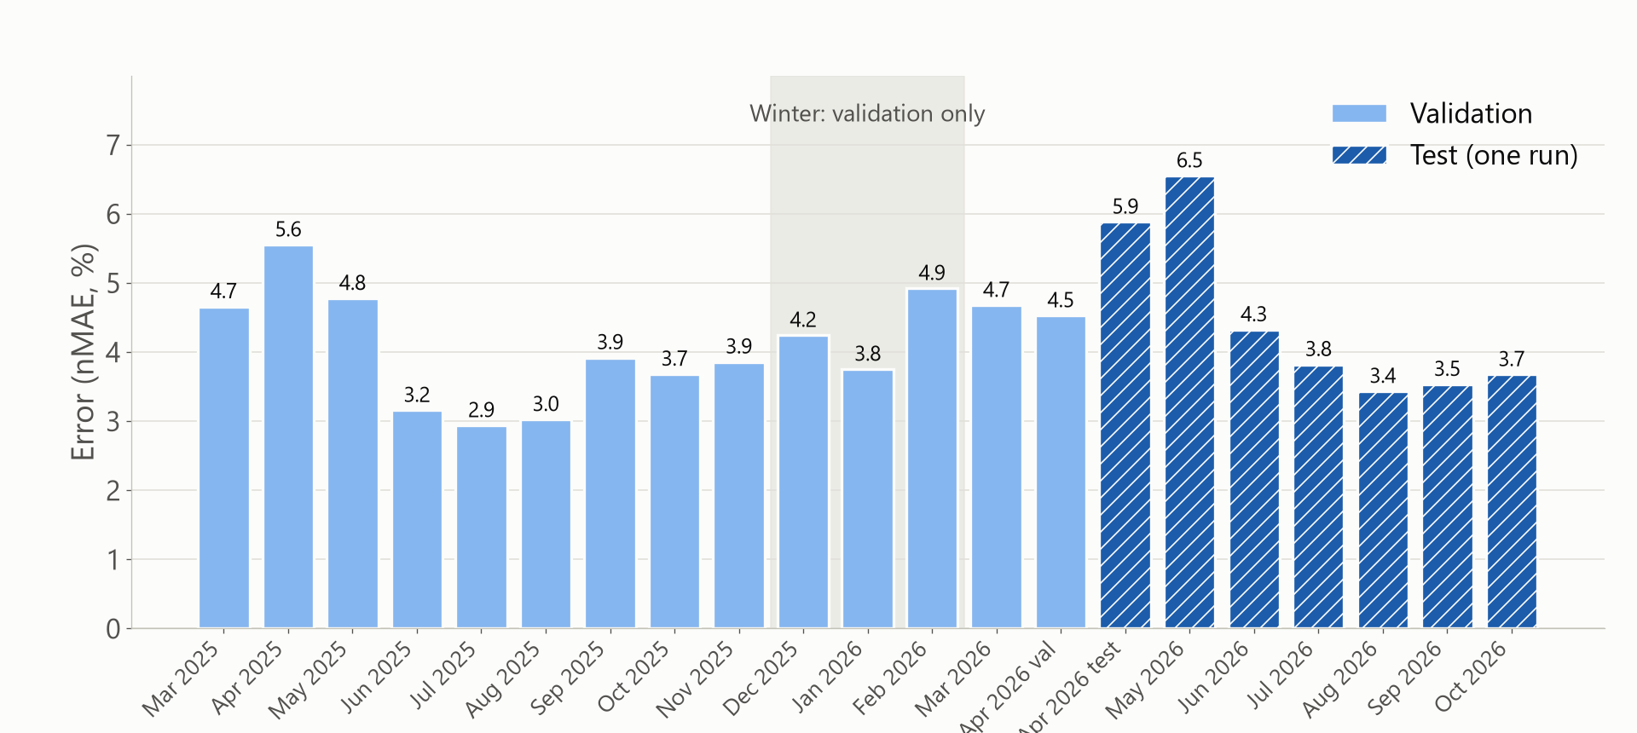
BACKUP: ERROR BY MONTH
Our error by month: the test run has no winter
Winter months (Dec 4.2%, Jan 3.8%, Feb 4.9%) appear only in the practice runs. On the test, April and May 2026 were our worst months: 5.9% and 6.5%.
Light bars: validation (practice runs on earlier time blocks). Hatched dark bars: the one test run. April 2026 is split at the test start (Apr 10). Validation spans Mar 2025 to Apr 9, 2026.
Notes:
April and May 2026 were hardest, because far more solar was turned down than a year before. Winter was never in the test, so we only have the practice runs for it.

Slide 4
BACKUP: PRACTICE RUNS AGAINST THE TEST
Our error rose from 4.0% to 4.4%, mostly in spring
MEASURE | PRACTICE RUNS | TEST
Our error | 4.02% | 4.43%
CAISO as published | 4.51% | 5.85%
Same as 2 days ago | 6.60% | 7.27%
Our error in spring | 4.95% | 6.34%
Our average miss (forecast minus actual) | -186 MW | +494 MW
Why: April and May 2026 had 24.0% and 20.7% of solar turned down, against 13.2% and 6.6% a year earlier. The model learned from earlier, lower turn-down levels, so on the test it forecast too high.
Practice runs: 4,508 hours on 374 days. Test: 2,457 hours on 187 days. Source: reports/test_vs_validation.csv, FAQ Decision D31. 141 of 231 comparisons moved by more than 0.5 points.
Notes:
The pooled error moved by 0.41 points, under our 0.5 flag, but many groups moved more. The main reason is spring 2026 turned-down solar. CAISO's published forecast was hit harder, because it forecasts before turn-downs. We have not proven the turn-down explanation, so we present it as our reading.

Slide 5
BACKUP: CAISO ADJUSTED
Why the adjusted CAISO score is not a fair yardstick
WHAT WE CHECKED
Turn-downs match CAISO's own over-forecast
CAISO measures turned-down solar against its own forecast. In hours with large turn-downs, the two numbers add up to 104%, correlation 0.89.
WHAT IT MEANS
Adding it back removes most of CAISO's error
In the 777 heaviest hours, CAISO's error is 11.75% as published and 2.77% adjusted. So the adjusted score is low partly by construction.
So our headline comparison is CAISO as published, and we show adjusted as a second line. On the test, adjusted is 3.54%.
Checked on the 4,508 validation hours (FAQ Decision D27).
Notes:
CAISO defines curtailment against its own forecast. When we add curtailed energy back to actual output, we are mostly adding back CAISO's own over-forecast. That is why we treat adjusted as a second line.

Slide 6
BACKUP: HOW THE MODEL WORKS
20 inputs, all known at 10 a.m.
WEATHER FORECAST, 2 DAYS BEFORE (10)
Day-2 forecasts of cloud cover, sunshine, temperature, humidity, wind and rain, plus a cloud index against a clear sky.
TIME AND SUN (7)
Hour of day, hour and day of year as smooth curves, sun height, clear-sky sunshine.
SIZE AND RECENT OUTPUT (3)
Installed capacity that month, output 2 days earlier, average output on the day 2 days earlier.
Left out on purpose: output from 1 day earlier, CAISO's forecast, and day-1 weather, because they arrive after the 10 a.m. bid close.
FAQ Decision D28. Two assumptions are not verified: the 2-day-old weather forecast is available by 10 a.m., and EIA's values from 2 days earlier are published by then.
Notes:
The model is a tree model, many small decision trees, each fixing the mistakes of the one before. All 20 inputs are known at 10 a.m. We left out anything that arrives later.

Slide 7
BACKUP: THE 10 A.M. RULE
Respecting the 10 a.m. rule costs about 0.15 points
WITH THE RULE (WHAT A REAL BIDDER COULD DO)
4.02% error
2-day-old weather forecast and output from 2 days earlier.
WITHOUT IT (COMPARISON ONLY)
3.87% error
1-day-old weather forecast. Better, but available too late to use in a bid.
The rule is a small price, and it keeps the score honest.
Practice runs, 4,508 hours (FAQ Decisions D28, D30).
Notes:
Using the day-1 weather forecast would improve us by 0.15 points on the practice runs, but it is published too late for a bid.

Slide 8
BACKUP: BACKUP POWER IN DETAIL
How much backup, for how many hours
FORECAST | 90 OF 100 HOURS | 95 OF 100 HOURS | 99 OF 100 HOURS
Our model | 2,650 MW | 3,630 MW | 5,740 MW
Same as 2 days ago | 3,230 MW | 4,790 MW | 8,470 MW
CAISO as published | 4,260 MW | 5,890 MW | 8,290 MW
Our model by season at 95 of 100 hours: spring 4,150 MW, summer 3,250 MW, fall 2,840 MW. The 99 figure rests on about 25 hours.
MW for today's fleet: share of capacity times EIA 860M nameplate Sep 2026, all CISO, 26,034.5 MW. Hours when solar was turned down count as shortfalls, so CAISO's figures are overstated most (spring alone: 7,770 MW).
Notes:
Backup power here is the over-forecast we would have had to cover, at three coverage levels. It counts every hour where actual output came in below the forecast, including hours when solar was turned down.

Slide 9
BACKUP: WHAT THE DOLLAR FIGURE MEANS
About $120 million a year: a size, not a savings promise
STEP 1
2.83 points
Error gap between the same-as-2-days-ago guess (7.27%) and our model (4.43%).
STEP 2
3.0 TWh a year
One point of error is about 1.06 TWh a year (Capstone 2 numbers). 2.83 times 1.06.
STEP 3
About $122 million
At $41 per MWh, CAISO's 2024 average day-ahead price. 2.83 times $43 million a point.
It sizes the problem. It does not say how much money a grid operator would save, and we do not compute a dollar figure against CAISO's own forecast.
Source: Capstone 2 numbers file (deck/capstone2/CAPSTONE2_NUMBERS.md) and reports/reserve_test.csv.
Notes:
The dollar figure is a size of the problem. From our Capstone 2 numbers, one point of error is about 1.06 terawatt-hours a year. At 41 dollars a megawatt-hour, that is about 43 million dollars a point.

Slide 10
BACKUP: KEEPING THE TEST HONEST
We saved the rules first, then ran the test once
BEFORE
Model and rules frozen
Model settings, 20 inputs and five questions with pass rules, committed before the run (commit c242a1c).
DURING
One run
The script only reads test rows with an explicit flag, and it is meant to run once.
AFTER
Report what came out
Four questions supported, one partly. The miss of 0.005 points stays a miss.
Files: reports/final_model_spec.md, reports/hypotheses.md, src/modeling/final_test.py (team repository).
Notes:
If someone asks whether we tuned to the test: we did not. The model and the pass rules were saved and committed before any test row was read, and the script needs an explicit flag to touch test rows.

Slide 11
BACKUP: LIMITS AND OPEN ITEMS
What we have not checked or cannot show
No winter in the test. Winter was checked only in practice runs.
2.6 years of history. Each month appears 2 or 3 times.
Two timing assumptions. The 2-day-old weather forecast is available by 10 a.m., and EIA's values from 2 days earlier are published by then. Neither is verified.
One capacity source. Errors are shares of EIA 860M nameplate, all CISO, and we name it next to every MW figure.
Turned-down solar is a rough series. It is above zero in 94% of hours, probably because CAISO defines it against its own forecast.
Forecast high on test. Bias +494 MW, cause only partly understood.
FAQ open items and Decision D31 (team repository).
Notes:
These are the limits we know about. We would rather list them than have them found.

Slide 12
BACKUP: SOURCES
Sources and where to find everything
Solar output and capacity: U.S. Energy Information Administration (hourly grid monitor, Form 860M).
Benchmark forecast and turn-downs: CAISO OASIS and CAISO curtailment reports.
Weather forecasts: Weather data by Open-Meteo.com (CC BY 4.0).
Dollar price: CAISO 2024 average day-ahead price, $41 per MWh.
Code, numbers and decisions: team repository, README "Start here", deck/capstone3/CAPSTONE3_NUMBERS.md and docs/DATA_FAQ.md (Decisions D27 to D31).
Team Solar Foresight · BUS 9430 · December 14, 2026
Notes:
Every number on the slides has a source in the Capstone 3 numbers file.

