Slide 1
BUS 9430 · CAPSTONE 3 · MODELS AND RESULTS
Tomorrow's Sun,
Today's Plan
What we built, how well it works, and what it means
Team Solar Foresight
Team: Carolina Lenes Arreola, Juan David Jaimes, Mohammad Mahmud, Vince Lanzillo and Raúl J. Solá Navarro
December 14, 2026
Notes:
[RAUL, slides 1 to 2. Finish by 1:10] Good morning. We are Team Solar Foresight. Last time we showed our data. Today we show what we built, how well it works, and what it means for the grid.

Slide 2
THE PROBLEM AND FIVE QUESTIONS
Guessing tomorrow's solar power, and five questions we tested
TARGET VARIABLE
Solar power for each hour of tomorrow
In megawatts (MW), for the whole CAISO grid.
1
Does the weather forecast help?
2
Can free public data get close to CAISO's own forecast?
3
Does a flexible model beat a straight-line one?
THE RULE
Only what we know at 10 a.m.
CAISO's bids close at 10 a.m. Pacific, the day before.
4
Do clouds make forecasts worse?
5
Does a better forecast mean less backup power?
We wrote the five questions and how we would judge them before we looked at the final test.
Notes:
California's grid operator, CAISO, makes tomorrow's power plan today, before 10 a.m. Solar is the hardest part to get right, because it depends on the weather. We forecast solar power for each hour of tomorrow, in megawatts, using only what is known at 10 a.m. [click] We turned that into five questions we could test, and we wrote them down before we looked at the final results. Does the weather forecast help? Can free public data get close to CAISO's own forecast? Does a flexible model beat a straight-line one? Do clouds make forecasts worse? And does a better forecast mean less backup power? [Hand off] Carolina will show how we tested them.

Slide 3
MODELING APPROACH
How we tested it, fairly
1
2
3
4
One table
The data from Capstone 2. 22,896 hourly rows: weather forecasts, solar output, installed capacity.
Five forecasts
Scored on the same hours. Same as 2 days ago. CAISO's own. A monthly average day. A straight-line model. Our tree model.
Learn from the past
Earlier days only. Models learn from earlier days and are checked on four time-ordered blocks, never on days they trained on.
Lock, then test once
Last 191 days, Apr 10 to Oct 17. Settings and questions saved first. The test ran once. We report whatever came out.
Our model is a tree model: many small decision trees, each fixing the mistakes of the one before. It reads 20 inputs, all known at 10 a.m.: the 2-day-old weather forecast, time of day and season, sun height, installed capacity, and output from 2 days earlier.
Notes:
We tested fairly. [click] One table: the 22,896 hours we prepared for Capstone 2. [click] Five forecasts, all scored on the same hours: same as two days ago, CAISO's own, a monthly average day, a straight-line model, and our tree model. A tree model is many small decision trees, each fixing the mistakes of the one before. It reads 20 inputs, all known at 10 a.m. [click] Models learn only from earlier days, and we checked them on four time-ordered blocks. [click] Then we locked the test. The settings and the five questions were saved before we touched the last 191 days, and we ran that test once. Whatever came out is what we report. [Hand off] Juan David will show the scores.

Slide 4
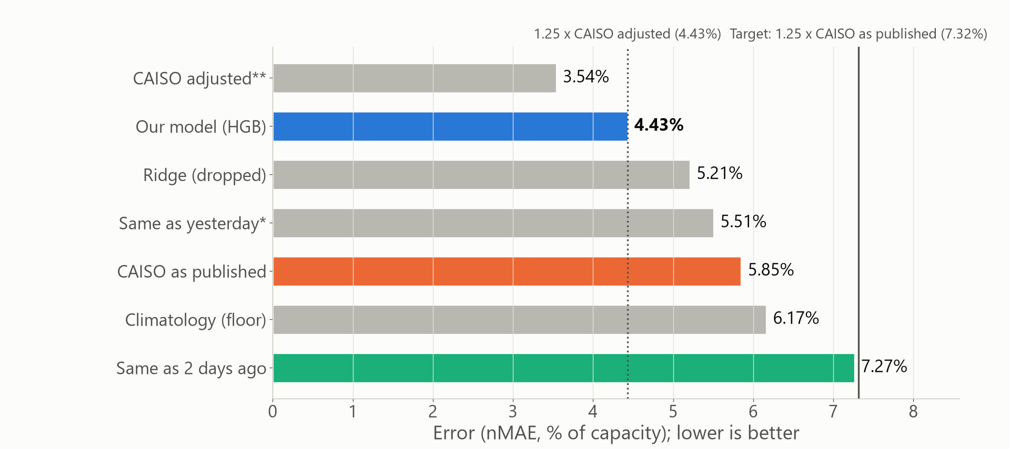
RESULTS: THE SCOREBOARD
Our error is 4.4%, inside the 7.3% limit we set
Error is the average miss as a share of installed solar. Ours 4.43%, CAISO as published 5.85%, same as 2 days ago 7.27%. Some of CAISO's miss is solar turned down later. Adjusted, CAISO scores 3.54%, just under us.
Test set: 2,457 daylight hours, Apr 10 to Oct 17, 2026. Error = mean absolute error as a share of installed solar (EIA 860M capacity). * Same as yesterday uses output from after the 10 a.m. bid close, so no bidder could use it. ** CAISO adjusted is partly circular (see backup).
Notes:
[JUAN DAVID, slides 4 to 5. Finish by 3:25] This is the scoreboard. Error here is the average miss as a share of installed solar, so lower is better. [click] The simple guess, same as two days ago, misses by 7.3 percent. CAISO's published forecast misses by 5.9. Ours misses by 4.4. Our limit was 1.25 times CAISO's published error, which is 7.3 percent, and we are well inside it. One caution. Part of CAISO's miss is solar that was turned down after its forecast, so this is not a fair fight with CAISO. Adjusted for that, CAISO scores 3.5, just under us.

Slide 5
RESULTS: THE FIVE QUESTIONS
Five questions, five answers
OUR QUESTION | WHAT WE FOUND | VERDICT
1. Does the weather forecast help? | Our skill score is 0.40: our errors are 40% lower than the simple guess. We needed 0.30. | Supported
2. Close to CAISO's own forecast? | Limit of 7.32% against CAISO as published: met at 4.43%. Against the adjusted limit (4.4294%) we are at 4.4348%: missed by 0.005 points, and we report it as a miss. | Partly supported
3. Flexible beats straight line? | 4.43% for the tree model, 5.21% for the straight-line model. | Supported
4. Do clouds hurt? | 5.9% error when very cloudy, 3.8% when clear. | Supported
5. Less backup power? | At the 95 of 100 hours level, 23% less than the simple guess. In practice runs it was 51%. | Supported
Questions and pass rules were saved before the test run (commit c242a1c). A "not supported" verdict would have stayed as it was.
Notes:
[click] Here are the five questions and the answers. Yes, the weather helps: our skill score is 0.40, meaning our errors are 40 percent lower than the simple guess, and we needed 30. Mostly yes on CAISO: we meet the main target. We miss the stricter adjusted one by five thousandths of a point, and we report it as a miss. Yes, trees beat the straight line. Yes, clouds hurt. And yes, less backup power, though the gain on the test was smaller than in our practice runs. [Hand off] Mohammad will show where it works and where it struggles.

Slide 6
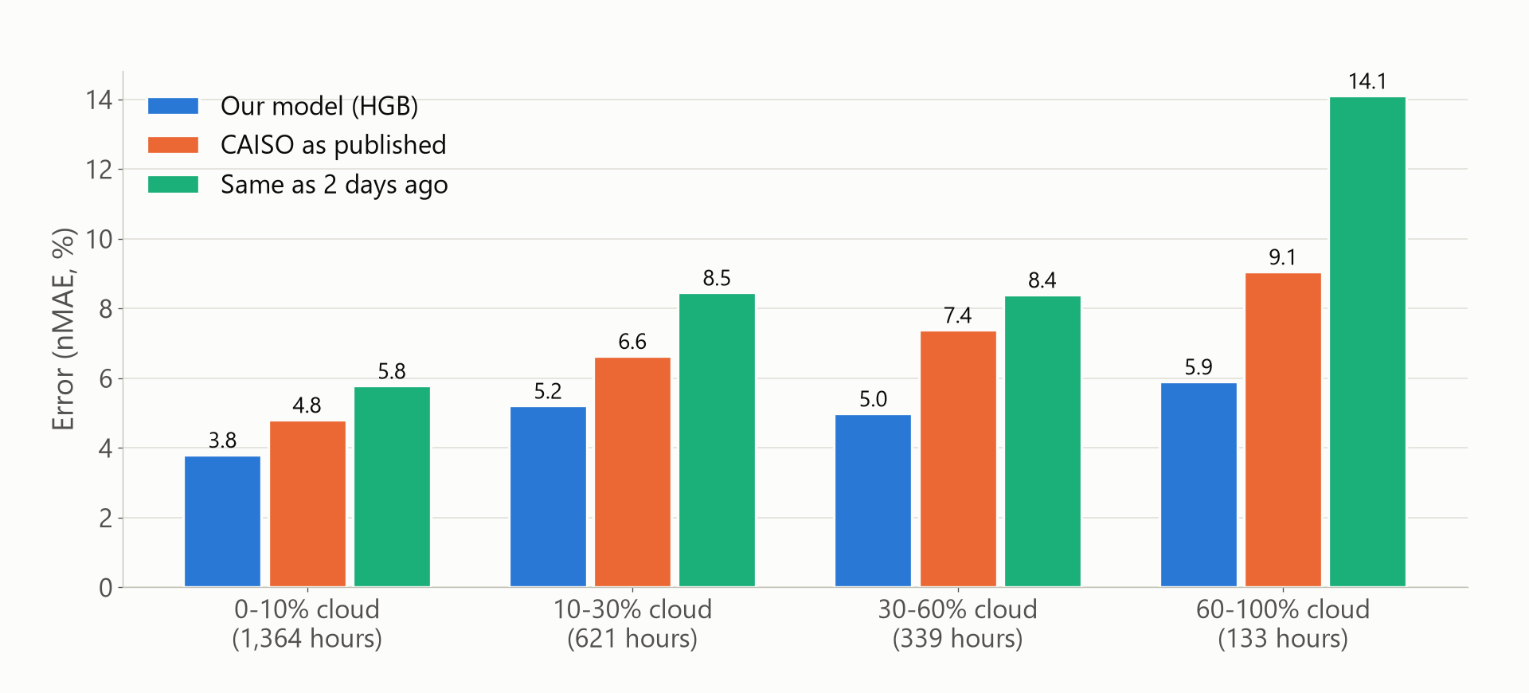
RESULTS: WHERE THE ERROR LIVES
Clouds hurt every forecast. Ours holds up best.
From clear to very cloudy, our error rises 2.1 points, CAISO's 4.3, the simple guess 8.3. Only 133 test hours were very cloudy, so treat the last group with care.
Error by the day-2 cloud forecast for each hour (known before the bid, not the observed sky). Daylight test hours, Apr 10 to Oct 17, 2026. Hours per group are under each label.
Notes:
[MOHAMMAD, slide 6. Finish by 4:20] Clouds are where forecasts struggle. We grouped hours by how cloudy the forecast said it would be. [click] On clear hours, our error is 3.8 percent. On very cloudy hours, 5.9. The simple guess goes from 5.8 to 14.1, and CAISO from 4.8 to 9.1. So clouds hurt everyone, and our forecast holds up best. Only 133 test hours were very cloudy, so treat that last group with care. In the backup slides you can see three ordinary days, clear, partly cloudy and cloudy, with our forecast next to what the sun delivered. [Hand off] Vince will show what this means for the grid.

Slide 7
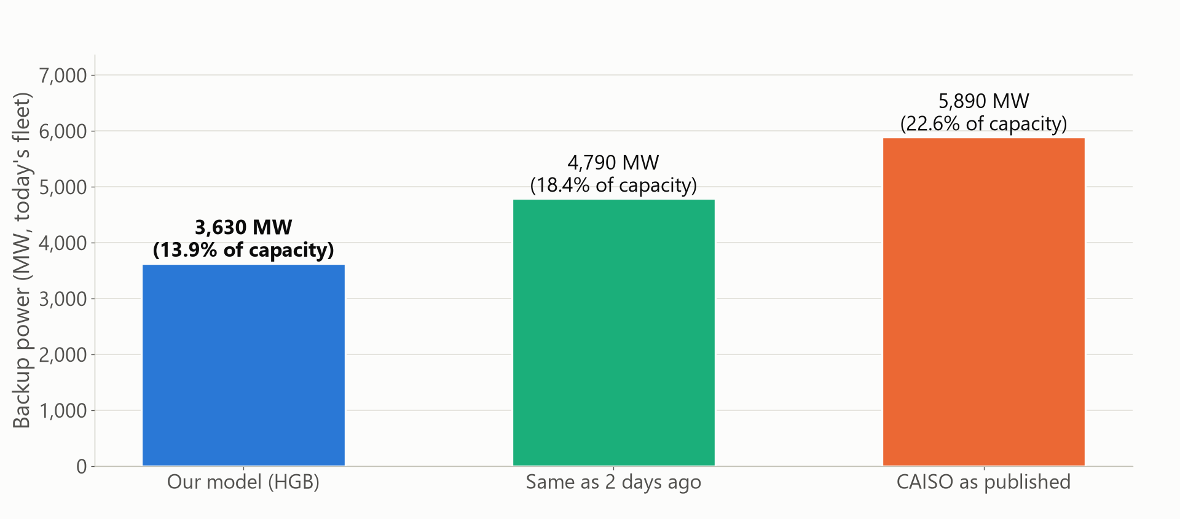
WHAT IT MEANS FOR THE GRID
A smaller error means less backup power to hold
To be covered in 95 of 100 daylight hours: about 3,630 MW of backup with our forecast, 4,790 MW with the simple guess. The error gap is worth about 3 TWh and $120 million a year: a size, not a savings promise.
Today's fleet: EIA 860M nameplate Sep 2026, all CISO, 26,034.5 MW. Hours when solar was turned down count as shortfalls here, which overstates CAISO's bar most. Price: $41 per MWh, CAISO 2024 average day-ahead.
Notes:
[VINCE, slide 7. Finish by 5:10] What does a smaller error mean? Backup power. [click] If a grid operator wanted to be covered in 95 of 100 daylight hours, with our forecast it would hold about 3,630 megawatts of backup. With the simple guess, 4,790. CAISO's bar is higher, 5,890, but that bar is overstated, because it counts hours when solar was turned down and nobody needed backup. For scale, the gap between our forecast and the simple guess is about 3 terawatt-hours a year, around 120 million dollars at CAISO's average day-ahead price. That is the size of the problem, not a savings promise. [Hand off] Raul will close with limits and next steps.

Slide 8
LIMITS AND NEXT STEPS
What we learned, where it stops, what to do next
WHAT WE LEARNED
Free data gets close to the pros
A simple model on public data comes close to CAISO's own forecast and holds up best when it is cloudy.
LIMITS
Spring and summer only
The test has no winter. Spring 2026 had far more turned-down solar than spring 2025, so we forecast about 500 MW too high on average. History is 2.6 years.
WHAT WE RECOMMEND
Refit often, use as a second opinion
Refit every month, watch turned-down solar, use it next to CAISO's forecast, and add winter data as it arrives.
Winter was checked only in practice runs (Dec to Feb error 3.8% to 4.9%). Sources: EIA, CAISO, Open-Meteo.com (CC BY 4.0).
Notes:
[RAUL, slide 8. Finish by 5:55] What we learned, the limits, and what we recommend. [click] We learned that free public data and a simple model get close to the grid operator's own forecast, and hold up best when it is cloudy. [click] The limits. The test has no winter, only spring and summer, so winter was checked only in practice runs. Spring 2026 had far more turned-down solar than spring 2025, and our model forecast about 500 megawatts too high on average. And the history is only 2.6 years. [click] Our recommendations. Refit the model every month, watch turned-down solar, use it as a second opinion next to CAISO's forecast, and add winter data as it arrives. Thank you. We are happy to take questions.

