Slide 1
CRM Training IT
A Web-Based Platform for IT Training, Sales & Client Management
Design, implementation, and evaluation of a course-catalog, booking, and invoicing platform that replaces a legacy desktop CRM with a browser-based, AI-assisted web application.
Veca Raul Bachelor's thesis Coordinator: Sebastian Stefaniga

Slide 2
What Our CRM Does Better — Now That the Platform Is Complete
The old Swing desktop CRM tied every task to one installed machine and manual paperwork. The web platform makes the whole training-sales workflow self-service, automated, and measurable.
a REST API over MariaDB, a modern Next.js web application, automatic invoicing, dual-role authentication, an Excel and PDF reporting
ANYWHERE ACCESS
The legacy Swing client had to be installed per machine. Clients, employees, and admins now use it from any browser, with role-based portals.
Desktop app → web app
SELF-SERVICE
Clients browse courses, get AI quiz recommendations, and book trainer sessions themselves — no back-and-forth email or manual scheduling.
Catalog, quiz & booking
AUTOMATED BILLING
Each session auto-generates a PAID invoice with the −60% employee discount applied automatically — no manual price lists or hand-written bills.
Invoices without paperwork
VISIBILITY
An admin dashboard tracks impressions and click-through, while an AI chatbot and recommendation quiz assist users — no external BI or support tooling.
Analytics & AI built in
CRM Training IT

Slide 3
What I Designed and Implemented
I built every layer of the system myself — the web client and course catalog, the domain logic and design patterns, the database and admin tooling, the AI features, and the security around them.
Frontend & Experience
Backend & Domain
Data, Admin & Security
Course portal & admin UI
Design-pattern architecture
MariaDB schema & DAO layer
Next.js / React catalog, recommendation quiz, and role-based admin dashboards.
Builder, Command, Factory, Observer, and Strategy patterns structure the domain and lead scoring.
Repository / DAO layer over MariaDB with HikariCP pooling for all core entities.
Courses, categories & enrollment
Spring Boot REST API & billing
Admin review & reporting area
Catalog with category filtering, enrollment, and per-contact purchase tracking.
Handles auth, session booking, and automatic PAID invoicing with employee discounts.
Admin-only area for analytics, contacts, employees, and Excel / PDF report export.
CRM workflow & app structure
Claude chatbot & quiz recommender
Auth, roles & validation
Defined the client, employee, and admin workflows and the overall module layout.
Anthropic Claude powers the in-app support chatbot and the course-recommendation quiz.
Email login with strictly separated user / admin roles and server-side validation.
CRM Training IT

Slide 4
How the Platform Is Built
Every layer — from the browser client down to the database — is built in-house, so the full training-sales workflow runs without relying on any third-party service.
Frontend
Next.js, React, TypeScript
Course portal, recommendation quiz, and admin dashboards
Styling
Tailwind CSS
Responsive interface and application layout
Backend
Spring Boot (Java 17) REST API
Handles auth, catalog, booking, invoicing, and reporting
Domain Logic
Design patterns (Builder, Command, Observer...)
Structures CRM entities, events, and lead scoring
AI
Anthropic Claude (anthropic-java)
Powers the support chatbot and course-recommendation quiz
Persistence
MariaDB + HikariCP / DAO layer
Stores contacts, courses, sessions, invoices, and purchases
Reporting
Apache POI & OpenPDF
Exports analytics and invoices to Excel and PDF
Auth
Email login, user / admin roles
Separated client portal and admin access control
CRM Training IT

Slide 5
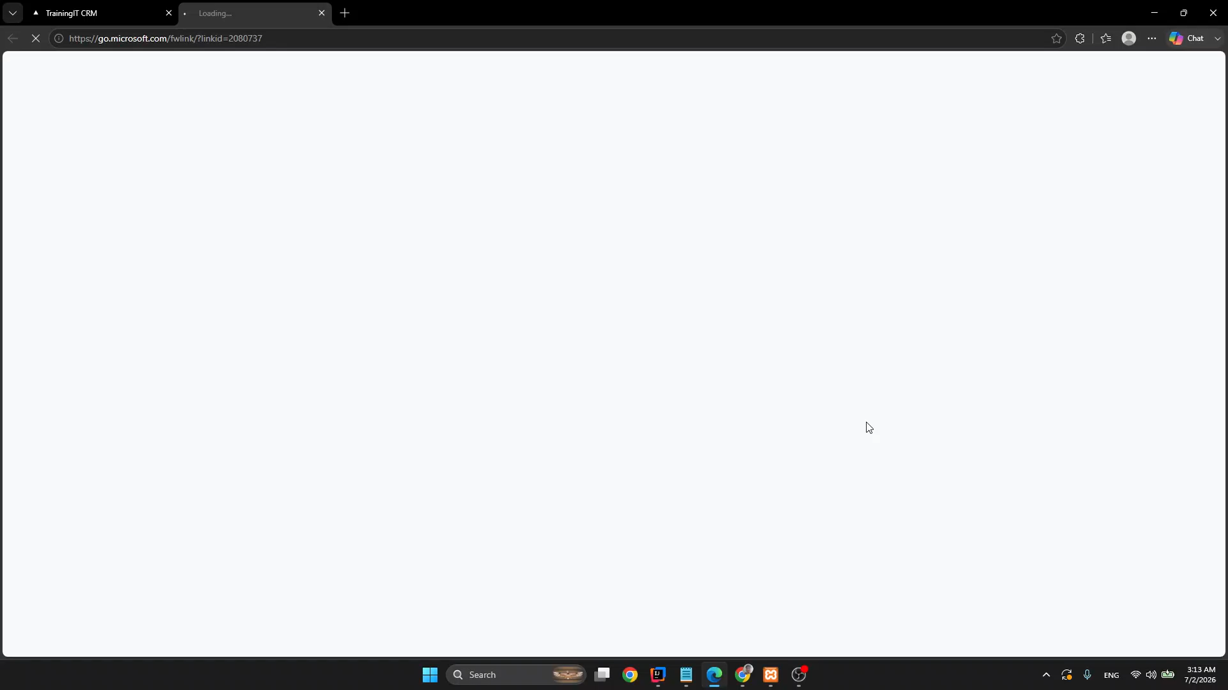
Live Demo
A walkthrough of the running application.
CRM Training IT

Slide 6
Thank you.
CRM Training IT · Veca Raul

