Slide 1

FACULTY OF COMPUTER SCIENCE
BACHELOR'S DEGREE PROGRAMME: COMPUTER SCIENCE
TRAININGIT
A WEB-BASED APPLICATION FOR SELLING PROGRAMMING COURSES
SUPERVISOR:
Lect. Dr. Sebastian Ștefănigă
CANDIDATE:
Raul Veca

Slide 2

Problem and Motivation
One system removes fragile synchronization between the storefront and CRM
The customer side
PROBLEM STATEMENT
Use one application and one shared data model so each customer action is captured once and drives the relevant CRM processes automatically.
One system. Two role-based experiences. No manual reconciliation.
Learners need a clear catalogue, trusted reviews, quick purchase and simple tutoring reservations.
The business side
The company needs leads, purchases, invoices, analytics and corporate clients in one operational view.
The integration gap
Separate tools create duplicate or inconsistent data and require slow manual reconciliation.
1 / 7

Slide 3
Related Work
Existing tools solve parts of the problem, not the whole workflow
Each tool family covers one side well; none unifies a course storefront and a CRM in a single product.
Tool family | Strength | Limitation
Course marketplaces e.g. Udemy, Coursera | Excellent storefront, catalogue, reviews and checkout | Aggregators: no owned customer relationship and no integrated CRM
Learning management e.g. Moodle | Strong at delivering and tracking course content | Built around content, not selling; commerce and CRM are bolted on
CRM platforms e.g. Salesforce, HubSpot | Powerful contacts, pipelines, lead scoring and reporting | Generic: no course catalogue, trainer calendar or public storefront
E-commerce engines e.g. WooCommerce | Self-hosted and able to sell anything, including courses | A course is only a product: no lead stages, tutoring sessions or corporate training
TrainingIT unifies both sides on one shared data model and specializes CRM workflows for training: sessions, calendars, tutoring, discounts and course analytics.
2 / 7

Slide 4
Contribution
A working product: storefront and CRM operate as one system
Applied contribution
TrainingIT combines a course marketplace and CRM in one Java web application. Each customer action is stored once and drives event-based workflows; the Claude AI layer remains optional. Major market innovations include real-time commerce-to-CRM automation, training-specific workflows from lead scoring to invoicing, and explainable recommendations for learners and corporate teams.
Objectives
Design boundary
Learner portal: browse, buy, review and book tutoring.
Admin portal with seven management tabs.
Event-driven domain automation.
Optional, fault-tolerant AI assistant.
Operational and CRM data in MariaDB.
Not a general-purpose e-commerce platform or CRM.
A focused training-company system: learner storefront plus a CRM a small team can run, with AI strictly additive.
3 / 7

Slide 5

System Architecture
Four layers behind one REST API and a real-time event stream
4 / 7

Slide 6
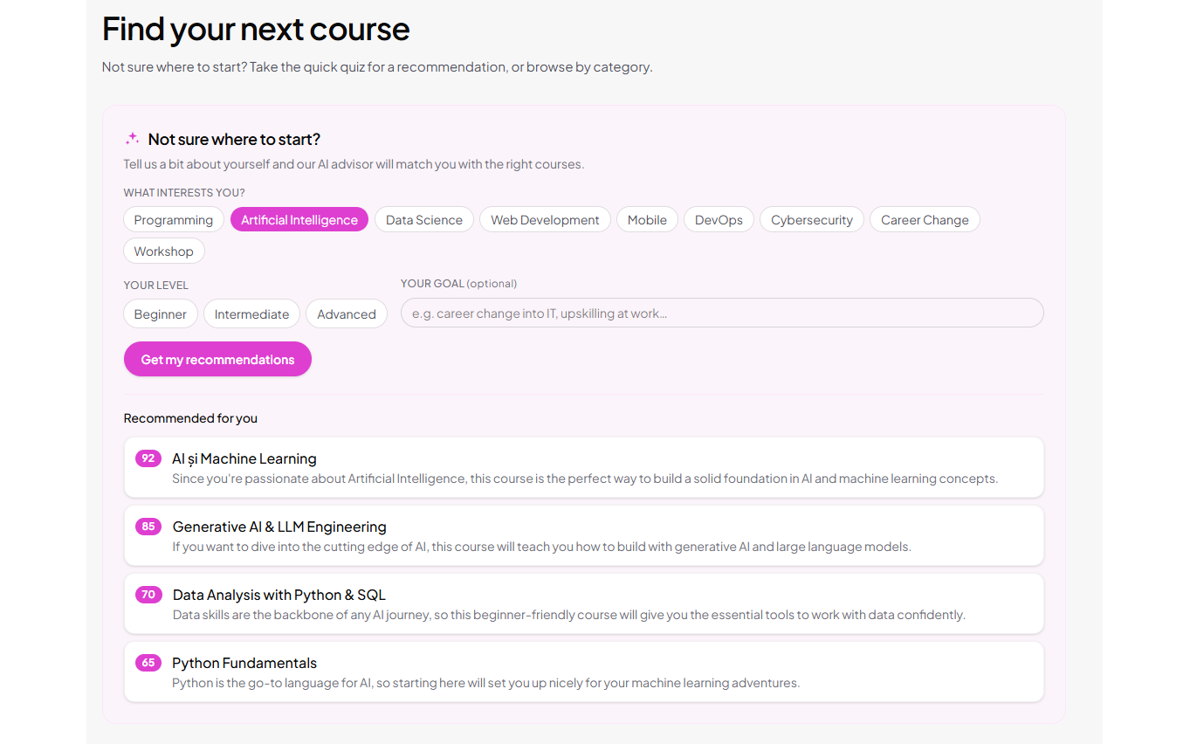
The AI Layer
Optional intelligence, powered by the Anthropic Claude API
Conversational assistant
/api/ai/chat
Answers questions about courses, enrolment and corporate training using the live catalogue as context.
Recommendation quiz
/api/ai/recommendations/visitor
Matches a visitor's interests, level and goal to courses, each with a fit score and a reason.
Per-company recommendations
/api/ai/recommendations/company
Analyses employee roles and interests to propose a training programme for a whole team.
All four features share one Claude client and one API key. The prompts, REST endpoints, structured JSON handling and matching interfaces are isolated so the application remains fully operational when AI is not configured.
Live page translation
/api/ai/translate
Translates the interface while preserving brand names, people, e-mails and numbers.
Strictly additive: without an API key, AI controls disappear and the core application keeps working.
5 / 7

Slide 7
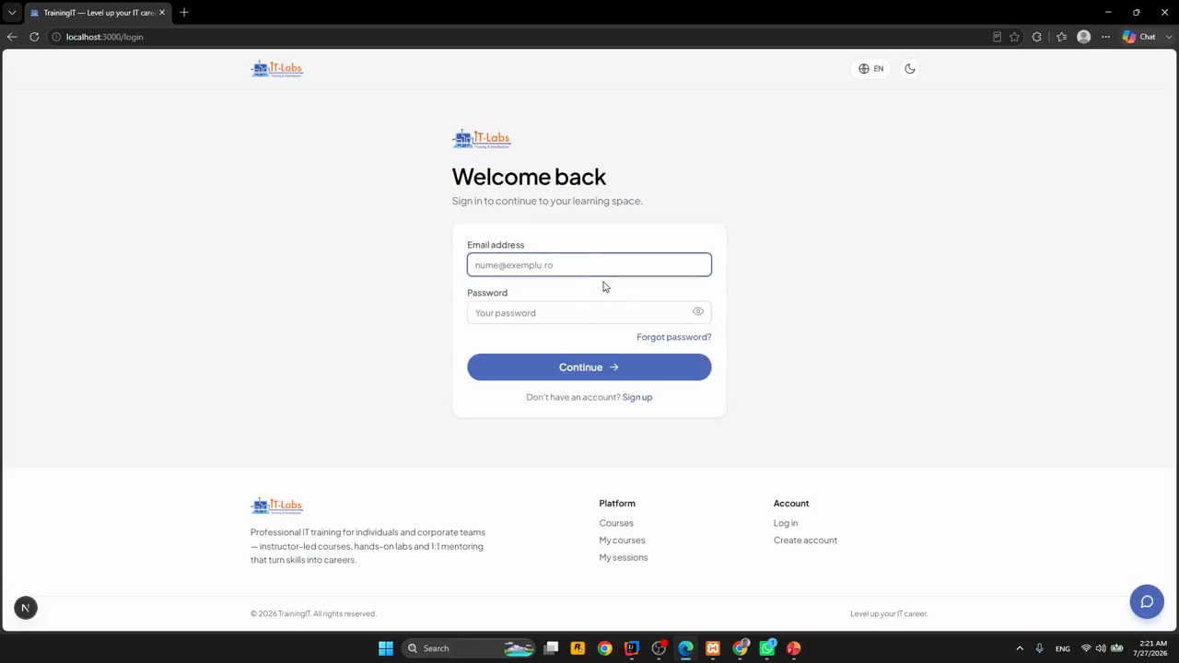
Application Demo
Live application walkthrough
LIVE DEMO
Storefront → CRM workflow → AI layer
6 / 7

Slide 8
Conclusion
TrainingIT demonstrates one coherent storefront and CRM
Implemented
Validated and next steps
Learner portal: catalogue, purchase, reviews and tutoring.
CRM portal: contacts, purchases, invoices, analytics and issues.
Event-driven domain: automated lead scoring and invoicing.
Live SSE statistics, imports and multi-format exports.
Optional Claude assistant, recommendations and translation.
End-to-end flows verified against a real MariaDB instance.
Duplicate invoices prevented through idempotent processing.
Observer failures are isolated; optional AI degrades safely.
Next: automated tests and production-grade authentication.
Next: richer analytics and cloud deployment.
Each customer action is recorded once and becomes immediately available to the business.
7 / 7

