Slide 1


WEST UNIVERSITY OF TIMIȘOARA
TrainingIT
A Web-Based Application for Selling Programming Courses
Raul Veca
Supervisor: Lect. Dr. Sebastian Ștefăniga
Faculty of Computer Science · Bachelor Thesis Defense, 2026
www.uvt.ro
Notes:
Good morning. My name is Raul Veca and I will present my bachelor thesis, TrainingIT: a web-based application for selling programming courses, supervised by Lect. Dr. Sebastian Ștefăniga.

Slide 2

Problem and Motivation
One storefront and one back office - normally two different systems
The customer side. A learner expects what any modern shop offers: a clear catalogue, prices and levels, reviews they can trust, a purchase in one click, and a private tutoring session booked at a time that suits them.
Problem statement
Build a single web application in which the customer-facing storefront and the business-facing CRM are not two integrated systems but one system - so that every customer action is captured exactly once and automatically drives enrolment, invoicing, lead scoring, auditing and support.
The business side. Behind the storefront the company must know who its leads are and how close each is to buying, keep a reliable purchase history, issue correct invoices with negotiated discounts, read the health of the business, and handle corporate clients who send whole teams.
It must also stay approachable for non-technical staff, keep the two roles strictly separated, and remain fully functional when optional services are switched off.
The integration gap. These two sides are normally separate tools that must be synchronised. Every synchronisation point is a place where data can drift, and manual reconciliation is slow and error-prone.
Raul Veca - WEST UNIVERSITY OF TIMIȘOARA
Page 1 / 13
Notes:
A training company that sells online has to satisfy two very different audiences with one system. Learners want a frictionless shop. The company needs to run an operation: leads, purchase history, invoices, analytics, corporate accounts. Normally that means an e-commerce platform plus a separate CRM, kept in sync - and every sync point is where data drifts. The problem this thesis addresses is to remove that gap entirely.

Slide 3
Related Work Gap
Existing tools solve parts of the problem, not the whole workflow
Each family of tools covers one side well; none unifies a course storefront and a CRM in a single product.
Tool family | Strength | Limitation
Course marketplaces e.g. Udemy, Coursera | Excellent storefront, catalogue, reviews and checkout | Aggregators: the provider owns no customer relationship and has no integrated CRM
Learning management e.g. Moodle | Strong at delivering and tracking course content | Built around content, not selling; commerce and CRM are plug-ins bolted on
CRM platforms e.g. Salesforce, HubSpot | Powerful contacts, pipelines, lead scoring and reporting | Generic: no course catalogue, trainer calendar or public storefront
E-commerce engines e.g. WooCommerce | Self-hosted and able to sell anything, including courses | A course is just a product: no lead stages, tutoring sessions or corporate training
TrainingIT unifies both sides in one application built on one shared data model, and specialises the generic CRM notions for the training domain: course sessions, trainer calendars, per-hour tutoring with employee discounts, and course-level click-through analytics.
Raul Veca - WEST UNIVERSITY OF TIMIȘOARA
Page 2 / 13
Notes:
Four families of tools address parts of the problem. Marketplaces like Udemy give you a storefront but you do not own the customer. Moodle manages content, not sales. Salesforce and HubSpot are strong CRMs but know nothing about courses or trainer calendars - and connecting them to a shop reintroduces exactly the integration gap. WooCommerce treats a course as an ordinary product. TrainingIT differs by unifying both sides on one data model.

Slide 4
Contribution
A working product, not a prototype: storefront and CRM as one system
Applied contribution
TrainingIT is a functional web application: a course marketplace whose every customer action is recorded exactly once in a complete CRM back office, on a Java domain layer organised around classic design patterns and an event-driven core, with an optional Claude-powered AI layer.
Objectives
Design boundary
A public client portal: browse, purchase, review, book one-to-one tutoring.
An administrator portal with seven management tabs.
A domain layer on design patterns and an event-driven core, so one action propagates into several automatic reactions.
An optional AI assistant that degrades gracefully.
All operational and CRM data persisted in MariaDB.
The goal is not a general-purpose e-commerce platform, nor a general-purpose CRM.
The goal is one coherent product for a training company: a storefront a learner can use without instructions, over a CRM core a small team can actually run - where the AI layer is strictly additive and never a dependency.
Raul Veca - WEST UNIVERSITY OF TIMIȘOARA
Page 3 / 13
Notes:
My contribution is an applied one: a functional system rather than a study. The objectives were a client portal, an administrator portal, a pattern-based event-driven domain layer, an optional AI layer, and persistent storage. The design boundary matters: this is not a general e-commerce platform or a general CRM - it is one coherent product for a training company.

Slide 5
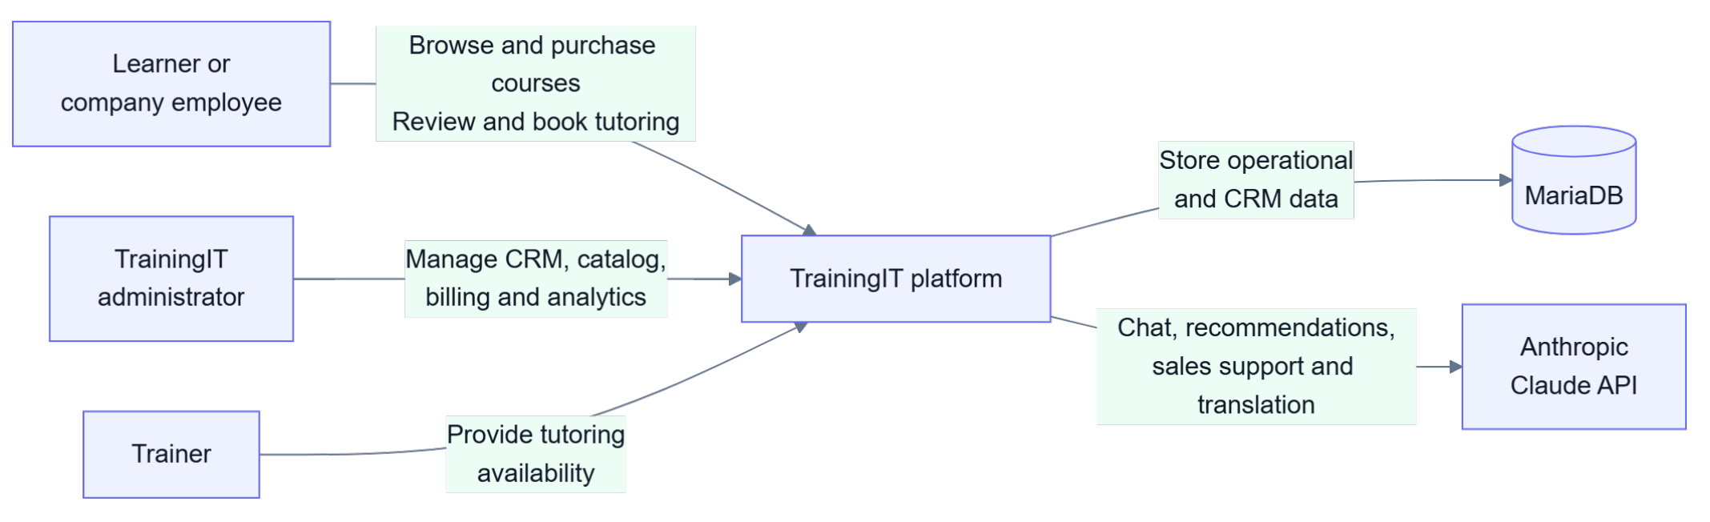
System Context
Three actors, one platform, two external services
Learners and partner-company employees buy and review courses; administrators run the CRM, catalogue, billing and analytics; trainers provide tutoring availability. MariaDB stores everything; the Anthropic Claude API is the only other dependency - and it is optional.
Raul Veca - WEST UNIVERSITY OF TIMIȘOARA
Page 4 / 13
Notes:
The system context. Three actors interact with the platform: the learner or company employee, the TrainingIT administrator, and the trainer. Externally the platform depends on MariaDB for storage and, optionally, on the Anthropic Claude API for chat, recommendations and translation.

Slide 6

Application Architecture
Four layers behind one REST API and a real-time event stream
Presentation - Next.js 16, React, Tailwind v4 Pages, route guards from the local session, a typed REST client and a Server-Sent Events client for live statistics.
Application - Spring Boot 3.5, Java 17 REST controllers under /api, the auth, AI, trainer and report services, and a public statistics broadcaster.
Domain - plain Java Commands, domain services, an EventBus with observers, and repositories. CrmFacade is the single entry point over all of it.
Persistence - MariaDB via JDBC and HikariCP Contacts, enrolments, invoices and issues survive restarts; the schema is created and updated at start-up.
Raul Veca - WEST UNIVERSITY OF TIMIȘOARA
Page 5 / 13
Notes:
The architecture has four layers. The browser runs a Next.js and React client with route guards driven by the local session. It talks to a Spring Boot REST API, which also pushes live catalogue statistics over Server-Sent Events. Behind the controllers is a plain-Java domain layer - commands, services, an event bus and repositories - reached through a single facade. Everything persists to MariaDB over JDBC with HikariCP.

Slide 7
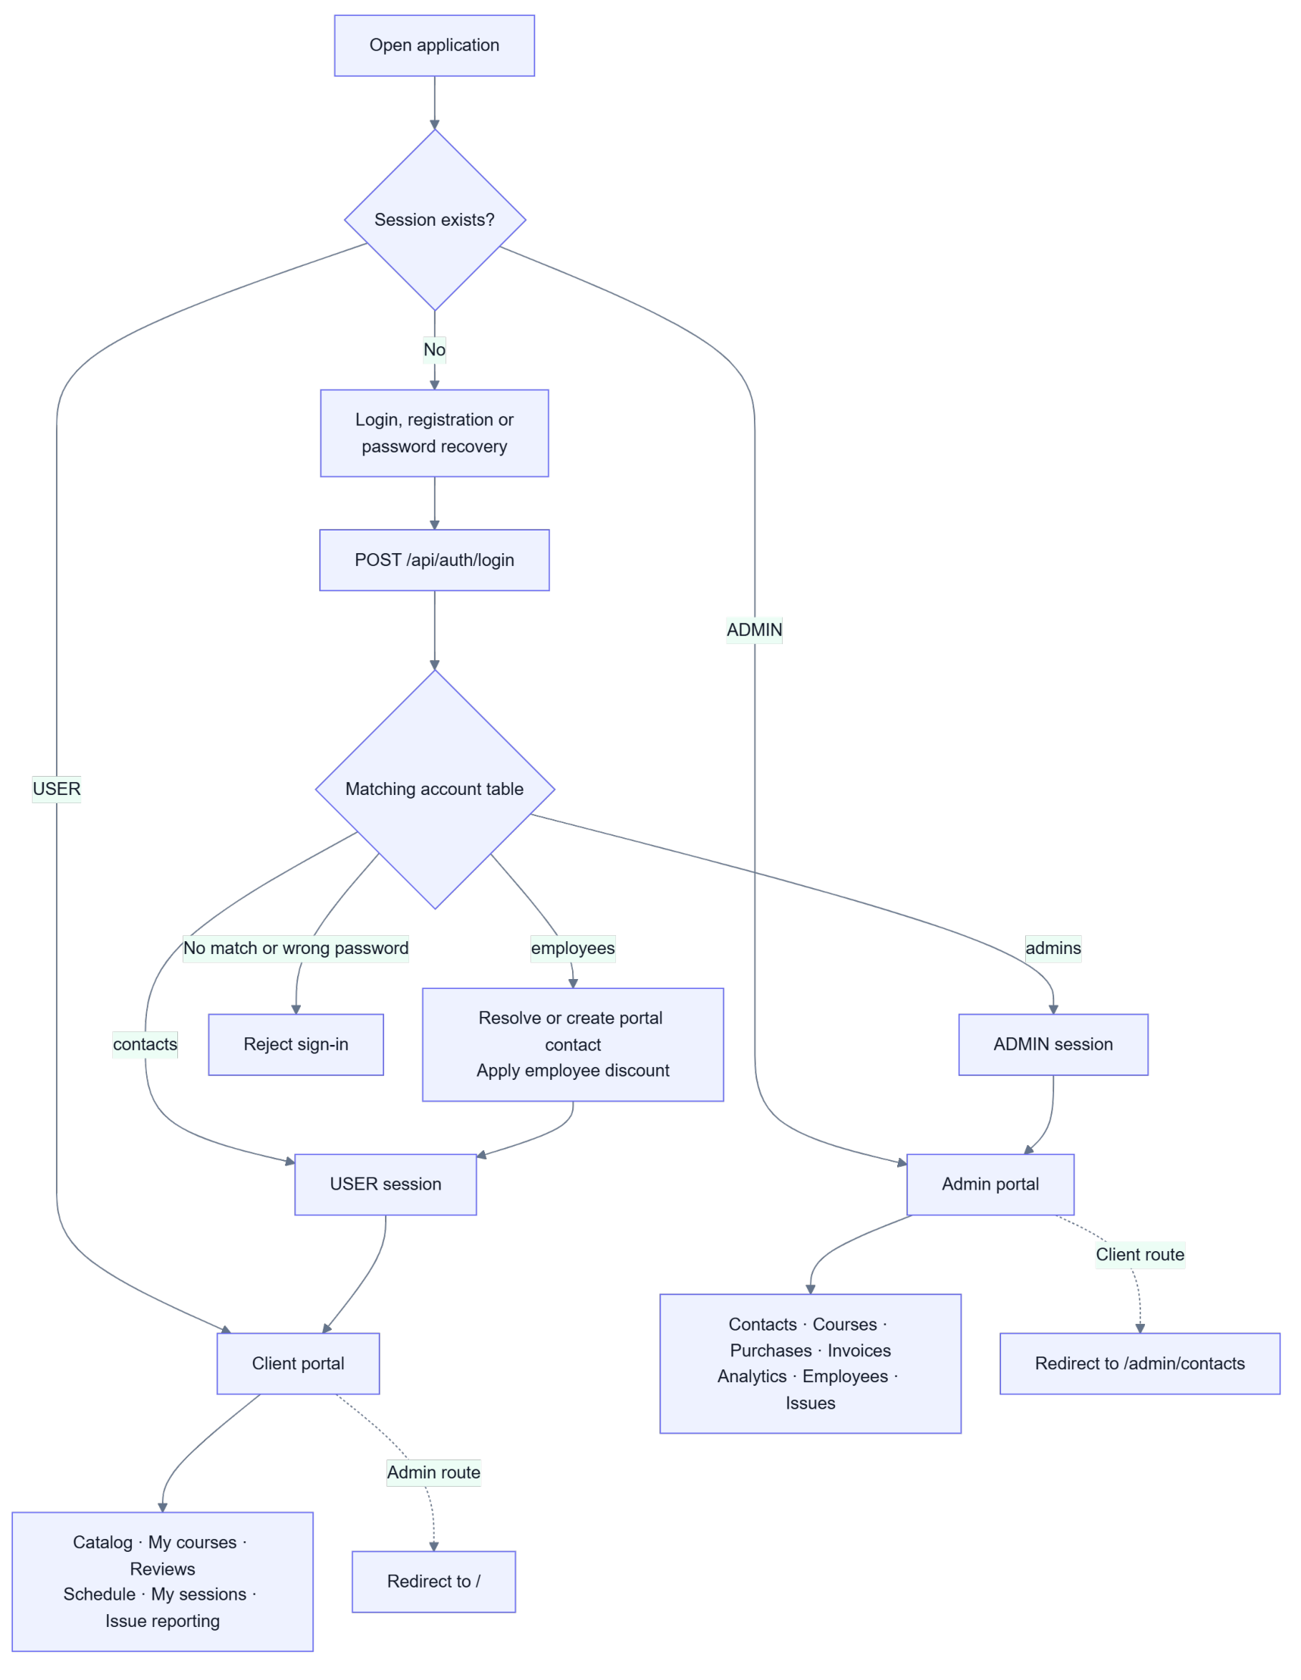
Role-Based Navigation
The login result decides the portal, and the two never mix
One login, two experiences. The back end looks the e-mail up across the contact, administrator and employee tables and verifies the password. The role it returns decides the destination: a USER lands on the public portal, an ADMIN on /admin.
Enforced separation
If an administrator requests a client route, or a client requests an administrator route, the application redirects them back to their own portal. An unauthenticated visitor reaches only the login, registration and password-recovery screens.
Employees are resolved on the way in
When a partner-company employee signs in, the system resolves or creates their portal contact and applies the negotiated employee discount automatically - so corporate pricing needs no separate account type.
Raul Veca - WEST UNIVERSITY OF TIMIȘOARA
Page 6 / 13
Notes:
Access is decided entirely at login. The back end checks the e-mail against contacts, admins and employees, and returns a role. USER goes to the public portal, ADMIN to the administration portal, and each is redirected back if they request the other's routes. Employees of partner companies are resolved into a portal contact on the way in, which is where the sixty-percent discount comes from.

Slide 8
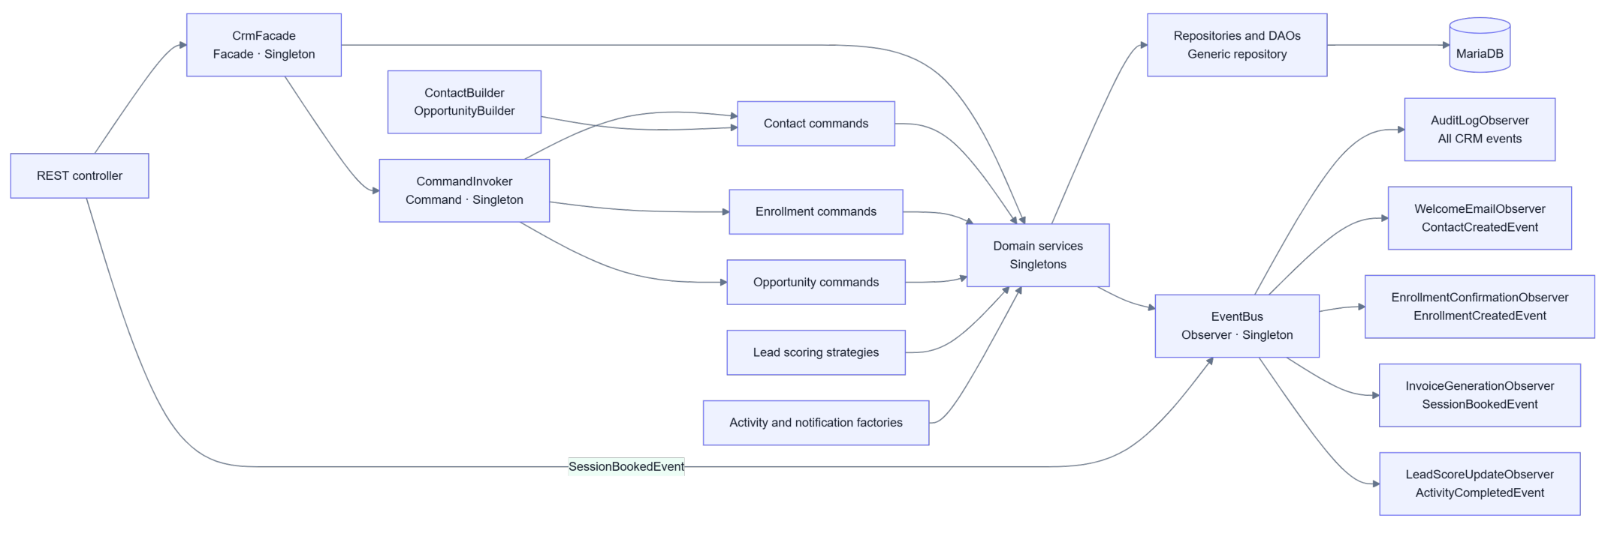
Domain Design
Classic design patterns keep the unified model maintainable
Facade - one entry point over the CRM · Command - every write is an executable command · Observer - an EventBus fans one event out to invoice generation, audit logging, confirmations and lead re-scoring · Strategy - individuals and companies score differently · Factory and Builder - notifications, activities, contacts and opportunities
Raul Veca - WEST UNIVERSITY OF TIMIȘOARA
Page 7 / 13
Notes:
The domain layer is deliberately organised around the Gang-of-Four patterns. A facade gives the controllers one entry point. Every write is a command. Lead scoring is a strategy, chosen per contact type. Factories build notifications and activities, builders assemble contacts and opportunities. The most important one is Observer: the event bus is what turns a single click into several automatic reactions.

Slide 9
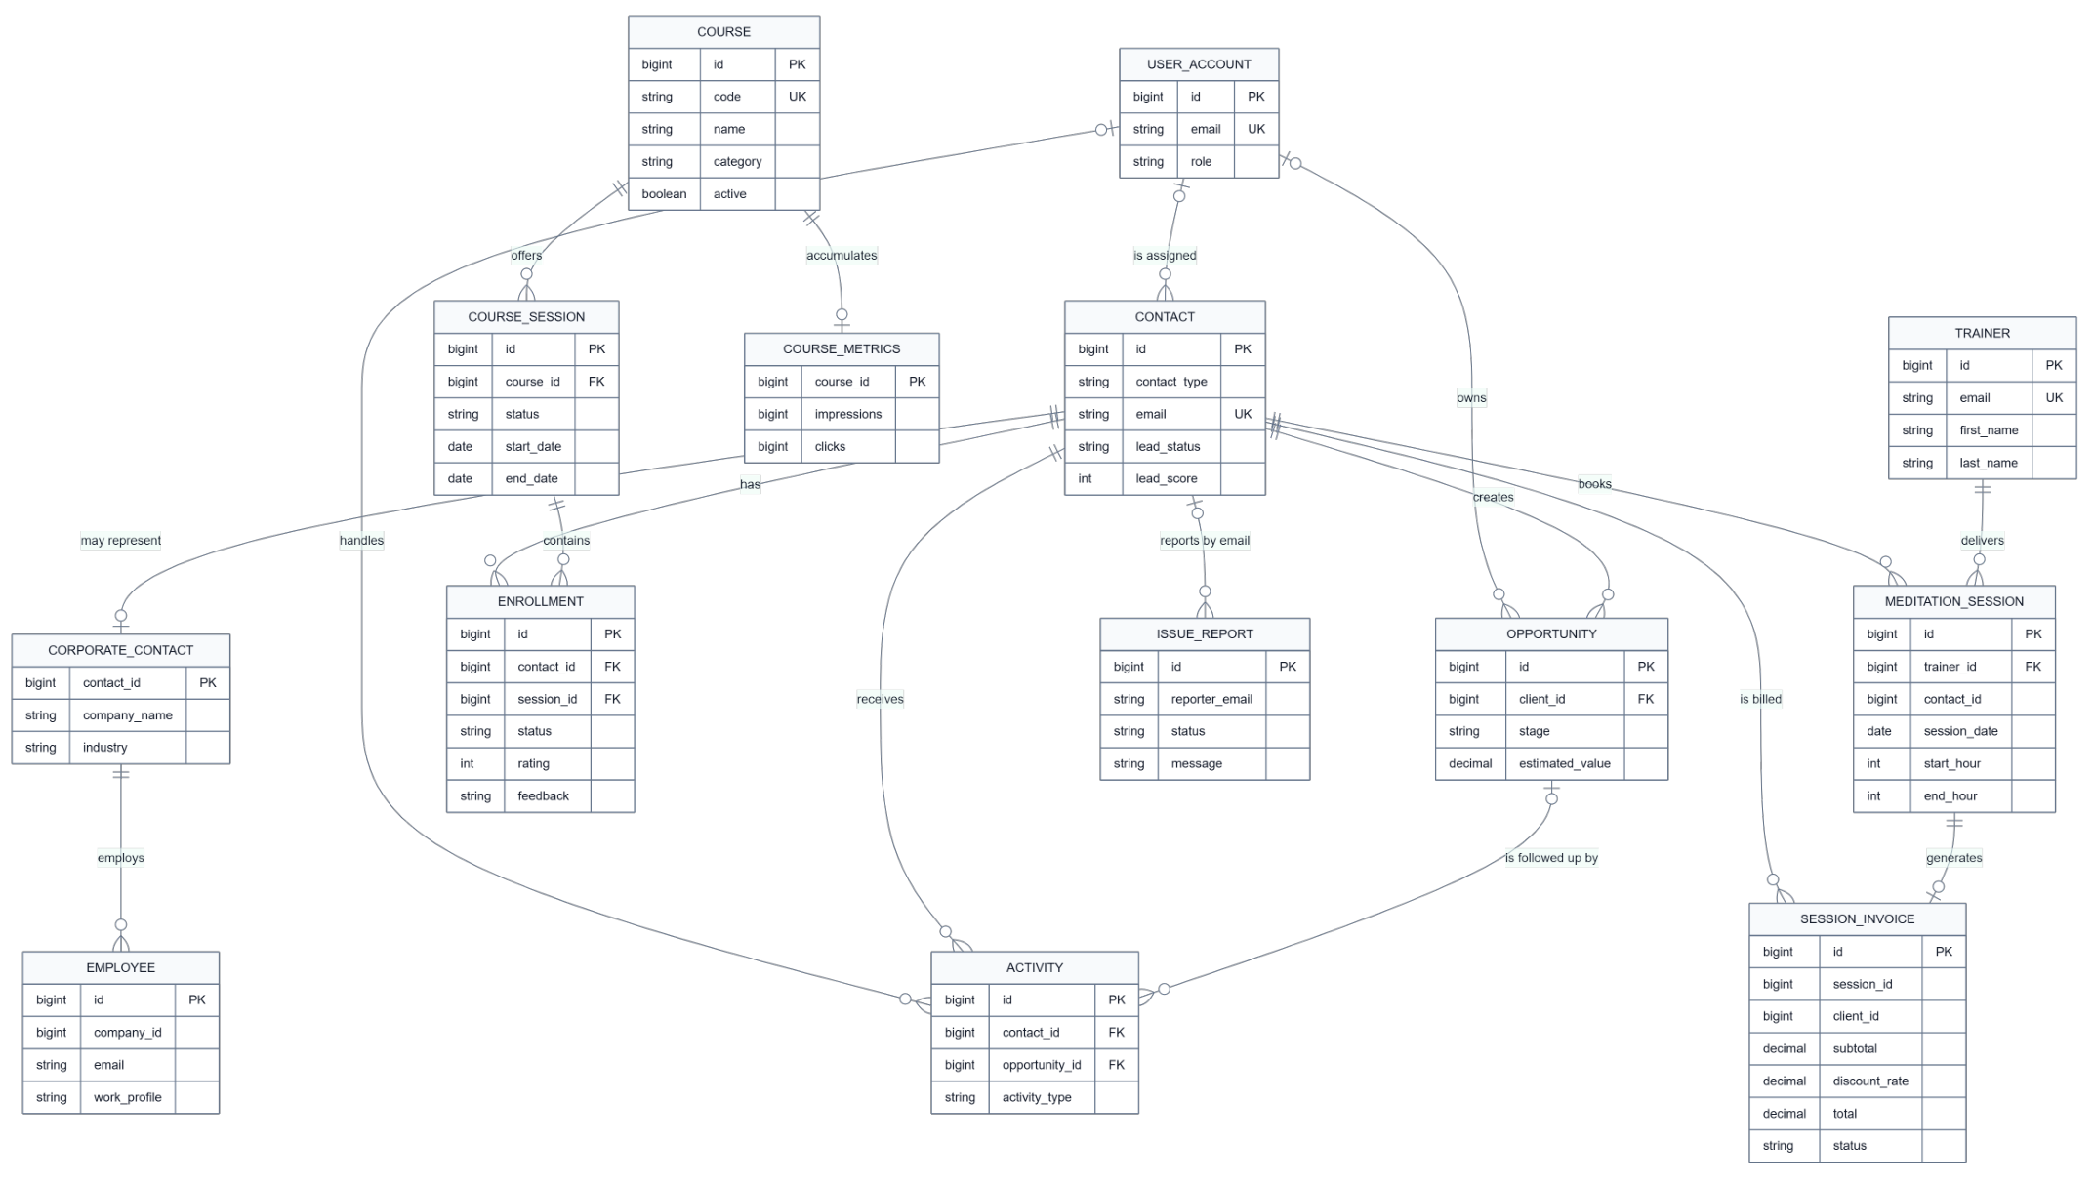
Data Model
One shared schema for the storefront and the CRM
Raul Veca - WEST UNIVERSITY OF TIMIȘOARA
Page 8 / 13
Notes:
This is the core data model. Because both portals are served by the same back end, there is one schema rather than two. Note two design decisions: a review has no table of its own - the rating and feedback live directly on the enrolment, which guarantees one review per learner per course and means only a buyer can review. And a session invoice is generated from a meditation session, never entered by hand.

Slide 10
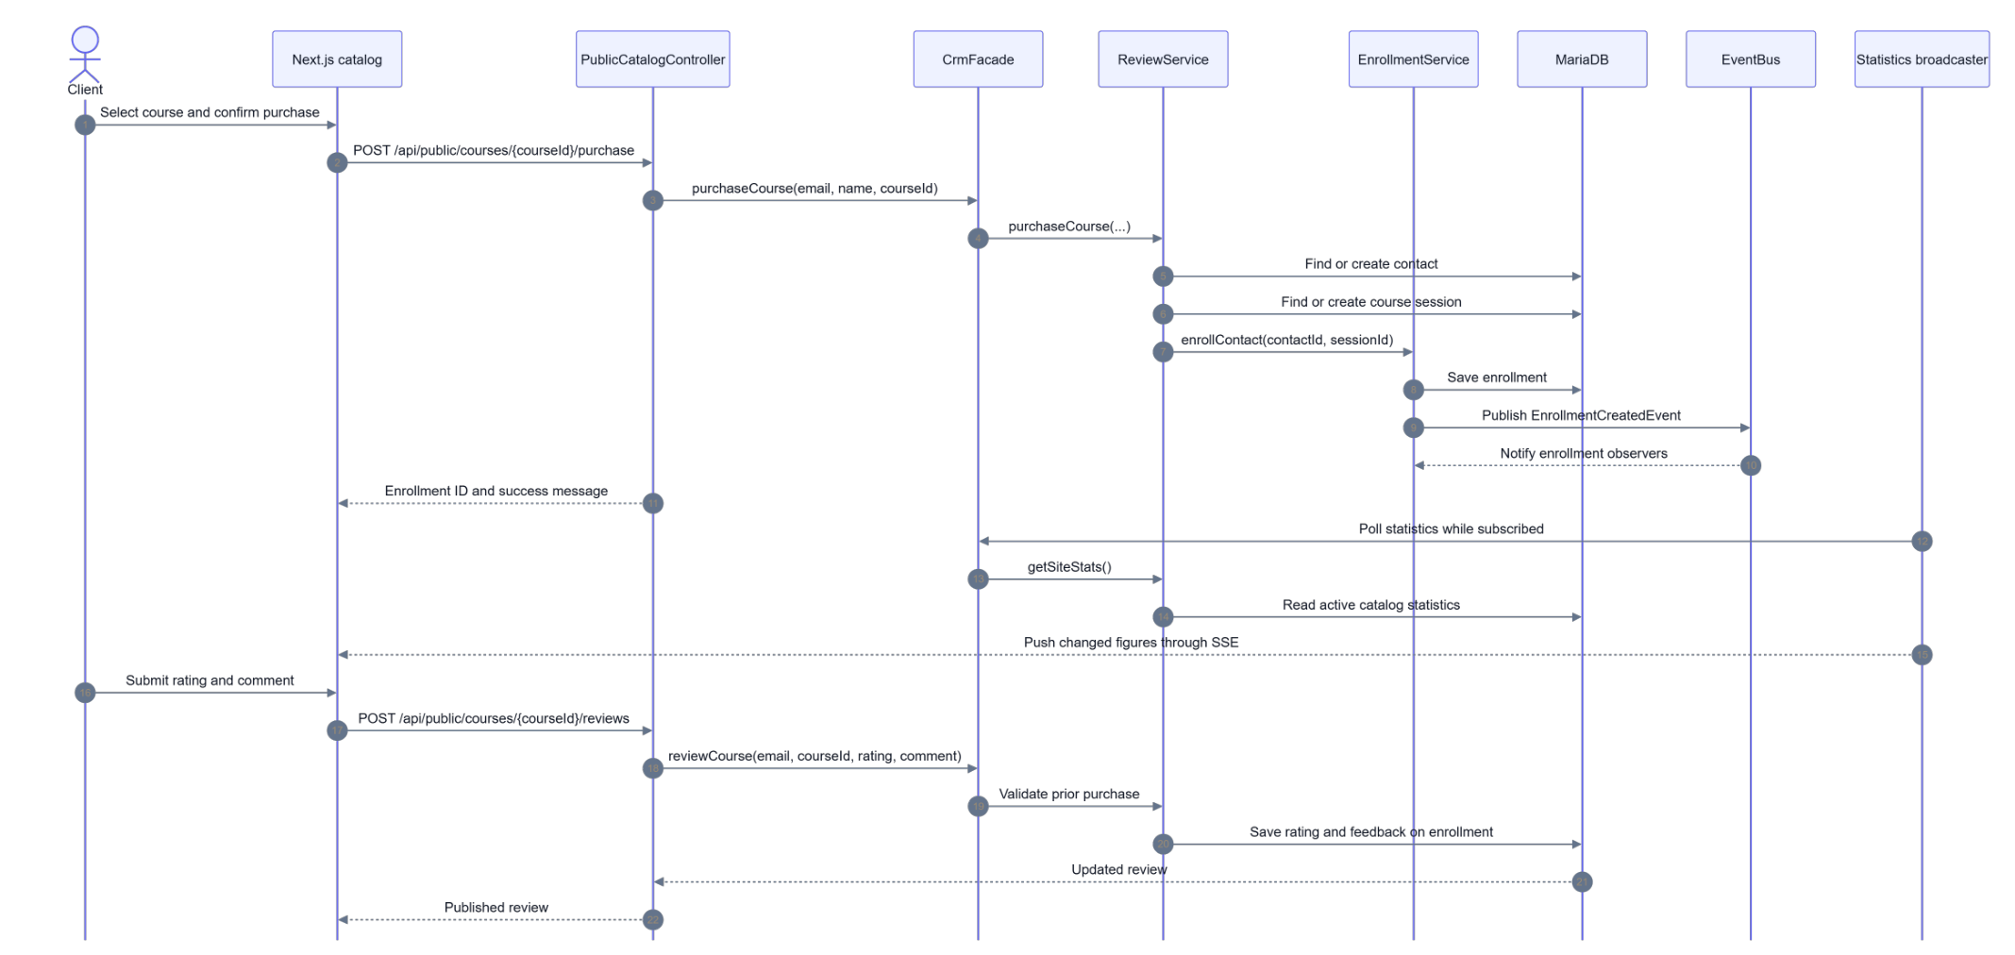
One Click, Several Reactions
Purchase and review, from the client's confirmation to live statistics
A single purchase finds or creates the contact and the course session, saves the enrolment, publishes an event, notifies the observers, and updates the live figures over SSE - with no manual reconciliation anywhere.
Raul Veca - WEST UNIVERSITY OF TIMIȘOARA
Page 9 / 13
Notes:
This sequence is the central idea of the solution. The client confirms a purchase; the facade finds or creates the contact and the course session, saves the enrolment, and publishes an EnrollmentCreatedEvent. The observers react on their own. Meanwhile the statistics broadcaster pushes the changed figures to every subscribed browser, so the learner count on the home page moves without a reload. The review at the bottom is validated against a prior purchase before it is stored on the enrolment.

Slide 11
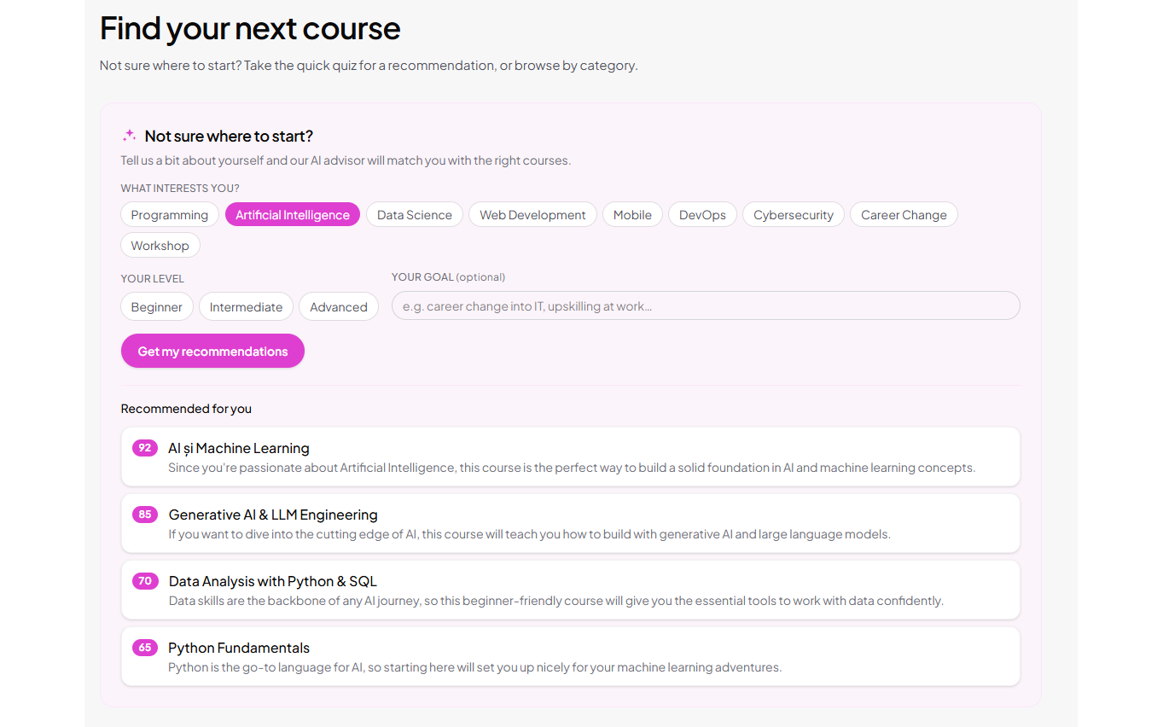
The AI Layer
Optional intelligence, powered by the Anthropic Claude API
Conversational assistant /api/ai/chat Answers questions about courses, enrolment and corporate training, using the live catalogue as context.
Recommendation quiz /api/ai/recommendations/visitor Matches a visitor's interests, level and goal to courses, each with a fit score and a reason.
Per-company recommendations /api/ai/recommendations/company Analyses employee roles and interests to propose a training programme for a whole team.
Live page translation /api/ai/translate Translates the interface into any language, preserving brand names, people, e-mails and numbers.
All four features share one Claude client and one API key. I implemented the prompts, the REST endpoints, the structured JSON response handling and the matching interfaces - and made sure the rest of the application stays fully operational when AI is not configured.
Strictly additive: with no API key the buttons disappear
Raul Veca - WEST UNIVERSITY OF TIMIȘOARA
Page 10 / 13
Notes:
The AI layer was the part I extended furthest myself. There are four features, all sharing one Claude client and one API key: a chatbot grounded in the live catalogue, a recommendation quiz for visitors, per-company recommendations for corporate training, and live page translation. I wrote the prompts, the endpoints, the structured JSON handling and the interfaces. The important property is that the layer is strictly additive - remove the key and the buttons simply do not render.

Slide 12
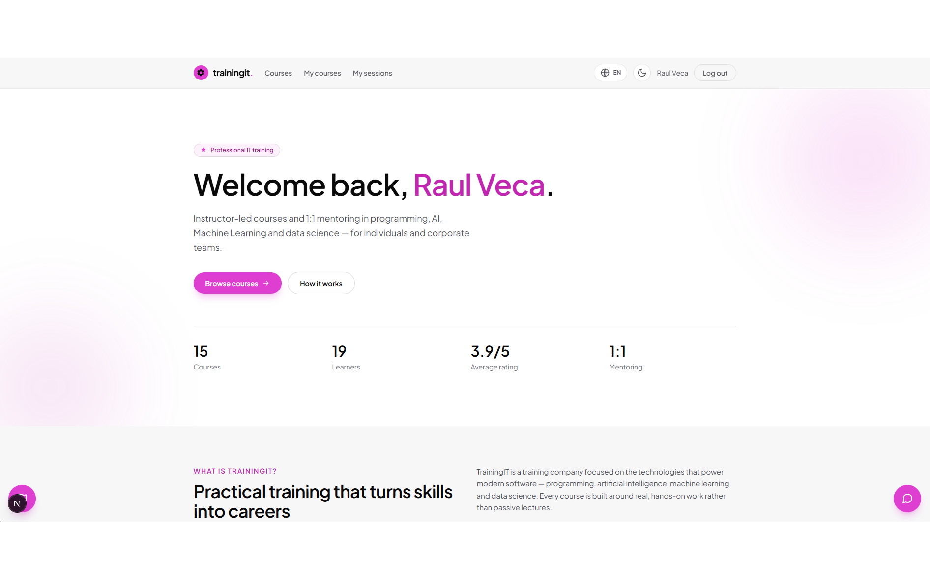
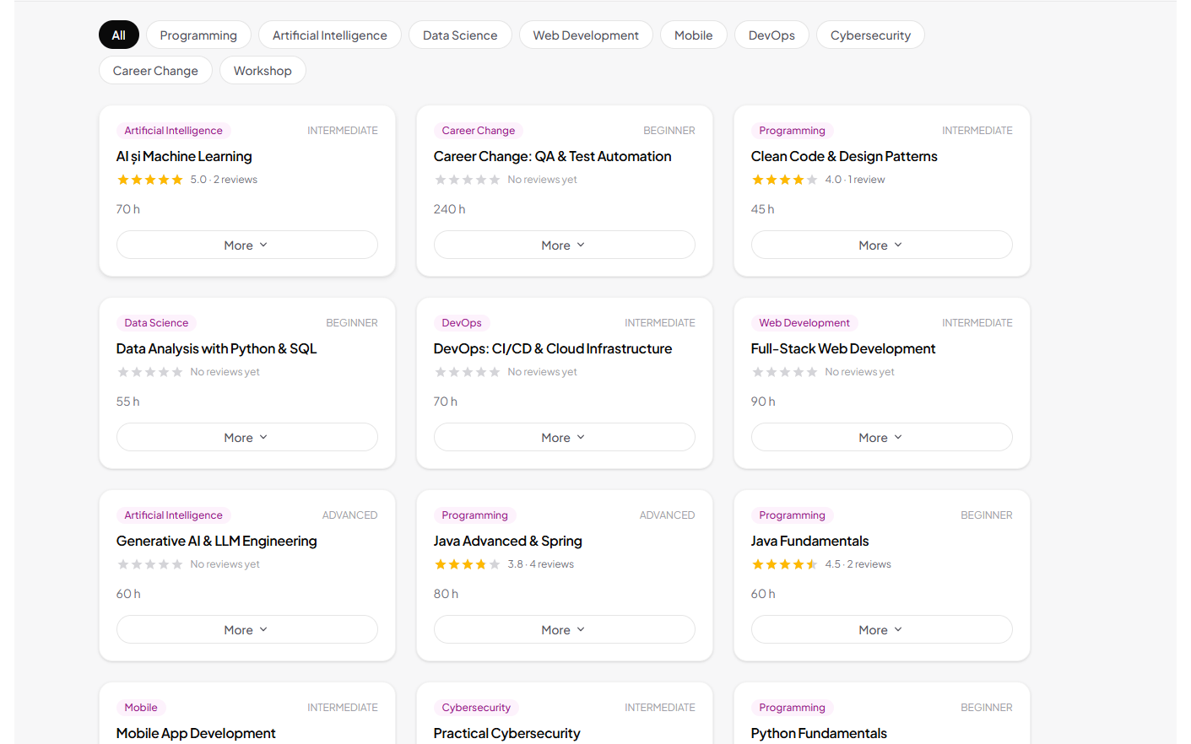
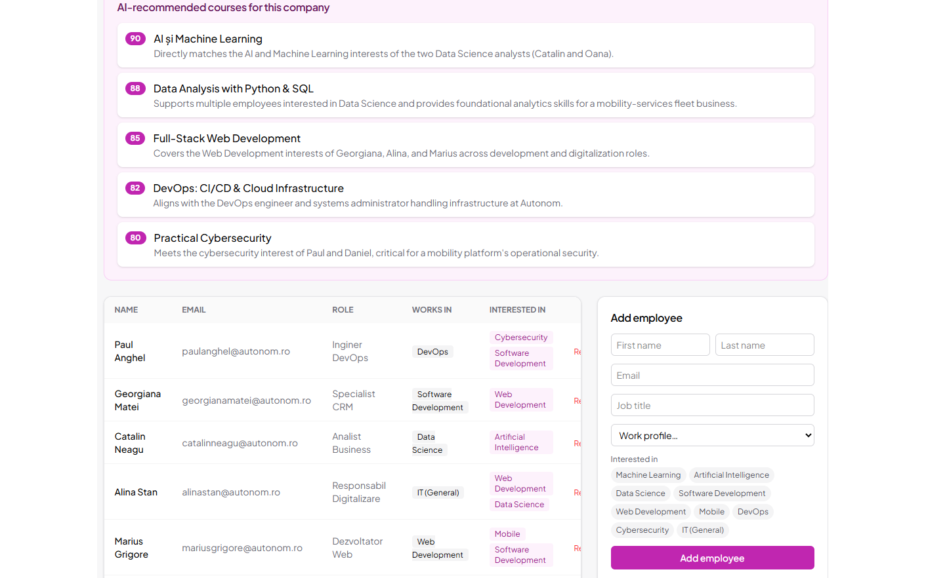
Application Demo
The running application
Authenticated learner home Personalised greeting and live catalogue statistics over SSE
Course catalogue Category filters; each card counts an impression and a click for CTR
Administrator · Employees Company teams, Excel import and AI course recommendations
The same session drives both sides: a purchase made on the catalogue appears immediately in the administrator's Purchases tab, a booking generates its invoice by itself, and a reported issue lands straight in the Issues tab.
Raul Veca - WEST UNIVERSITY OF TIMIȘOARA
Page 11 / 13
Notes:
A short tour of the running application. On the left, the authenticated learner home page with the live statistics. In the middle, the catalogue with its category filters - every card view and every expansion is counted, which is what feeds the click-through analytics. On the right, the administrator's Employees tab with the Excel import and the AI recommendations. If there is time I will demonstrate a purchase appearing live in the Purchases tab.

Slide 13
Testing and Validation
Correctness here is about propagation, not isolated algorithms
Input validation
Robustness by design
Functional testing
Validated on two levels. The client checks missing fields, password confirmation and the mandatory GDPR consent. On the server, payloads pass Spring Validation, and contact data additionally goes through a Chain-of-Responsibility validator that checks the e-mail, the phone number, the GDPR flag and the contact type in sequence - so an invalid contact never reaches the database.
Invoice generation is idempotent, so a repeated event cannot produce a duplicate. Observer failures are isolated: an error while generating an invoice is logged but does not roll back the booking that triggered it. The AI layer degrades gracefully. Deletions in the Issues tab are guarded by an explicit "this cannot be undone" confirmation.
The main user journeys were tested manually against a running instance backed by a real MariaDB database: registration creating a lead; login routing USER and ADMIN correctly; a one-click enrolment appearing in Purchases; a review updating the average rating live; a booking producing an invoice with the right discount; exports to CSV, Excel and PDF.
The project also includes the Spring Boot test harness as a foundation; extending it into full unit and integration coverage is identified as future work.
Raul Veca - WEST UNIVERSITY OF TIMIȘOARA
Page 12 / 13
Notes:
Because correctness here depends on a user action propagating through the whole system, testing concentrated on three things. Input validation on both client and server, including a chain-of-responsibility validator for contacts. Robustness properties I verified by forcing the failure: idempotent invoices, isolated observer failures, graceful AI degradation, guarded deletions. And functional verification of the end-to-end journeys against a real database. The Spring Boot test harness is in place as a foundation for an automated suite, which I list as future work.

Slide 14
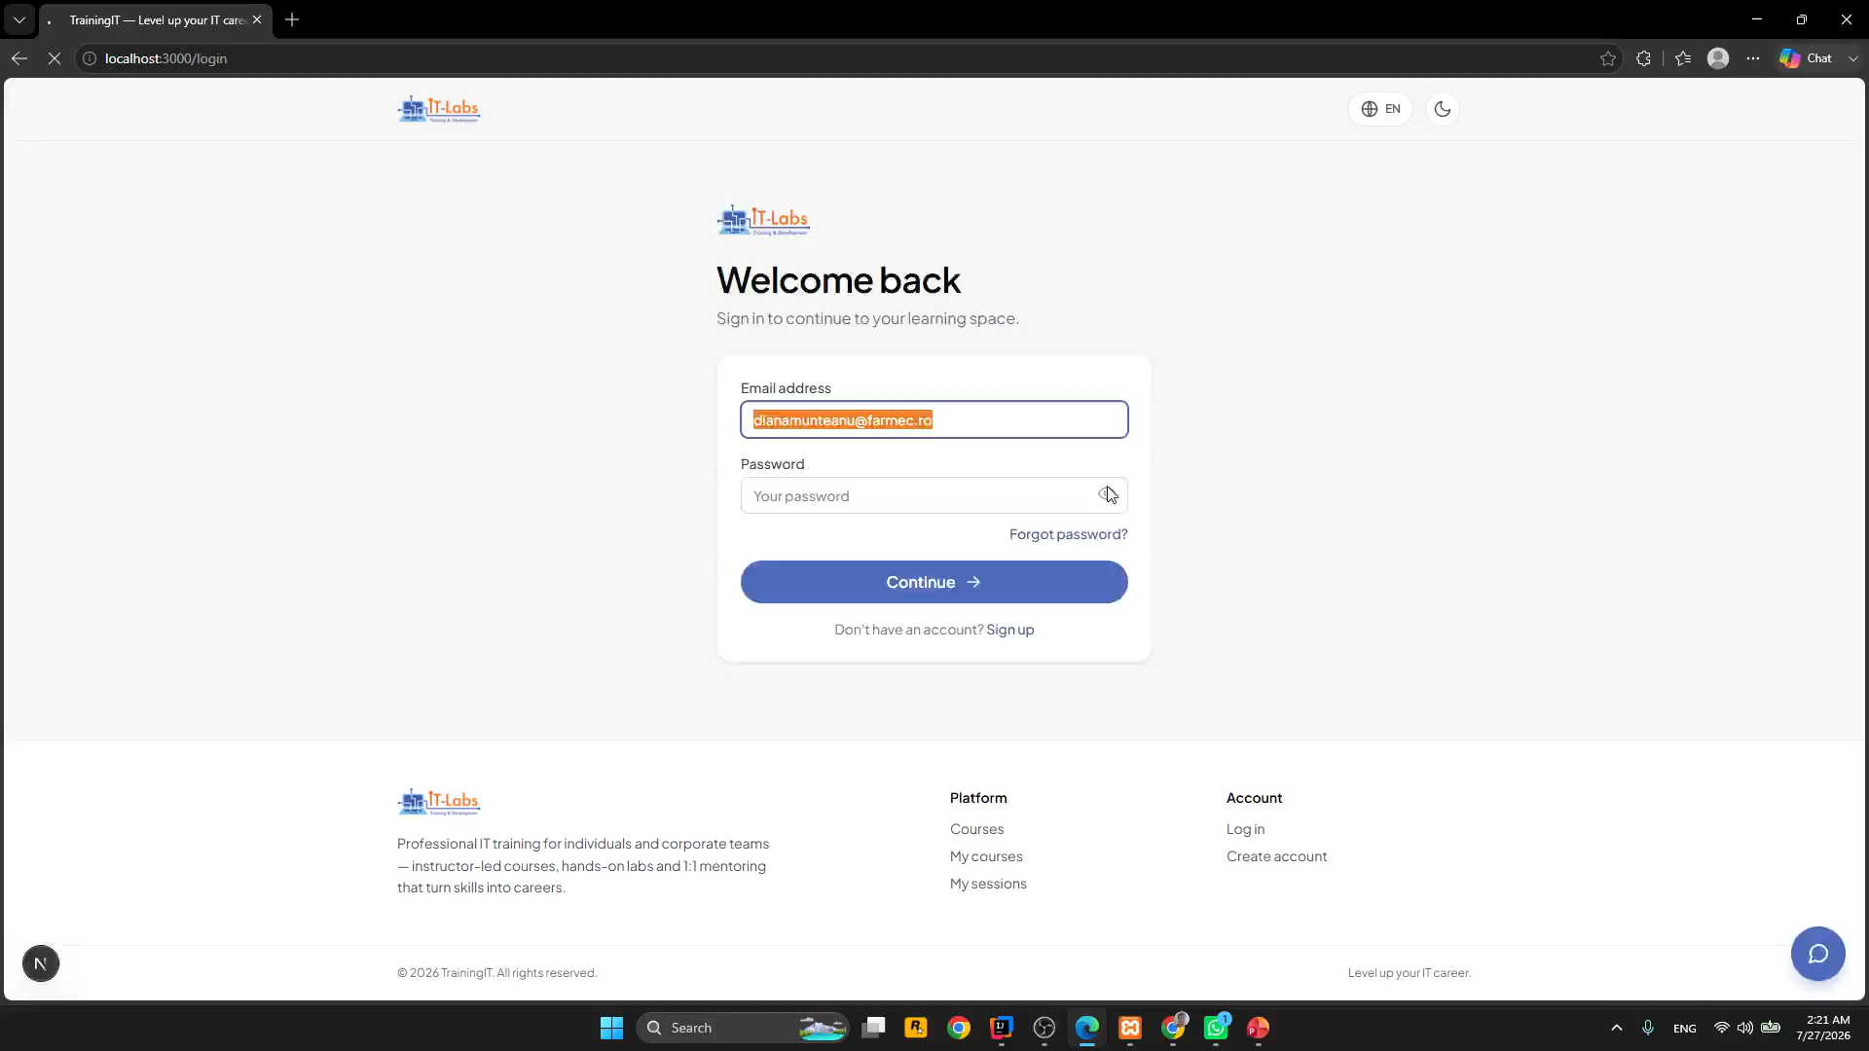
Application Demo
Video
Raul Veca - WEST UNIVERSITY OF TIMIȘOARA
Page 12 / 13
Notes:
Because correctness here depends on a user action propagating through the whole system, testing concentrated on three things. Input validation on both client and server, including a chain-of-responsibility validator for contacts. Robustness properties I verified by forcing the failure: idempotent invoices, isolated observer failures, graceful AI degradation, guarded deletions. And functional verification of the end-to-end journeys against a real database. The Spring Boot test harness is in place as a foundation for an automated suite, which I list as future work.

Slide 15
Conclusion and Future Work
One product where the storefront and the CRM are the same system
Implemented
Limitations and next steps
A client portal: catalogue, one-click purchase, star reviews, 1:1 booking with calendar and payment, issue reporting.
A seven-tab administrator portal: contacts, courses, purchases, invoices, analytics, employees, issues.
An event-driven Java domain layer on classic design patterns, with automatic invoicing and lead scoring.
Live statistics over SSE, Excel import, and CSV / Excel / PDF export.
An optional Claude layer: assistant, recommendation quiz, per-company advice, live translation.
Automated test suite - unit and integration tests over the commands, observers, scoring strategies and REST endpoints, enabling continuous integration.
Stronger authentication - token-based sessions, password hashing at rest, e-mail verification and a genuine reset flow with expiring links.
Richer analytics - historical trends, cohort analysis and exportable dashboards beyond point-in-time metrics.
Deeper AI - conversation memory and AI summaries of support issues.
Deployment and scaling - containerising the two services for a cloud deployment.
A visitor becomes a tracked lead on registration and a customer on the first purchase, and every action after that propagates into the administration portal by itself. That is the result: one click, several reactions, no reconciliation.
Raul Veca - WEST UNIVERSITY OF TIMIȘOARA
Page 13 / 13
Notes:
To conclude. TrainingIT delivers a client portal, a seven-tab administrator portal, a pattern-based event-driven domain layer, live statistics and reporting, and an optional AI layer - meeting the objectives set out in the introduction. The limitations are honest ones: the test suite is a foundation rather than full coverage, and authentication would need hardening for production. The central result is that the storefront and the CRM are not two integrated systems but one. Thank you - I am happy to take questions.

