Slide 1


WEST UNIVERSITY OF TIMIȘOARA
TrainingIT
A Web-Based Application for Selling Programming Courses
Raul Veca
Supervisor: Lect. Dr. Sebastian Ștefăniga
Faculty of Computer Science · Bachelor Thesis Defense, 2026
www.uvt.ro
Notes:
Good morning. My name is Raul Veca and I will present my bachelor thesis, TrainingIT: a web-based application for selling programming courses, supervised by Lect. Dr. Sebastian Ștefăniga.

Slide 2

Problem and Motivation
One storefront and one back office - normally two different systems
The customer side. A learner expects what any modern shop offers: a clear catalogue, prices and levels, reviews they can trust, a purchase in one click, and a private tutoring session booked at a time that suits them.
Problem statement
Build a single web application in which the customer-facing storefront and the business-facing CRM are not two integrated systems but one system - so that every customer action is captured exactly once and automatically drives enrolment, invoicing, lead scoring, auditing and support.
The business side. Behind the storefront the company must know who its leads are and how close each is to buying, keep a reliable purchase history, issue correct invoices with negotiated discounts, read the health of the business, and handle corporate clients who send whole teams.
It must also stay approachable for non-technical staff, keep the two roles strictly separated, and remain fully functional when optional services are switched off.
The integration gap. These two sides are normally separate tools that must be synchronised. Every synchronisation point is a place where data can drift, and manual reconciliation is slow and error-prone.
Raul Veca - WEST UNIVERSITY OF TIMIȘOARA
Page 1 / 13
Notes:
A training company that sells online has to satisfy two very different audiences with one system. Learners want a frictionless shop. The company needs to run an operation: leads, purchase history, invoices, analytics, corporate accounts. Normally that means an e-commerce platform plus a separate CRM, kept in sync - and every sync point is where data drifts. The problem this thesis addresses is to remove that gap entirely.

Slide 3
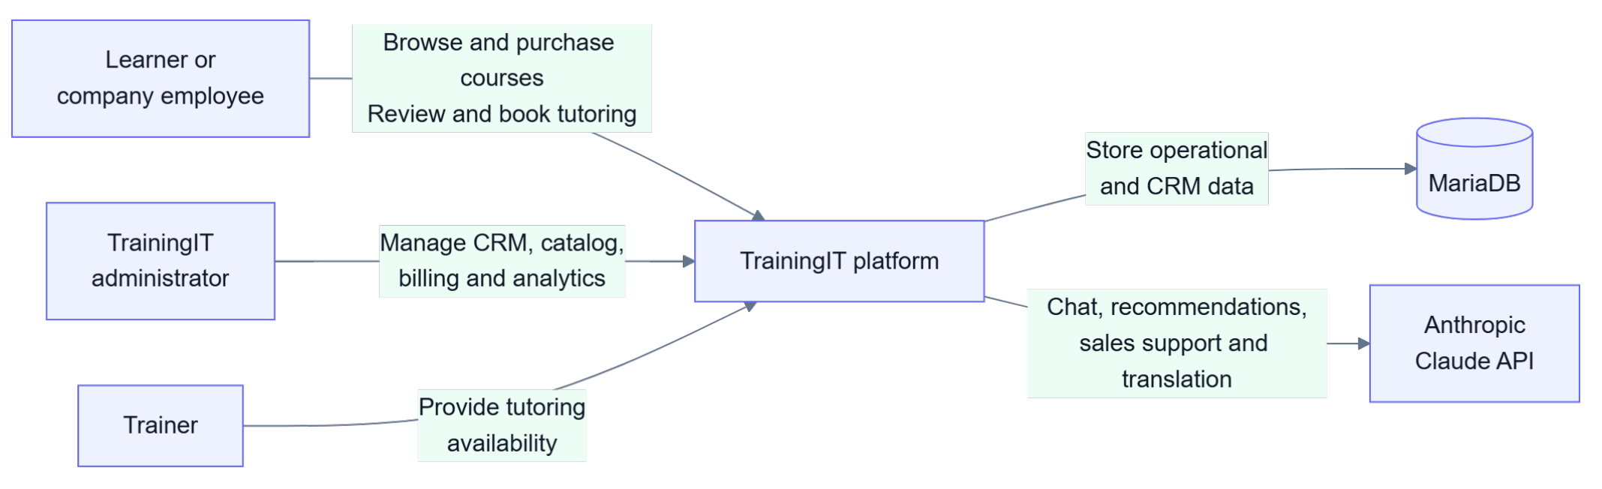
System Context
Three actors, one platform, two external services
Learners and partner-company employees buy and review courses; administrators run the CRM, catalogue, billing and analytics; trainers provide tutoring availability. MariaDB stores everything; the Anthropic Claude API is the only other dependency - and it is optional.
Raul Veca - WEST UNIVERSITY OF TIMIȘOARA
Page 4 / 13
Notes:
The system context. Three actors interact with the platform: the learner or company employee, the TrainingIT administrator, and the trainer. Externally the platform depends on MariaDB for storage and, optionally, on the Anthropic Claude API for chat, recommendations and translation.

Slide 4

Application Architecture
Four layers behind one REST API and a real-time event stream
Presentation - Next.js 16, React, Tailwind v4 Pages, route guards from the local session, a typed REST client and a Server-Sent Events client for live statistics.
Application - Spring Boot 3.5, Java 17 REST controllers under /api, the auth, AI, trainer and report services, and a public statistics broadcaster.
Domain - plain Java Commands, domain services, an EventBus with observers, and repositories. CrmFacade is the single entry point over all of it.
Persistence - MariaDB via JDBC and HikariCP Contacts, enrolments, invoices and issues survive restarts; the schema is created and updated at start-up.
Raul Veca - WEST UNIVERSITY OF TIMIȘOARA
Page 5 / 13
Notes:
The architecture has four layers. The browser runs a Next.js and React client with route guards driven by the local session. It talks to a Spring Boot REST API, which also pushes live catalogue statistics over Server-Sent Events. Behind the controllers is a plain-Java domain layer - commands, services, an event bus and repositories - reached through a single facade. Everything persists to MariaDB over JDBC with HikariCP.

Slide 5
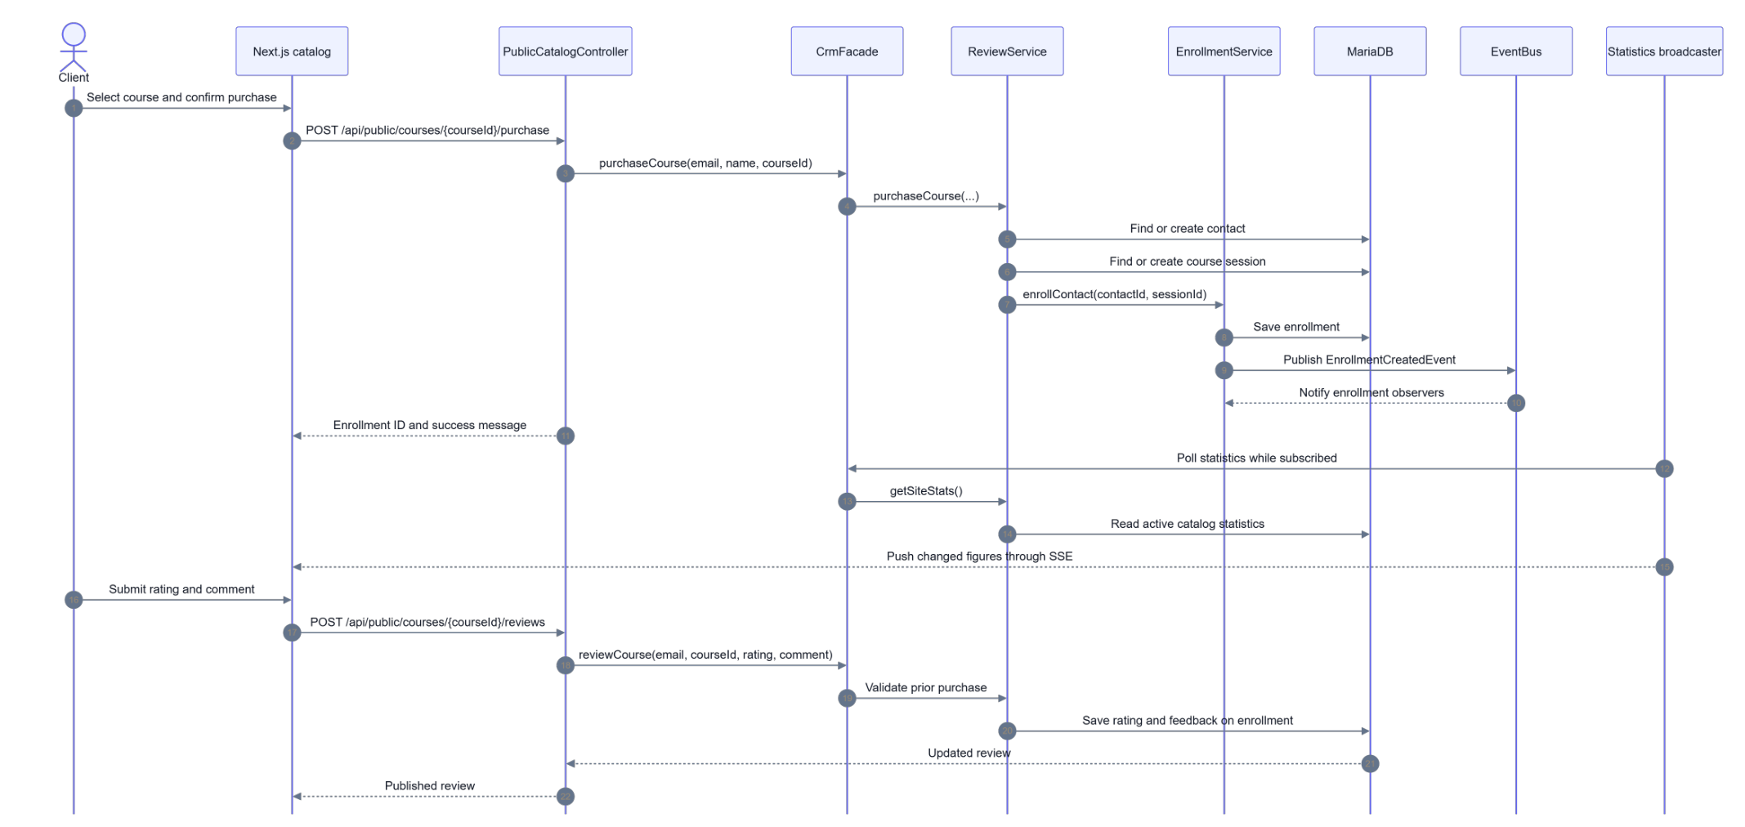
One Click, Several Reactions
Purchase and review, from the client's confirmation to live statistics
A single purchase finds or creates the contact and the course session, saves the enrolment, publishes an event, notifies the observers, and updates the live figures over SSE - with no manual reconciliation anywhere.
Raul Veca - WEST UNIVERSITY OF TIMIȘOARA
Page 9 / 13
Notes:
This sequence is the central idea of the solution. The client confirms a purchase; the facade finds or creates the contact and the course session, saves the enrolment, and publishes an EnrollmentCreatedEvent. The observers react on their own. Meanwhile the statistics broadcaster pushes the changed figures to every subscribed browser, so the learner count on the home page moves without a reload. The review at the bottom is validated against a prior purchase before it is stored on the enrolment.

Slide 6
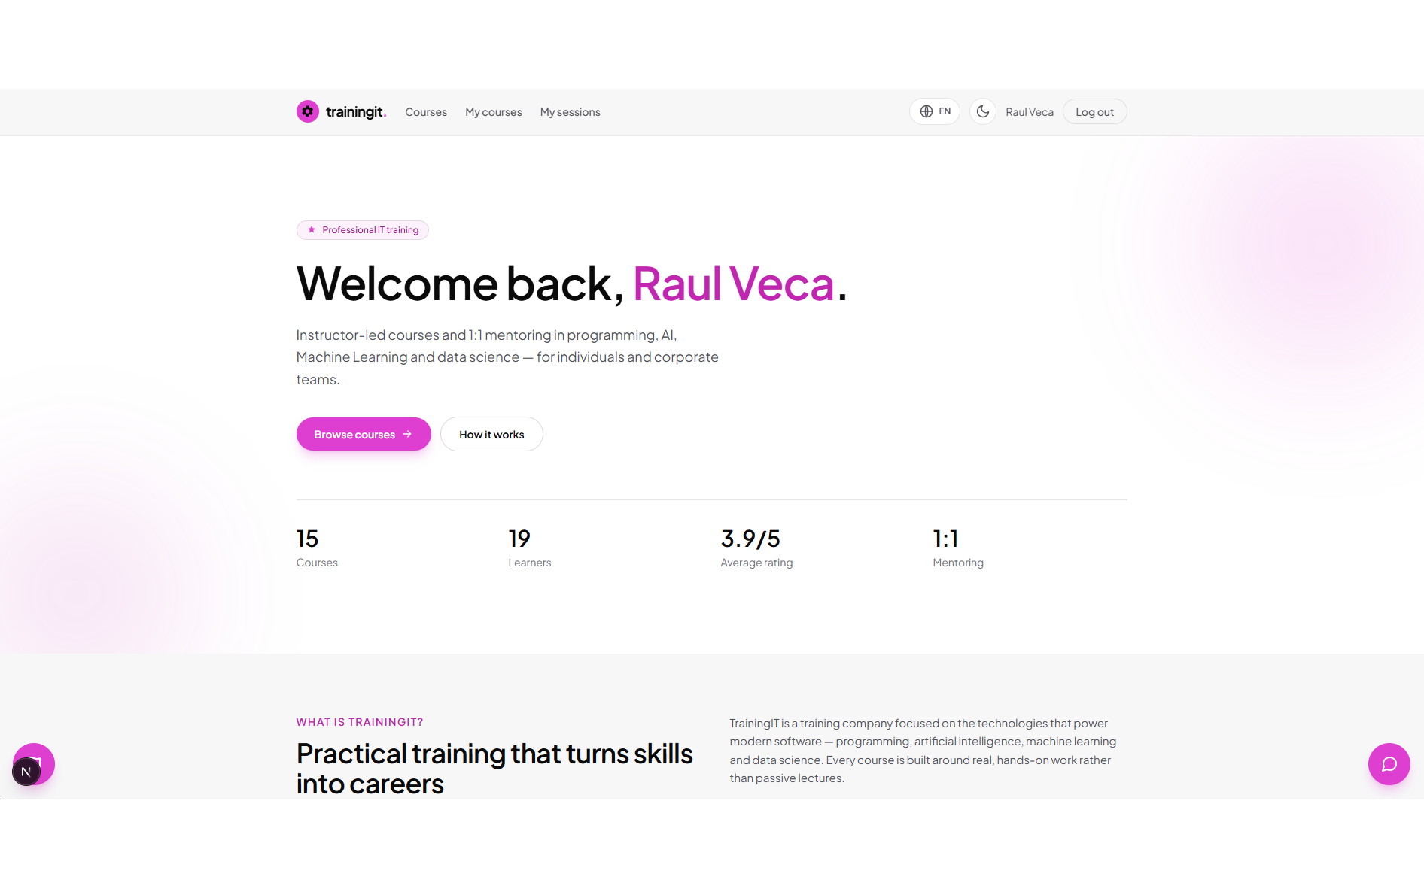
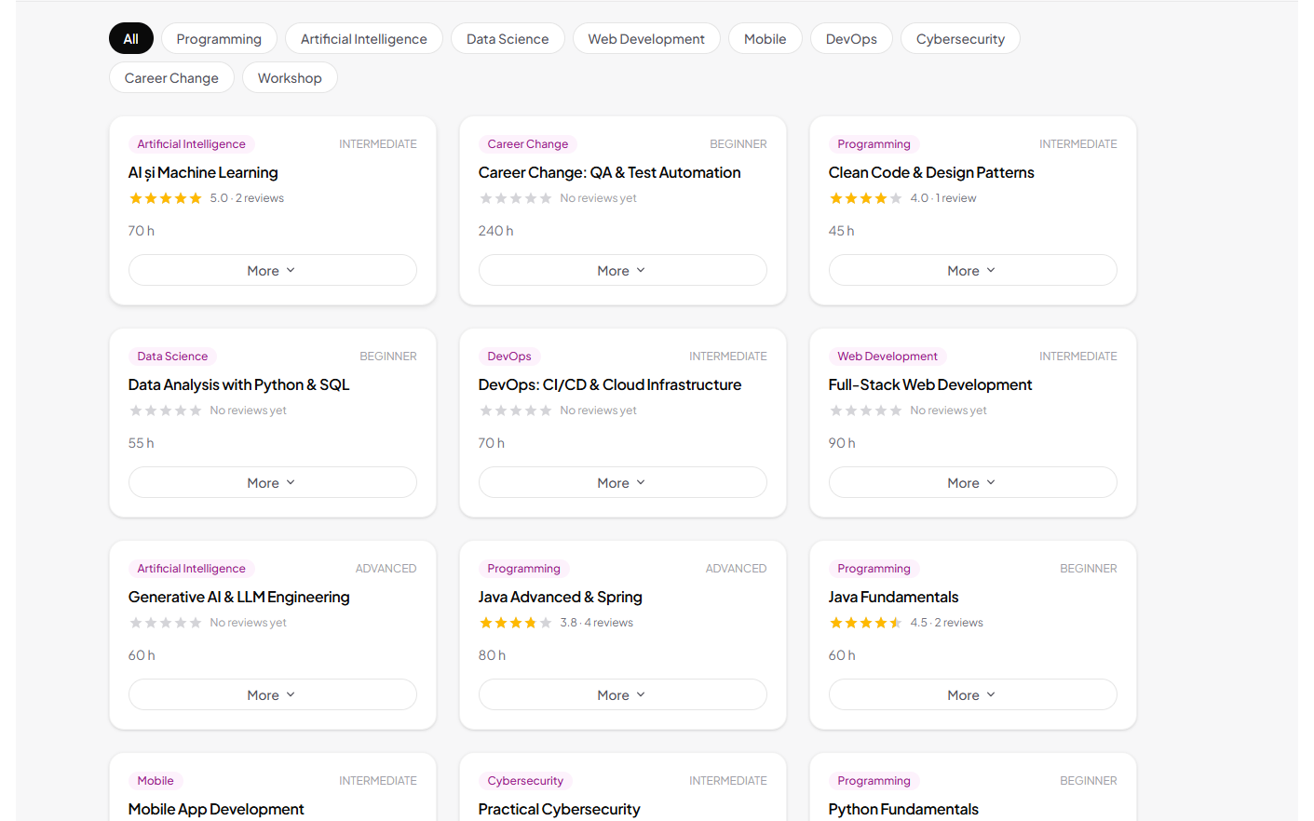
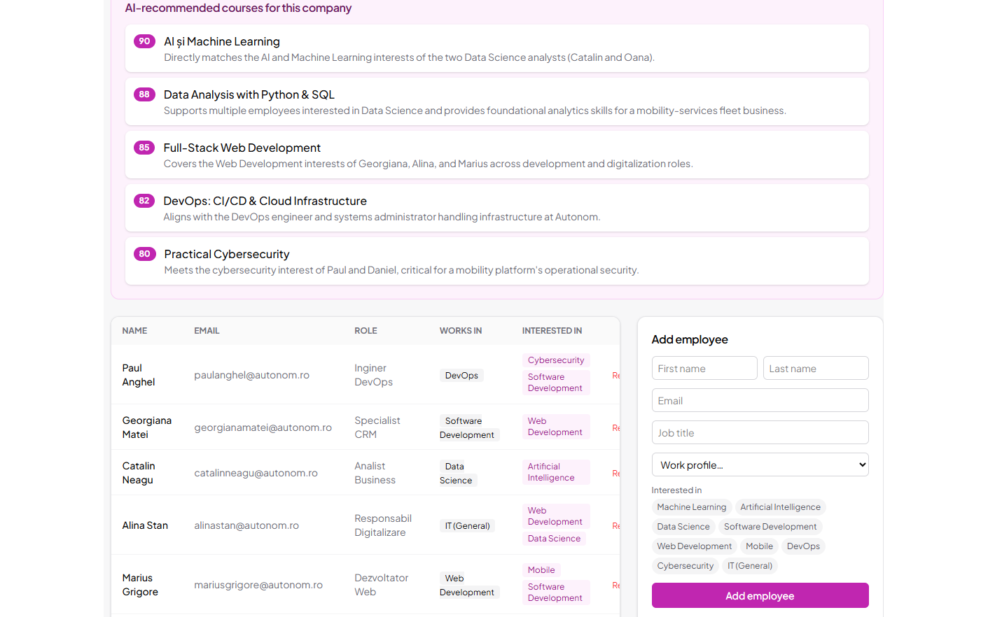
Application Demo
The running application
Authenticated learner home Personalised greeting and live catalogue statistics over SSE
Course catalogue Category filters; each card counts an impression and a click for CTR
Administrator · Employees Company teams, Excel import and AI course recommendations
The same session drives both sides: a purchase made on the catalogue appears immediately in the administrator's Purchases tab, a booking generates its invoice by itself, and a reported issue lands straight in the Issues tab.
Raul Veca - WEST UNIVERSITY OF TIMIȘOARA
Page 11 / 13
Notes:
A short tour of the running application. On the left, the authenticated learner home page with the live statistics. In the middle, the catalogue with its category filters - every card view and every expansion is counted, which is what feeds the click-through analytics. On the right, the administrator's Employees tab with the Excel import and the AI recommendations. If there is time I will demonstrate a purchase appearing live in the Purchases tab.

Slide 7
Conclusion and Future Work
One product where the storefront and the CRM are the same system
Implemented
Limitations and next steps
A client portal: catalogue, one-click purchase, star reviews, 1:1 booking with calendar and payment, issue reporting.
A seven-tab administrator portal: contacts, courses, purchases, invoices, analytics, employees, issues.
An event-driven Java domain layer on classic design patterns, with automatic invoicing and lead scoring.
Live statistics over SSE, Excel import, and CSV / Excel / PDF export.
An optional Claude layer: assistant, recommendation quiz, per-company advice, live translation.
Automated test suite - unit and integration tests over the commands, observers, scoring strategies and REST endpoints, enabling continuous integration.
Stronger authentication - token-based sessions, password hashing at rest, e-mail verification and a genuine reset flow with expiring links.
Richer analytics - historical trends, cohort analysis and exportable dashboards beyond point-in-time metrics.
Deeper AI - conversation memory and AI summaries of support issues.
Deployment and scaling - containerising the two services for a cloud deployment.
A visitor becomes a tracked lead on registration and a customer on the first purchase, and every action after that propagates into the administration portal by itself. That is the result: one click, several reactions, no reconciliation.
Raul Veca - WEST UNIVERSITY OF TIMIȘOARA
Page 13 / 13
Notes:
To conclude. TrainingIT delivers a client portal, a seven-tab administrator portal, a pattern-based event-driven domain layer, live statistics and reporting, and an optional AI layer - meeting the objectives set out in the introduction. The limitations are honest ones: the test suite is a foundation rather than full coverage, and authentication would need hardening for production. The central result is that the storefront and the CRM are not two integrated systems but one. Thank you - I am happy to take questions.

