Slide 1


WEST UNIVERSITY OF TIMIȘOARA
TrainingIT
A Web-Based Application for Selling Programming Courses
Raul Veca
Supervisor: Lect. Dr. Sebastian Ștefăniga
Faculty of Computer Science · Bachelor Thesis Defense, 2026
www.uvt.ro
Notes:
Timing: 0:00-0:15
Good morning. My name is Raul Veca, and I will present TrainingIT, a web application for selling programming courses. The main idea is simple: the learner-facing storefront and the company's CRM are implemented as one product.
[Sources]
- Powerpoint_Presentation.pptx, source slide 1
- TrainingIT_thePDF.pdf, cover and abstract

Slide 2

Problem and Motivation
A storefront and a CRM should not depend on fragile synchronization
The customer side. Learners need a clear catalogue, trusted reviews, quick purchase and simple tutoring reservations.
Problem statement
Use one application and one shared data model so each customer action is captured once and drives the relevant CRM processes automatically.
The business side. The company needs leads, purchases, invoices, analytics and corporate clients in one operational view.
One system. Two role-based experiences. No manual reconciliation.
The integration gap. Separate tools create duplicate or inconsistent data and require slow manual reconciliation.
Raul Veca - WEST UNIVERSITY OF TIMIȘOARA
Page 1 / 6
Notes:
Timing: 0:15-0:55
A training company serves two audiences. Learners expect a modern storefront: clear courses, trusted reviews, quick purchasing and simple tutoring reservations. The company needs a reliable back office for leads, purchases, invoices, analytics and corporate customers. These are normally separate systems. Every synchronization point can create missing or contradictory data, so the practical problem is not only selling courses; it is keeping the customer experience and the CRM consistent.
[Sources]
- TrainingIT_thePDF.pdf, Problem Description
- TrainingIT_conspectare.docx, Chapter 2

Slide 3
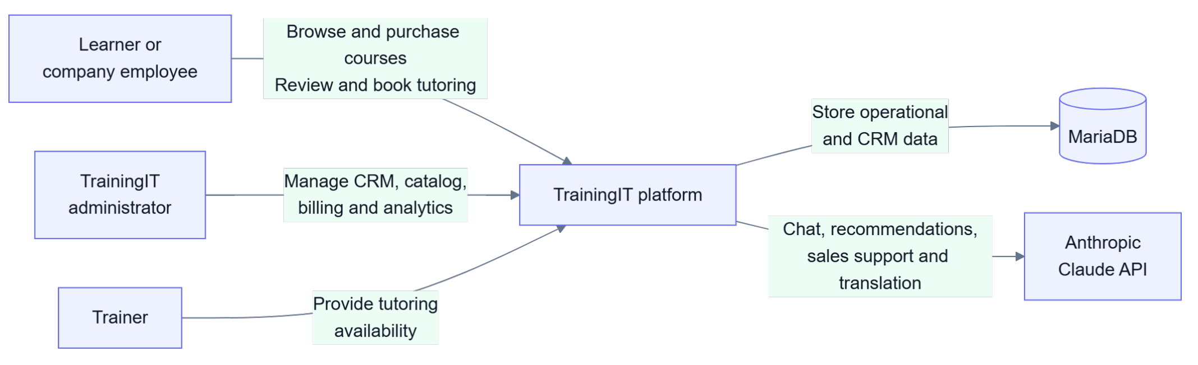
One Platform, Two Experiences
The learner portal and the CRM share the same operational data
Learners create business events; administrators immediately see the resulting contacts, purchases, invoices and issues. MariaDB stores both operational and CRM data; Claude remains optional.
Raul Veca - WEST UNIVERSITY OF TIMIȘOARA
Page 2 / 6
Notes:
Timing: 0:55-1:35
TrainingIT removes that synchronization boundary. Learners, administrators and trainers use different interfaces, but they act on the same backend and the same data model. When a learner registers, buys, reviews, books a session or reports an issue, the corresponding CRM information already exists. MariaDB stores both the operational and CRM records. Claude adds chat, recommendations and translation, but it is optional, so the product remains functional without it.
[Sources]
- TrainingIT_thePDF.pdf, Proposed Solution and Application Architecture
- TrainingIT_conspectare.docx, Chapters 1 and 5

Slide 4

Architecture in Four Layers
REST for commands, SSE for live statistics, EventBus for reactions
Presentation - Next.js 16, React, Tailwind v4 Role-based learner and administrator portals, a typed REST client and live statistics over SSE.
Application - Spring Boot 3.5, Java 17 REST controllers delegate to authentication, AI, trainer, reporting and statistics services.
Domain - plain Java Commands, services and EventBus observers implement the business rules behind one facade.
Persistence - MariaDB via JDBC and HikariCP JDBC and HikariCP persist both CRM and operational data in one relational schema.
Raul Veca - WEST UNIVERSITY OF TIMIȘOARA
Page 3 / 6
Notes:
Timing: 1:35-2:25
The implementation has four layers. Next.js and React provide the learner and administrator portals. Spring Boot exposes the REST API and the live statistics stream. The domain layer contains commands, services, repositories and the EventBus, so business rules are separated from the web controllers. MariaDB persists contacts, enrollments, invoices and issues through JDBC and HikariCP. This structure keeps the application understandable and allows secondary reactions to evolve without rewriting the main user operation.
[Sources]
- TrainingIT_thePDF.pdf, Application Architecture and Technologies Used
- TrainingIT_conspectare.docx, Chapters 5 and 7

Slide 5
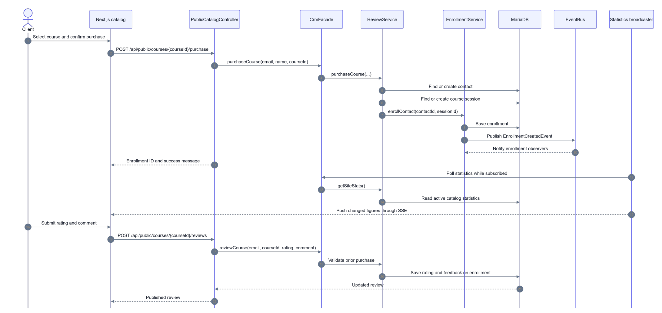
One Click, Several Reactions
One purchase becomes enrollment, audit, CRM history and live statistics
The purchase is saved once. Independent observers handle secondary reactions, so the main operation stays focused and the CRM updates without reconciliation.
Raul Veca - WEST UNIVERSITY OF TIMIȘOARA
Page 4 / 6
Notes:
Timing: 2:25-3:10
This purchase flow is the key technical example. After confirmation, the server finds or creates the contact and the course session, saves the enrollment, and publishes an event. Independent observers can then update the audit trail, lead state and live statistics. The main purchase service does not need to know every secondary effect. The same design supports idempotency: if a booking event is repeated, it does not generate a second invoice.
[Sources]
- TrainingIT_thePDF.pdf, Implementation Details: event-driven core
- TrainingIT_conspectare.docx, Chapter 8

Slide 6
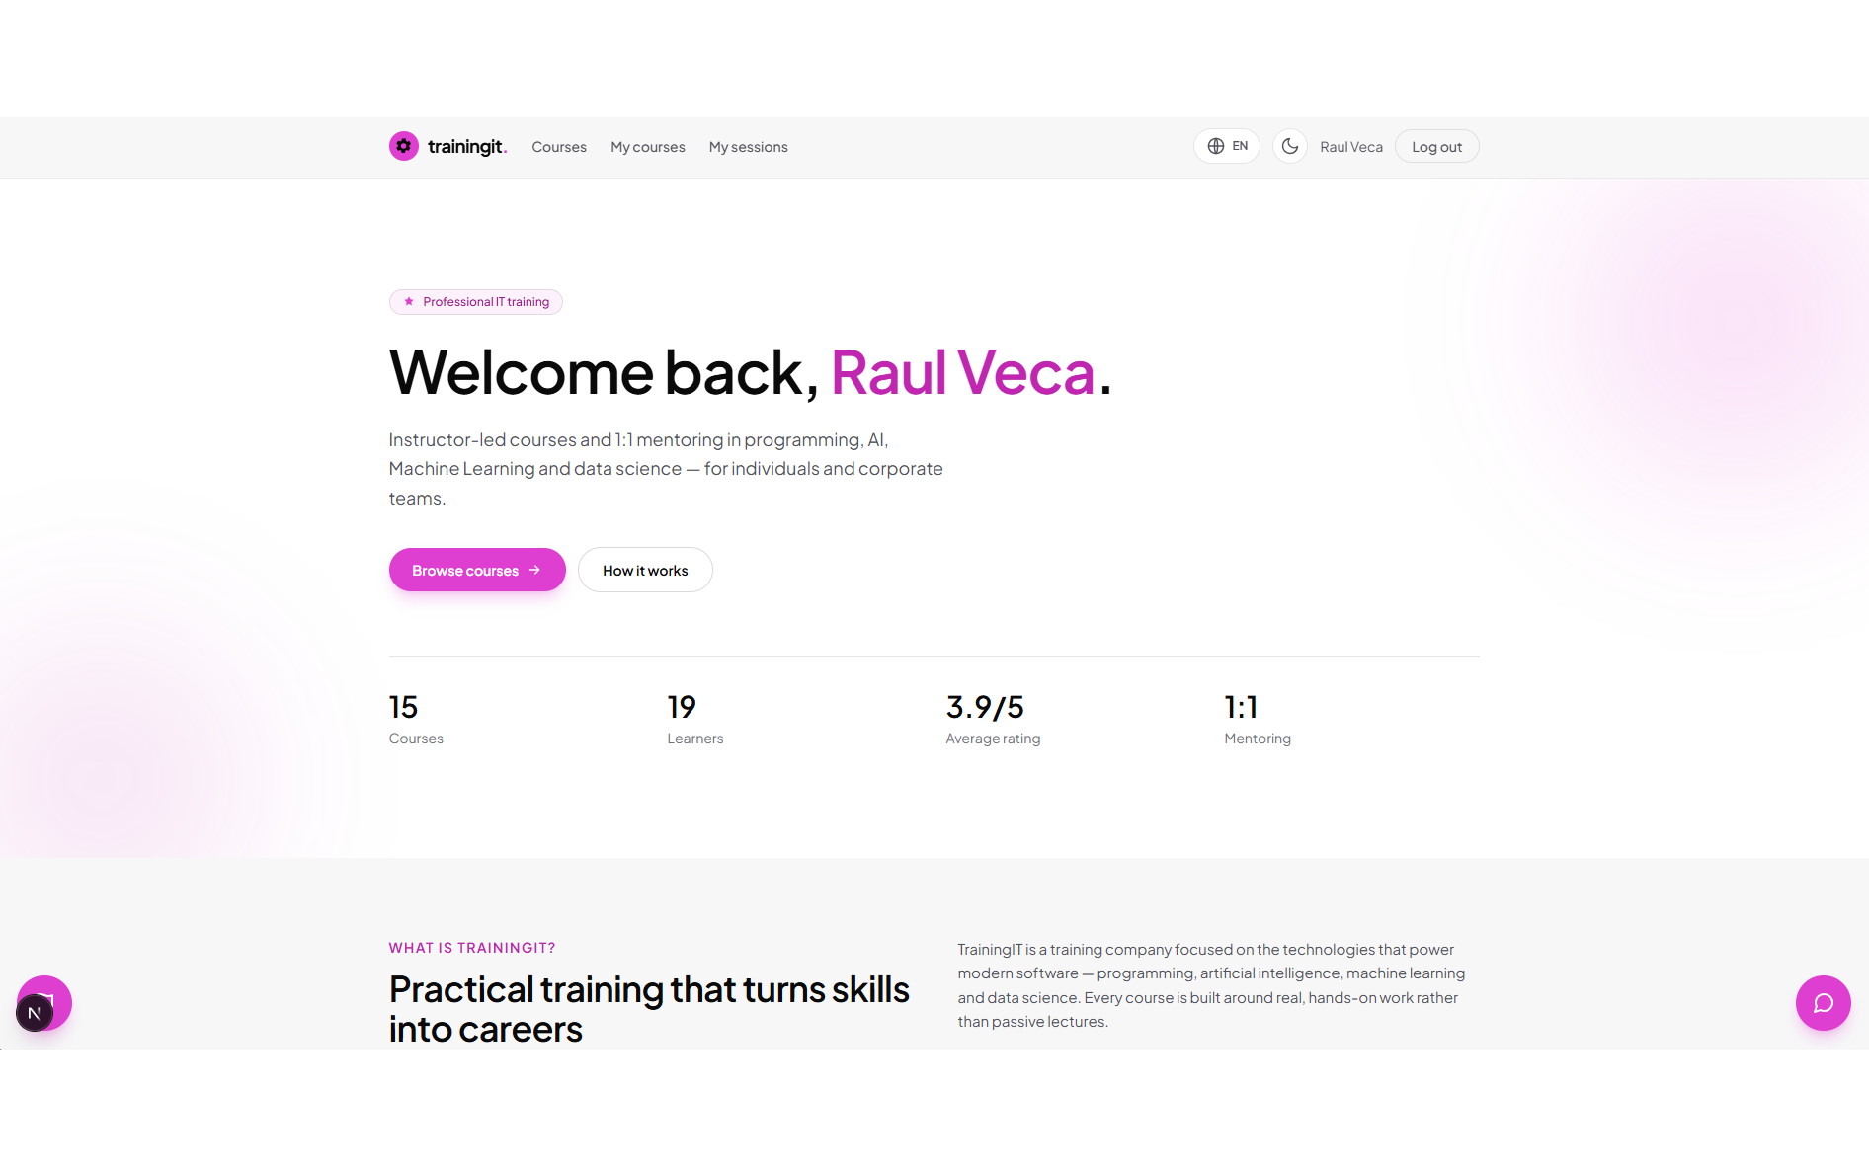
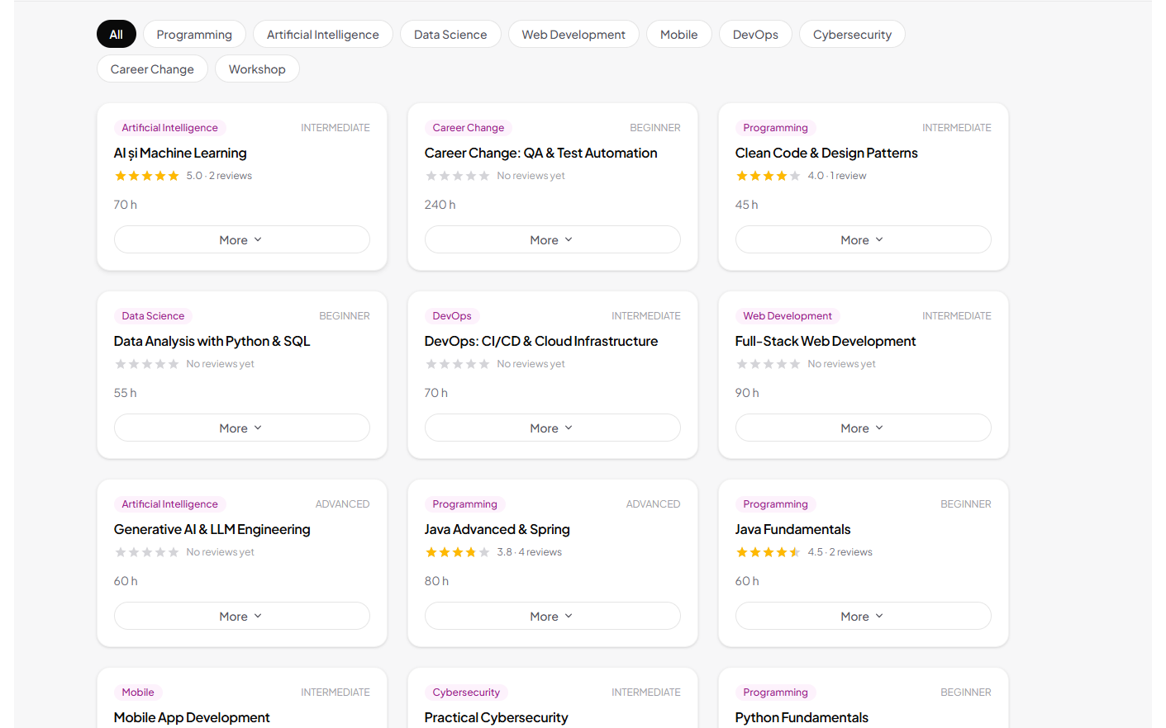
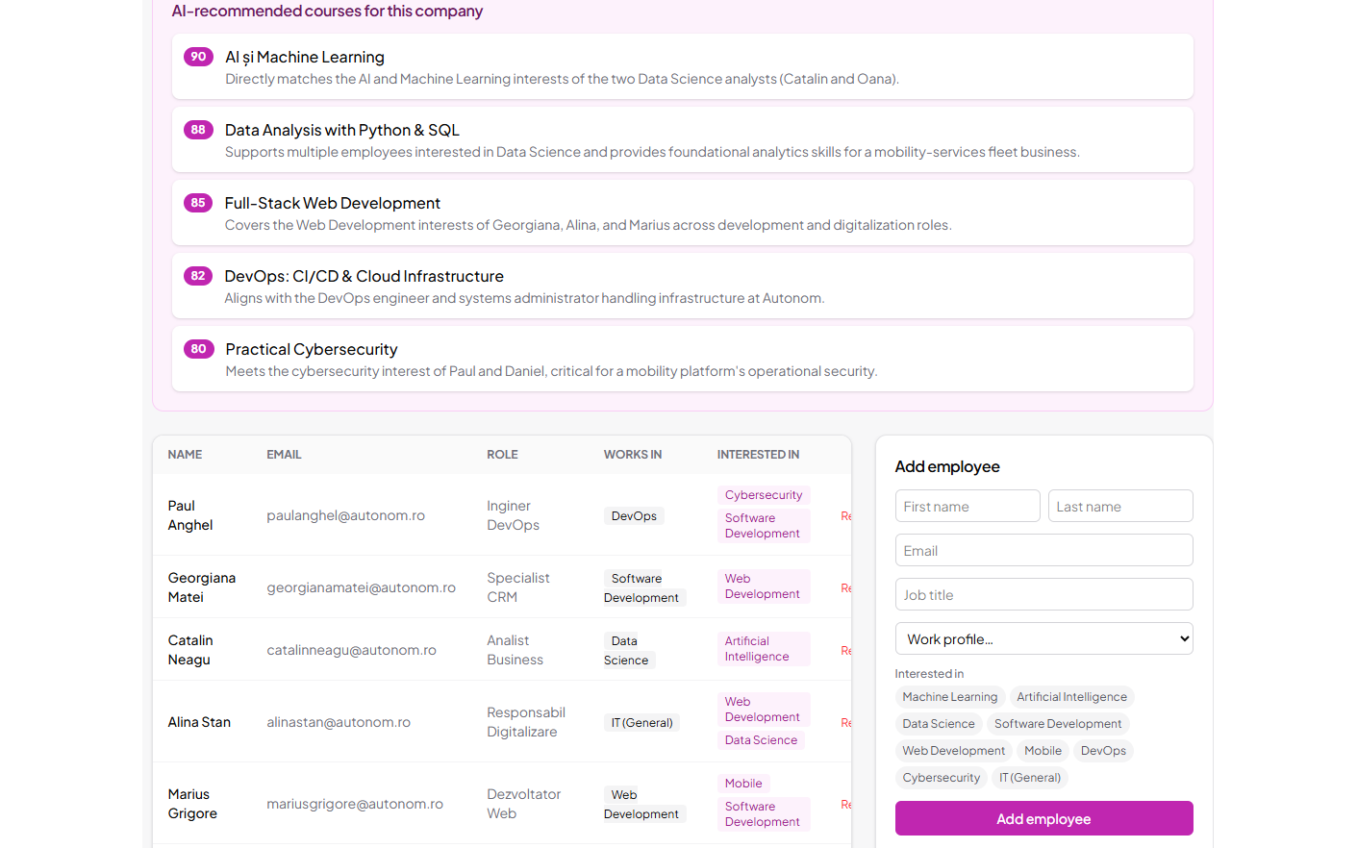
Application Demo
Three views of the same shared system
Authenticated learner home Personalised greeting and live catalogue statistics over SSE
Course catalogue Category filters; each card counts an impression and a click for CTR
Administrator · Employees Company teams, Excel import and AI course recommendations
A learner action appears immediately in the administrator portal, while live statistics and CRM records update from the same data.
Raul Veca - WEST UNIVERSITY OF TIMIȘOARA
Page 5 / 6
Notes:
Timing: 3:10-4:25
Demo path: log in as a learner; open the catalogue; purchase one course; show that it appears in My Courses; add or update a review; then switch to the administrator portal and open Purchases or Contacts to show the same action in the CRM. If time remains, show a tutoring booking and the generated invoice. Keep the narration focused on one action becoming several business reactions.
[Sources]
- Embedded application demo from Powerpoint_Presentation.pptx
- TrainingIT_thePDF.pdf, Application Features
- TrainingIT_conspectare.docx, Chapters 6 and 10

Slide 7
Conclusion and Future Work
TrainingIT demonstrates one coherent storefront and CRM
Implemented
Validated and next steps
Learner portal: catalogue, purchase, reviews and tutoring.
CRM portal: contacts, purchases, invoices, analytics and issues.
Event-driven domain: automated lead scoring and invoicing.
Live SSE statistics, imports and multi-format exports.
Optional Claude assistant, recommendations and translation.
End-to-end flows verified against a real MariaDB instance.
Duplicate invoices prevented through idempotent processing.
Observer failures are isolated; optional AI degrades safely.
Next: automated tests and production-grade authentication.
Next: richer analytics and cloud deployment.
Each customer action is recorded once and becomes immediately available to the business.
Raul Veca - WEST UNIVERSITY OF TIMIȘOARA
Page 6 / 6
Notes:
Timing: 4:25-5:00
In conclusion, TrainingIT delivers the learner portal, the CRM portal and an event-driven domain on one shared model. The end-to-end flows were verified against MariaDB, including duplicate-event and observer-failure scenarios. The next priorities are automated tests, stronger production authentication, richer analytics and cloud deployment. The central result is that each customer action is recorded once and becomes immediately available to the business. Thank you.
[Sources]
- TrainingIT_thePDF.pdf, Testing and Conclusion
- TrainingIT_conspectare.docx, Chapters 9 and 11

