Slide 1

Problem and Motivation
One platform for learning and CRM operations
The customer side. Learners need a clear catalogue, trusted reviews, fast purchase and simple tutoring bookings.
Problem statement
TrainingIT implements both experiences on one backend and one data model. Each customer action is stored once and automatically updates enrolment, billing, lead scoring, audit and support.
The business side. The company must track leads, purchases, invoices, analytics, corporate teams and support requests.
USER and ADMIN remain strictly separated; optional services never block the core workflows.
The integration gap. Separate shop and CRM systems drift out of sync and require slow, error-prone reconciliation.
Raul Veca - WEST UNIVERSITY OF TIMIȘOARA
Page 1 / 7
Notes:
A training company serves two audiences. Learners expect a simple online shop, while the company needs leads, invoices, analytics and support history. If the shop and CRM are separate, every synchronisation point can lose or contradict data. TrainingIT removes that gap: both experiences use the same backend and data model, so each customer action is recorded once and triggers the necessary administrative reactions.

Slide 2
Related Work
Existing tools cover one side of the workflow
Each tool family is strong in one area; none owns the full storefront-to-CRM workflow.
Tool family | Strength | Limitation
Course marketplaces e.g. Udemy, Coursera | Excellent storefront, catalogue, reviews and checkout | Aggregators: the provider owns no customer relationship and has no integrated CRM
Learning management e.g. Moodle | Strong at delivering and tracking course content | Built around content, not selling; commerce and CRM are plug-ins bolted on
CRM platforms e.g. Salesforce, HubSpot | Powerful contacts, pipelines, lead scoring and reporting | Generic: no course catalogue, trainer calendar or public storefront
E-commerce engines e.g. WooCommerce | Self-hosted and able to sell anything, including courses | A course is just a product: no lead stages, tutoring sessions or corporate training
TrainingIT's distinction: one shared backend and data model, specialised for course sessions, trainer calendars, employee discounts and course analytics.
Raul Veca - WEST UNIVERSITY OF TIMIȘOARA
Page 2 / 7
Notes:
Existing products solve only part of this workflow. Course marketplaces offer discovery and checkout but do not give one provider an integrated CRM. Moodle focuses on learning delivery. Salesforce and HubSpot manage customers but do not understand course sessions or trainer calendars. WooCommerce sells courses as ordinary products. TrainingIT's difference is domain-specific integration: storefront and CRM are one product.

Slide 3
Contribution
An implemented product: storefront and CRM as one system
Applied contribution
TrainingIT is an implemented full-stack product - not a prototype - that unifies a course storefront and CRM on one backend and shared data model.
Objectives
Design boundary
Client portal: catalogue, purchase, reviews and 1:1 booking.
Admin portal: seven CRM and operational sections.
Event-driven Java domain layer with classic patterns.
Optional AI with graceful degradation.
Operational and CRM data persisted in MariaDB.
TrainingIT is specialised for one training company, not a general e-commerce platform or generic CRM.
The AI layer adds capabilities, but core workflows never depend on it.
Raul Veca - WEST UNIVERSITY OF TIMIȘOARA
Page 3 / 7
Notes:
The contribution is applied: a working full-stack system, not only a design. It includes a client portal, a seven-section administrator portal, persistent MariaDB data and an event-driven Java domain layer. Classic patterns keep responsibilities separated, while the AI layer is optional. The boundary is deliberate: this is a specialised product for a training company, not a generic shop or generic CRM.

Slide 4

Notes:
The browser layer is Next.js and React, with route protection, a typed REST client and SSE for live statistics. Spring Boot exposes thin controllers and application services. The Java domain layer contains commands, services, EventBus observers, repositories and DAOs. MariaDB persists both operational and CRM data through JDBC and HikariCP. Claude is the only optional external service.

Slide 5
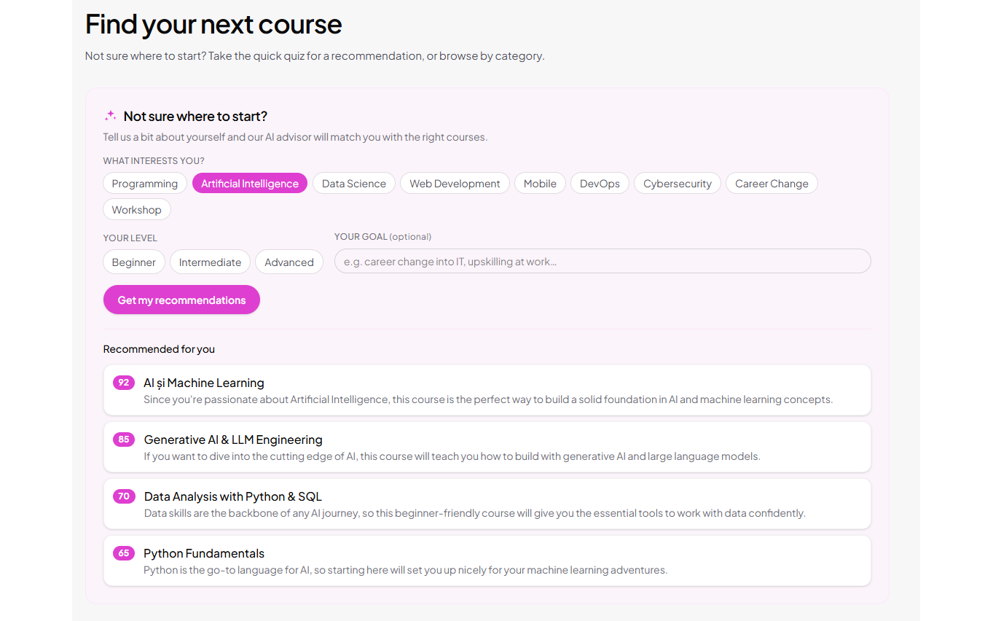
The AI Layer
Four optional capabilities; zero dependency for core workflows
Conversational assistant /api/ai/chat Answers questions about courses, enrolment and corporate training, using the live catalogue as context.
Recommendation quiz /api/ai/recommendations/visitor Matches a visitor's interests, level and goal to courses, each with a fit score and a reason.
Per-company recommendations /api/ai/recommendations/company Analyses employee roles and interests to propose a training programme for a whole team.
Live page translation /api/ai/translate Translates the interface into any language, preserving brand names, people, e-mails and numbers.
One Claude client powers all four features. Prompts, REST endpoints and structured responses are isolated so the application remains fully operational without an API key.
Strictly additive: with no API key the buttons disappear
Raul Veca - WEST UNIVERSITY OF TIMIȘOARA
Page 5 / 7
Notes:
The AI layer provides four capabilities: catalogue-aware chat, a visitor recommendation quiz, training suggestions for company teams and dynamic page translation. They share one Claude client, while prompts and structured responses stay behind dedicated endpoints. The key architectural property is graceful degradation: without an API key, the AI controls disappear and all core application workflows continue normally.

Slide 6
Application Demo
Live demonstration
Raul Veca - WEST UNIVERSITY OF TIMIȘOARA
Page 6 / 7
Notes:
I will now switch to the running application. I will show the learner catalogue, a purchase appearing in the administrator portal, and the AI recommendation flow if time allows. The important observation is that both portals operate on the same session data and shared backend, so the administrative result appears without a separate synchronisation step.

Slide 7
Conclusion and Future Work
One product, one data model, no manual reconciliation
Implemented
Limitations and next steps
Client portal for course discovery, purchase, reviews, tutoring and issues.
Seven-tab admin portal for CRM and operations.
Event-driven Java domain layer with automatic reactions.
Shared MariaDB data and live statistics via SSE.
Optional Claude assistant, recommendations and translation.
Automated unit and integration tests with CI.
Hardened authentication and password handling.
Historical and cohort analytics with exports.
AI memory and summaries of support issues.
Containerised deployment and cloud scaling.
Result: one customer action is stored once and propagated automatically - no manual reconciliation.
Raul Veca - WEST UNIVERSITY OF TIMIȘOARA
Page 7 / 7
Notes:
TrainingIT meets the main objective: the storefront and CRM work as one coherent product. A registration creates a lead; a purchase, review, booking or issue is reflected automatically in administration. The next priorities are automated test coverage, stronger authentication, richer analytics, deeper AI context and cloud deployment. The final result is simple: one action, several reactions, no manual reconciliation.

