Slide 1

HvA Immersive Lab Template
Introduction

Slide 2
Basics of the template I
No need to re-render for the position
Easy to change
Content
Content
Content
Content
Content
Screen/
beamer
Screen/
beamer
Screen/
beamer
Screen/
beamer
Screen/
beamer

Slide 3
Basics of the template II
No need to re-render for the position
Easy to change
Content
Splitter
Screen/
beamer
Screen/
beamer
Screen/
beamer
Screen/
beamer
Screen/
beamer

Slide 4
Types of content we can load
Images
Video
Sound

Slide 5
Basics of the template - interaction
Content
Modifier
Screen/
beamer
Interaction/trigger

Slide 6

Your body can modify your content.

Slide 7
Triggers ready to use
Mac / Windows
Device movement
Facial recognition
Open mount
Smile
Eyes closed
Windows (NVIDIA)
Body tracking
Hands position
Squads

Slide 8

Depending on your ideas we can add more triggers and interactions.

Slide 9
Zig sim I
Free version
Good for interactions where you attach the device to the user
Pro Version
Facial recognition
Depth Camera
Not very stable for body tracking

Slide 10
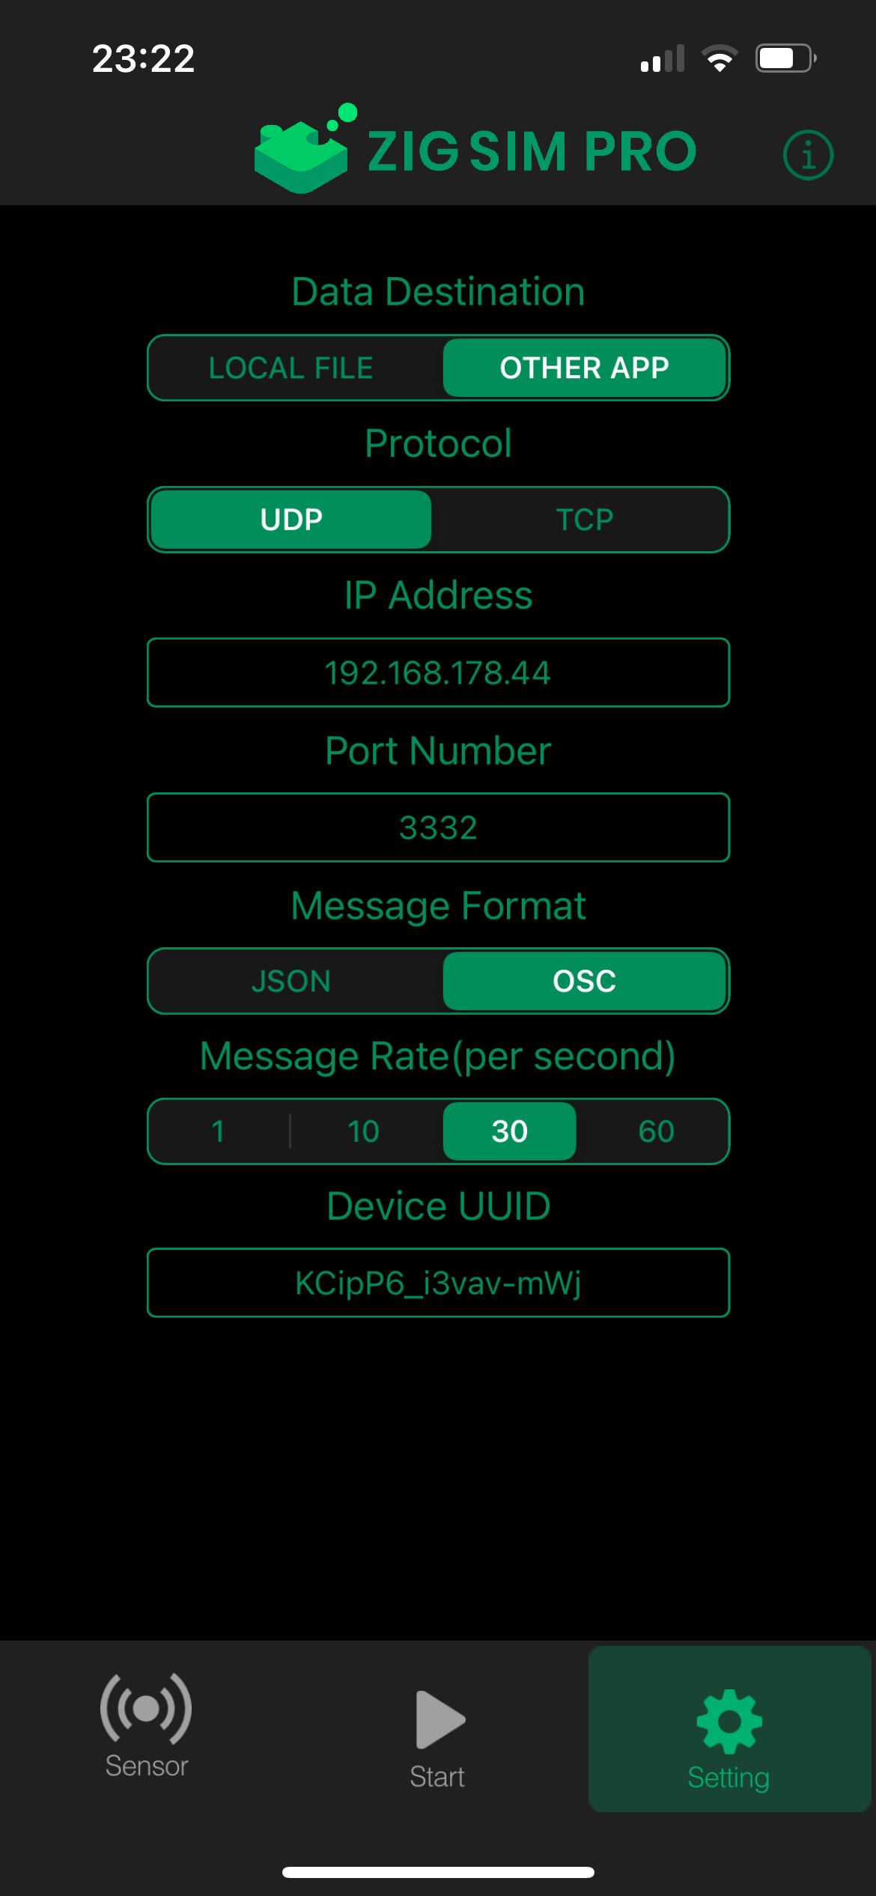
Zig Sim II

Slide 11
References
Zig Sim https://1-10.github.io/zigsim/getting-started.html
ARKIT Face recognition model
Body track model

