Slide 1
Touch Designer basic Workshop
16-10-2023 Immersive Environments minor – HvA Amsterdam
By Raul Leal

Slide 2
Constrains…
It is done in
TochDesigner and...
Only uses...
Only uses...
It is a 2d animation,
i.e no 3d scenes, objects etc..

Slide 3

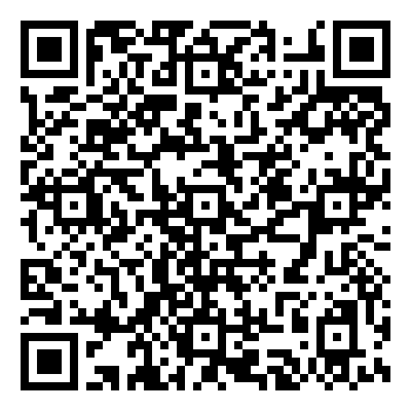
YouTube channel
https://www.youtube.com/watch?v=AMGkNHyQ4o0&list=PL3zGSOEHGdiR5x5BIg8E8yn2BQMbQ6igb

Slide 4

TouchDesigner Documentation
https://docs.derivative.ca/Main_Page

Slide 5

Git repository for this course
https://github.com/Rauleal/Immersive_enviroments_hva

Slide 6





Interesting Artist/tutorials
Elekktronaut
Paketa12
Noto the talking ball
The Interactive Immersive HQ
Derivative foundamentals

