Slide 1
Touch Designer basic Workshop
16-10-2023 Immersive Environments minor – HvA Amsterdam
By Raul Leal

Slide 2
Hi my name
is Raul Leal

Slide 3

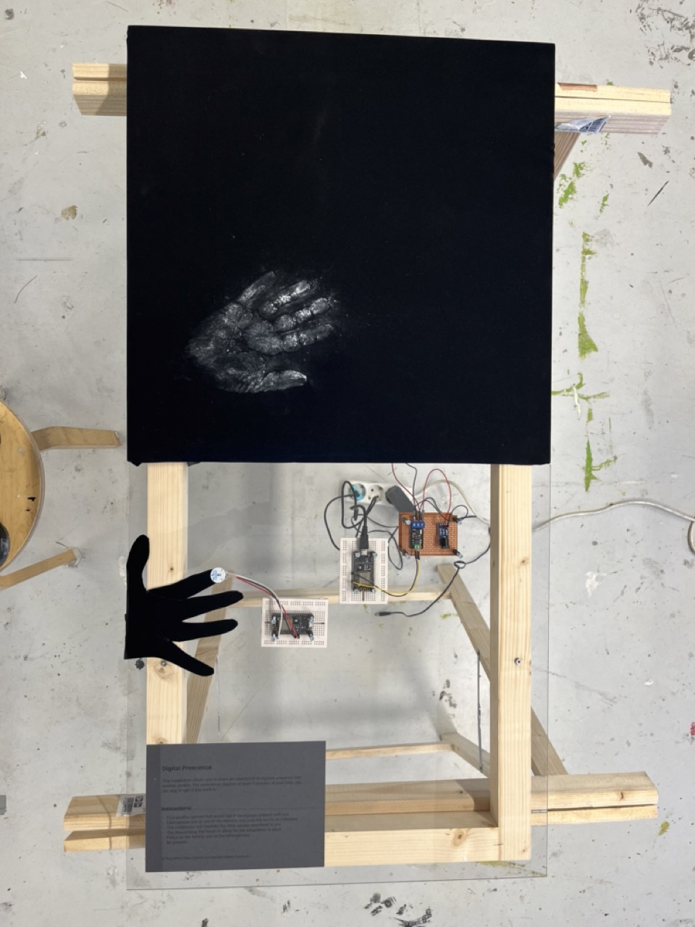
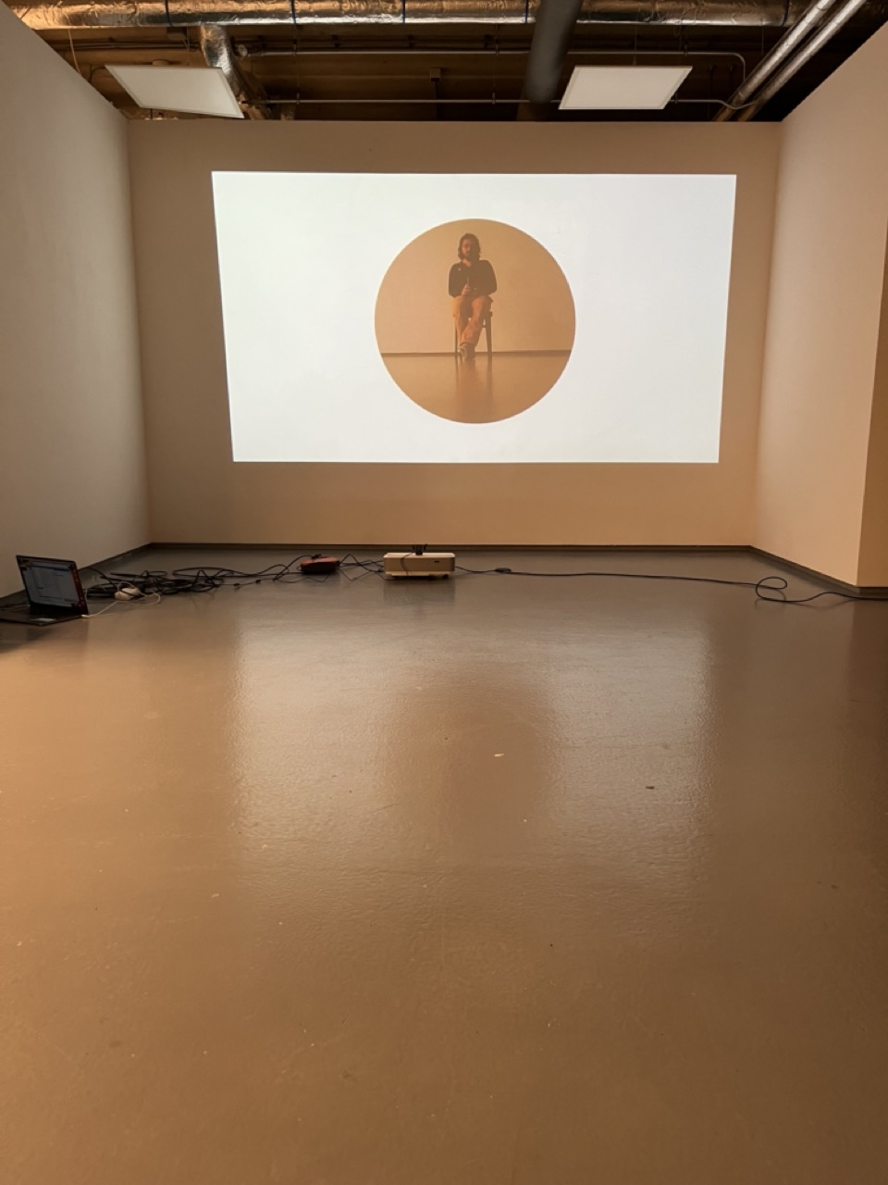
Me
Creative technologist
Rietveld – DogTime Unestable Media
In my practice I aim to use technology as companion for creation instead of simply as a tool

Slide 4
TouchDesigner
Node based programming language
Essentially function composition f(g(h(x)))
Very good for making data into visuals (not scientific)
Very good for sensor data and sending it back to devices
Not good to make sound – go to Ableton or Max
Good to orchestrate midis though

Slide 5
Constrains for the workshop…
It is done in
TochDesigner and...
Only uses...
Only uses...
It is a 2d animation,
i.e no 3d scenes, objects etc..

Slide 6
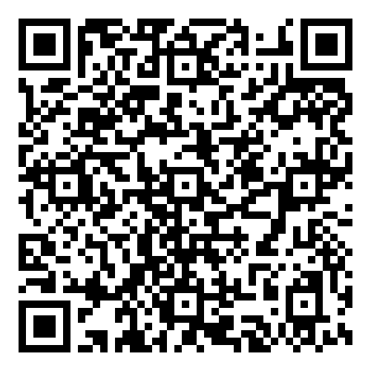
YouTube channel
https://www.youtube.com/watch?v=AMGkNHyQ4o0&list=PL3zGSOEHGdiR5x5BIg8E8yn2BQMbQ6igb

Slide 7
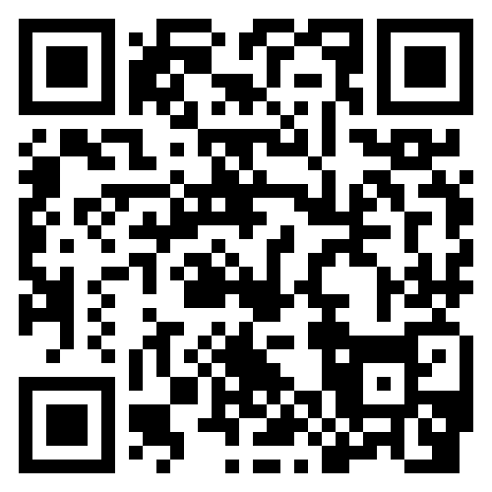

Email_to: raul.leal@thefuturepartners.nl
https://www.instagram.com/raul.andres.leal/
https://rauleal.com/

Slide 8

Git repository for this course
https://github.com/Rauleal/Immersive_enviroments_hva

Slide 9

TouchDesigner Documentation
https://docs.derivative.ca/Main_Page

Slide 10

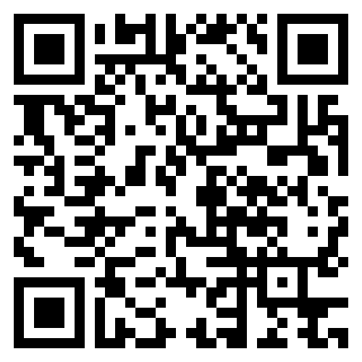



Interesting Artist/tutorials
Elekktronaut
Paketa12
Noto the talking ball
The Interactive Immersive HQ
Derivative foundamentals

