Slide 1

UI-Programming Project
By Rauls Bergs

Slide 2
Short Description
Name of the Game: Warrior on a Killing Spree
About the Game: The player will have a sword , shield and heal ability at their disposal to defeat the enemies. Killing enemies will grant them coins to increase the effectiveness of their skills. The objective is to kill 10 rounds of enemies to win the game.

Slide 3
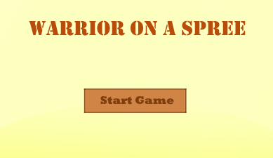
Opening Screen
The player will be greeted with a simple opening screen prompting the player to press the “start game” button.

Slide 4
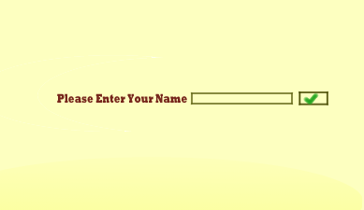
Enter Username
This is the next screen and will ask the player to input the name they want to be addressed by

Slide 5
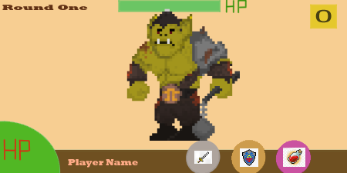
Round one Battle Screen
Round one enemy is an Orc. The player will be able to choose between attacking the orc , shielding against its attack or heal.
As the players health is full , he decided to take a risk and attack.

Slide 6
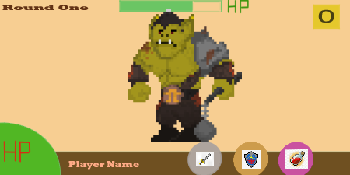
Round one Battle Screen
The player deals damage to the orc.

Slide 7
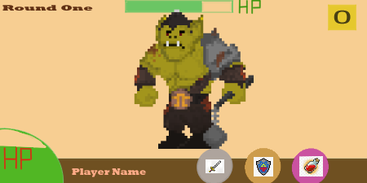
Round one Battle Screen
The orc attacks the player, and the player loses health.

Slide 8

Round one Battle Screen
The players uses the heal ability and is restored to full health.

Slide 9
Round one Battle Screen
The orc shielded. (gameplay unaffected)

Slide 10
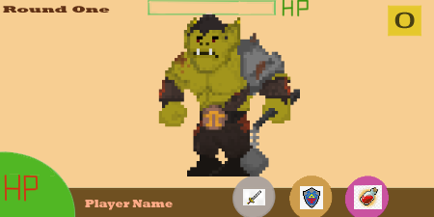
Round one Battle Screen
The player chose to attack again. It was a critical hit, and the orc is destroyed.

Slide 11
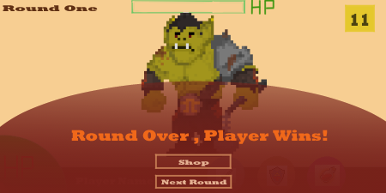
Round one Battle Screen
The player Got 11 Coins from defeating the first-round enemy.
The player chooses to go to the shop before starting the next round

Slide 12
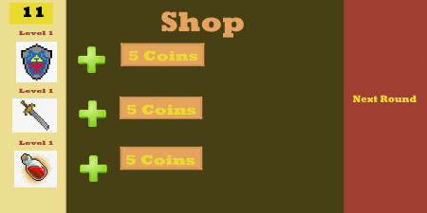
Shop UI
The player has 11 coins in total
The player can upgrade all the abilities , first upgrade costs 5 coins.

Slide 13

Shop UI
The player upgraded their shield ability to level 2 to mitigate more damage.
The player has now 6 coins left in total and the next upgrade for the shield is 10 coins.
Player pressed the ‘Next Round’ Banner.

Slide 14
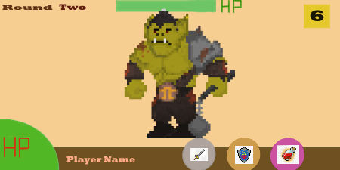
Round 2
The player is now in round 2.

Slide 15

Finish
That is the core game loop and mock layout of the User Interface in the game.

