Slide 1

New Type of Crowdfunding

Slide 2



The Situation
(recurring payments)

Slide 3

Revealing personal data
High fees for transactions
Lack of trust
The Problem

Slide 4
The Solution

Slide 5

Privacy preserved
1.

Slide 6

Low fees
2.

Slide 7
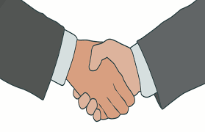
Trustless execution
3.

Slide 8



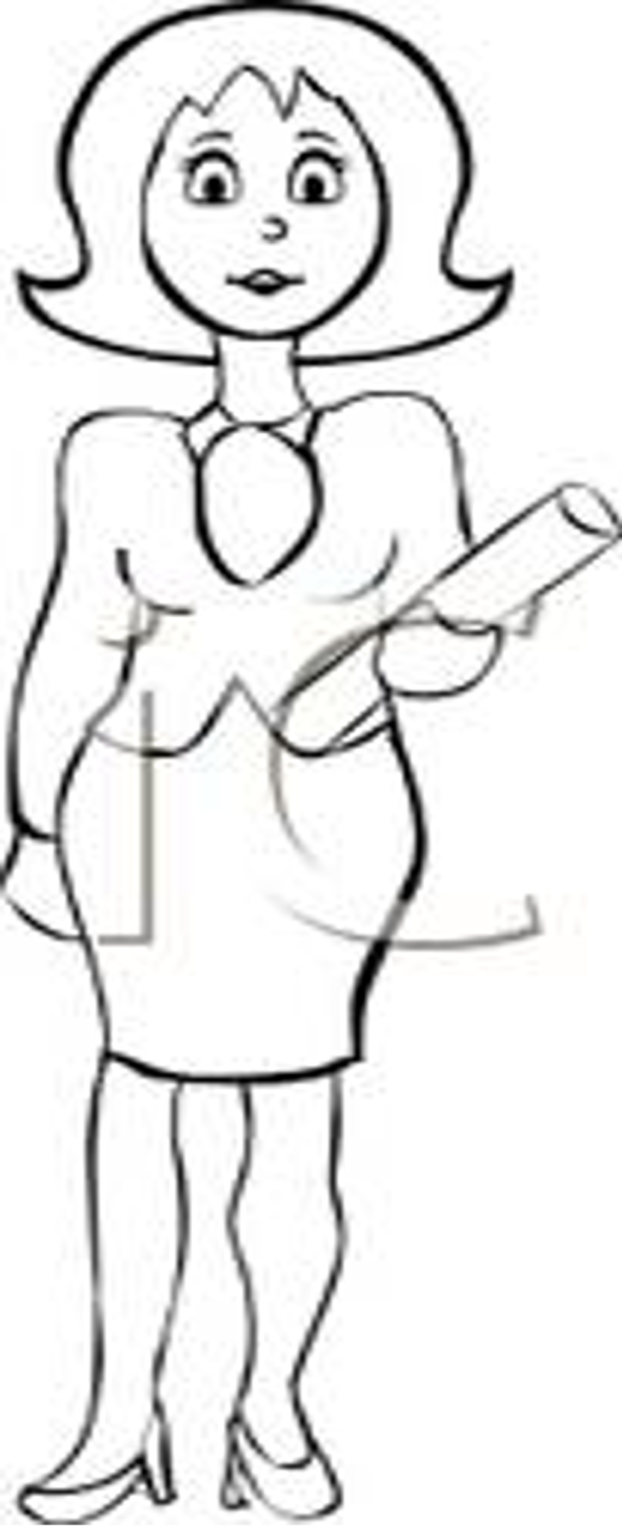


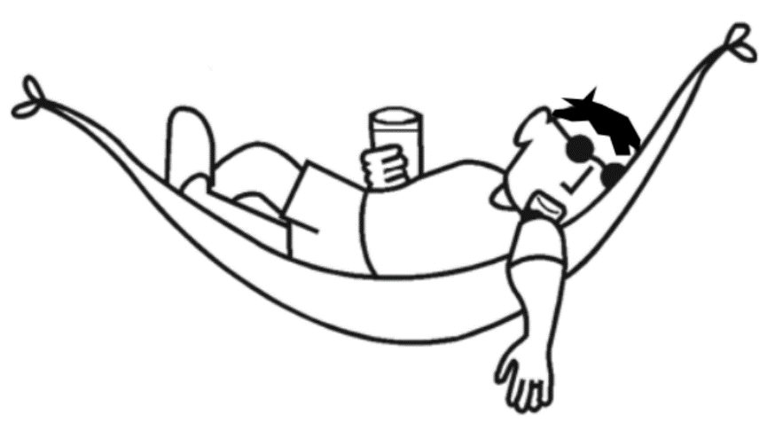
6
3
1
2
12
11
10
9
8
7
5
4
12
Bob
Alice
Charlie

Slide 9
Demo

Slide 10
github.com
/s-tikhomirov
/pethreon
Code

