Slide 1


Census Project
Name – Raunak Masih
Student Number - 202405832

Slide 2
A brief overview about the presentation:
1. Objective
2.The Process of Cleaning Data
3. Cleaning Measures Taken
4.Significant Findings and Future Steps

Slide 3
Objective
1. Aim of the Census Project: The principal aim of the census project is to guarantee the integrity and accuracy of the gathered demographic information.
2. Thorough Data Cleaning Procedures: This entails putting in place comprehensive data cleaning procedures to find and rectify any errors, missing numbers, or inconsistencies in the dataset.
3. Enhancing Data Reliability and Quality: The goal of data cleaning is to raise the overall standard and reliability of census data. This is crucial for making informed policy decisions and resource allocations based on accurate demographic information.
4. Make well informed decision about investments and land development by analyzing census data.

Slide 4
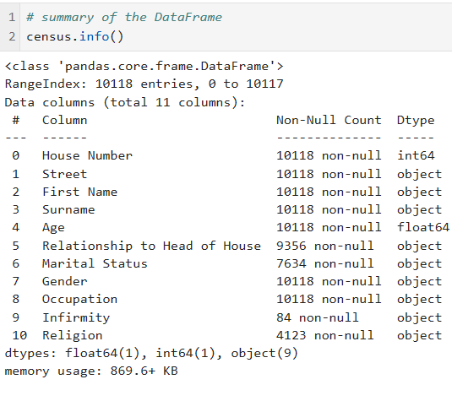
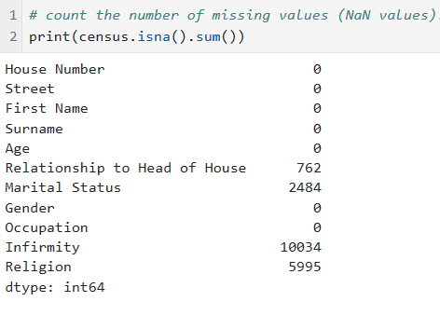
Data Cleaning
Summary of the DataFrame
Count the number of missing (NaN) values

Slide 5
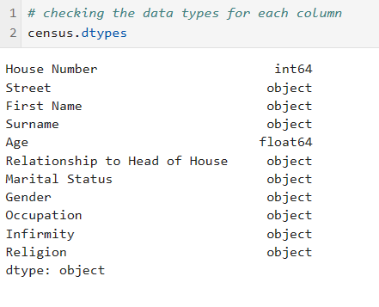
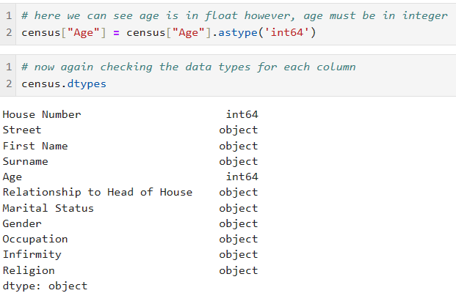
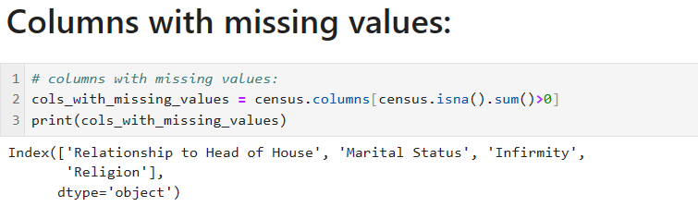
Checking the data type of columns and converting it to appropriate type
Checking the data type
Converting the data type

Slide 6

Cleaning and Filling ‘Relationship to Head of House’
Checking number of NaN values:
Fill the missing values in 'Relationship to Head of House' column:
We first extract the values with same "house number" and "street" then take the non missing values of the “Relationship to head of house" afterwards, perform some operations and then fill blank with either ‘child’, ‘spouse’ or ‘lodger/visitor’.

Slide 7
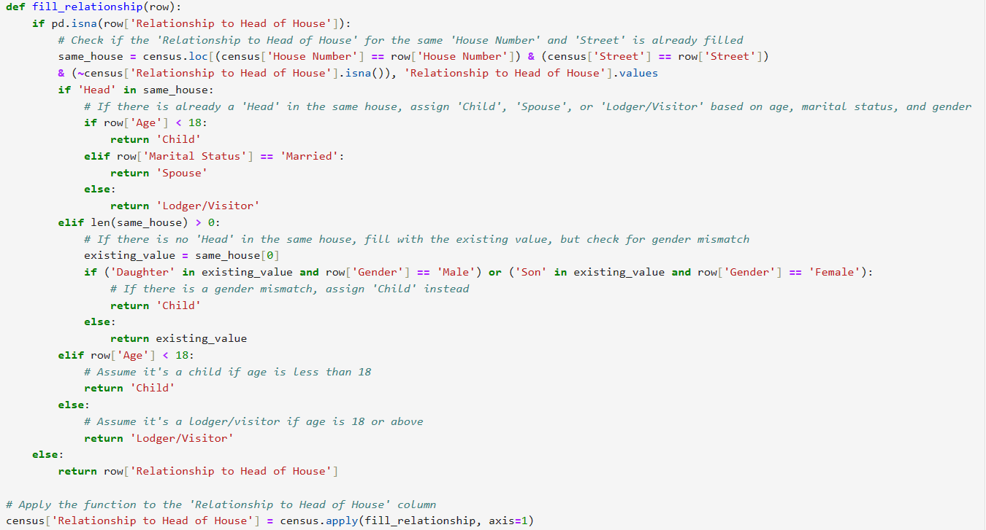


Slide 8

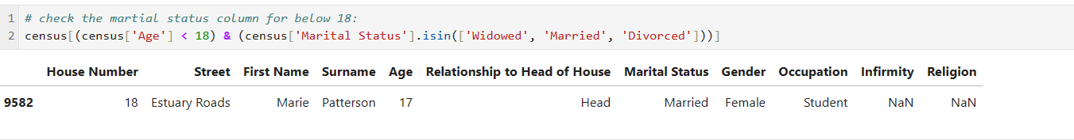
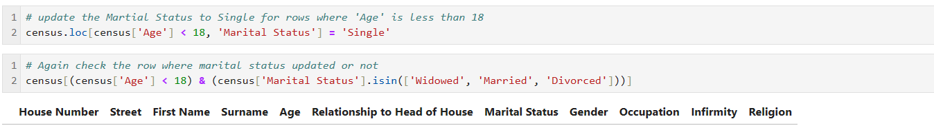
Cleaning and Filling ‘Marital Status’

Slide 9
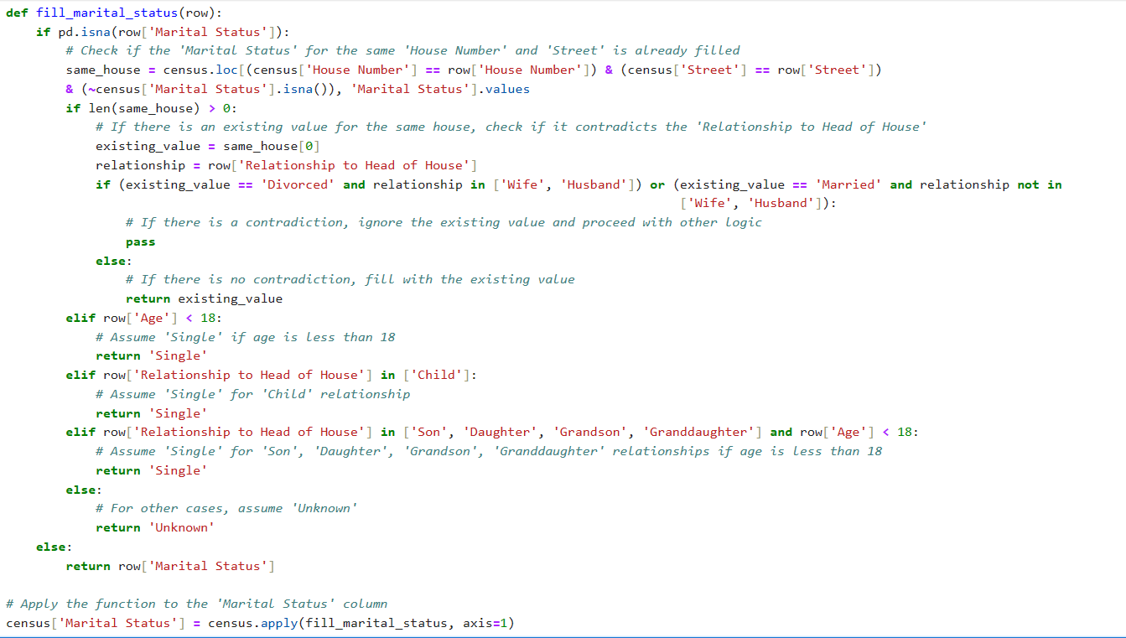


Slide 10
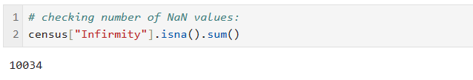
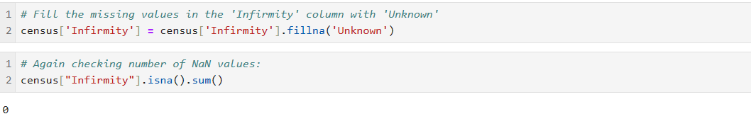
Cleaning and Filling ‘Infirmity’

Slide 11
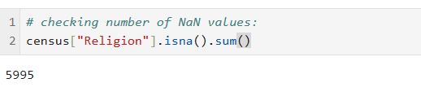
Cleaning and Filling ‘Religion’
If everyone in a certain "house number" and "street" shares the same "religion," then fill in the blank with that specific value. If not, mark the missing religion as "unknown."

Slide 12
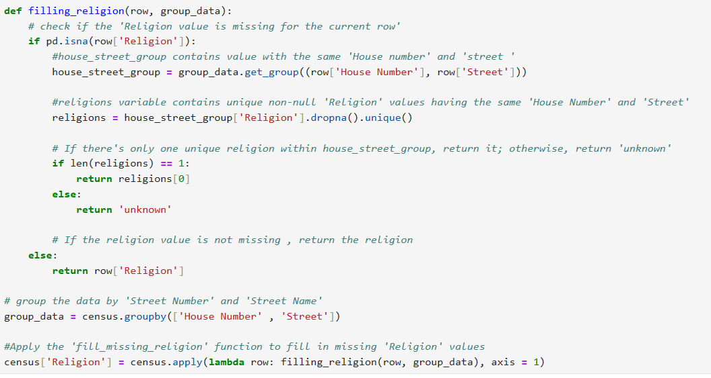
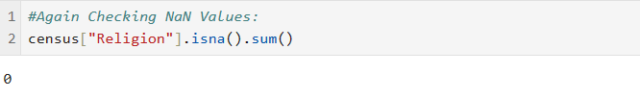

Slide 13
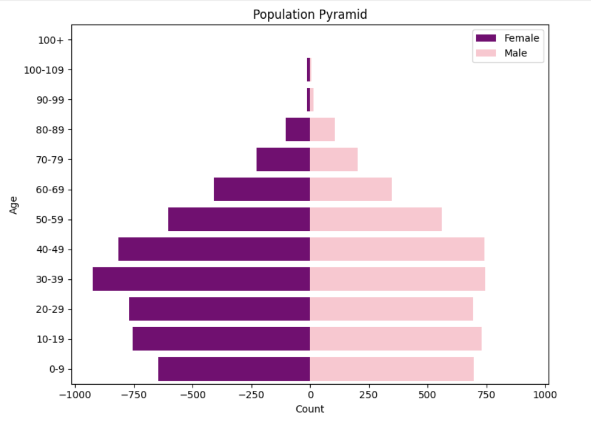
Early Insights
30-39 is the highest population group.
If the population is increasing significantly, especially in the 20–39 age range, then high density housing should be constructed.
If the town could see a rise in commuter demand, a train station should be constructed. The age range of 10 to 19 years old may be a reliable predictor of future commuters..
If there is a chance that there may be more injuries or pregnancies in the future, especially among the 20–39 age range, emergency medical buildings should be constructed.
In the event that there is evidence of widespread unemployment in the population, particularly in the 20–39 age range, employment and training should be prioritized.
If there is evidence of an increase in the number of school-age children (new babies or families moving into the town), particularly in the 0–19 age group, then increasing school funding should given priority.
If the town is growing, more money will need to be invested in general infrastructure since waste collection, road servicing, and other services would be needed.

Slide 14
Further Analysis:
Birth Rate
Death Rate
Unemployment Rate
Religious Distribution
Divorce and Marriage Rate

Slide 15
Thank you

