Slide 1

Multiplex BOOKING SYSTEM
Team –B:
Hanush kumar
Raunak Das
Rahul Tej
Sandhya Kumari
Bhaviteja
Revathi

Slide 2
USER REGISTRATION Hanush Kumar
Multiplex Booking System is an Application, which is used to book Movie Tickets.
User needs to register his profile in order to login and book movie tickets.
Upon Registering himself using his details like name, email id, phone number, password, the page redirects to another page which displays as registration successful
If the user is an existing user then he needs to login using the valid credentials. If the user enters invalid credentials, it will show the error message to enter valid credentials

Slide 3
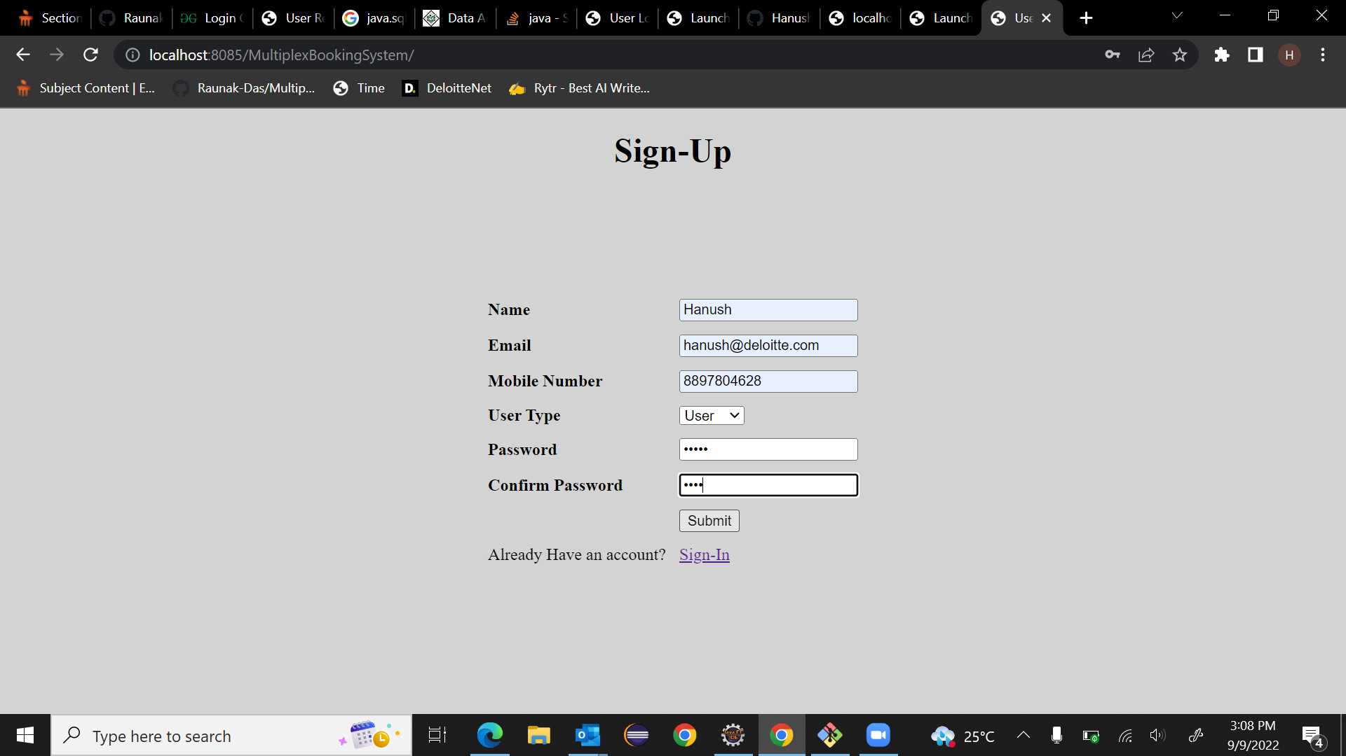
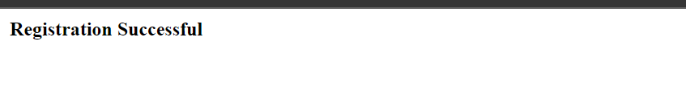
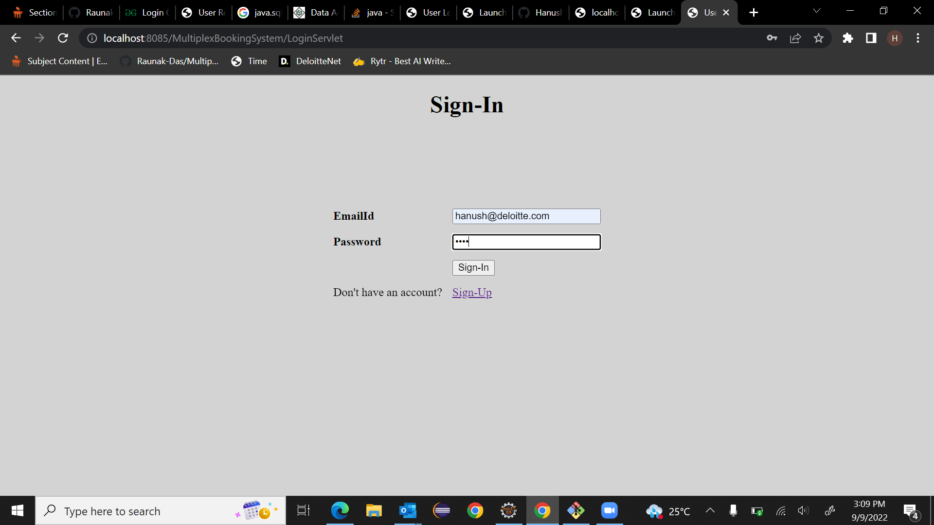

Slide 4
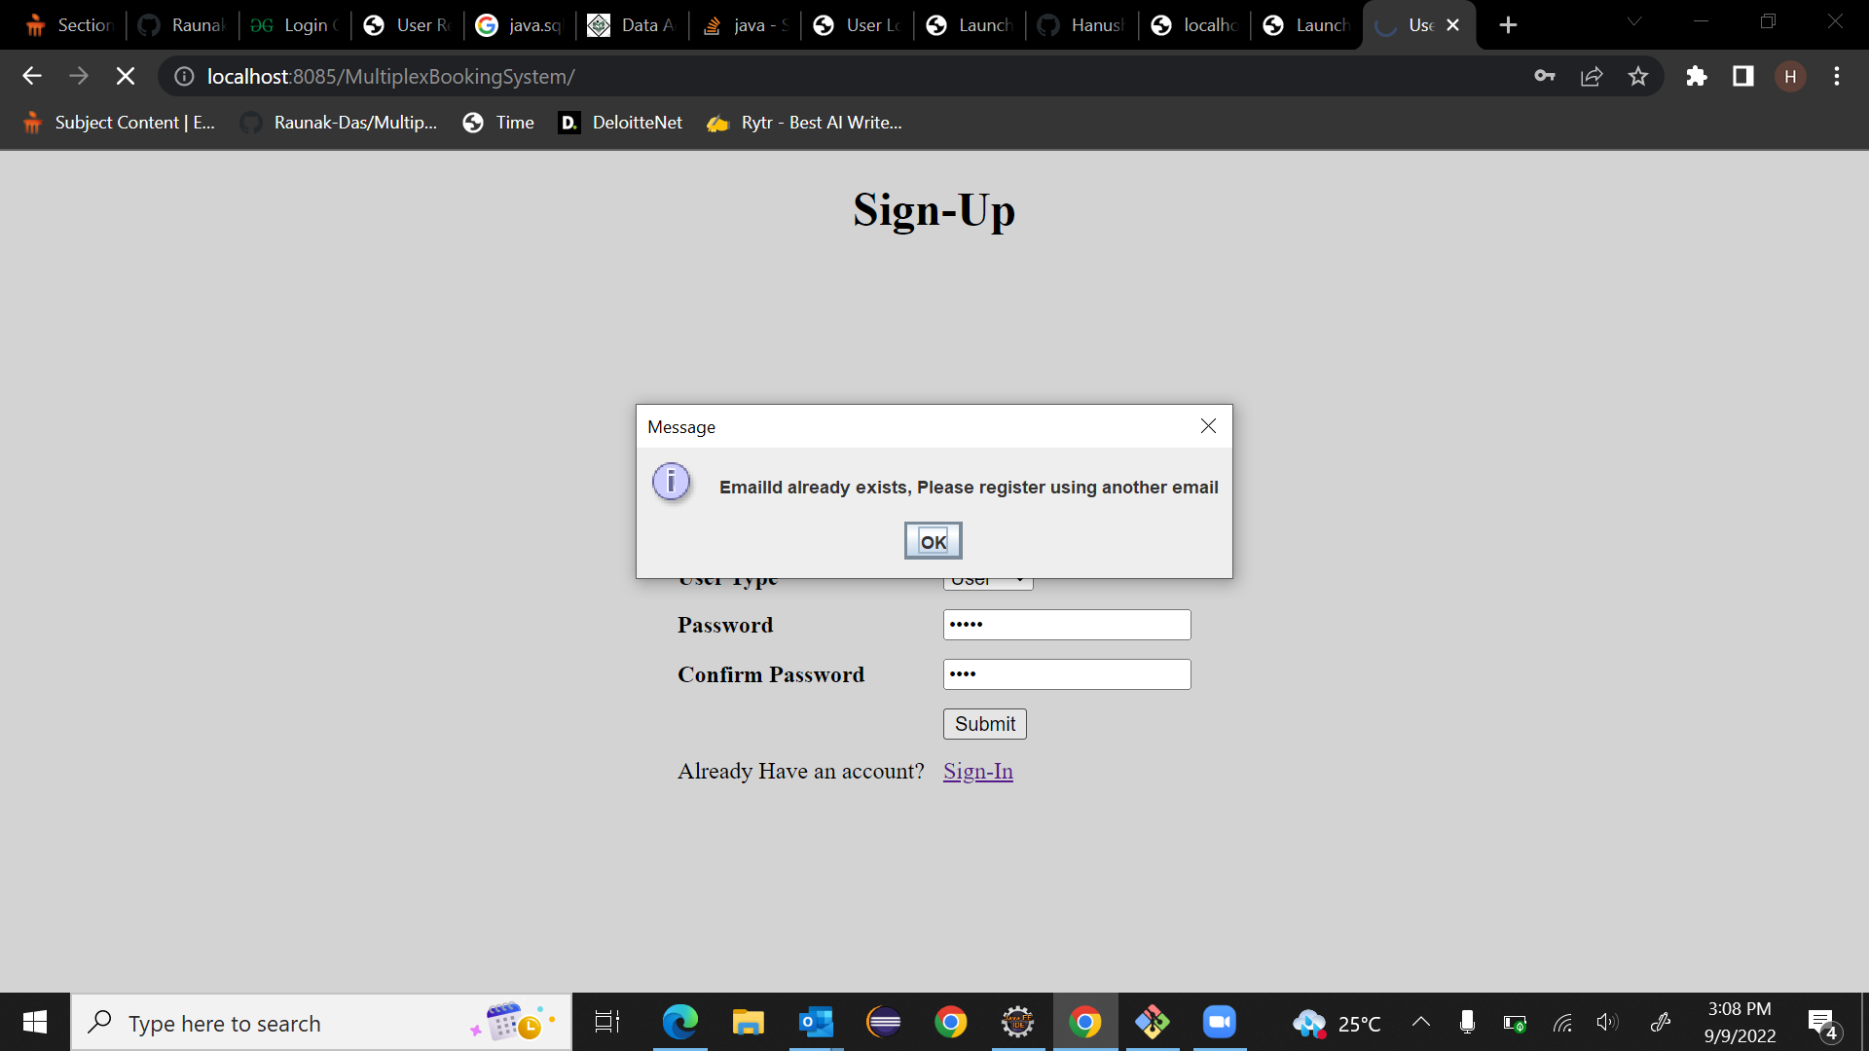

Slide 5
Query Details of the show
Raunak Das
Any user can query for the details of movie, hail and seat availability for a show.
From the list of shows displayed, if the user clicks on a show id, details of the selected show show id, its timings, movie name and the hall name should be displayed. Upon clicking on a show, it should show details of the show along with the movie link and available seats.
Clicking on link should show the details of the movie (name, type, key actors, brief description about the movie)

Slide 6
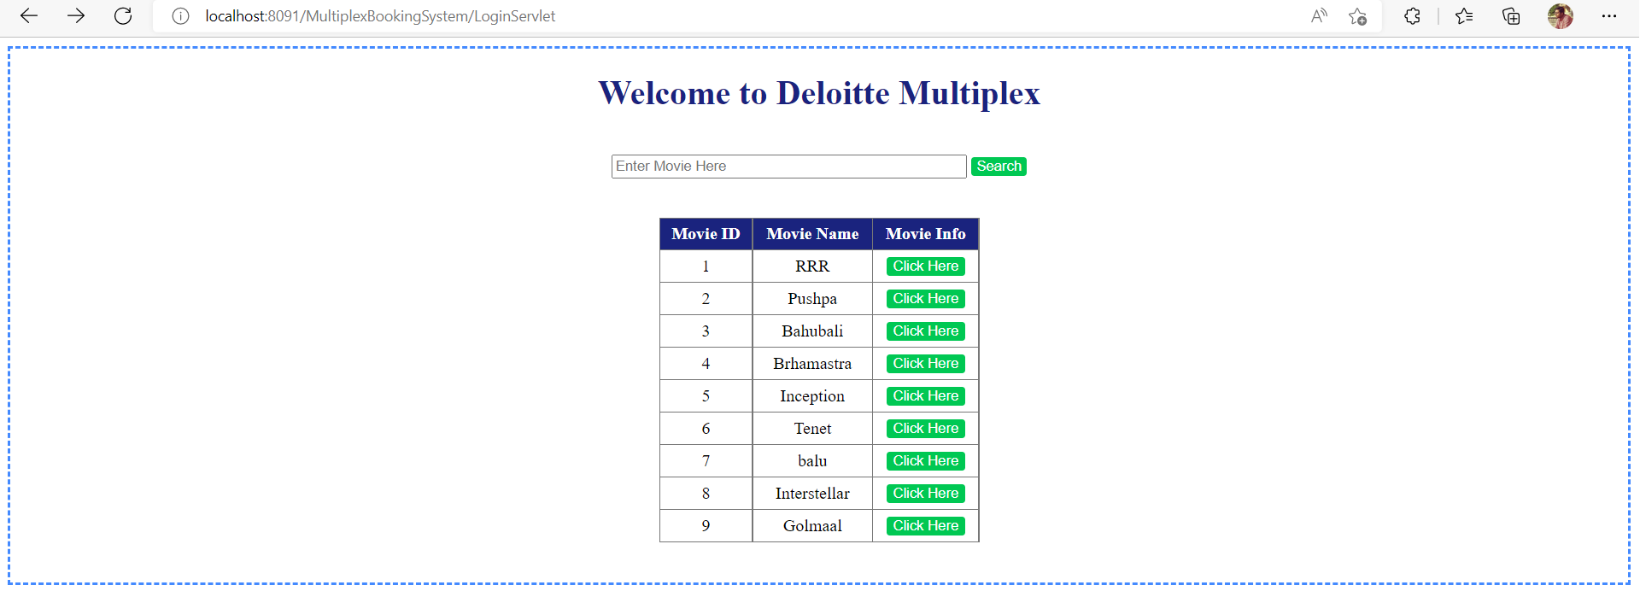

Slide 7
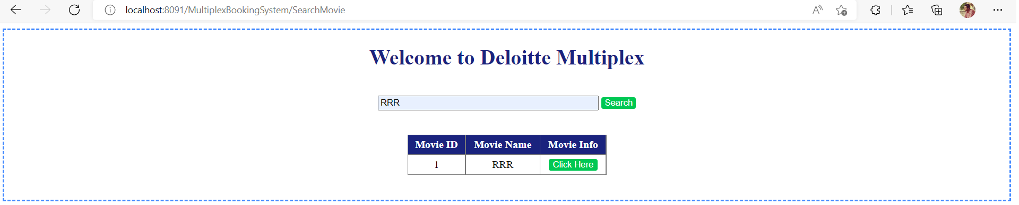

Slide 8
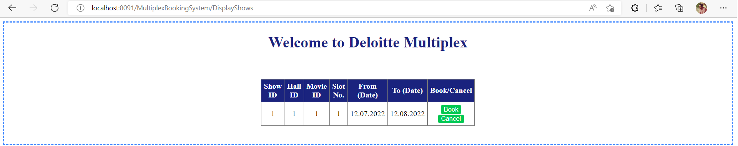

Slide 9
Book Seats Rahul Tej
To book the seat the webpage will have the information with showed,hall,moviename,slotid,seattype seatsavailable,price and dates.
And there is a button to book the seats.
Since all the constraints are checked beforehand the seats will be booked .
The corresponding seat updates will be done in the database.

Slide 10
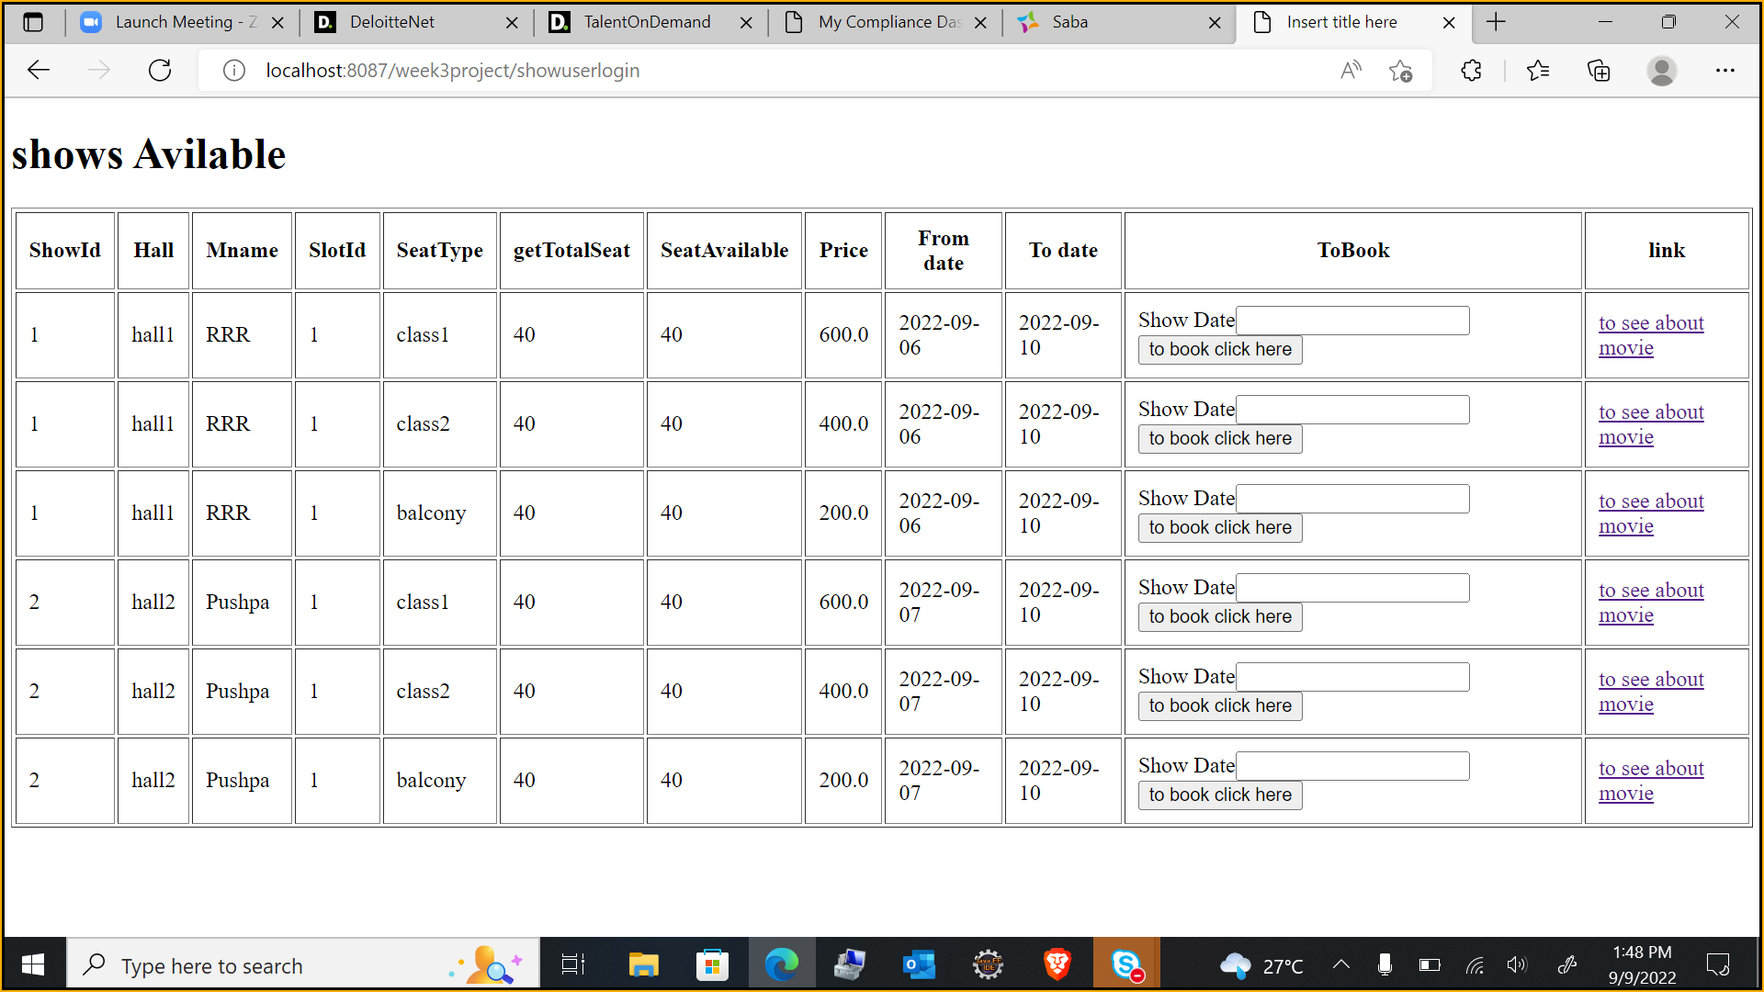

Slide 11
Cancel Seats Sandhya kumari
After clicking cancel button it redirects to a page which has the previous booking details.
There we have to enter booking id of tickets which we want to cancel.
It shows the booking data and on the right side there will be a cancel button.And after clicking the cancel button a pop will be displayed showing ticket cancelled successfully.
Data will be updated from the database. If the booking id is not present in database it shows invalid booking id.

Slide 12
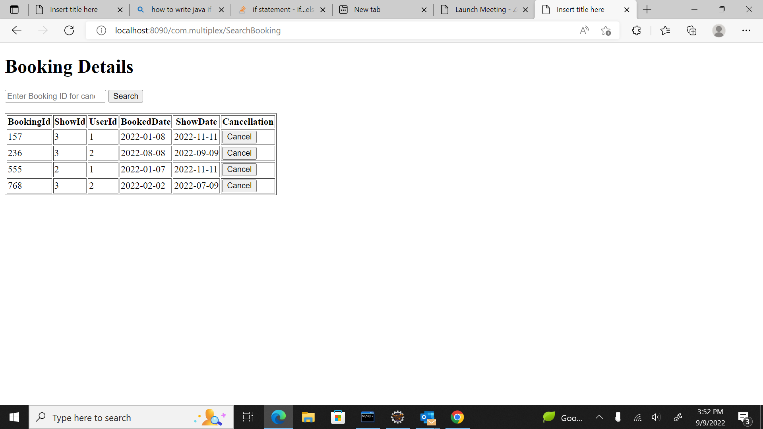
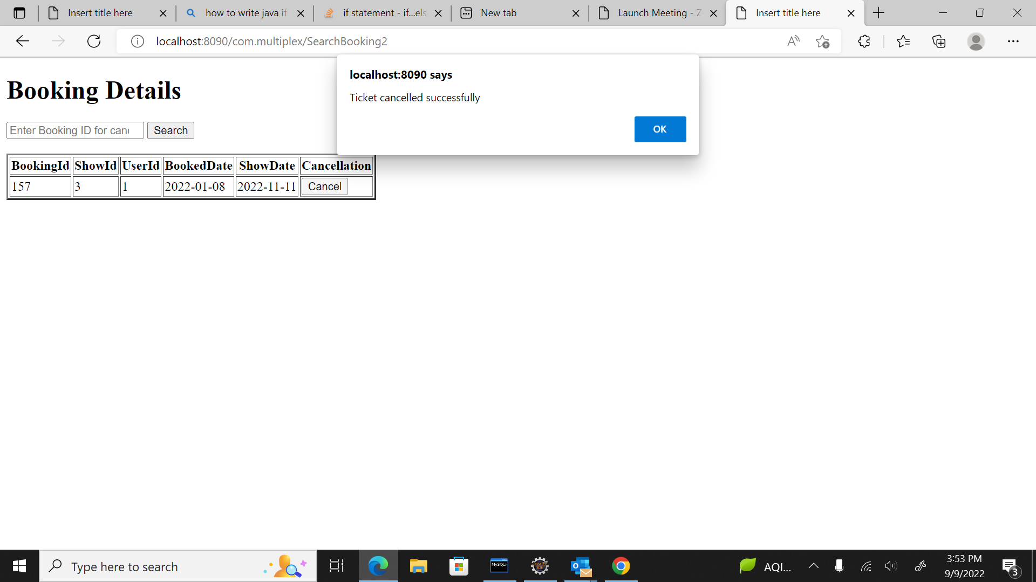
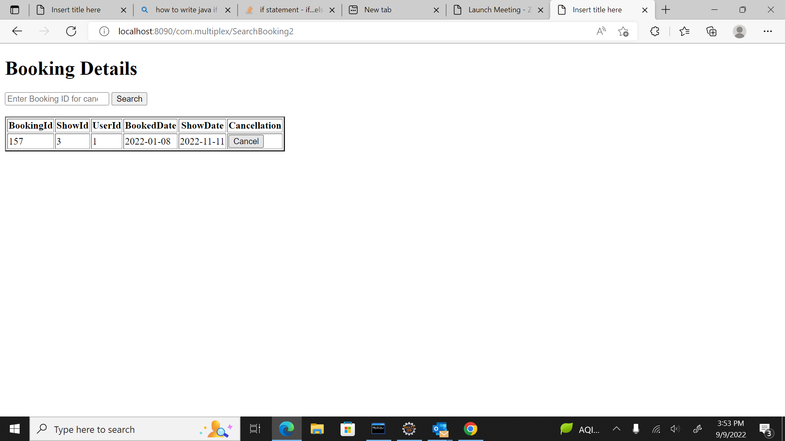

Slide 13
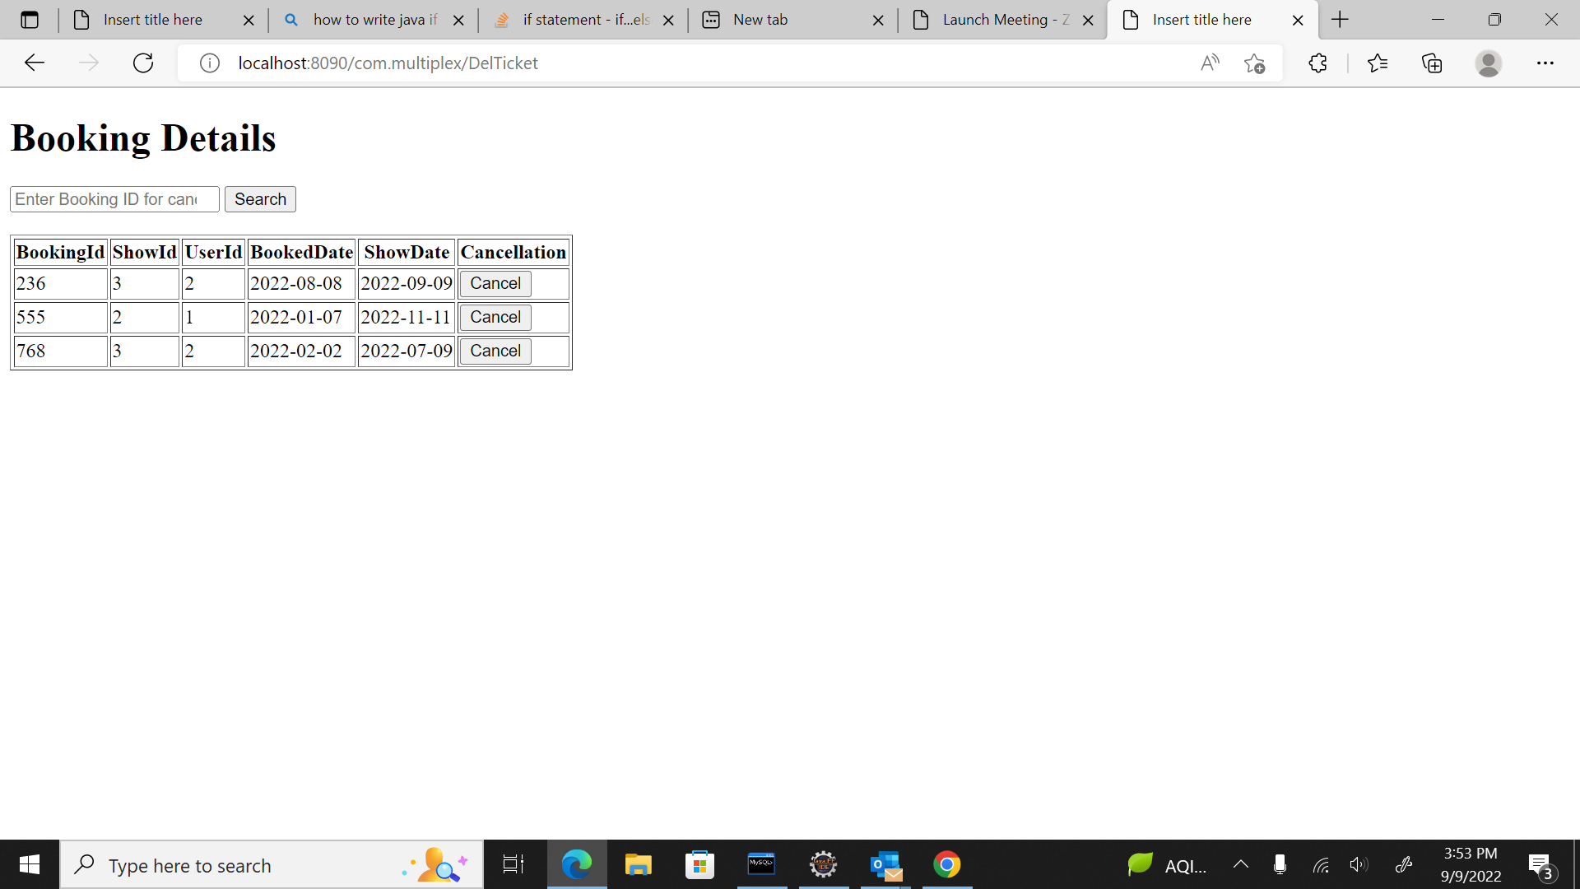
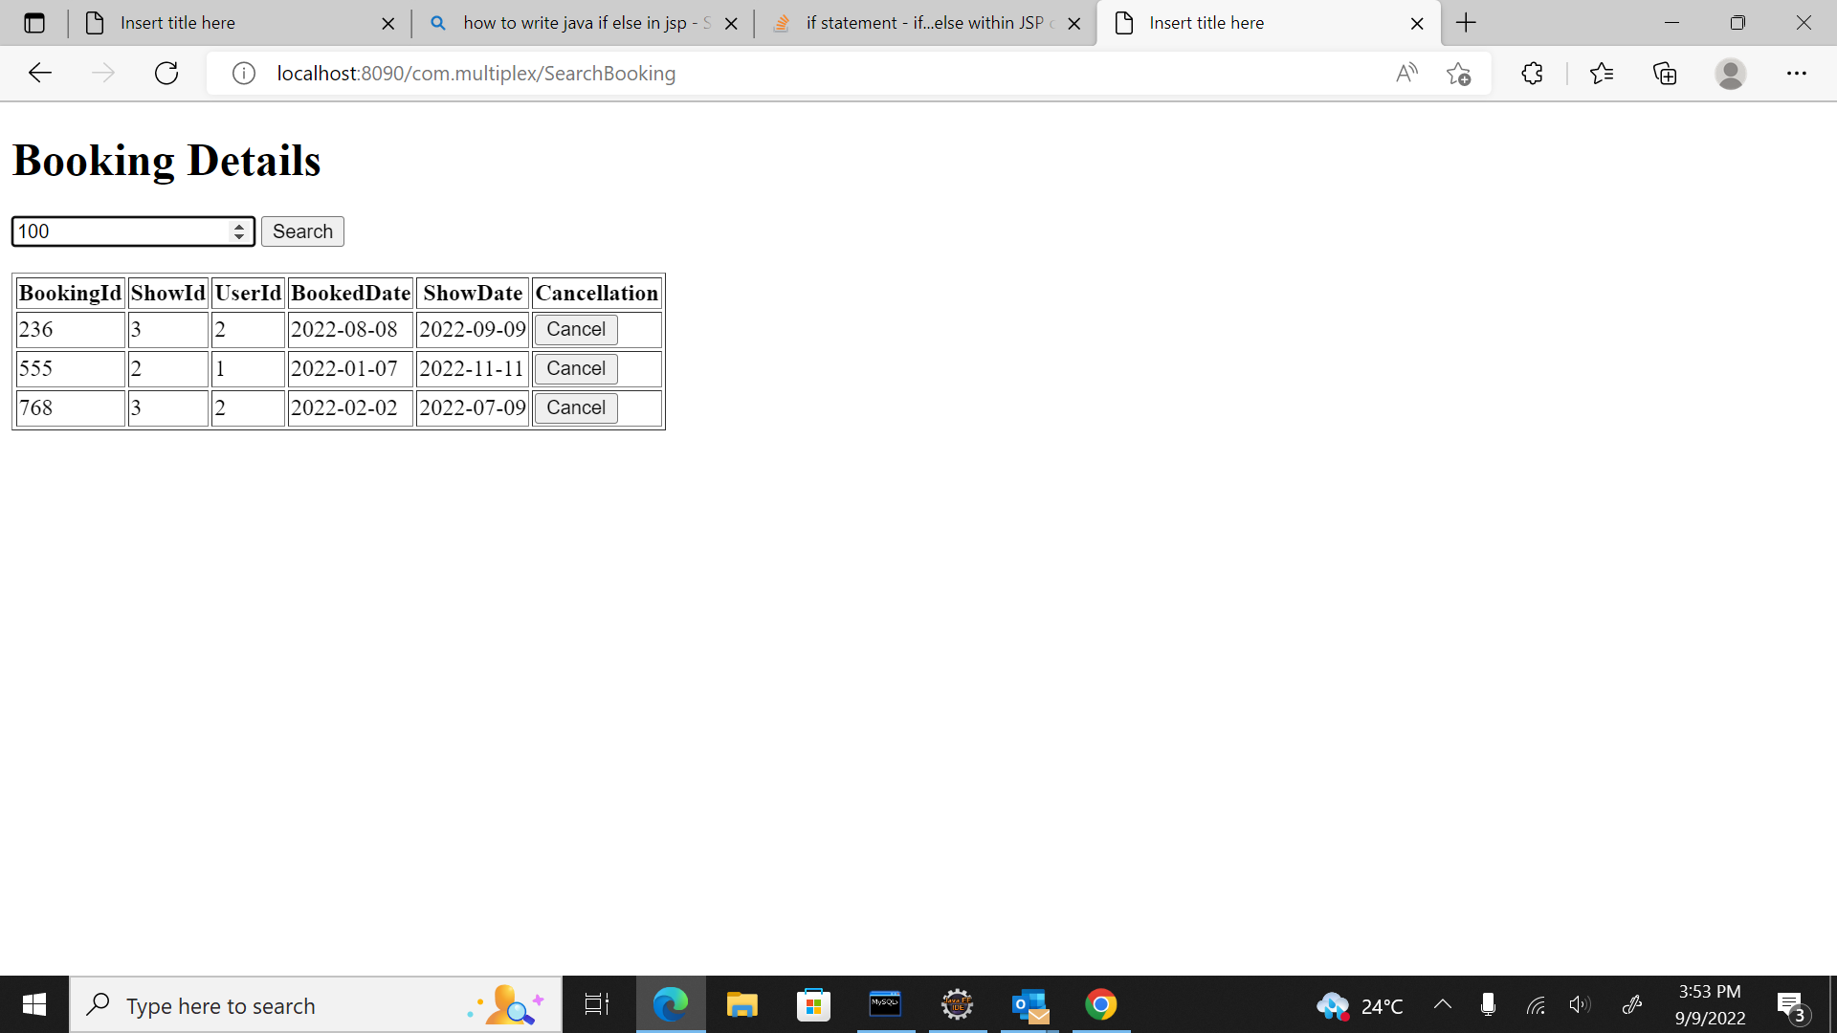
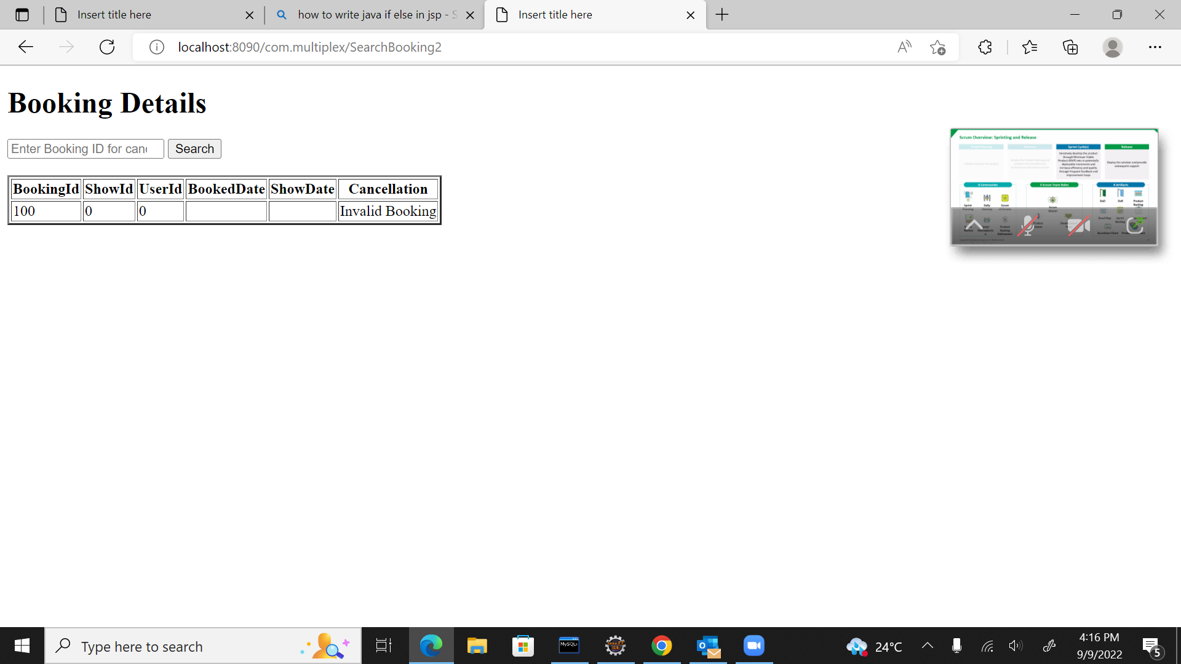

Slide 14
Publish show Details Bhavi Teja
Publish a list of movies to be shown in various time slots in different screens along with the total number of seats available in each hall.
User (admin) choose the hall and timeslot for the selected movies. Publish the shows list show id, movie name, time slot, hall name, from and to dates) once the user confirms it.
Clicking on the movie name, should show its details like name, type, key actors, etc.

Slide 15
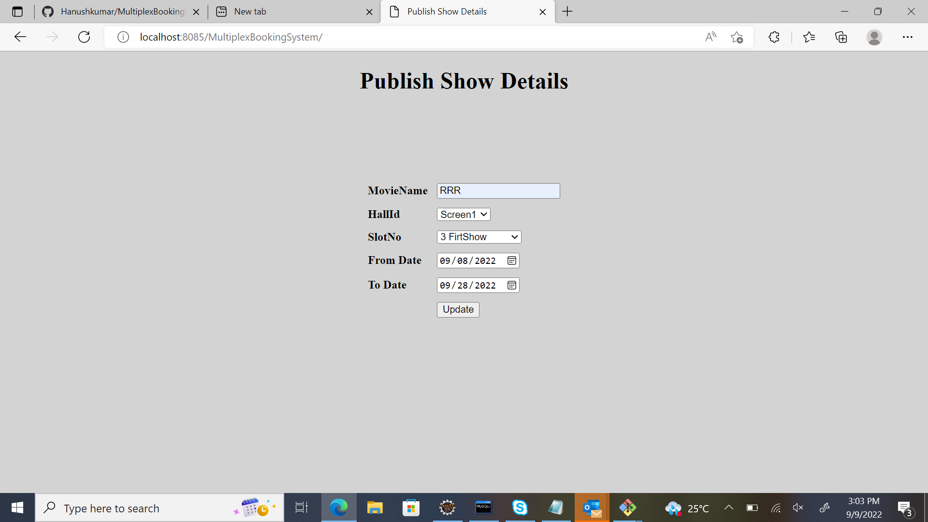

Slide 16
Generate Earning Report Revathi
A report for the management to know the total earnings for a given date range.
For the given date range, print the total sum up the total fares for all confirmed seats.

Slide 17
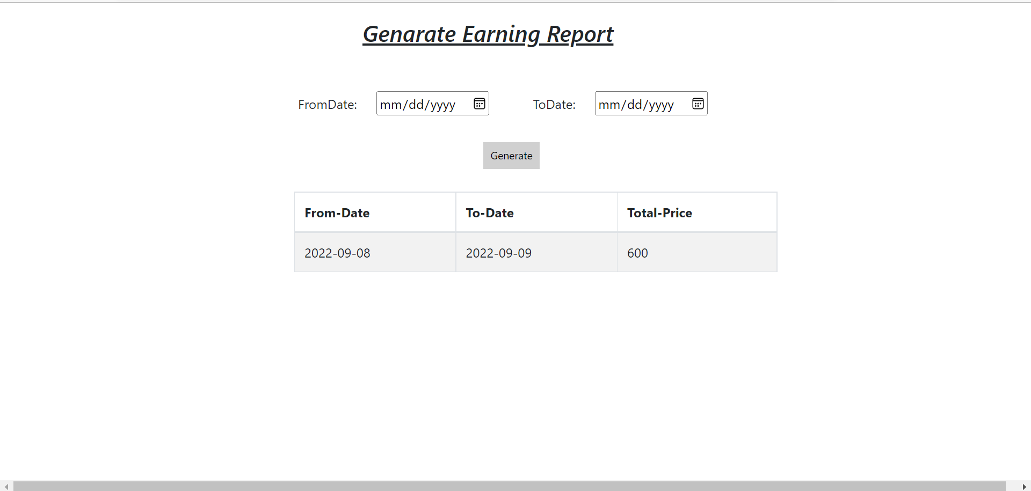

Slide 18
Thank you

