Slide 1
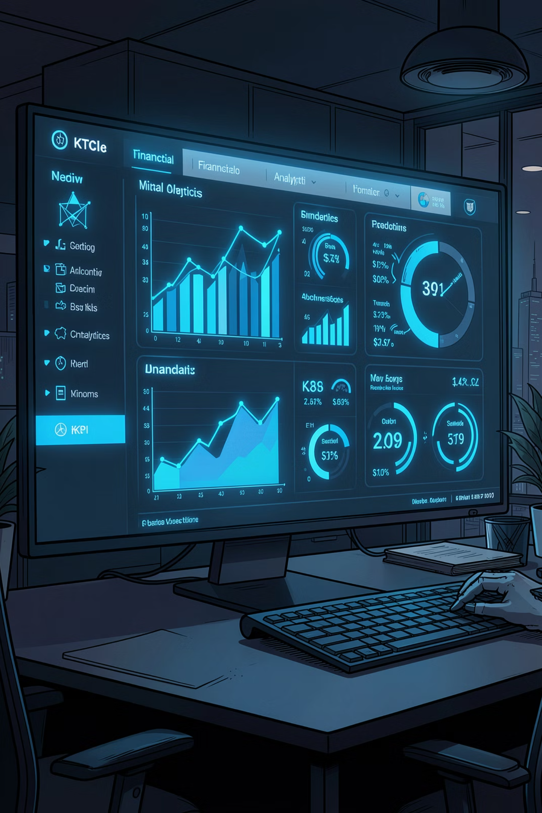
Mutual Fund Analytics Dashboard
Building an End-to-End Mutual Fund Analytics Platform using Data Engineering, Financial Analytics, and Interactive Dashboards
CAPSTONE PROJECT · DATA & FINANCIAL ANALYTICS
Raunak Rai

Slide 2



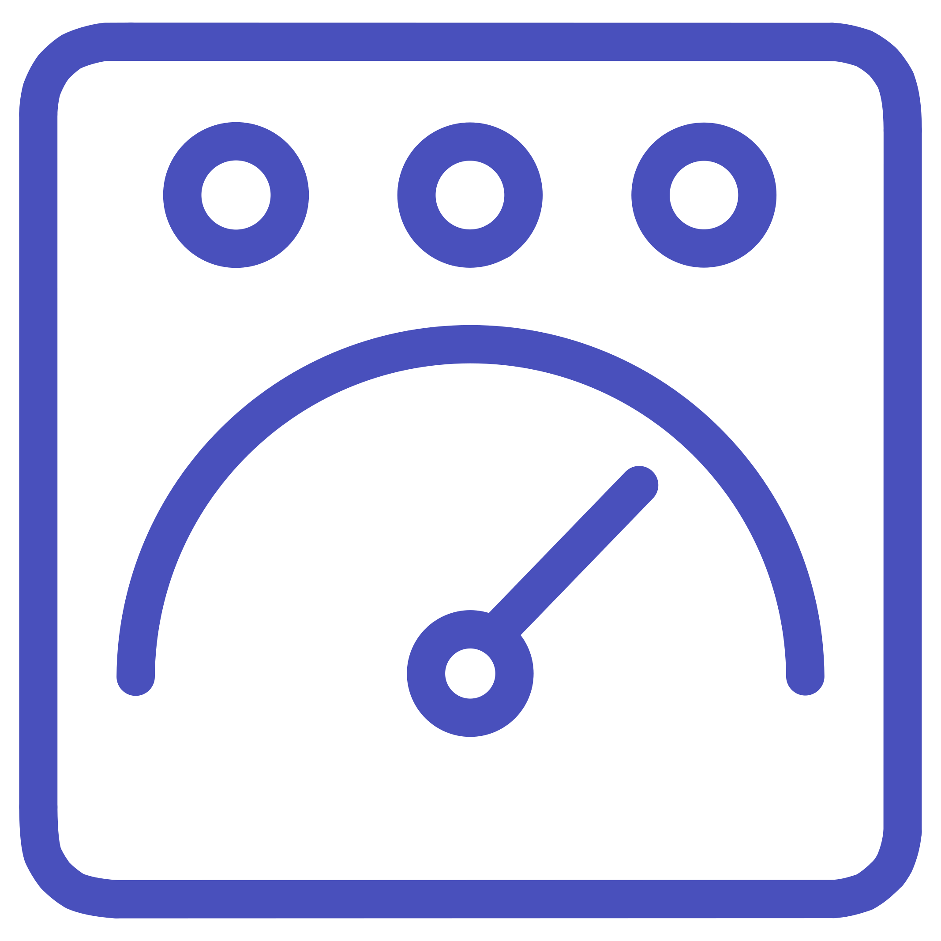
The Problem: Fund Evaluation at Scale
Investors and advisors lack systematic tools to compare thousands of mutual funds across performance, risk, and concentration — manual analysis is slow, inconsistent, and error-prone.
Build a Unified ETL Pipeline
Ingest, clean, and standardize 8 financial datasets into a single SQLite database
Compute Advanced Risk Metrics
Sharpe, Sortino, VaR, CVaR, Alpha/Beta, and Maximum Drawdown at fund level
Deliver an Interactive Dashboard
Streamlit-powered platform for real-time exploration, rankings, and recommendations

Slide 3
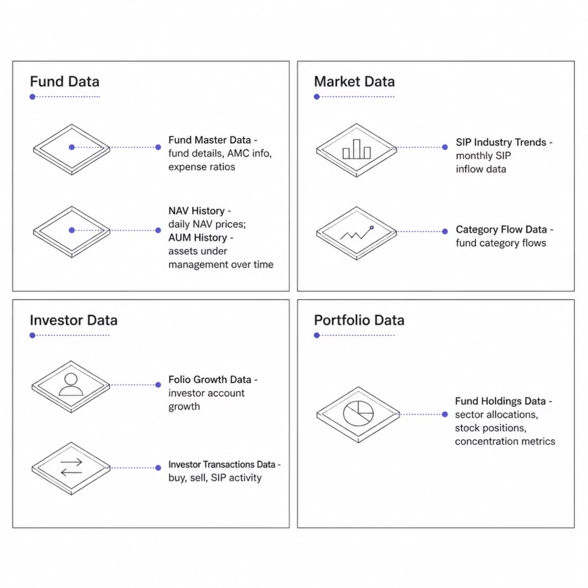
Data Architecture: 8 Integrated Datasets
Eight datasets spanning fund metadata, market performance, investor behavior, and portfolio holdings — forming the analytical backbone of the platform.
Technology Stack
Python — Core analytics and ETL logic
Pandas & NumPy — Data transformation and computation
SQLite — Relational data storage
Matplotlib — Visualization and charting
Streamlit — Interactive dashboard interface

Slide 4

End-to-End Platform Architecture
A production-grade pipeline transforms raw financial data into actionable investor insights — from ingestion through interactive visualization.
Raw Data
Analytics
ETL Processing
Each stage is modular and independently testable — enabling incremental development, validation, and future extensibility without disrupting upstream components.

Slide 5
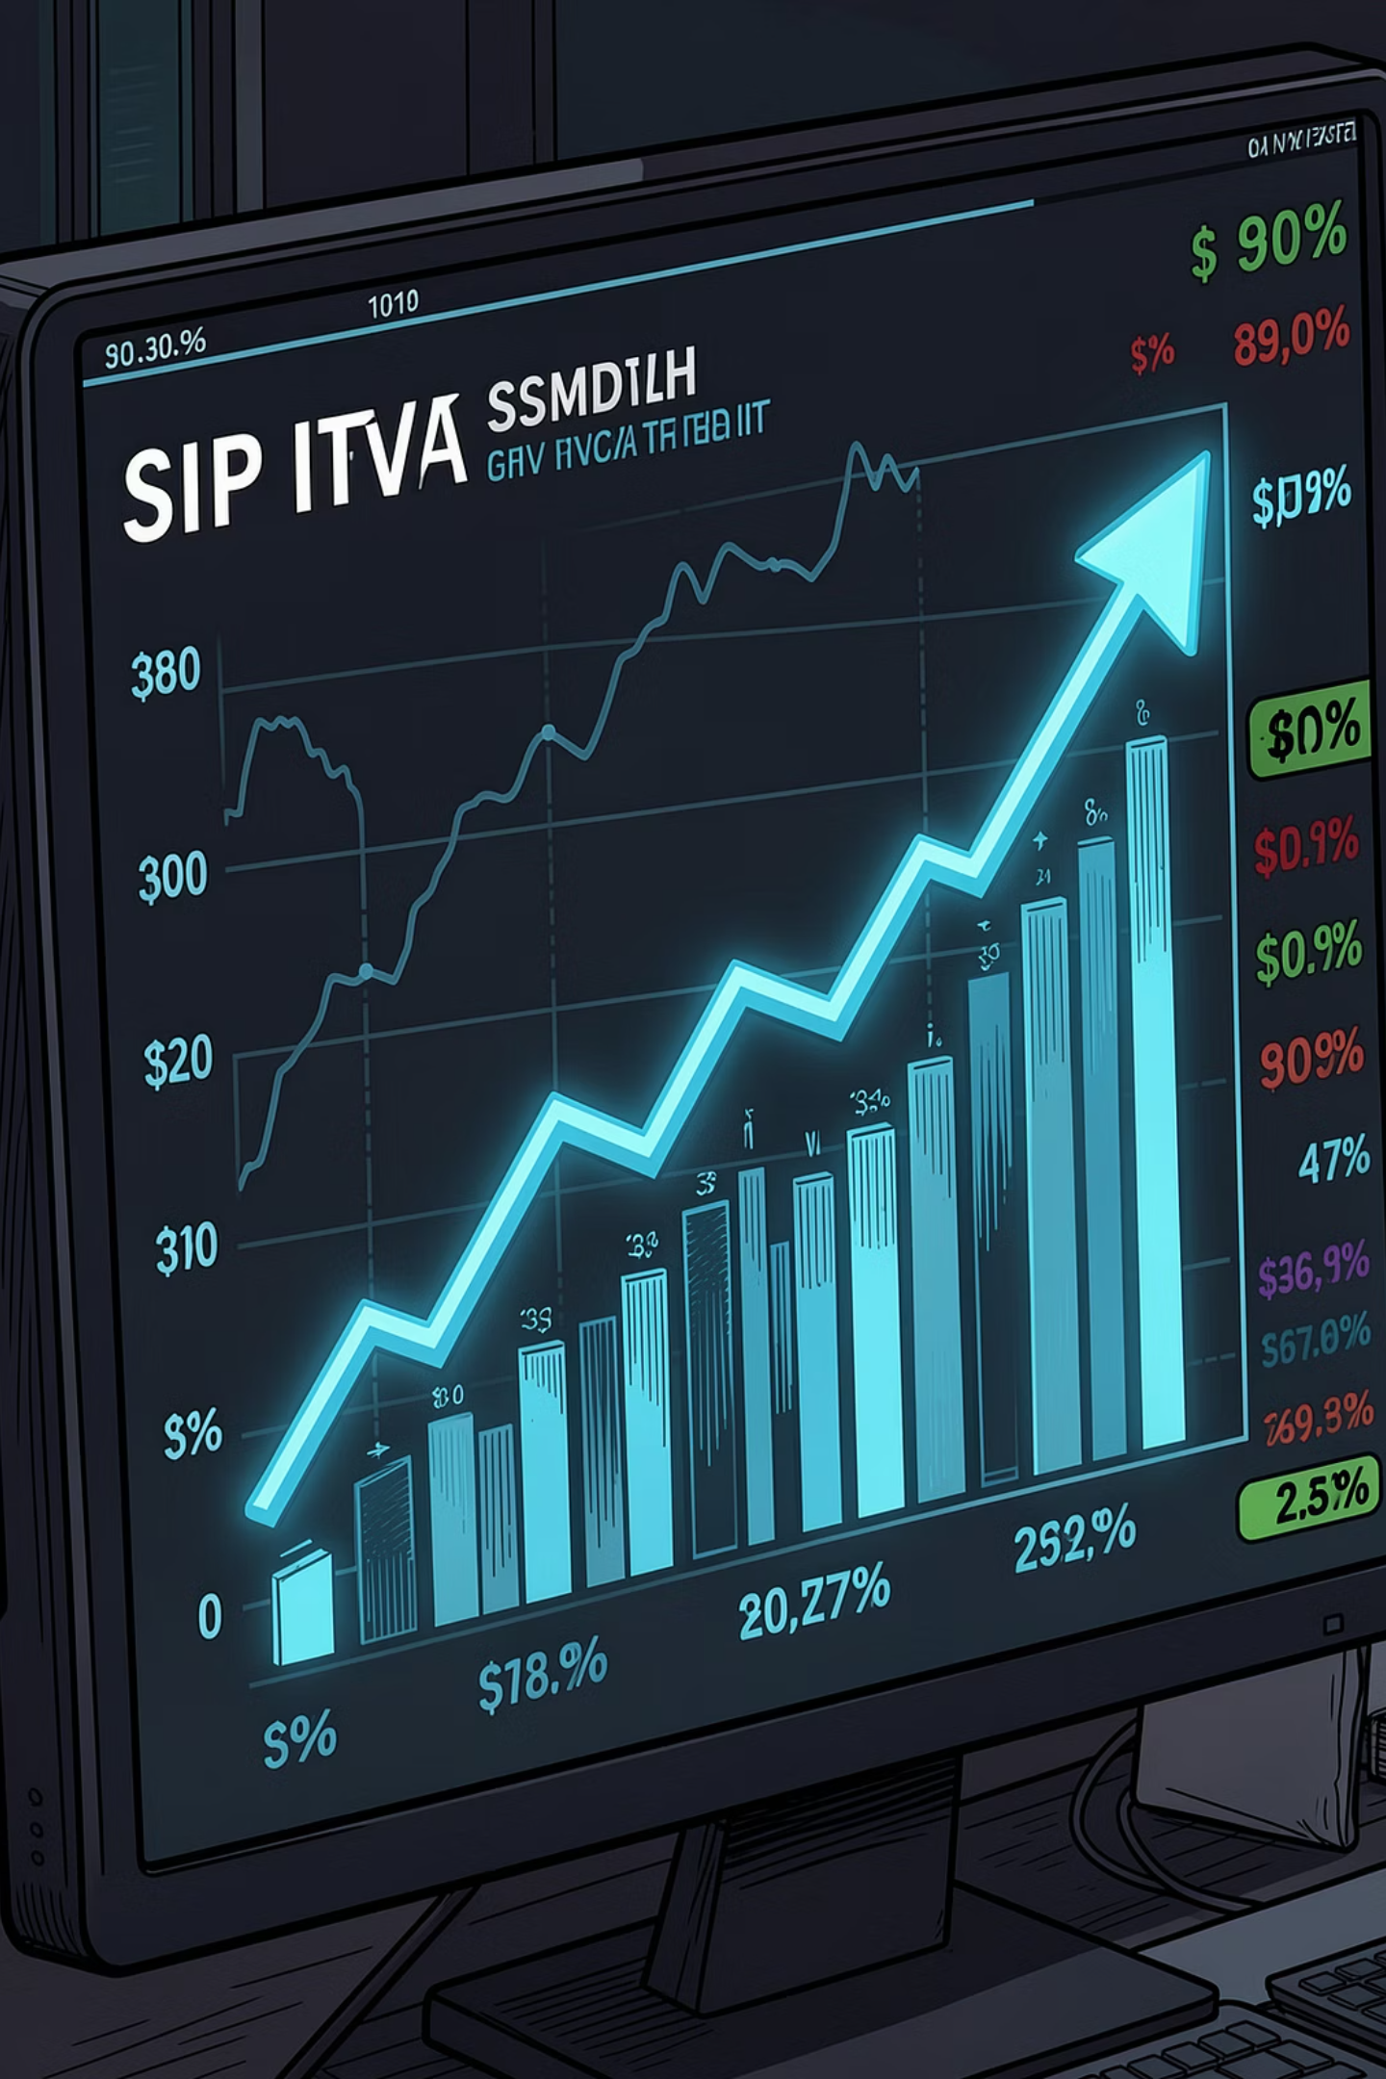
Exploratory Data Analysis: Industry Growth Signals
₹31K Cr
Peak Monthly SIP Inflow
Up from ₹11,517 Cr — a 169% increase over the analysis period
26Cr+
Total Active Folios
Crossed 26 Crore investor accounts — reflecting deep market penetration
1,300+
At-Risk Investors
Flagged for SIP discontinuity — a critical retention signal for AMCs
#1
SBI Mutual Fund
Largest AMC by AUM, folio count, and category dominance

Slide 6
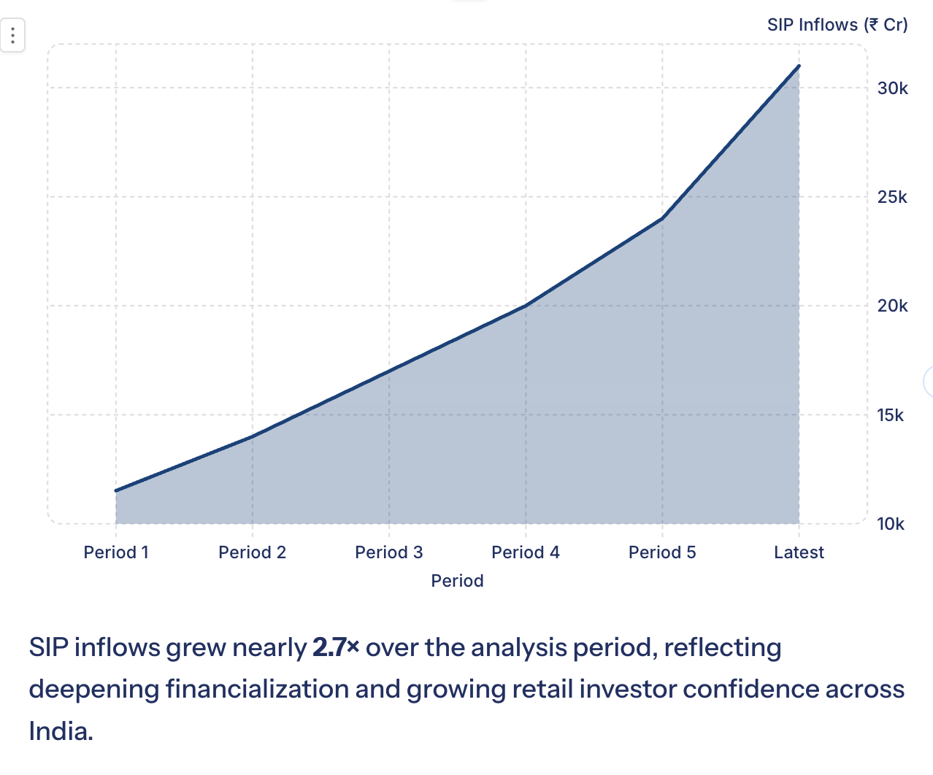
Industry Growth & Investor Participation
Executive Summary
The mutual fund industry experienced significant growth in investor participation and systematic investment activity during the analysis period.
SIP inflows increased from ₹11,517 Cr to ₹31,002 Cr
Total investor folios crossed 26.12 Crore
Strong participation from retail investors
Consistent growth across multiple fund categories

Slide 7

Performance Analytics: Risk-Adjusted Fund Rankings
Key Metrics Computed
Top Performer: Mirae Asset Large Cap Fund achieved the highest Sharpe Ratio (~1.45), outperforming all peers on a risk-adjusted basis.
CAGR(Compound Annual Growth Rate) — measures long-term growth rate
Sharpe Ratio(Return per unit of total risk) — higher values indicate better risk-adjusted performance
Sortino Ratio(Return relative to downside risk only) — penalizes harmful volatility
Alpha(Excess return over benchmark) — measures active manager skill
Beta(Sensitivity to market movements) — measures systematic risk exposure
Max Drawdown(Worst historical peak-to-trough decline) — measures downside severity

Slide 8
Top Risk-Adjusted Funds by Sharpe Ratio
Rank | Fund | Sharpe Ratio | Category
1 | Mirae Asset Large Cap Fund | 1.45 | Large Cap
2 | Kotak Flexicap Fund | 1.31 | Flexi Cap
3 | Mirae Asset Tax Saver Fund | 1.23 | ELSS
4 | SBI Bluechip Fund | 1.21 | Large Cap
5 | ICICI Prudential Midcap Fund | 1.18 | Mid Cap

Slide 9





Advanced Analytics: Beyond Traditional Returns
VaR & CVaR
Rolling Sharpe
Investor Cohorts
Value at Risk and Conditional VaR quantify tail-risk exposure — critical for downside protection analysis
Time-varying Sharpe Ratio reveals performance consistency and identifies style drift over market cycles
Segmented SIP behavior analysis by entry vintage uncovers retention patterns and churn risk signals
HHI Concentration
Fund Recommendation Engine
Herfindahl-Hirschman Index measures portfolio diversification — Banking & IT dominate most fund holdings
Rule-based engine ranks funds by investor risk profile, combining Sharpe, Sortino, and drawdown scores

Slide 10
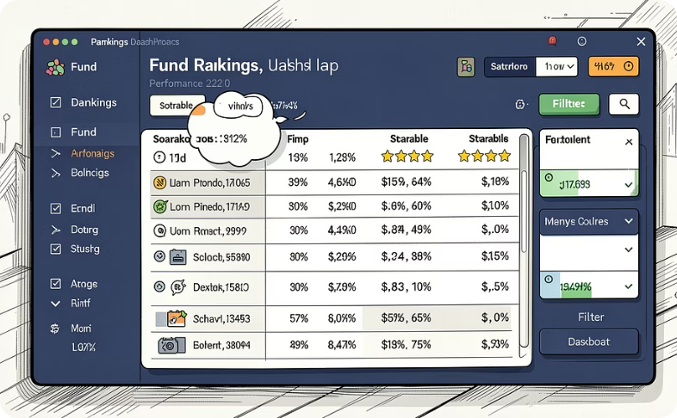
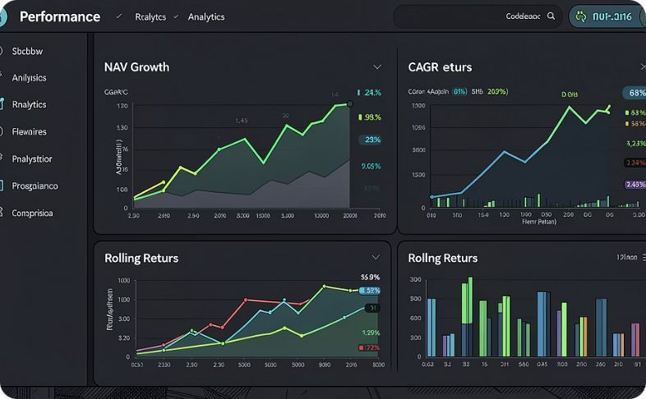
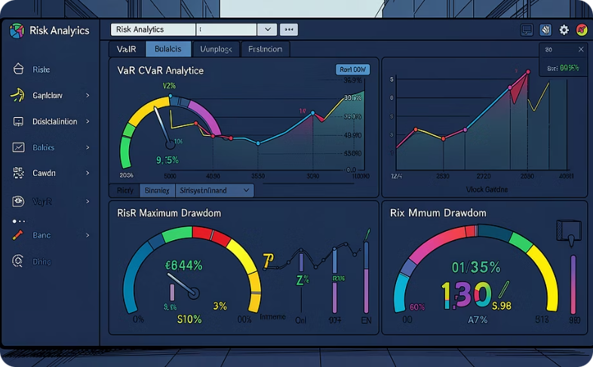
Interactive Dashboard: Modules & Deep Dive
The Streamlit dashboard consolidates all analytics into a single, filterable interface — designed for both exploratory analysis and executive reporting.
Fund Rankings
Performance Analytics
Risk Analytics
Multi-criteria sortable rankings by Sharpe, CAGR, and risk scores with AMC and category filters
Interactive NAV charts, CAGR comparisons, and rolling return visualizations across time horizons
VaR, CVaR, Maximum Drawdown, and Rolling Sharpe visualizations with fund-level drill-down capability

Slide 11
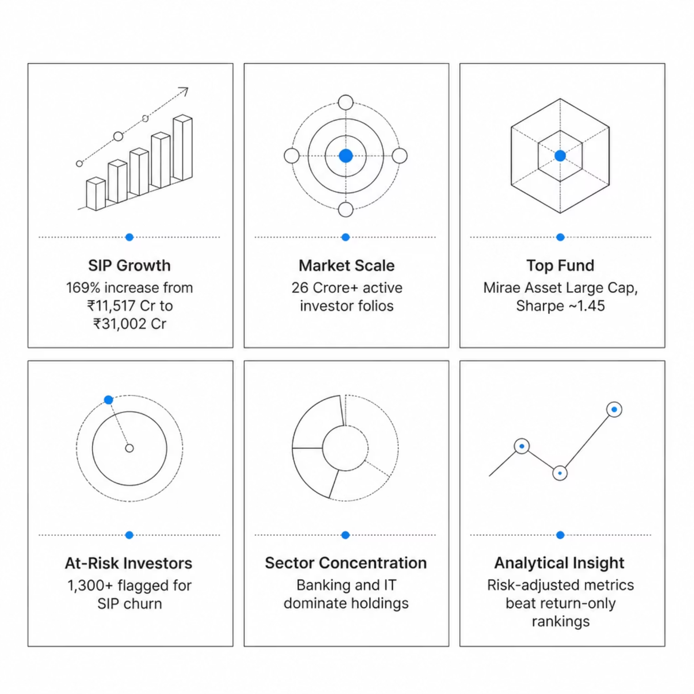
Key Findings & Business Insights
Six high-impact findings validate the platform's analytical rigor and surface actionable intelligence for investors, AMCs, and advisors.
SIP inflows grew 169% — from ₹11,517 Cr to ₹31,002 Cr
Total folios exceeded 26 Crore; SBI MF leads by AUM and reach
Mirae Asset Large Cap topped rankings with Sharpe of ~1.45
1,300+ investors flagged as At-Risk for SIP discontinuity
Banking & IT are the dominant sectors across fund portfolios
Risk-adjusted metrics outperform return-only approaches for fund selection

Slide 12
Conclusion & Future Roadmap
Project Achievements
Roadmap
End-to-end ETL pipeline processing 8 financial datasets
17 analytical modules — from EDA to advanced risk metrics
Production-grade SQLite database with optimized schema
Interactive Streamlit dashboard with fund recommendations
Real-Time Data — Live API integration for current NAV and AUM
Machine Learning — Predictive models for fund performance and churn
Portfolio Optimization — Mean-variance and risk-parity algorithms
Cloud Deployment — AWS/GCP hosting with automated pipelines
Thank You
Questions welcome.

