Slide 1
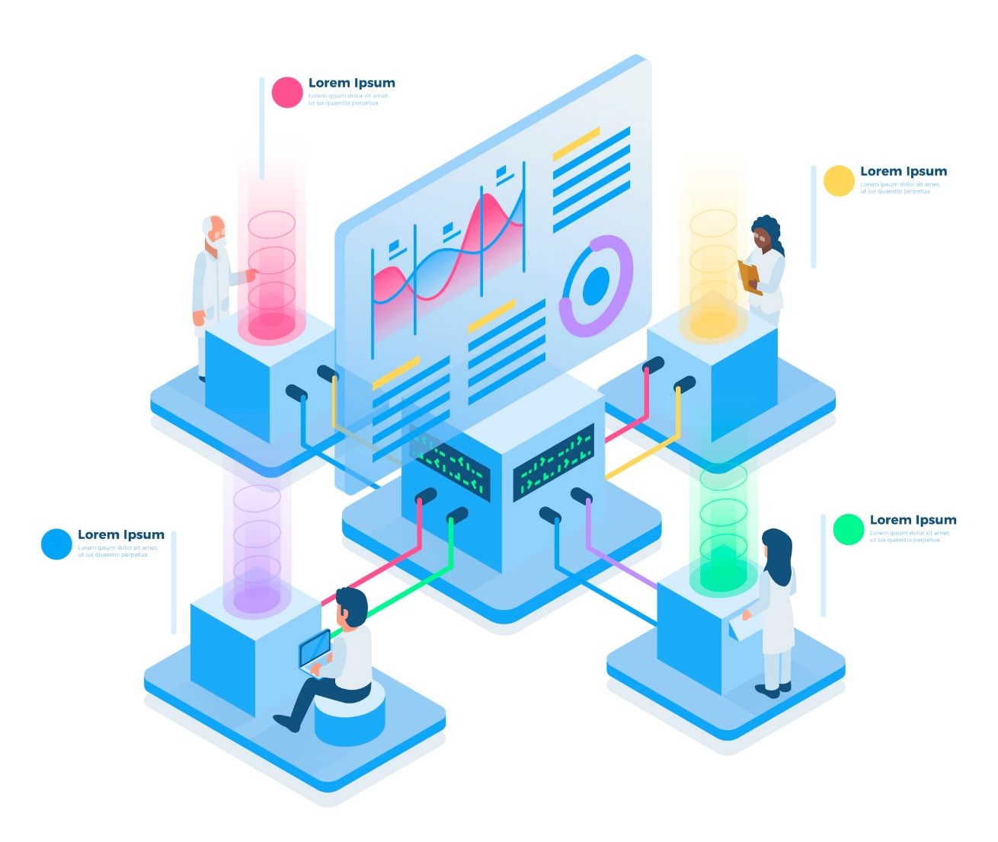

Customer Relationship Management (CRM) System

Slide 2
Overview of CRM Project
Introduction to the CRM project:
Introducing CRM System a cutting-edge solution for managing customer relationships and sales processes.
Objectives and goals:
Our goal: Develop a streamlined CRM system to enhance customer interactions, sales efficiency, and decision-making.
Importance of CRM in business operations:
CRM is vital for centralizing customer data, improving communication, and driving revenue growth.

Slide 3
Application Overview
Description of the CRM application:
It is a user-friendly CRM application designed to streamline customer relationship management and sales processes. It provides a centralized platform for managing customer data, tracking sales opportunities, and improving communication with clients.
Features and functionalities:
Key features include:-
Customer and contact management
Opportunity tracking and pipeline management
Task and activity management
Product catalog and inventory management

Slide 4
Technology Stack
The CRM project utilizes MySQL database for data storage and Hibernate framework for database management.
Details:
MySQL database is used for structured data storage, providing reliability and scalability for the CRM application.
Hibernate framework simplifies database operations by providing object-relational mapping (ORM) capabilities, enhancing data access and management.
Software use includes:
IDE: Visual Studio Code (VSCode) for development
Programming Language: Java for backend development
Minimum hardware specifications:
Processor: Intel Core i5 or equivalent
RAM: 8GB
Storage: 256GB SSD
Operating System: Windows 10 or Linux

Slide 5
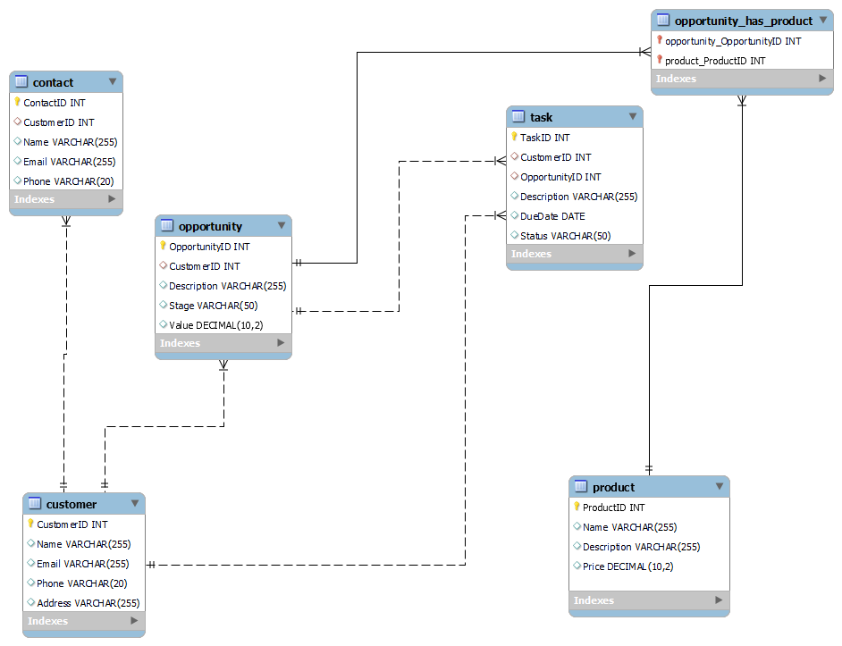
Entity-Relationship Diagram (ERD)
Entities
Customer: Represents individual customers or companies interacting with the CRM system.
Contact: Represents individuals associated with the customers.
Opportunity: Represents potential sales opportunities or deals.
Task: Represents tasks or activities associated with customers or opportunities.
Product: Represents products or services offered by the company.
Relationships
Each Customer can have multiple Contacts (one-to-many relationship).
Each Customer can have multiple Opportunities (one-to-many relationship).
Each Opportunity is associated with a single Customer (many-to-one relationship).
Each Opportunity can have multiple Tasks (one-to-many relationship).
Each Task is associated with a single Customer or Opportunity (many-to-one relationship).
Products may be related to Opportunities (many-to-many relationship), indicating which products are associated with specific opportunities.

Slide 6
THANK YOU!

