Slide 1
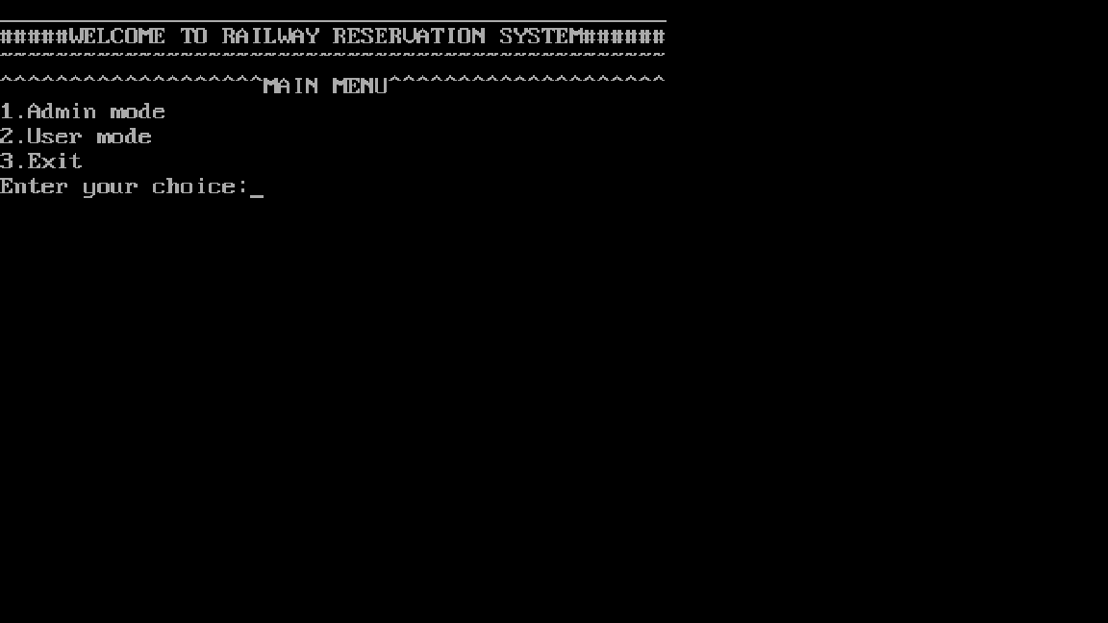
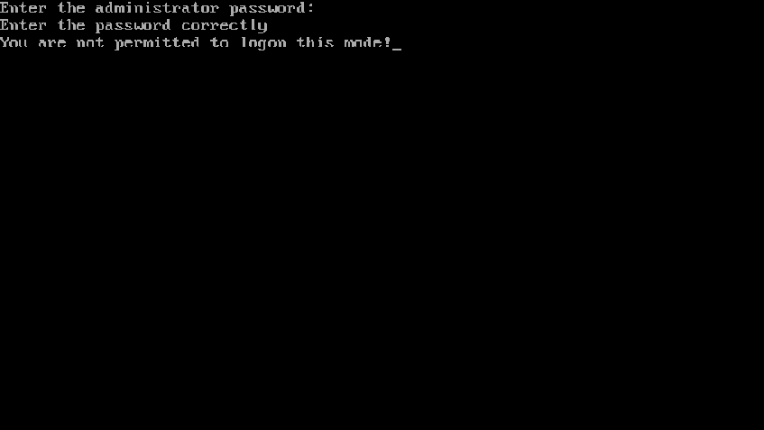
MAIN PAGE
ADMIN MODE(incorrect password)

Slide 2
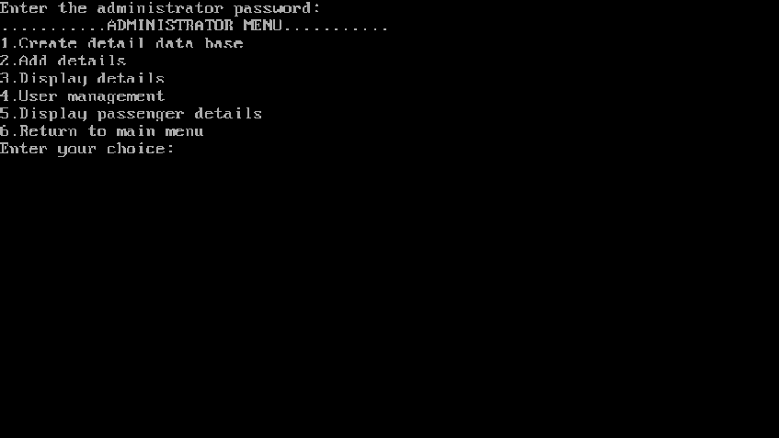
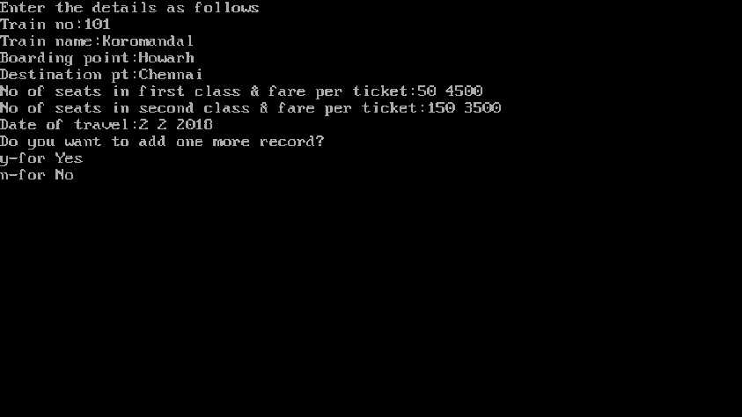
ADMIN MODE(correct password)
ADMIN MODE 1

Slide 3
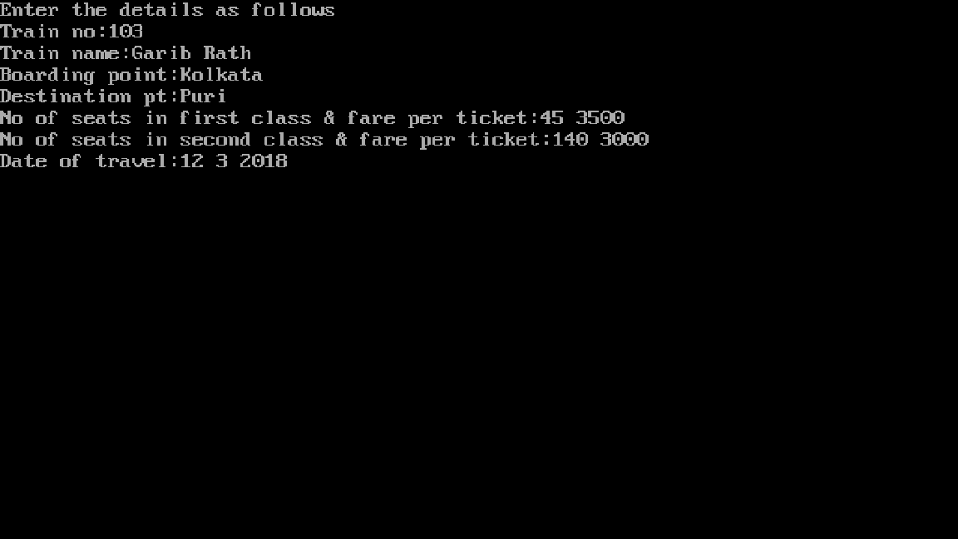
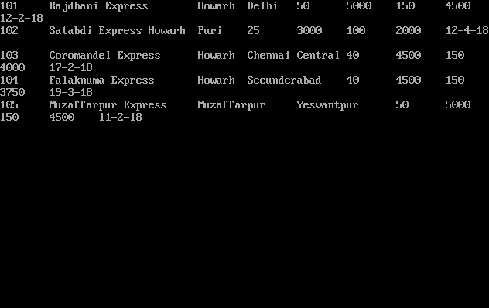
ADMIN MODE 2
ADMIN MODE 3

Slide 4


ADMIN MODE 4
ADMIN MODE 4.1

Slide 5


ADMIN MODE 4.2
ADMIN MODE 4.3

Slide 6


USER MODE(incorrect password)
USER MODE(correct password)

Slide 7


USER MODE 1
USER MODE 3

