Slide 1
Breast Cancer Diagnosis
Title:
Guided by: Dr. Priyanka Singh

Slide 2
Introduction
Machine learning and Data Science is branch of AI which incorporates a large set of statistical techniques.
These techniques enable data scientists to create a model which can learn from past data and detect patterns from massive, noisy and complex data sets.
Researchers use machine learning for cancer prediction and prognosis.
Machine learning allows inferences or decisions that otherwise cannot be made using conventional statistical methodologies. With a robustly validated machine learning model, chances of right diagnosis improve.
It specially helps in interpretation of results for borderline cases.

Slide 3
Breast Cancer: An overview
The cancer is most common disease in worldwide.
Early detection is the most effective way to reduce cancer deaths.
Early diagnosis requires an accurate and reliable procedure to distinguish between benign cell from malignant ones.
Breast Cancer Types - three types of breast tumors: Benign breast tumors, In-situ cancers, and Invasive cancers.
The majority of breast tumors detected by mammography are benign.
They are non-cancerous growths and cannot spread outside of the breast to other organs.
In some cases, it is difficult to distinguish certain benign masses from malignant lesions with mammography.
If the malignant cells have not gone through the basal membrane but is completely contained in the lobule or the ducts, the cancer is called in-situ or noninvasive.
If the cancer has broken through the basal membrane and spread into the surrounding tissue, it is called invasive.
This analysis assists in differentiating between benign and malignant tumors.

Slide 4
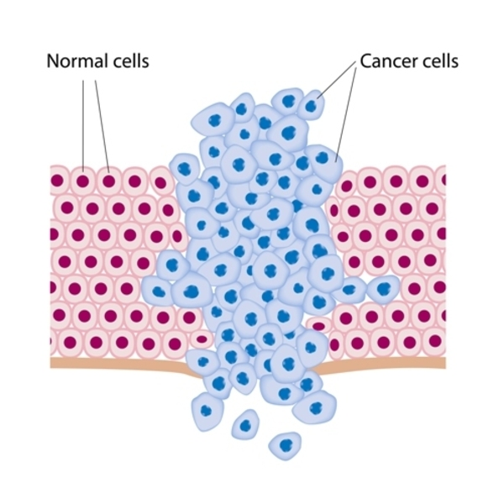

Slide 5
Data Files
s.n | Data File Name | No. of records | No. of attribute
1 | Breast_cancer_data.csv | 570 | 32
1) ID number 2) Diagnosis (M = malignant, B = benign) 3-32)
Ten real-valued features are computed for each cell nucleus:
a) radius (mean of distances from center to points on the perimeter) b) texture (standard deviation of gray-scale values) c) perimeter d) area e) smoothness (local variation in radius lengths) f) compactness (perimeter^2 / area - 1.0) g) concavity (severity of concave portions of the contour) h) concave points (number of concave portions of the contour) i) symmetry j) fractal dimension ("coastline approximation" - 1)
e

Slide 6
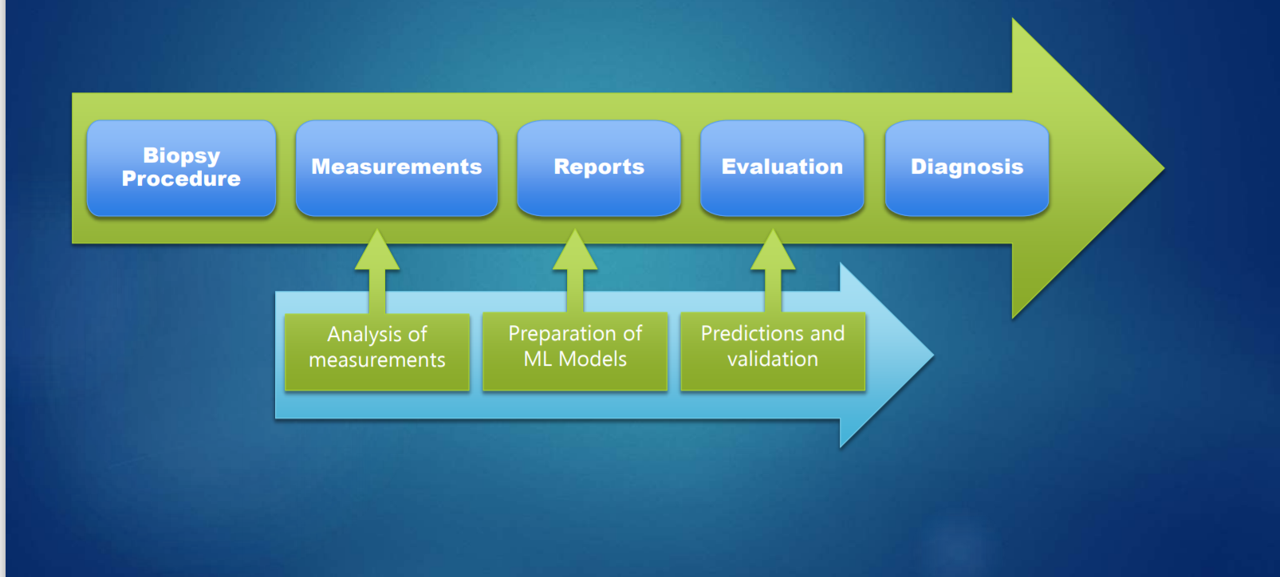
Flow of data

Slide 7
Analysis
Lab setup
Tkinter
component
RandomForestClassifier
G
U
I
Train_test_spilit
Breast_cancer_data.csv
Test_files.csv
Prediction
Input files
Output
pyplot
Libraries
Pandas
Numpy
matplotlib
Seaborn
Scikit-learn
Envirnoment
Python
Windows

Slide 8
Architecture
Dataset
Data Pre-processing
Cleaning
Transformation
Feature selection
Test Data
Training Data
Prediction of cancer
SMOTE
Generating report
Machine Learning model
Display in Tkinter GUI
Patient new data

Slide 9
UNDERSTANDING ALGORITMS (module description)
A machine learning model is a file that has been trained to recognize certain types of patterns. We train a model over a set of data, providing it an algorithm that it can use to reason over and learn from those data.
Here we used following ML model to predict Breast cancer Diagnosis:
1.Decision Tree Classifier
2. Random Forest Classifier
3. XG boost classifier
4. Logistic Regression
5. SVM Classifier( Support Vector Machine)

Slide 10
Decision Tree Classifier
It is one of the most widely used and practical methods for supervised learning. Decision Trees are a non-parametric supervised learning method used for both classification and regression tasks. The goal is to create a model that predicts the value of a target variable by learning simple decision rules inferred from the data features.

Slide 11
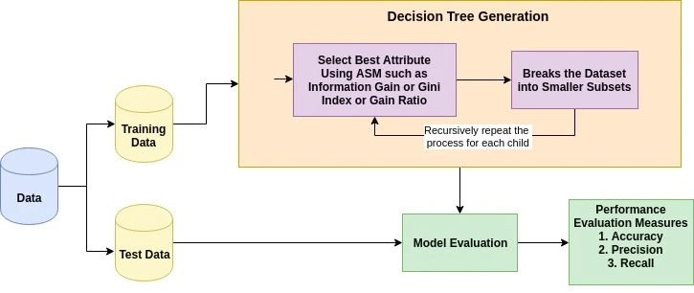
Continue…

Slide 12
SVM(support vector Machine)
“Support Vector Machine” (SVM) is a supervised machine learning algorithm which can be used for both classification or regression challenges. However, it is mostly used in classification problems. In the SVM algorithm, we plot each data item as a point in n-dimensional space (where n is number of features you have) with the value of each feature being the value of a particular coordinate. Then, we perform classification by finding the hyper-plane that differentiates the two classes very well .

Slide 13
Random forest
Random forest, like its name implies, consists of a large number of individual decision trees that operate as an ensemble. Each individual tree in the random forest spits out a class prediction and the class with the most votes becomes our model’s prediction (see figure below).

Slide 14
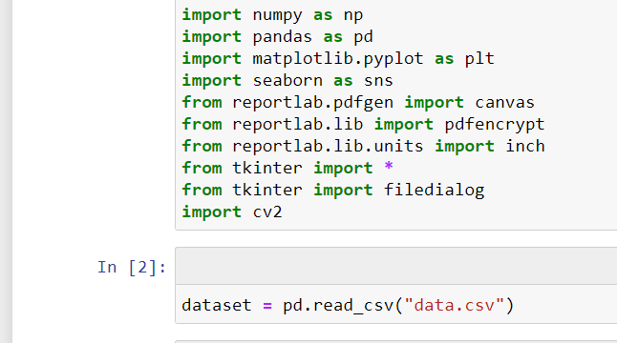
Workflow
Importing library and Dataset

Slide 15
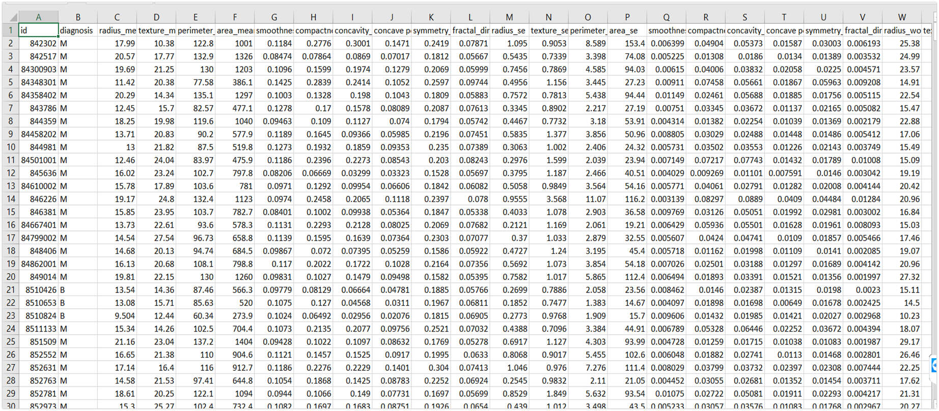
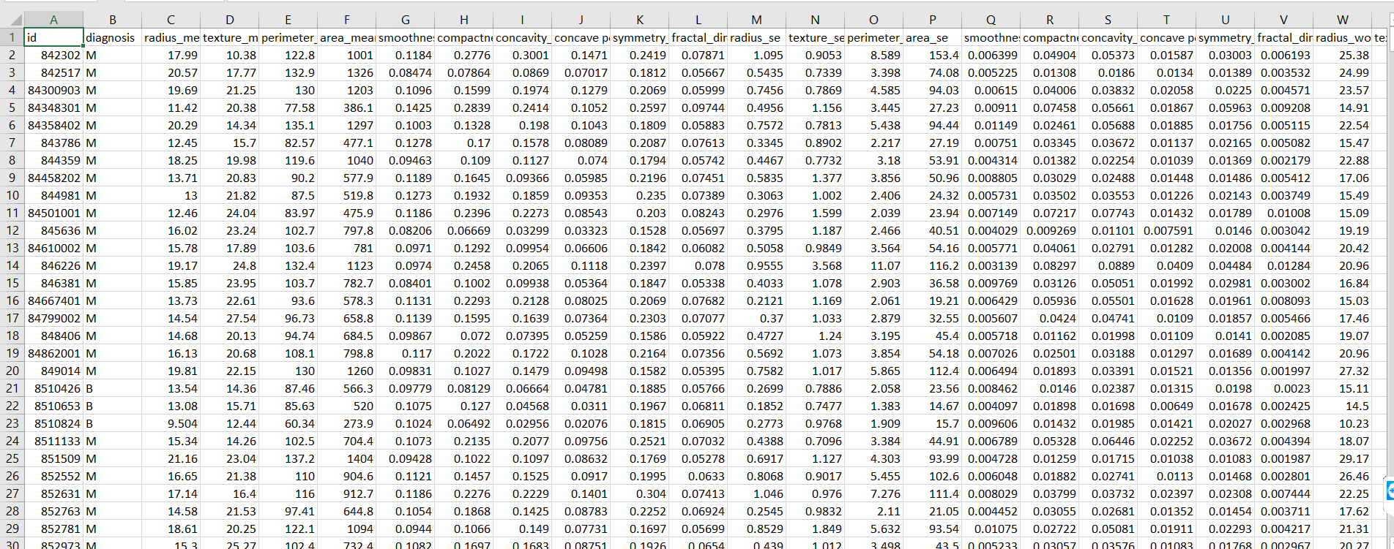
Continue… View of Data

Slide 16
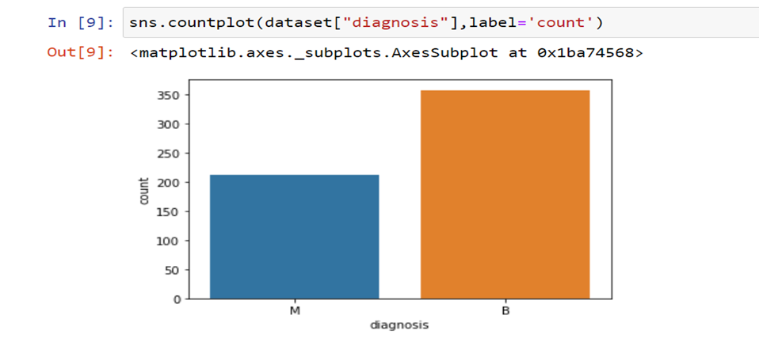
Continue… Output cells

Slide 17
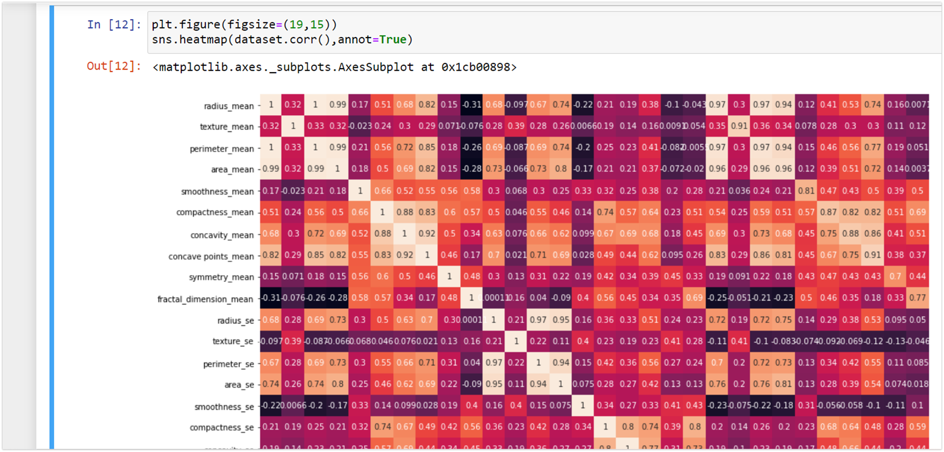
Visualization of heatmap

Slide 18
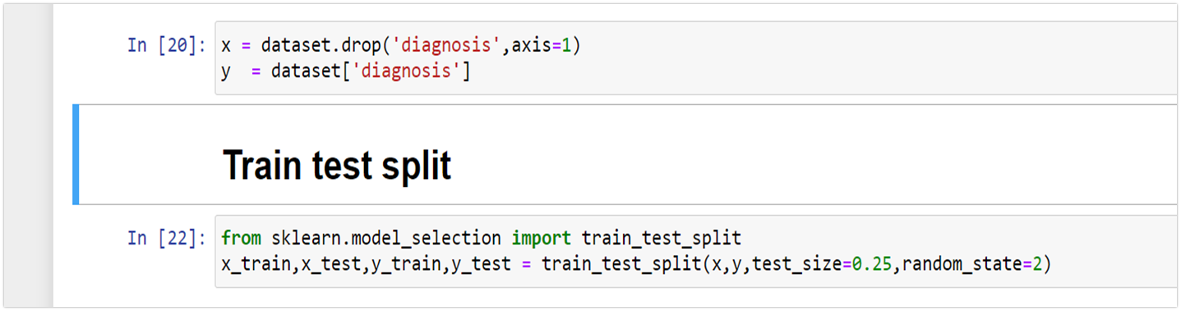
Data preparation - train test split
Training dataset = 75%
Test dataset = 25%

Slide 19
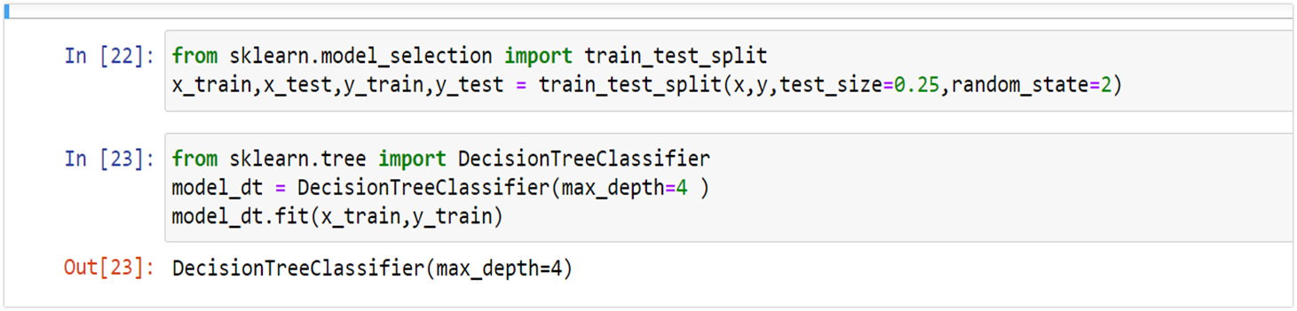
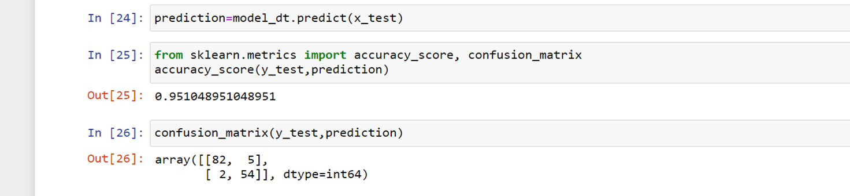
Model Implementation - DTC
Training model on dataset
Accuracy score and confusion matrix of Decision tree Classifier

Slide 20
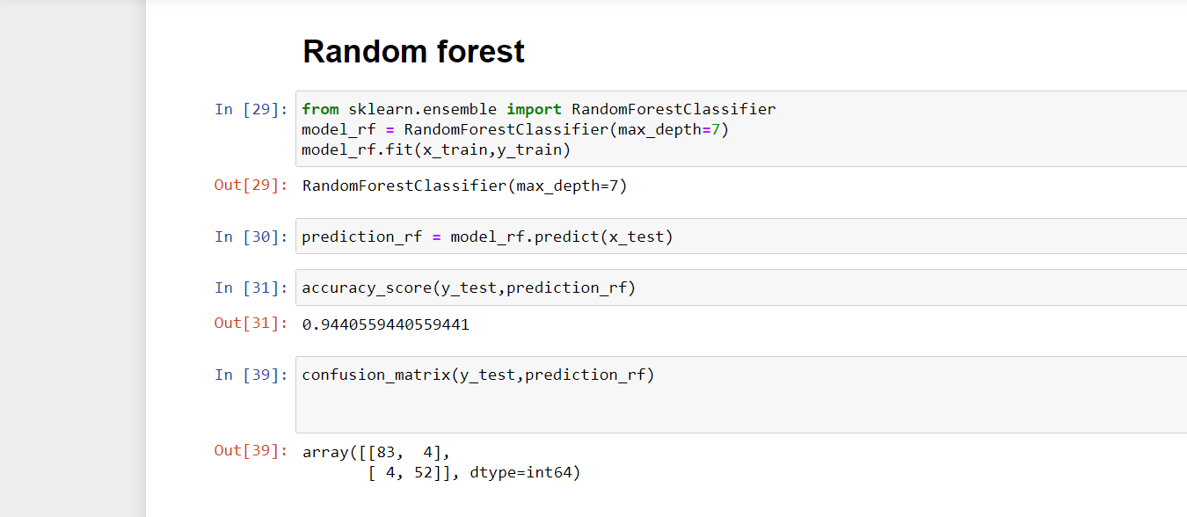
Model Implementation - RFC

Slide 21
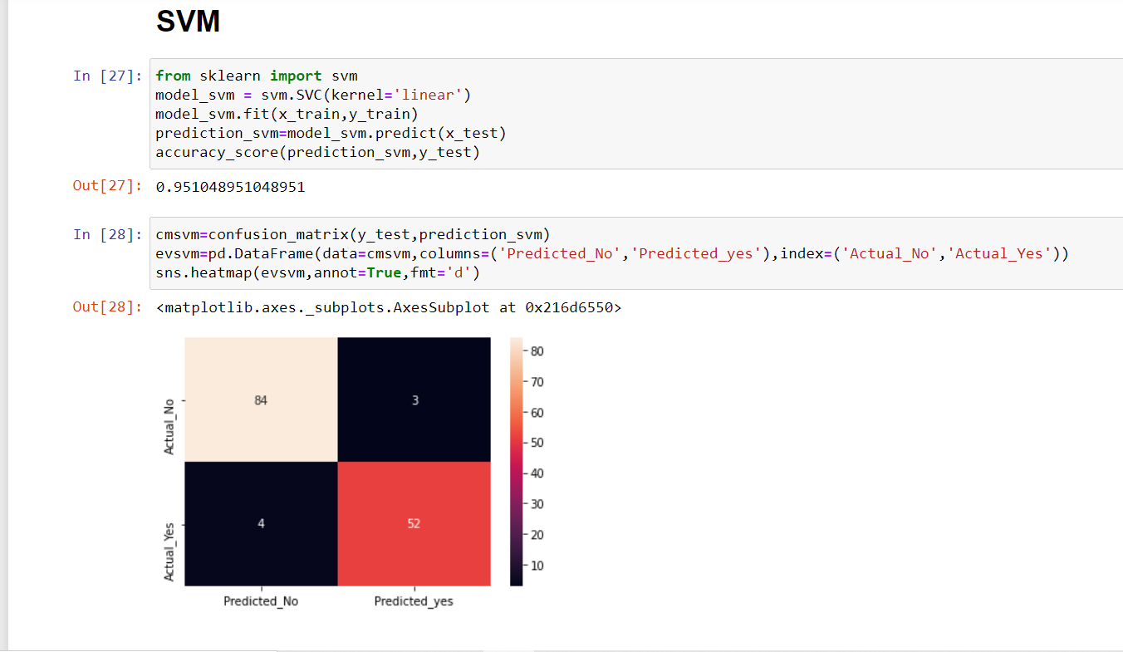
Model Implementation - SVM

Slide 22
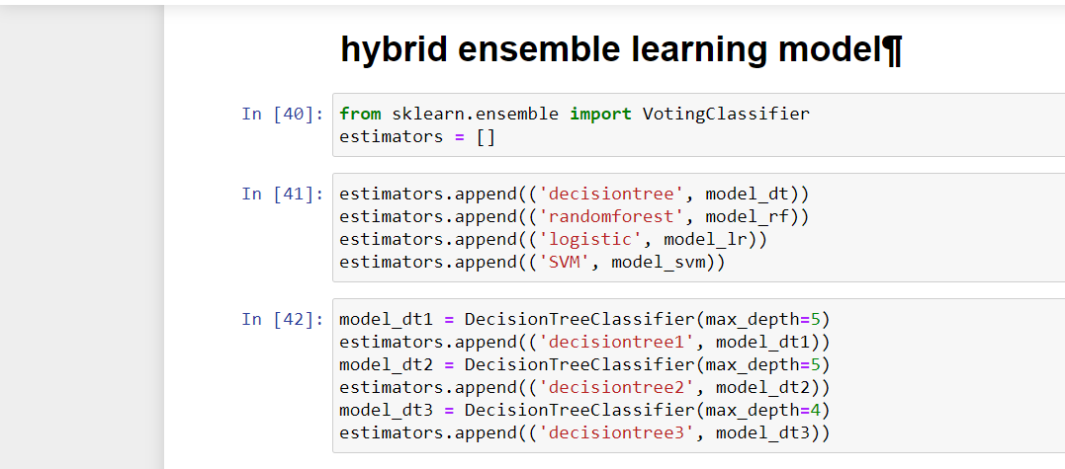
Hybrid Model

Slide 23
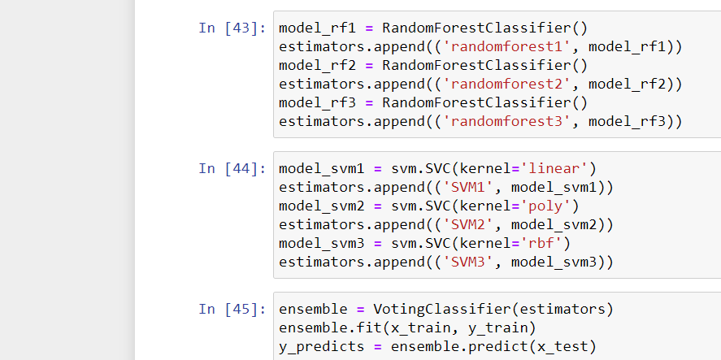
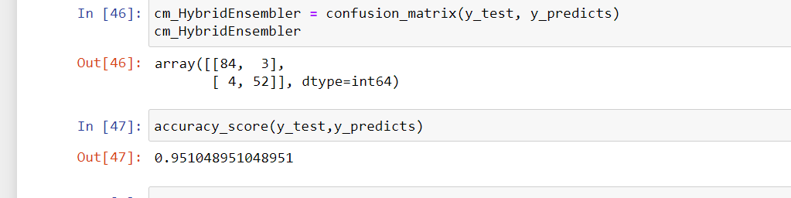
Continue…

Slide 24

Demo Video and Testing

Slide 25
Input and Output

Slide 26
Conclusion
According to WHO there are large number of Breast Cancer patient increasing per year . Health centres lab done many patient health check up and find positive for Breast cancer . And after check up the report reach to the doctor then doctor decide for Breast Cancer Positiveness and negative and this is lot of time consuming here Machine Learning came to light.
In this project in python with Machine Learning , we learned to build a breast cancer tumor predictor on the Wisconsin dataset and created graphs and results for the same. It has been observed that a good dataset provides better accuracy. Selection of appropriate algorithms with good home dataset will lead to the development of prediction systems. These systems can assist in proper treatment methods for a patient diagnosed with breast cancer. There are many treatments for a patient based on breast cancer stage; data mining and machine learning can be a very good help in deciding the line of treatment to be followed by extracting knowledge from such suitable databases.

Slide 27
Presented by :-
NAME | REG NO.
RAUNAK ANSARI | 19MIM10078
PREM SAGAR KUSHWAHA | 19MIM10080
HARSH DEV SINGH SENGER | 19MIM10073
ISWAR SINGH PAWAR | 19MIM10070

Slide 28
Thankyou

