Slide 1
Automotive Service Operations
Intelligence Agent
Voice and text shift updates become derived repair-order state, a prioritised handover, and a grounded agent — on one L40S
14
10
100%
5 of 6
NVIDIA components
13 running, 1 blocked
typed tools
deterministic SQL and vector reads
grounded and traceable
524 of 524 citations resolve
question classes answered
with no model call at all
Notes:
One L40S carries all three NIMs. Nothing in the answer path calls a hosted model; speech is the single hosted dependency.

Slide 2
AGENTIC AI USE CASE
Automotive Service Operations Intelligence Agent
OBJECTIVE
BUSINESS OUTCOME
A service department's day is recorded in speech and free text at the bay. Turning that into the state of each repair order is done by hand and from memory, so updates are lost and a manager's question gets an answer nobody can trace back.
Spoken and typed updates become repair-order state
Every figure in an answer traces to an order and an update id
Five of six question classes need no model call at all
ARCHITECTURE
NVIDIA COMPONENTS
NVIDIA FRAMEWORK
ROADMAP · BLOCKED
INPUTS
SERVICE OPERATIONS INTELLIGENCE AGENT
EXPERIENCE
Spoken update
1 · CAPTURE & UNDERSTANDING
Operations console · 6 tabs
Riva ASR
Nemotron 8B
Entity resolver
Reconciler
Typed update
2 · EVENT LOG & DERIVED STATE
Review workbench · 7 panes
Manager question
Event log
Fold engine
Lifecycle gate
Diff card
HTTP API · 27 routes
3 · PREPARATION & INDEXING
CORPORA
NeMo Curator
NV-EmbedQA E5
Milvus upsert
Index audit
OBSERVABILITY
Repair orders · 400
4 · RETRIEVAL & GROUNDING
NVIDIA DCGM · 19 series
Vector search
NV-RerankQA 4B
Context assembly
Citations
Shift updates · 1,949
Prometheus · 13 series
5 · REASONING & ANSWERING
Labour op codes · 104
Query planner
Switchyard
11 typed tools
Narration
Grafana · 11 panels
Staff · 50
6 · GUARDRAILS & VERIFICATION
Attu and sqlite-web
NeMo Guardrails
Injection rail
Grounding rail
Release claim
TRACEABILITY, ASSURANCE & GOVERNANCE
Answer log
706 logged
NeMo Relay
trace spans
NeMo Evaluator
run over run
Riva Magpie TTS
speech harness
Acceptance gates
six floors
NemoClaw
blocked
Infrastructure
NVIDIA Brev · L40S 48 GB
NVIDIA NIM · 3 served models
Milvus · SQLite · Gradio · FastAPI · Prometheus · Grafana
Notes:
Six lanes, read top to bottom. The write path fills lanes 1-3; a question runs through 4-6. Thirteen of the fourteen NVIDIA components are running; NemoClaw is blocked by a platform fault, so it is drawn dashed.

Slide 3
Application flow
One loop, not two paths: what a technician says becomes the state and the corpus a manager's question is then answered from
CAPTURE → STATE · what a technician says, becoming the record
Capture
spoken at the bay, or typed
Riva ASR
speech to text, on the GPU
Nemotron 8B
free prose → strict JSON
Resolve & reconcile
orders matched; conflicts surfaced
Curate & embed
six Curator stages, then indexed
SYSTEM OF RECORD · the only thing both halves share
Event log — 10,927 events
Append-only. Every order's state is folded from it on each read.
Vector index — 1,949 @ 1024d
Derived, and rebuildable. Holds no fact the record does not.
QUESTION → CITED ANSWER · and what a manager can then ask of it
Question
console or HTTP API
Rails
injection, scope, NeMo self-check
Plan → tool call
routes 37 of 37 with no model
Retrieve + rerank
free-text search only
Compose or narrate
figures computed, then prose
Grounding check
every digit must be in the payload
Negation check
a flipped "not" inverts a safety answer
Release-claim rail
authorisation needs evidence
Answer log
route, tools, citations, seconds
Cited answer — every claim tied to a repair order and an update id, and logged — which is what the evaluator scores the next release against
Notes:
The loop: answers are logged with the payload they were built from, those rows become the evaluation dataset, and the scores gate the next change.

Slide 4
NVIDIA components
Thirteen running, one blocked — every status here measured by running the thing, not by importing it
NIM — LLM
Prose → JSON in, tool payload → prose out. Nothing else.
Nemotron Nano 8B · :8000
NeMo Agent Toolkit
A second front end onto the same eleven tools; its calls arrive as text.
tools run 18/18 · answers 3/18
NIM — Embedding
Vectors for 1,949 updates and for op-code matching.
NV-EmbedQA E5 v5 · :8001
NeMo Guardrails
Input rail judged by the local model.
self check input
NIM — Reranking
Reorders candidates to the passages actually cited.
NV-RerankQA 4B · :8002
NeMo Curator
Six stages; the sixth quarantines injection.
run before indexing
Riva — ASR
Speech to text for spoken shift updates.
Parakeet CTC 0.6B · gRPC
NeMo Evaluator
Seven BYOB benchmarks, run over run.
Evaluator result schema
Riva — TTS
Synthesises the speech the ASR leg is tested with.
Magpie TTS · gRPC
NeMo Relay
How an answer was produced, not just what it said.
per-stage trace spans
NVIDIA DCGM
GPU utilisation, framebuffer, power, temperature.
19 series · :9401
NeMo Switchyard
Efficient model local, capable one hosted.
off unless enabled
NVIDIA Brev
The deployment target carrying all three NIMs.
L40S 48 GB
NemoClaw / OpenShell
Would add a containment boundary and a sandboxed compute tool.
BLOCKED — platform fault
The blocked row costs the containment boundary and a sandboxed compute tool. It is not in the answer path: the agent the console and the API call is this project's own router, and nothing in it executes untrusted code.

Slide 5
Deployment
One Brev L40S. All three NIMs co-reside in roughly 40 GB of the 48 — which is why escalation leaves the box
NVIDIA BREV · L40S 48 GB
GPU — served models
LLM NIM · :8000
Nemotron Nano 8B · about 22.5 GB
Embedding NIM · :8001
NV-EmbedQA E5 v5 · 1024 dimensions
Reranking NIM · :8002
NV-RerankQA 4B · no hosted equivalent
DCGM exporter · :9401
19 GPU series, scraped every 10s
Datastores
Milvus · :19530
the vector store; metrics on :9091
SQLite
system of record; every app read is read-only
An unused embedded store
present and NOT in use — the startup report names it
Named volumes
Prometheus retention survives a recreate
Application and operator surfaces
HTTP API · :8080
27 routes, OpenAPI at /docs
Console · :7860
6 tabs, optional public link
Metrics · :9400
separate from the API port
Operator UIs
Prometheus :9090 · Grafana :3000 · Attu :8101 · sqlite-web :8102 — loopback only
What is reachable from outside the box
The optional public console link, and nothing else. The API, the vector store, Grafana, Prometheus and both store browsers are not exposed beyond the instance. The API key lives in an ignored environment file, is never committed and is never printed.

Slide 6
Data model
SQLite is the system of record; the vector store is derived from it and can always be rebuilt
SYSTEM OF RECORD
DERIVED — rebuildable from the log
ros 400
updates 1,949
events 10,927
Milvus collection one row per update
ro_number PK
vin · registration
make · model · year
pay_type · wait_type
promised_time
advisor · primary_tech
concern · category
update_id PK
ro_number → ros
staff_id → staff
at · shift
text (untrusted)
ground_truth
event_id PK
ro_number → ros
type · at
actor_id → staff
shift
source_update_id
payload (json)
pk INT64
vector FLOAT_VECTOR(1024)
update_id · ro_number
staff · at · shift
text VARCHAR(8192)
vehicle · category · vin
staff 50
labour_ops 104
answer_log 706
Repair-order snapshot computed, never stored
staff_id PK
name · role
skill · shift · team
op_code PK
description · category
flat_rate_hrs
safety_critical
answer_id PK · at
question · answer
route · composed
grounded · citations
state (1 of 13)
blocking · at_risk · safety
booked hours · tech
contradictions
Why derived means rebuildable
The vector store holds no fact SQLite does not; dropping the collection and re-running the index loses nothing, which is what makes editing it safe to offer at all. The reverse is not true — events can never be rebuilt from anything, which is why they are append-only and why every application read of the record is opened read-only.

Slide 7
Repair order lifecycle
Thirteen states, and only these transitions. Anything absent is rejected by the engine and surfaced
CHECKED IN
DISPATCHED
DIAGNOSING
ESTIMATE PREPARED
AWAITING AUTHORISATION
vehicles sit here
AUTHORISED
INVOICED
terminal
READY FOR DELIVERY
ROAD TEST
QUALITY CONTROL
REPAIR IN PROGRESS
LEAVES AND REJOINS THE LINE
PARTS HOLD
Entered from diagnosing, authorised or repair-in-progress; leaves to repair-in-progress or back to awaiting authorisation.
DECLINED
Entered only from awaiting authorisation, when the customer says no; leaves to ready-for-delivery or straight to invoiced.
Deliberately not IN_PROGRESS / COMPLETE
The states that matter are the blocking ones — that is where vehicles actually sit, and where the agent creates value.
The authorisation rule
Repair cannot legitimately begin before the customer has said yes. That gate is why the release-claim rail exists.
QC failure is an edge, not an error path
Quality control and road test can both send a job back to the bench, and supplementary work re-opens authorisation.
Amber marks the two blocking states; green marks the terminal one. The second row flows right to left, so every arrow drawn here is a transition the engine actually allows.

Slide 8
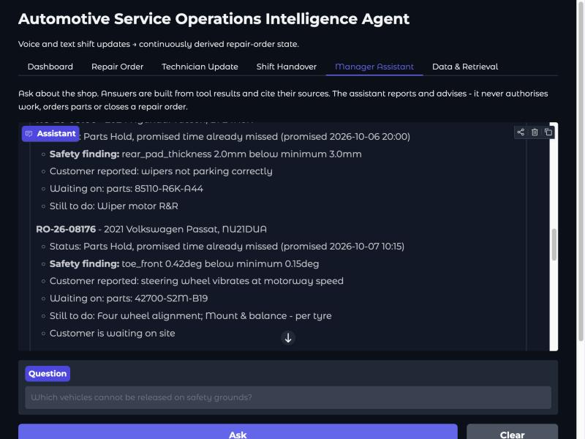
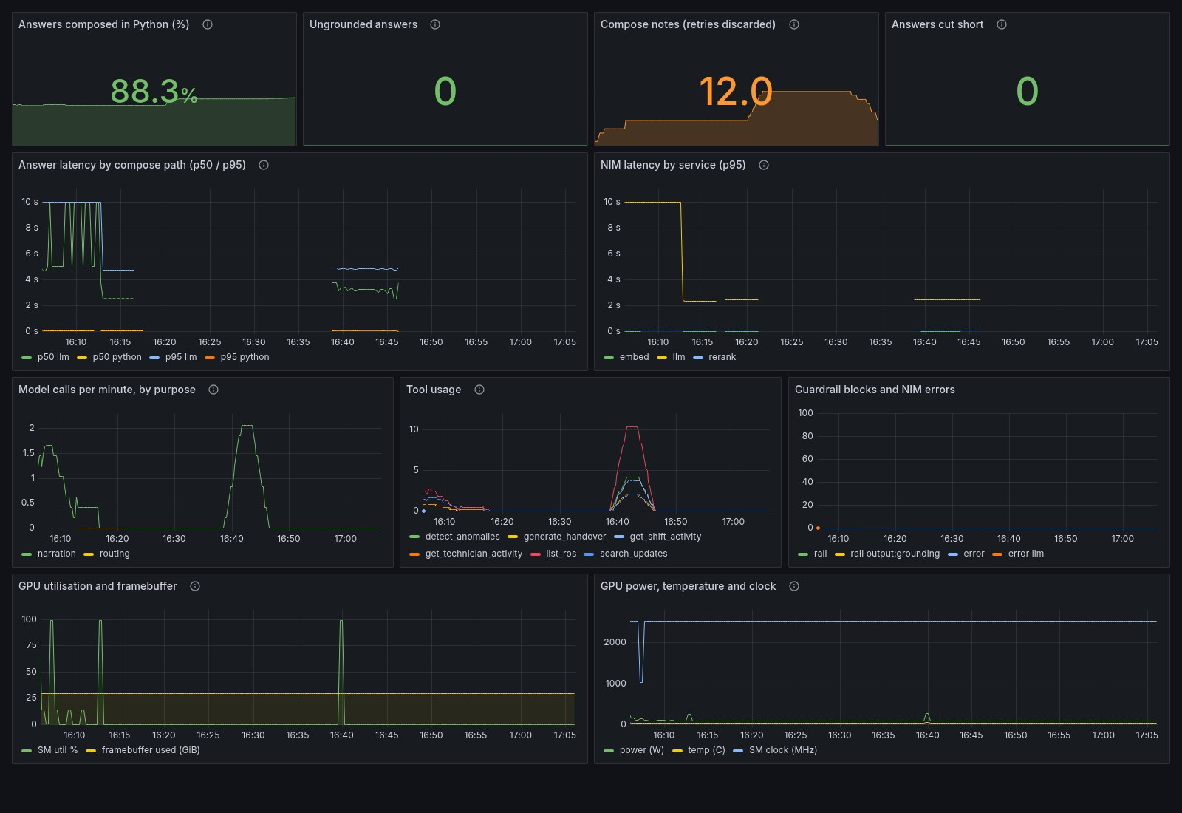
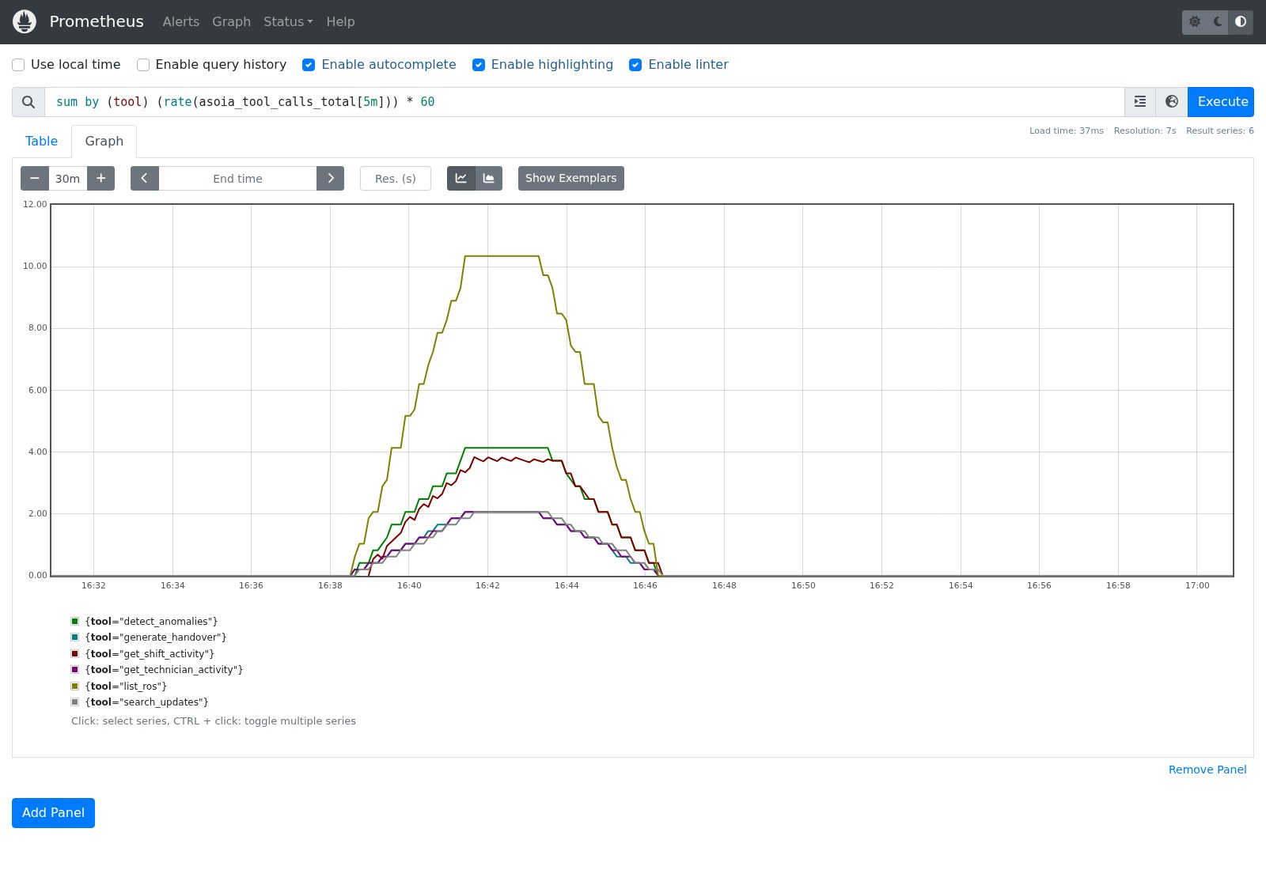
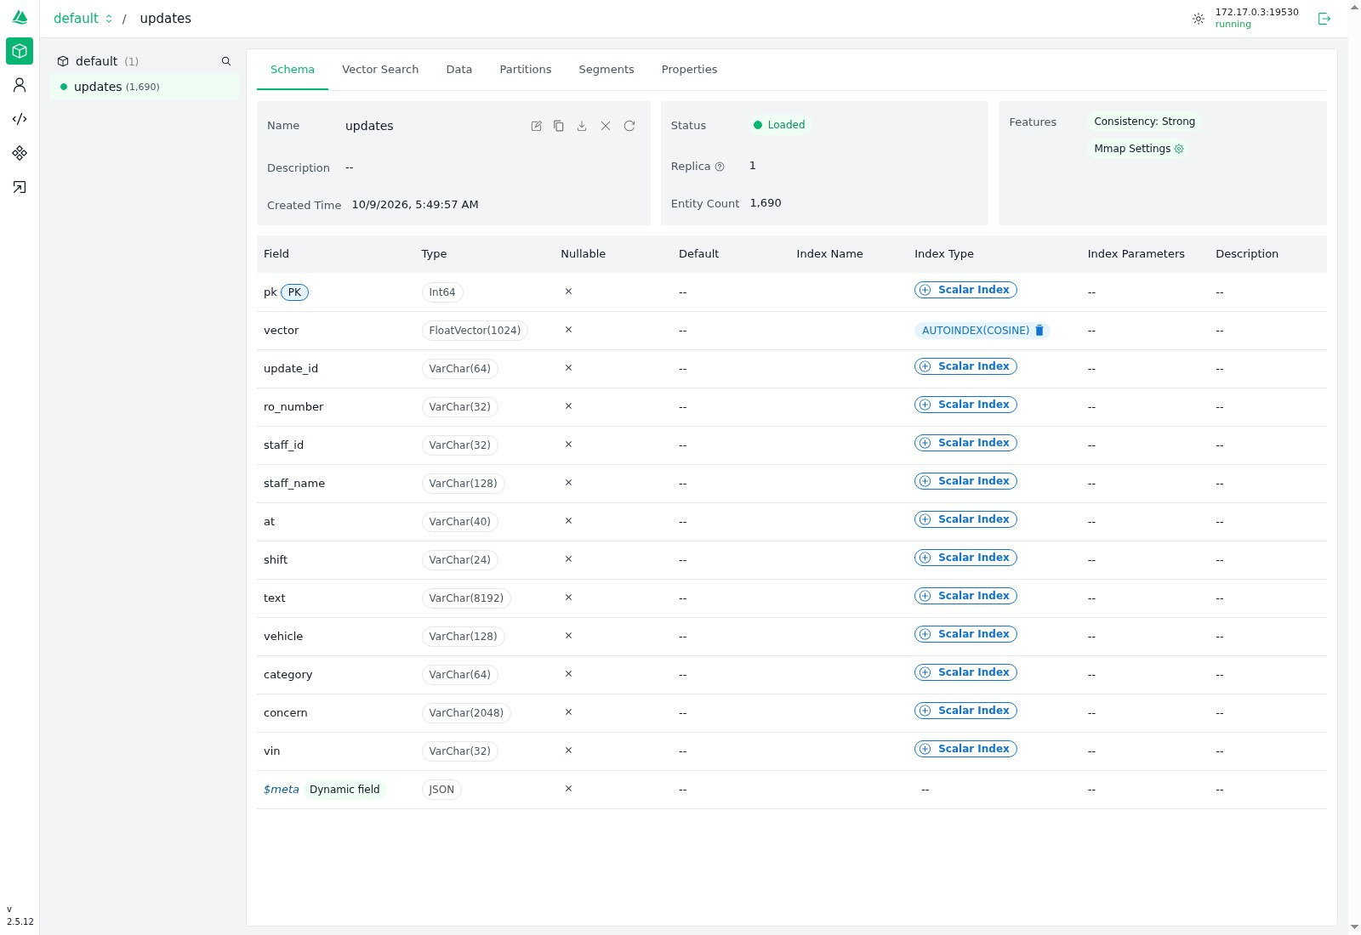
What it looks like in use
One question, end to end — and the three consoles that show it happened. Captured from a live run on the L40S, all three NIMs local.
1 · Question
typed in the UI,
or spoken and transcribed
2 · Route
keyword match picks one typed tool.
No model call here
3 · Read
SQL over the event log, or
embed > Milvus > rerank
4 · Compose
Python builds the answer.
The model only narrates prose
5 · Check
every figure must trace back
to a tool result, or it is blocked
6 · Answer
with the record ids
it was built from
Steps 1, 2, 4 and 6 never touch a model. Only step 3's semantic branch and step 4's narration do - which is why eight of eleven questions answer in under a tenth of a second.
The question a service manager asks
Grafana — the thesis, measured
Plain English in; a keyword router picks one typed
tool - no model call to decide what to run
Every figure carries the record id it came from
Measured: 9 of 11 questions answer in under 0.11s
Answers composed in Python 88.3% over the hour
Ungrounded 0 · cut short 0 · rail blocks 0
p50 by path: python ~0s against llm ~3s - and the
step down at 16:40 is the guided-JSON fix landing
Prometheus — which tools actually ran
Milvus in Attu — the store, in full
rate(asoia_tool_calls_total[5m]) x 60, six series
list_ros peaks ~10/min; search_updates is the rare
one, because retrieval is the minority path here
Counters are per-process: load must hit the API
vector: FloatVector(1024), AUTOINDEX(COSINE)
Loaded, replica 1, entity count 1,690, 13 fields
Width is load-bearing: the hosted embedder is 2048,
so switching mode without rebuilding breaks search
Notes:
The flow strip is the read path. The four frames are the same run seen from the app, from Grafana, from Prometheus and from the store. On the Python share: do NOT claim Grafana corroborates the eleven timings in docs/EXAMPLES.md - it measures a different thing. Over 80 answers, 92.5% finished on the Python path and 86.25% were Python by design once the 5 model fallbacks are removed.

Slide 9
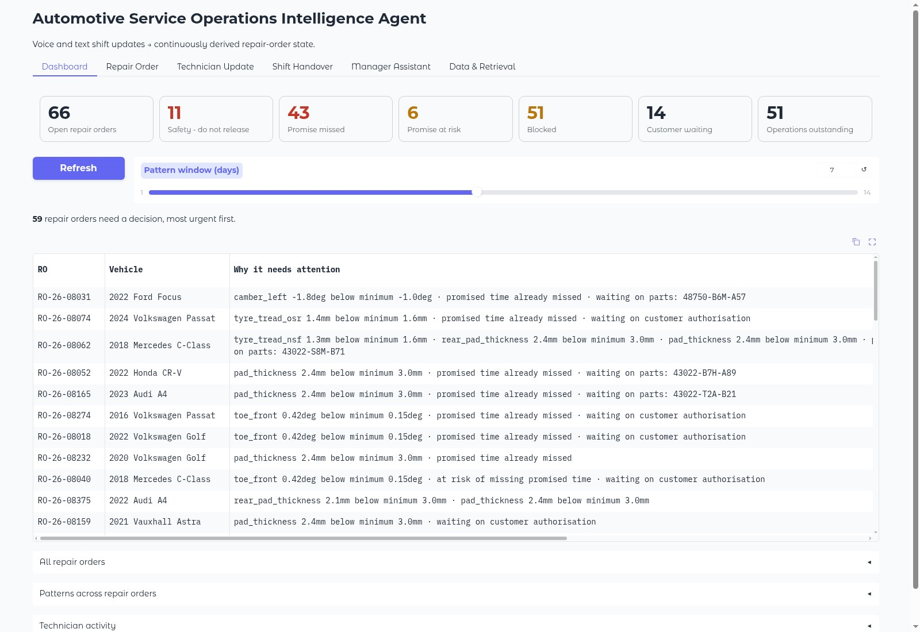
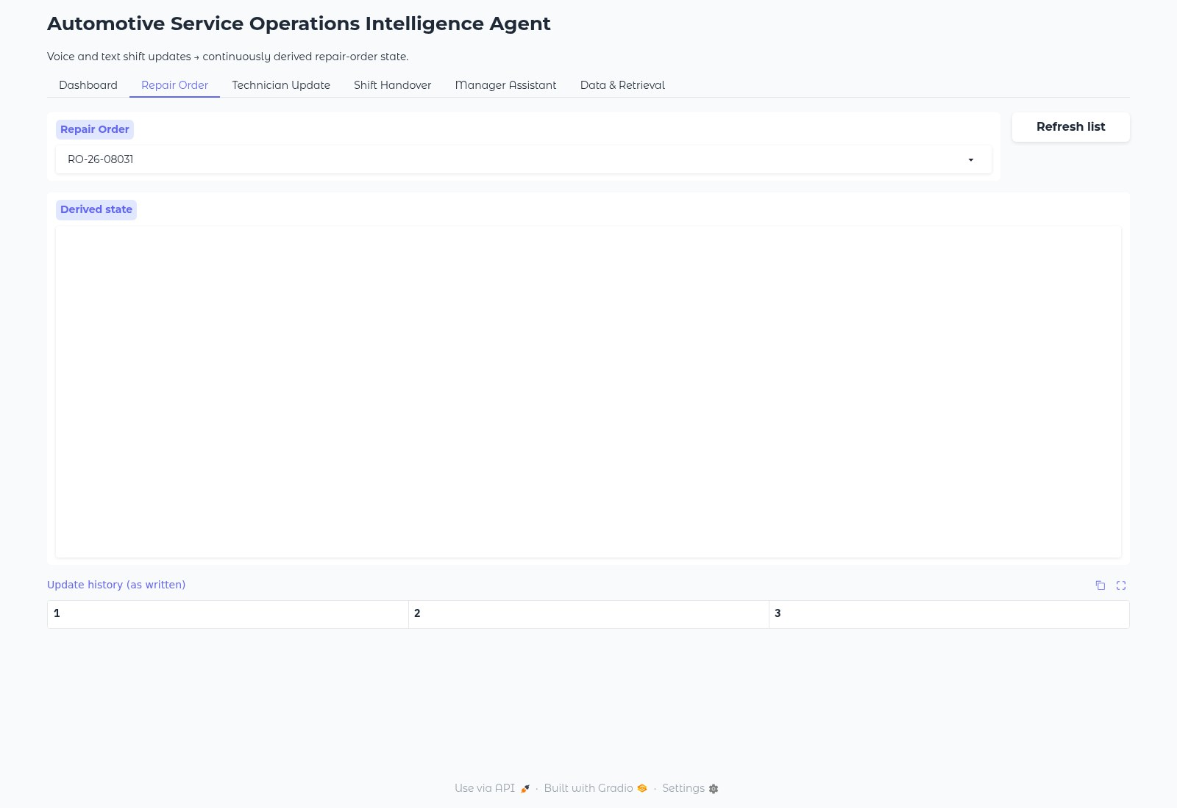
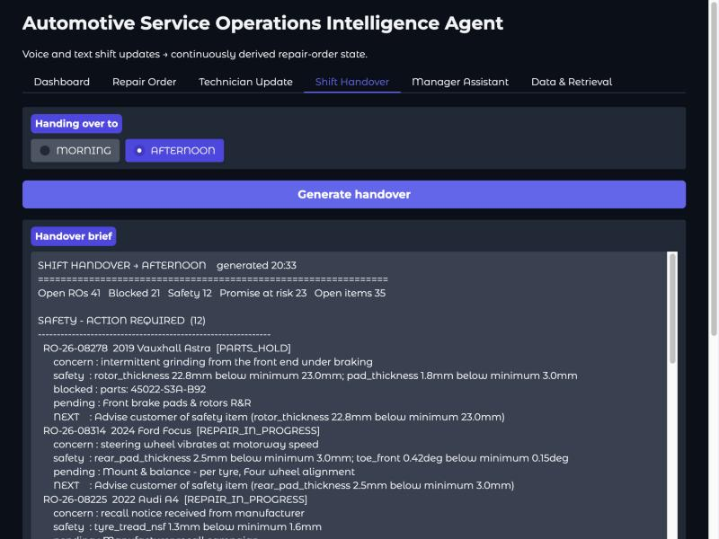
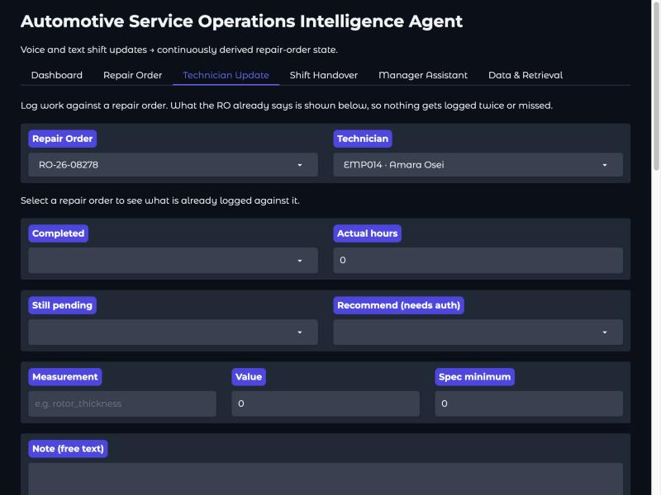
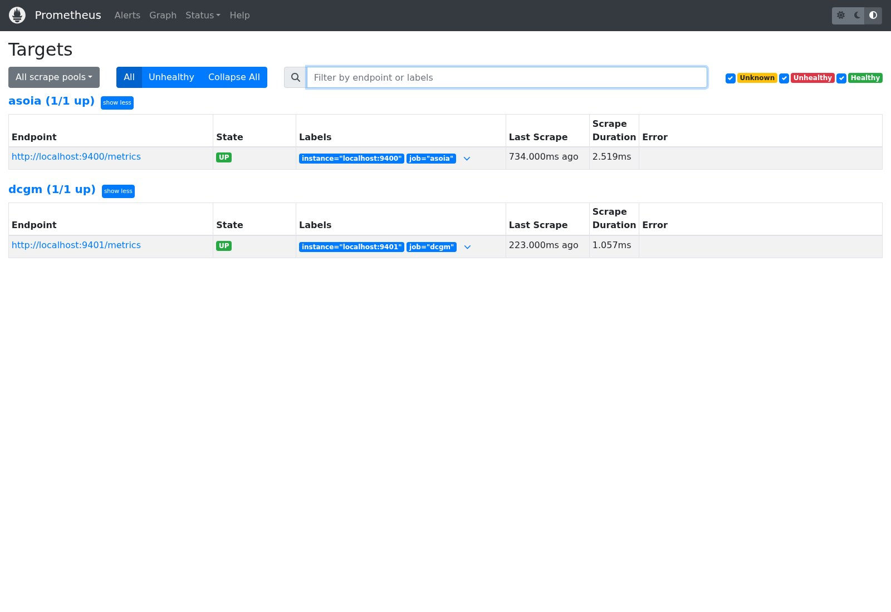
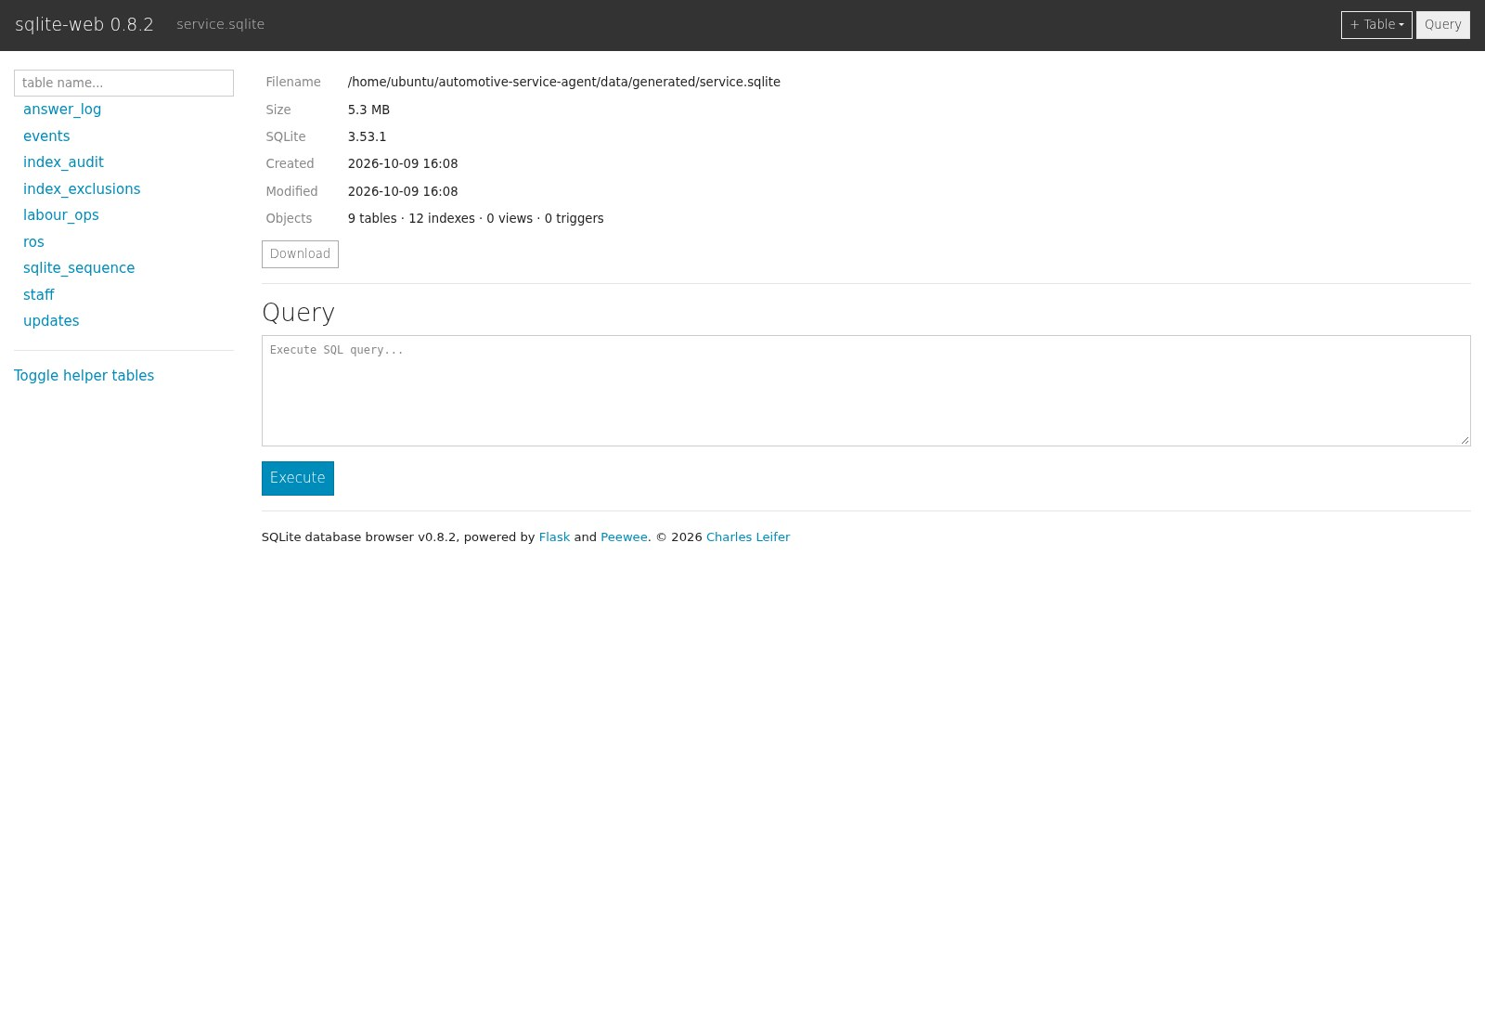
The rest of the surface
Five tabs a service advisor actually uses, and the two store consoles behind them. The agent's UI shows no vector internals — that is an operator's view, and it lives in Attu and sqlite-web.
Dashboard
Repair Order
Shift Handover
400 live ROs, filtered to safety, blocked, at-risk or waiting — each row says WHY, with the measurement against its limit
State folded from the event log rather than stored, beside the technician updates exactly as written
The brief a manager reads at changeover: safety first, then breached, at-risk, blocked — composed in 0.05s
Technician Update
Prometheus targets
sqlite-web
Dictate or type the update; the diff card shows exactly what changed in the record, for confirmation before it lands
Both scrape jobs up: the app on :9400 and NVIDIA DCGM on :9401, which is what puts real GPU telemetry on the dashboard
The system of record itself — 8 tables, 12,266 rows. An operator view, deliberately outside the advisor's UI
Technician Update, Shift Handover and Data & Retrieval were captured against the hosted models rather than the local NIMs — Chromium hangs on those three Gradio tabs, so they are not re-taken automatically. docs/screenshots/README.md dates every frame.
Notes:
Nothing here needs a GPU except the voice leg and the semantic tab. The store consoles are deliberately outside the advisor's UI.

