Slide 1
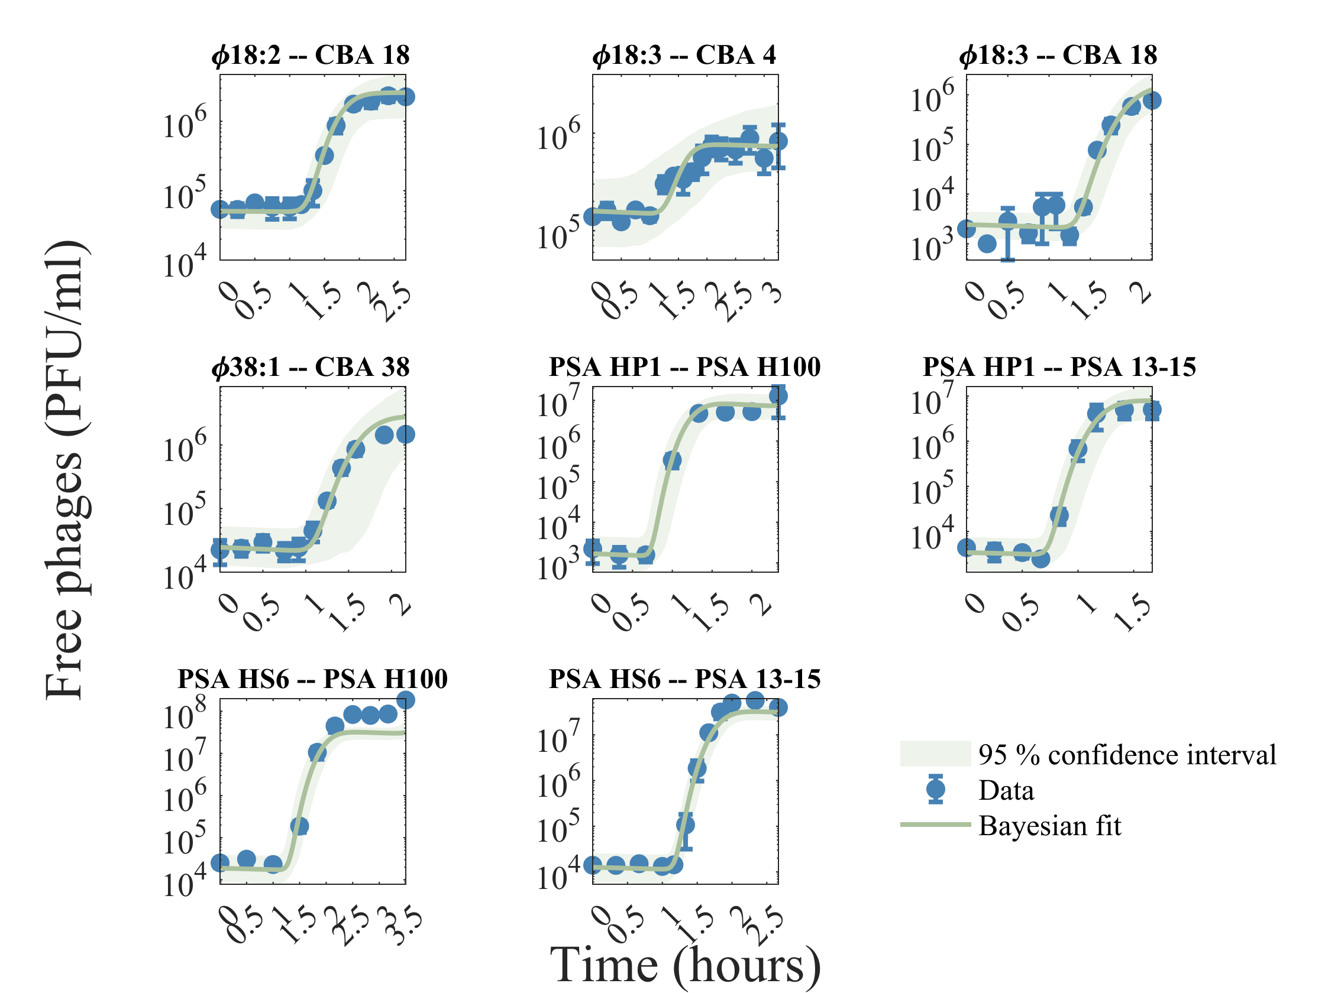
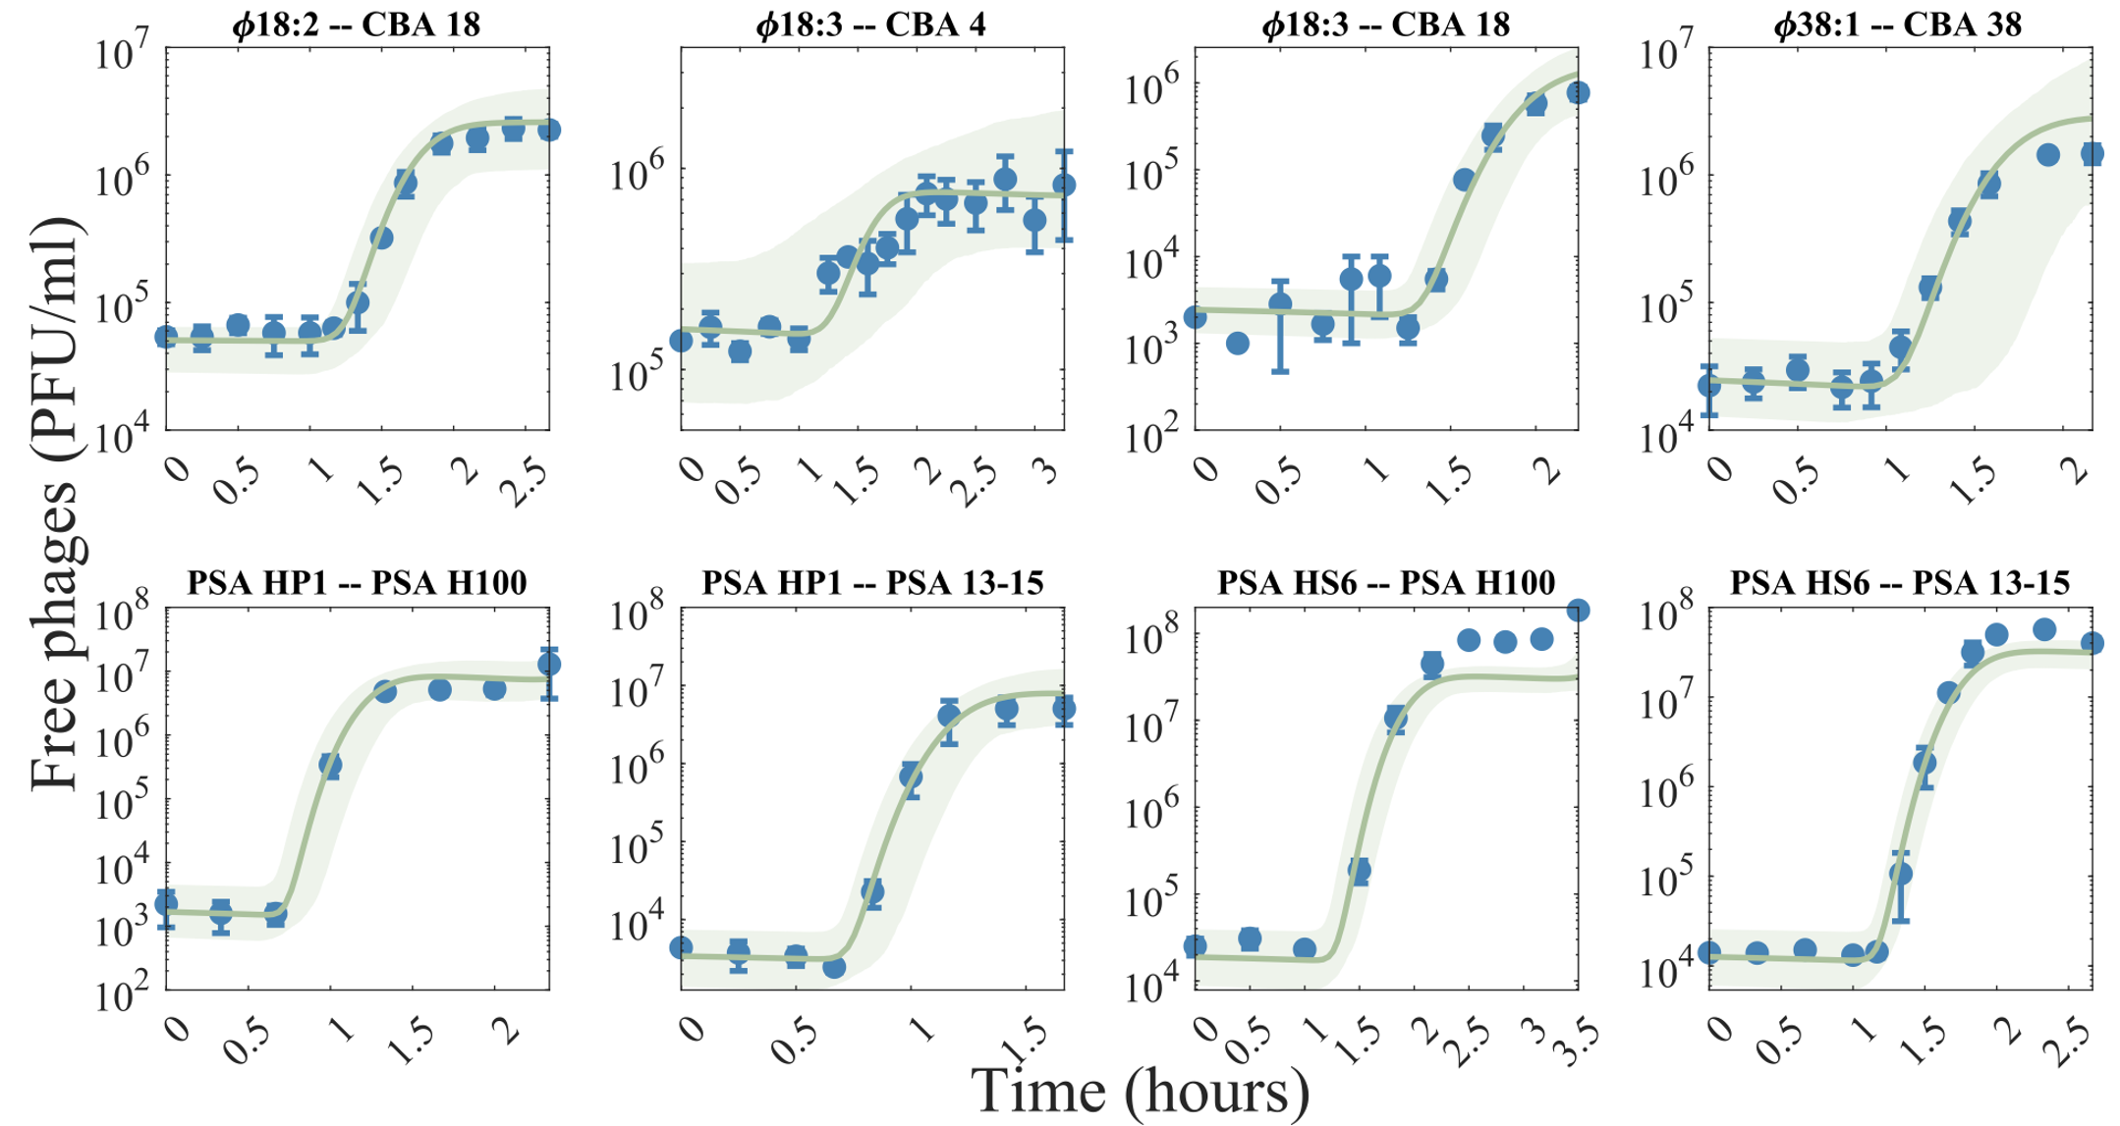
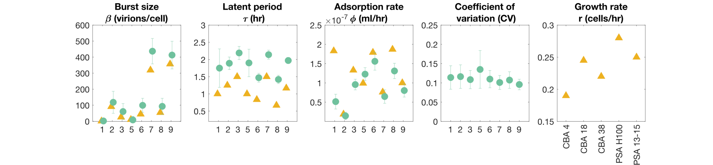
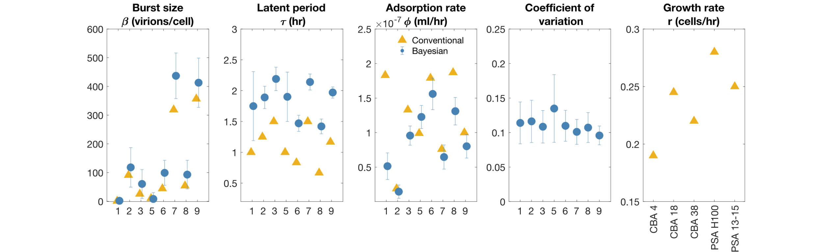

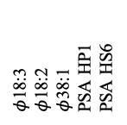







$φ$18:3
$φ$18:2
$φ$38:1
PSA HP1
PSA HS6
a
$$φ$$
b
$$r$$
S
$$φ$$
$$E_{1}$$
$$⋯$$
$$E_{N_{E}}$$
I
$$β$$
V
a
CBA 4
CBA 18
CBA 38
PSA H100
PSA 13-15
1
$$τ$$
2
3
4
5
6
7
8
9
c
d

