Slide 1
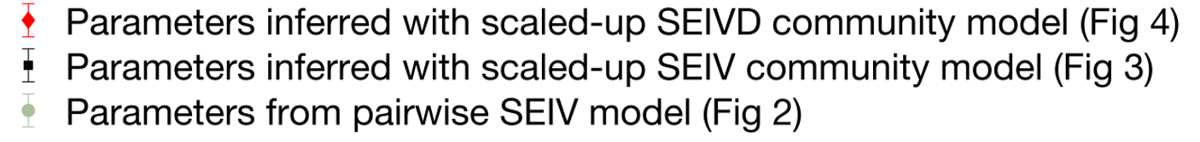
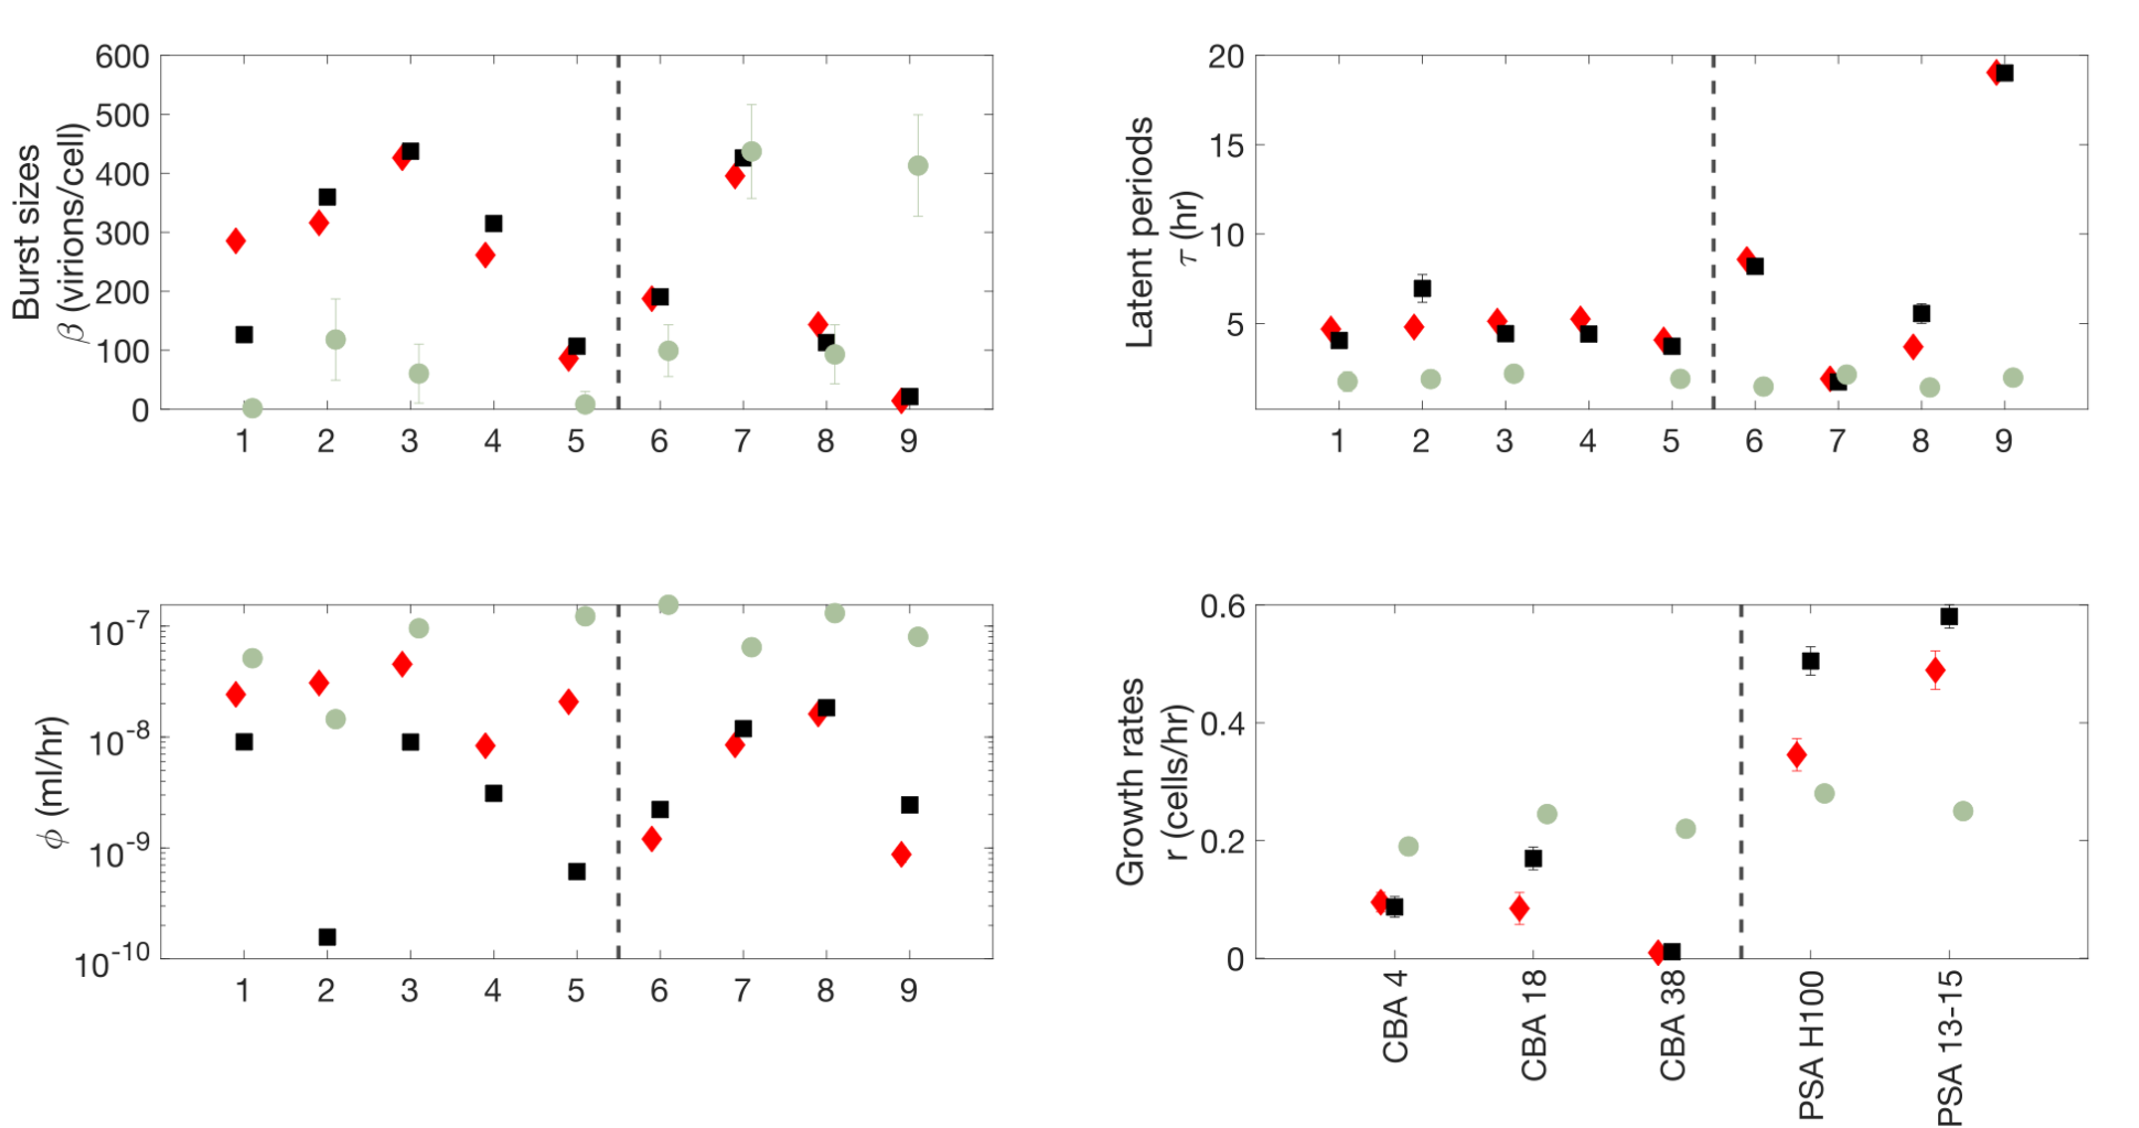
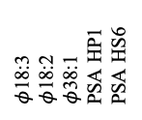
$φ$18:3
$φ$18:2
$φ$38:1
PSA HP1
PSA HS6
CBA 4
CBA 18
CBA 38
PSA H100
PSA 13-15
a
1
2
3
4
5
6
7
8
9
a
b
CBA
PSA
CBA
PSA
c
d
CBA
CBA
PSA
PSA

