Slide 1
PHAMILI – PHAge MIcrobe Lysis Inhibition
Models of inhibiting lysis and mediating coexistence of phages and their hosts

Slide 2
Main Challenges:
Take the microscopic mechanistic view and write macroscopic population level models on how the population will behave.
When and how will we see coexistence and how much percent of the species will survive – calculating the fixed points or even Jacobian for complicated equations is difficult – there are numerical ways (I have some ideas, ignore this part for now)

Slide 3
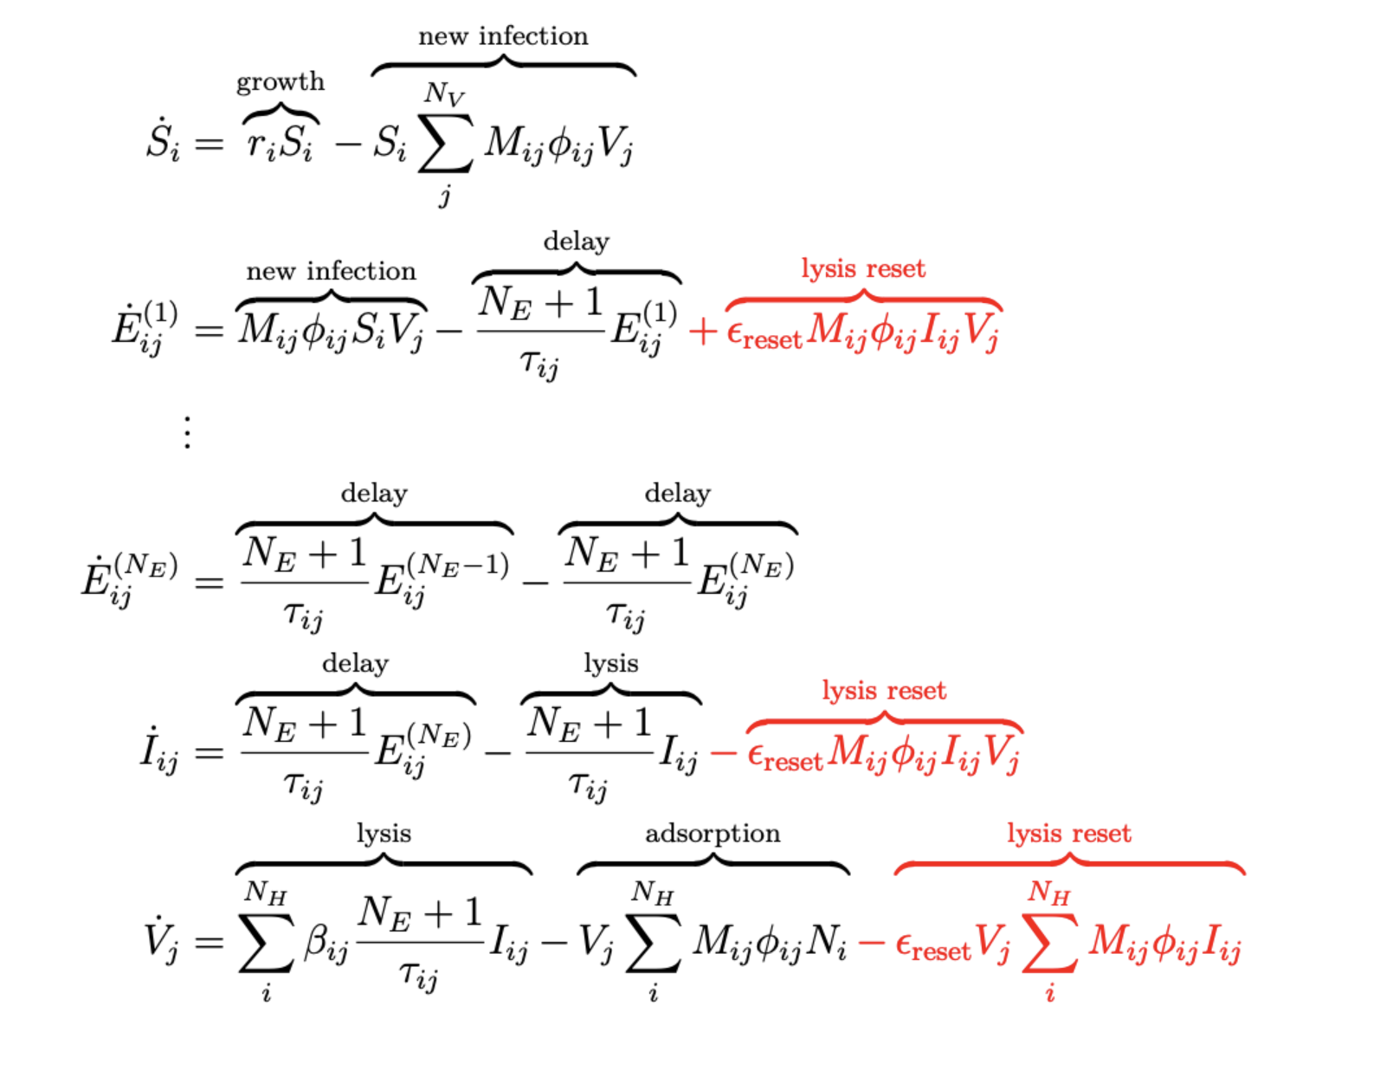



Superinfection Exclusion
Akash has some idea on this – use of multiple E and I classes with decreasing rate of transfer
Lysis reset idea: When infected – go back to first component (borrowing Ashley + David’s idea)
Irreversible attachment to infected host (Joshua’s book – pg 85)

Slide 4

Latent period is not a constant but a function
Even in non-compartmental model – put lysis term as $φβSVe^{−ωt}$ so as time progresses, it becomes slower (Joshua’s book pg 82)
or if we want no lysis in the beginning, we can use another probability of lysis p(t) so that it is like p(t) = (1-exp(-at)) – so initially no lysis (Raunak’s hunch)

Slide 5





Effects of Debris (surrounding cellular lysates)
Raunak’s Hill function approach
Our attachment to debris theory --

Slide 6


Effects of Restriction Modification enzymes
Host and Viral DNA gets cleaved by restriction enzymes – but the viral DNA doesn't have methylation enzymes to protect itself.
Proposing Macroscopic model (Raunak's Idea 1): a equation needed

Slide 7

Abortive Infection Effect
Sacrifice (suicide) infected cells – do not release the containing viral particles. (because suicide before they are even formed)

Slide 8
Degradation of viral components:
Some bacteria employ proteases or other enzymes to degrade viral proteins or nucleic acids upon infection. This degradation prevents the proper assembly of phage particles, inhibiting the release of functional virions and subsequent cell lysis.
With time, the host is used to the virus, so at later times, the rate of these transfer will change (decrease, as a defense mechanism)

Slide 9

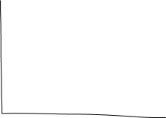

Repairing damaged DNA:
Rate of transfer between compartments

Slide 10
Suppression of phage gene
Bacteria can suppress the expression of phage genes through various mechanisms, such as RNA-based interference or protein-based inhibition. By preventing or limiting the production of phage proteins involved in host cell lysis, bacteria can inhibit the lytic cycle and reduce cell death.

Slide 11

Altered cell-membrane
Different adsorption rates

Slide 12

Enhanced DNA repair of hosts: Hosts recover from infection
Added pathway to recovery in the big model.
The recovered bacteria may have different properties.

Slide 13
CRISPR-CAS immunity
It involves capturing short segments of phage DNA (spacer sequences) into the host genome, which are later transcribed and processed into CRISPR RNAs (crRNAs). The crRNAs guide Cas proteins to recognize and degrade complementary viral DNA, inhibiting viral replication and lysis

Slide 14
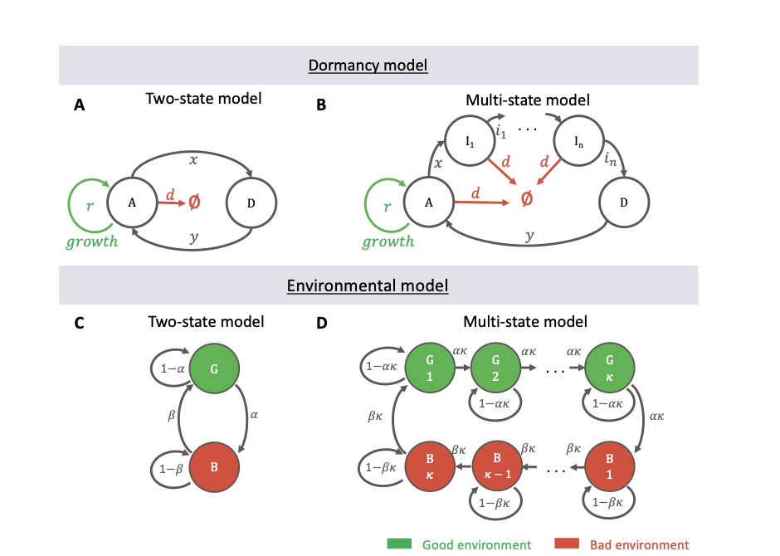
Bacteria becomes dormant
One example spore formation
Simply can write a percent of bacterial population be dormant and they do not get exposed – that proportion changes depending on stuff.
Copied from Andrea’s dormancy paper – there’s obviously a much simplier one where S goes to D and vis-a-vis

Slide 15







Quorum sensing
Bacteria stop growing is the population of bacteria is dropping – be innovative and write functions.

Slide 16
Comments
Some of these models may have the opposite effect of lysis inhibition: They might predict that cells can get exposed and infected at an earlier stage before and then that infection propagation slows down over time.

Slide 17
Mixed models
One or more mixture of all these ideas with different weights.

