Slide 1


Bitcoin Price Prediction Using Time Series Forecasting
Raunak Nandkumar More (101136778)

Slide 2
Introduction
Purpose of the Study:
The primary goal is address the challenge of prediction of volatile Bitcoin prices using deep learning models which is an open ended system.
Importance of Accurate Predictions
Accurate predictions of these prices can lead better planning for investors,buyers and financial analysts.

Slide 3
Problem Definition
Usage of an Ensemble of Neural Networks for prediction of Bitcoin Amount using Historical Data
Comparing it to Naïve forecast which forms as baseline for performance comparison of the neural networks
Core idea behind usage of Neural Network for creation of ensemble model is that we use 3 different loss function mae,mse and mape to generate sequential models with 2 dense layers with 128 neurons each. Since the initial weight assignment is random we can get better confidence levels when looking at predictions as we take the median of these models.

Slide 4
Literature Review
Heaton et al. (2017): Demonstrated the superiority of ensemble methods over single-model approaches in financial applications.
Zhang et al. (2019): Showed that ensemble learning could effectively reduce prediction error in stock market forecasting.
Hansen and Salamon (1990): Introduced the concept of neural network ensembles, which has been widely adopted in financial forecasting.

Slide 5
Methodology
Data Collection:
We download the dataset for daily bitcoin prices from 2010-07-17 to 2024-05-03 using the coincodex
# https://coincodex.com/crypto/bitcoin/historical-data/
Data Preprocessing:
Converting the ‘Date’ column to datetime objects for proper time series analysis.
Inverting the order of the DataFrame to align the data chronologically.
Extracting the ‘Close’ price and renaming it to ‘Price’ to simplify the dataset.
We preprocess the dataset differently for both models:
For Naïve Forecast, we chose the closing amount as price of bitcoin.
We create a lagging series by shifting price variable by 1 so that each value in the new series is the value of the ‘Close’ price from the previous day.

Slide 6
Methodology
Ensemble Models:
Creating Windowed Features:
We create new columns in the bitcoin_prices DataFrame for windowed features. Here we use window size as 7 and horizon as 1 meaning we used 7 previous days’ data to predict the 8th day data
Formatting for Supervised Learning:
The windowed features are used as input variables (X), and the current day’s price is used as the output variable (y). This is done as it transforms the time series forecasting problem into a supervised learning problem.
Splitting the Data:
The dataset is split into training and testing sets based on an 80/20 ratio. The training set is used to fit the models, and the testing set is used to evaluate their performance.
Creating TensorFlow Datasets:
The training and testing sets are converted into TensorFlow Datasets, which allows for efficient data manipulation and batching during model training.
Batching and Prefetching:
The TensorFlow Datasets are batched and prefetched. Batching groups the data into manageable sizes for the model to process, and prefetching allows the data to be preloaded, improving training efficiency.
Model Fitting:
The ensemble models are then fitted to the training data. Each model in the ensemble is trained using a different loss function (mae, mse, mape) to encourage diversity in learning.
Early Stopping and Learning Rate Reduction:
During training, callbacks such as EarlyStopping and ReduceLROnPlateau are used. EarlyStopping prevents overfitting by stopping training if the validation loss doesn’t improve for a set number of epochs. ReduceLROnPlateau reduces the learning rate when the validation loss plateaus, helping the model to converge.
Using Median Values for ensemble model prediction results and create 15 models ie 5 NN with 3 different loss functions.

Slide 7
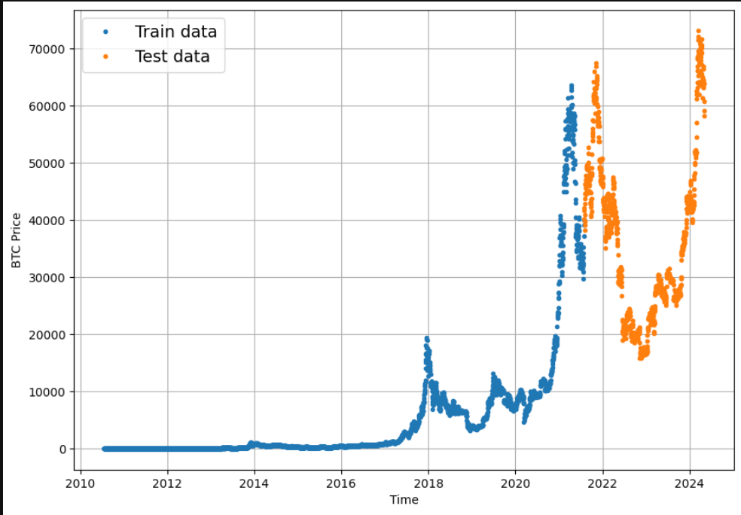
Methodology
Naïve Forecast :
While creating train test splits for Naïve Forecast we make sure to pick an arbitrary point the divides the data into 80-20 split.
We make sure the split is sequential as shown:

Slide 8
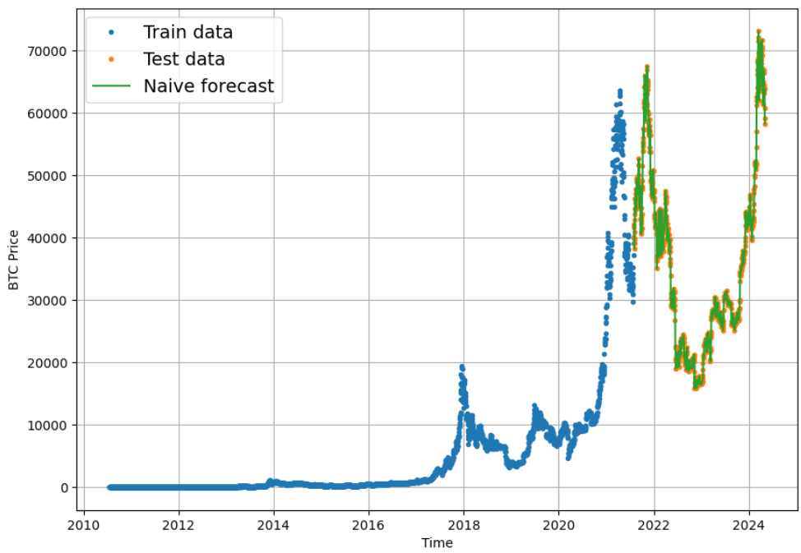
Results
Naïve Forecast
This forms as our baseline model to compare performance of ensemble model to.
As this model works by assigning predicted value to previously known value the forecast results are pretty accurate with a sort of lag in predicted curve.
So while mean Bitcoin value is 35526$, and average prediciton is off by 763$(MAE) we can say the prediction is good enough

Slide 9
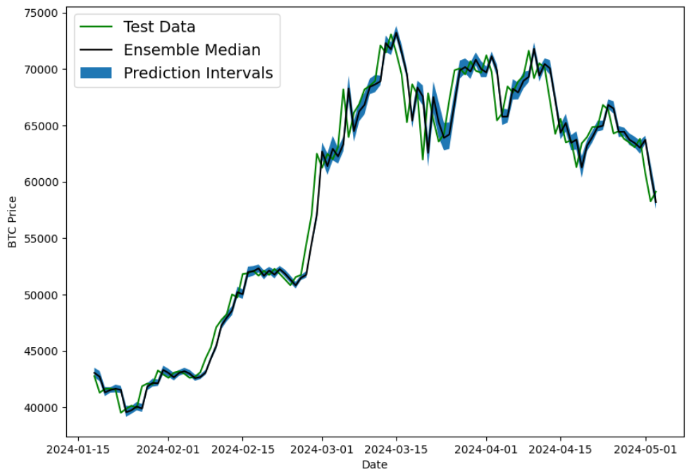
Results
Ensemble Forecast
For predictions using this model , we go with 95% confidence prediction interval by plotting a range of bitcoin amount rather than 1 value.
We do this by multiplying the value predicted by 1.96 as its seen 95% values fall under 1.96 standard deviations of the mean then adding and substracting it from the predictied value to get a upper and lower boundary value

Slide 10
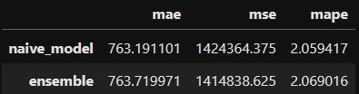
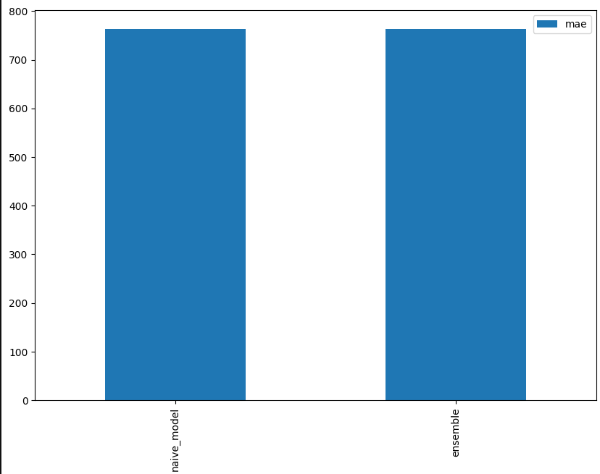
Conclusion
Summary of Findings:
Comparing the loss functions we see that the ensemble model is almost as good as naïve forecast.
This suggests that deep learning models might not be able to predict forecasts for any kind of open system with a reasonable accuracy.
Recommendations for Future Work:
Consideration of sota models for prediction and comparison of their performances.

Slide 11

THANK You!

