Slide 1

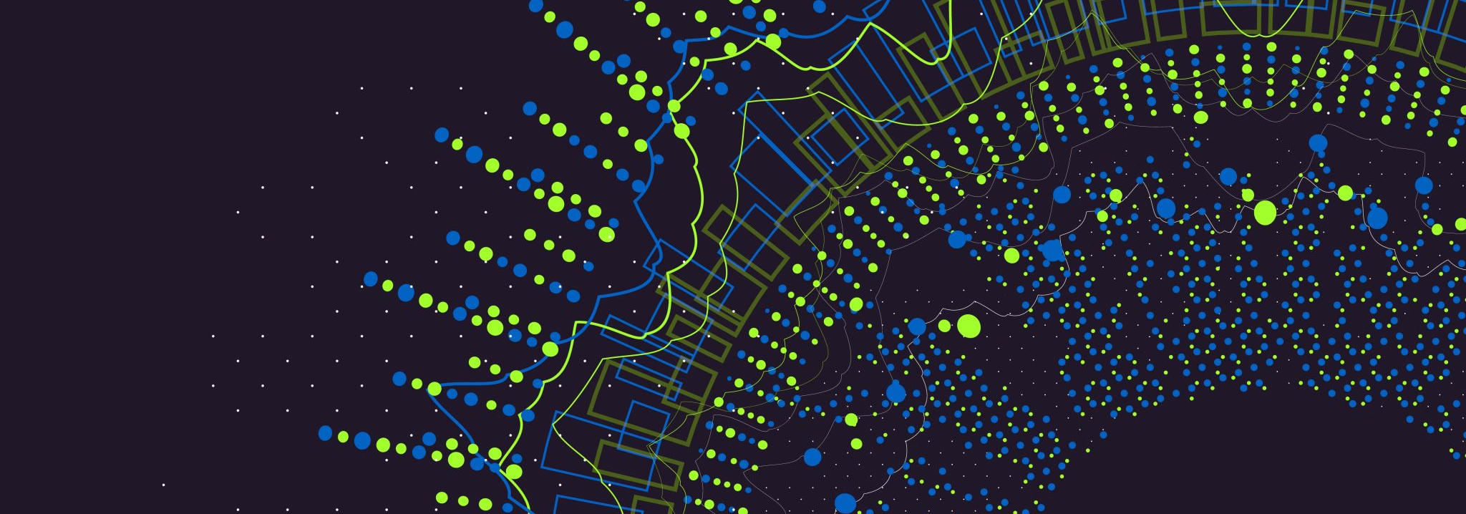
IOT System Performance and Optimization
AbhiShek Chaudhary (101126200)
Raunak Nandkumar More (101136778)

Slide 2
Introduction
This project presents a comprehensive approach to real-time anomaly detection in sensor data, utilizing machine learning algorithms to monitor and analyze temperature values from the Intel Berkeley Research lab dataset. The significance of the problem, the formulation of the challenge, the novel approach adopted, and the validation of the proposed solution through experiments are discussed, followed by a conclusion that outlines the strengths and limitations of the work.

Slide 3
Motivation of the Problem
Importance of Temperature Monitoring: Monitoring temperature values in critical environments, such as research labs, is vital for ensuring the integrity of experiments and the safety of equipment.
Significance of the Intel Berkeley Research Lab Dataset: The Intel Berkeley Research lab dataset, comprising temperature readings from 52 sensors, presents a significant challenge due to the sheer volume of data and the need for timely detection of anomalies.

Slide 4
Problem Formulation
Primary Challenge: The primary challenge is the real-time detection of temperature anomalies across multiple sensors, requiring an efficient and accurate analysis of continuous data streams.
Associated Challenges: The high dimensionality of the data, the need for immediate response to potential anomalies, and the minimization of false positives and negatives are key challenges in this context.

Slide 5
Approach Taken
Utilization of IsolationForest and OneClassSVM: A unique solution involving IsolationForest and OneClassSVM algorithms is implemented within a real-time data streaming framework.
Data Preprocessing and Dimensionality Reduction: The approach includes data preprocessing, dimensionality reduction via PCA, and the integration of email alerts for immediate notification of detected anomalies.
Scalable and Responsive System: The solution effectively addresses the problem by providing a scalable and responsive system capable of handling high-frequency data and adding another layer of email system once anomaly is detected.

Slide 6
Validation of Approach
Experimental Setup
Preprocessing and Dimensionality Reduction: The dataset is preprocessed using StandardScaler and reduced to two principal components for visualization.
Training Anomaly Detection Models: Anomaly detection models are trained on a subset of the data to identify anomalies in the sensor data.

Slide 7
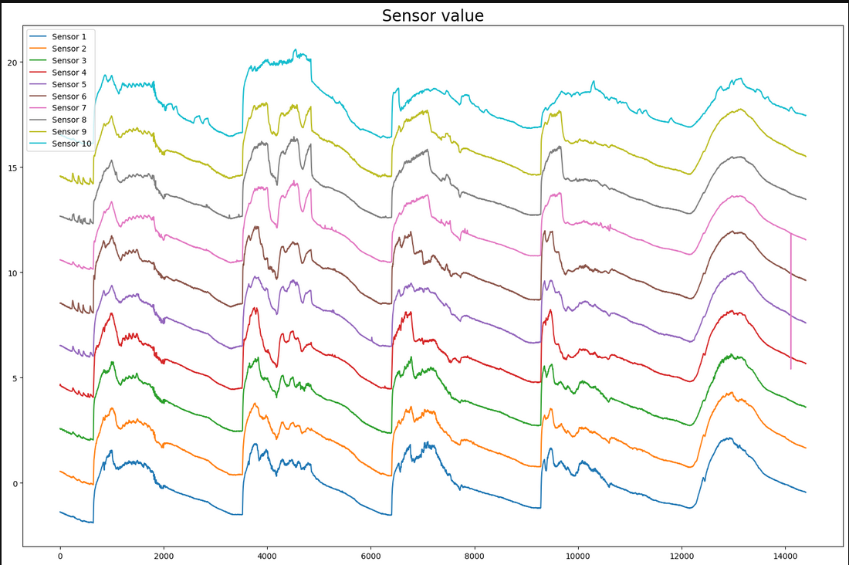
Results
If seen as a time series it is difficult to spot the anomalies, however using different representations like candle graphs and biolin graphs, we are able to spot the anomalies

Slide 8
Results
Successful Anomaly Identification: The models successfully identify anomalies in the sensor data, and the real-time alert system is capable of sending email notifications upon detection.

Slide 9
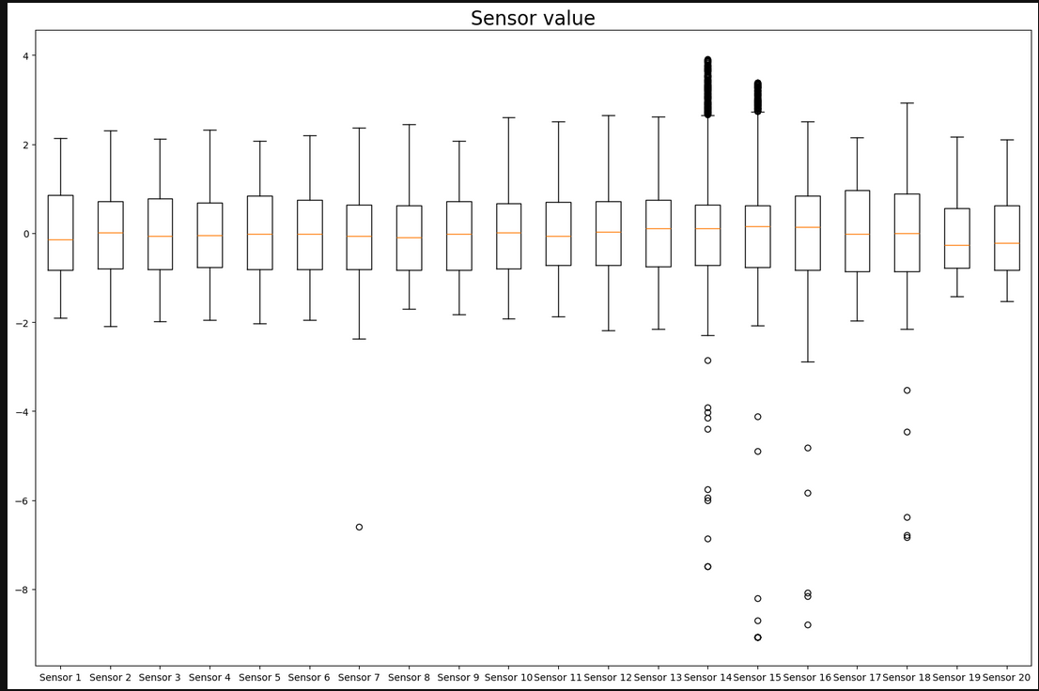
As seen here, the anomalies are plotted which are outside the candle graph’s wick lengths

Slide 10
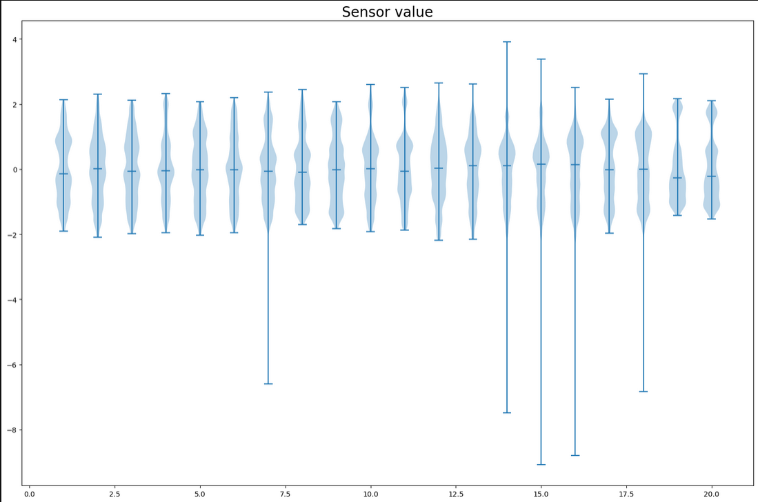
Similarly anomalies are seen on violin graphs too.

Slide 11
Conclusion with Pros and Cons
Summary
Development and Implementation of Real-Time Anomaly Detection System: The report summarizes the development and implementation of a real-time anomaly detection system for sensor data, highlighting its successful application to the Intel Berkeley Research lab dataset.
Pros
Accurate Anomaly Detection: The system provides accurate anomaly detection with real-time alerts(implemented using email alerts) , allowing for prompt response to potential issues.
Cons
Limitations and Areas for Further Research: The dataset we have used for this application is a small one with 14400 entries , as such scaling it for a huge number of data points might get us different results which needs to looked into

Slide 12
Future Research
Exploration of Additional Data Sources: Future work could explore the integration of additional data sources and the refinement of model parameters.
Expansion to Other Domains: The expansion of the system to other domains presents an opportunity for further research and application.

